Slide 1
Practical Energy-aware Real-Time Systems
2012.10.24
2013.09.23 (updated)
Koo

Slide 2
Warm-up Question
What the most energy consuming case in your wireless device? (off-line & on-line)
My answer:
When you use your smart phone for HD video recoding, you will use maximum capacity of application processor, camera, LCD, microphobne, etc.
When you use your smart phone for video call in poor antenna condition, you will use maximum capacity of communication/application processor, camera, LCD, microphone, speaker, etc.
When you use your smart phone for video call in poor antenna condition on your fast moving, it will be one of the most power consuming case.

Slide 3
Energy-aware Real-Time Systems
There will be three main types of power management techniques.
DVFS (Dynamic Voltage & Frequency Scaling)
DMS (Dynamic Modulation Scaling)
Network Coding

Slide 4
Energy-aware Real-Time Systems
Contents
Part I. Introduction of Practical Real-Time systems
Part II. Energy-aware Real-time scheduling (DVFS)
Part III. Introduction of Network Coding

Slide 5
Part I. Introduction of Practical Real-Time systems
Contents
Block diagram
Function applications
Case study by worse case
Power consumption by L-04A (NTT DoCoMo)
Conclusion

Slide 6
1. Block Diagram
I/O devices
RF ICs
[LTE, WCDMA, GSM, GPS, etc.]
Application processor
with modem
PMIC
Memory (DRAM, eMMC)

Slide 7
1. Block Diagram (RF; e.g. Qualcomm RTR8600)
SP 6T
RF IC
GSM PA
GSM
Duplexer
Coupler
WCDMA dual PA
TX SAW
WCDMA
Duplexer
Coupler
TX SAW
LTE
RX SAW
GPS
* PA : Power Amplifier
* SAW : Surface Acoustic Wave
* RX: Receiving
* TX : Transmitting
* SP6T: Single Pole 6 Throws
→There are various types of RF ICs such as Blue Tooth, WLAN, and RFID.

Slide 8
1. Block Diagram (Baseband; e.g. Qualcomm MSM8960)
I/O devices
LCD
Application processor
with modem
Camera
Speaker
USB
Memory (DRAM, MMC)
PMIC
Keypad
Vibrator
LPDDR2 SDRAM
Battery
eMMC
Adapter
*LPDDR : Low Power Double Data Rate
* eMMC : embedded Multi Media Card

Slide 9
2. Function application (LCD operation)
MSM 8960
MDP (Mobile Display Processor)
PMIC
LED backlight
HDMI
(High Definition
Multimedia Interface)
MIPI
(Mobile Industry
Processor Interface)
LCD
Camera
→ When a LCD module operates, it needs a LED backlight. A LCD module displays an image by LED backlighting. The backlight is one of major power consumptions in a cell phone . Its amount depend on brightness of LCD.

Slide 10
2. Function application (wireless communication)
Wireless communications
GSM, WCDMA, HSPA, LTE
Bluetooth
GPS
RFID
Wireless LAN
IrDA (Infrared Data Association)
Modes of
power amplifier
Stand-by mode
Low mode
Middle mode
High mode
←Max. power owing to lack of connectivity

Slide 11
Example(from previous slide)
A brief flow chart of power scheduling
Computation System(off-line operation)
Communication System (on-line operation)
Power-on
Start-up
Three types of call modes
Communication
off / on
High power
mode
Idle mode
High freq. & low vtg.
Medium power
mode
Low power
mode
Sleep mode
Active mode
Low freq. & low vtg.
High freq. & high vtg.
*For DVS, there are low & high frequency clocks . DC converter and LDO provide various types of voltages.
*Low /medium/high power mode is decided by antenna condition.

Slide 12
3. Case study (worse case)
Video call & high power mode on WCDMA
: This case needs a LCD and a camera with the max. power of power amplifier at WCDMA communication.
Memory (DRAM, MMC)
RFIC
Duplexer
Coupler
WCDMA dual PA
Application processor
with modem
TX SAW
WCDMA
Camera
LCD
PMICs
LED backlight

Slide 13
4. Power consumption by L-04A (NTT DoCoMo)
The most power consumption 5 & 5
No. | Condition1 | Condition 2 | Current consumption [Vin= 3.8V]
1 | Camera | VGA CAMERA | 250mA
2 | Camera | 2M CAMERA | 213mA
3 | MP3 | Speaker | 92mA
4 | MP3 | Ear-mic | 57.5mA
5 | Stand-by |  | 1mA
No. | Condition1 | Condition 2 | TX power | Current consumption [Vin= 3.8V]
1 | W2100 | VT | 23 dBm | 732mA
2 | W800 | VT | 23 dBm | 721mA
3 | W800 | Talk | 23 dBm | 520mA
4 | W2100 | VT | 12 dBm | 487mA
5 | W800 | VT | 12 dBm | 480mA

Slide 14
5. Conclusion
Multimedia parts (ARM core, power regulators, LCD, camera, etc.) are the major part of power consumption when a wireless embedded system does not work for communication.
RX power amplifier, RF module will also critical when the system work for wireless communication.

Slide 15
Part II. Energy-aware Real-time scheduling
Contents
PMIC
System Block Diagram
Case Study (DVFS)
General methods of Power Management
Future Works

Slide 16
1. PMIC (Power Management IC)
Why do we need PMIC?
-. From a single battery to various types of inside modules and I/O devices, PMIC controls their power.
What are its main tasks?
-. Input power (battery, charger, USB)
-. Output power (SMPS, LDO, charge pump) ; DVFS
-. IC interface (PA control, GPIO)
-. General housekeeping by internal CLKs
-. User Interface (LED, LCD, Vibrator, Headset, Speaker)

Slide 17
2. System Block Diagram
RF(Radio Frequency) vs. BB (Baseband)
I/O devices
RF ICs
[LTE, WCDMA, GSM, GPS, etc.]
Application processor
with modem
PMIC
Memory (DRAM, MMC)

Slide 18
3. DVFS (Dynamic Voltage and Frequency Scaling)
DVFS
-. According to scheduled modes, PMIC provides processors’ core with different types of power by scaling voltage and frequency.

Slide 19
4. General Power Management
Step 1) Analyze a target task/application
: min./max. power requirement
Step 2) Seek leakage/unnecessary power
e.g.) pending task after interrupt
Step 3) Make up a specific algorithm with possible scenarios
e.g.) DVFS, FSM, etc.
Step 4) Verify a side effect after testing a new PM algorithm

Slide 20
Part III. Introduction of Network Coding
Contents
Basic concept of Network Coding
Why Network Coding is beneficial?
My algorithm to select the best TX one(s)
Testbed for Network-coding algorithm

Slide 21
1. Basic concept of Network Coding
When a relay needs to send several messages to clients, the relay will use their resource by XOR.
XOR
=
B
A
Relay
A
B
Alice
Bob
Alice’s packet
Bob’s packet
B
A
Alice’s packet
Bob’s packet
A
B

Slide 22
1. Basic concept of Network Coding
If the relay does not use clients’ resource, it will need one more transmission.
Relay
A
A
B
B
Alice
Bob
Alice’s packet
Bob’s packet
B
A
Alice’s packet
Bob’s packet
A
B

Slide 23
2. Why Network Coding is beneficial?
Alice Bob
Charlie
Charlie’s packet
C
Bob Charlie
Alice’s packet
A
Charlie Alice
Bob’s packet
B
C
XOR
XOR
=
Relay
A
B
C
A
B
Bob
Alice
Bob’s packet
B
Alice’s packet
A
Charlie’s packet
Bob’s packet
C
B
Alice’s packet
Charlie’s packet
A
C

Slide 24
2. Why Network Coding is beneficial?
When the relay transmits a Network-coded message, it will take one transmission energy rather than multiple transmission energy. (Multicasting Network duplicates the coded message)
Range of Wireless Network
Relay
Charlie
Bob
Alice
RX
TX
RX
RX
Multicasting Network

Slide 25
3. My algorithm to select the best TX one(s)
C1
I need {A}.
I have {B, C}.
Given conditions
R
C2
I need {B}.
I have {C, A}.
I will transmit {A, B, C}. Then how?
C3
I need {C}.
I have {A}.

Slide 26
3. My algorithm to select the best TX one(s)
Given conditions
Matrix for Required Messages = $\begin{matrix}C1 \\ C2 \\ C2\end{matrix}\left[\begin{matrix}1 & 0 & 0 \\ 0 & 1 & 0 \\ 0 & 0 & 1\end{matrix}\right]$
Matrix for Resource in clients = $\begin{matrix}C1 \\ C2 \\ C2\end{matrix}\left[\begin{matrix}0 & 1 & 1 \\ 1 & 0 & 1 \\ 1 & 0 & 0\end{matrix}\right]$
Then assemble them together.
➔ $\begin{matrix}C1 \\ C2 \\ C2\end{matrix}\left[\begin{matrix}1 & 1 & 1 \\ 1 & 1 & 1 \\ 1 & 0 & 1\end{matrix}\right]$
A B C
A B C
A B C

Slide 27
3. My algorithm to select the best TX one(s)
Steps of my algorithm
Step 1) $\begin{matrix}C1 \\ C2 \\ C2\end{matrix}\left[\begin{matrix}1 & 1 & 1 \\ 1 & 1 & 1 \\ 1 & 0 & 1\end{matrix}\right]$ ➔ Look for whether there is ‘1’ in the column.
Step 2) $\begin{matrix}C1 \\ C2 \\ C2\end{matrix}\left[\begin{matrix}1 & 1 & 1 \\ 1 & 1 & 1 \\ 1 & 0 & 1\end{matrix}\right]$
If there are n ‘1’s, check whether there are (n-1) columns which has n ‘1’s. If no pair, go to n-1.
Repeat until n =2
Step 2-1) $\begin{matrix}C1 \\ C2 \\ C2\end{matrix}\left[\begin{matrix}1 & 1 & 1 \\ 1 & 1 & 1 \\ 1 & 0 & 1\end{matrix}\right]$
Step 2-1-2) $\begin{matrix}C1 \\ C2 \\ C2\end{matrix}\left[\begin{matrix}1 & 1 & 1 \\ 1 & 1 & 1 \\ 1 & 0 & 1\end{matrix}\right]$
Step 2-1-3) $\begin{matrix}C1 \\ C2 \\ C2\end{matrix}\left[\begin{matrix}1 & 1 & 1 \\ 1 & 1 & 1 \\ 1 & 0 & 1\end{matrix}\right]$
Both step 2-2 or step 2-3 are possible.

Slide 28
3. My algorithm to select the best TX one(s)
Steps of my algorithm
Step 2-1-2) $\begin{matrix}C1 \\ C2 \\ C2\end{matrix}\left[\begin{matrix}1 & 1 & 1 \\ 1 & 1 & 1 \\ 1 & 0 & 1\end{matrix}\right]$
I take step 2-1-2; TX1=A (XOR) B
Step 2-2) $\begin{matrix}C1 \\ C2 \\ C2\end{matrix}\left[\begin{matrix}0 & 0 & 0 \\ 0 & 0 & 0 \\ 1 & 0 & 1\end{matrix}\right]$
If one candidate is selected, the whole rows will be null. Then go to the next row.
Step 2’) $\begin{matrix}C1 \\ C2 \\ C2\end{matrix}\left[\begin{matrix}0 & 0 & 0 \\ 0 & 0 & 0 \\ 1 & 0 & 1\end{matrix}\right]$
If there is not ‘1’ , the TX will be itself
; TX2=C
Step 2’-1) $\begin{matrix}C1 \\ C2 \\ C2\end{matrix}\left[\begin{matrix}0 & 0 & 0 \\ 0 & 0 & 0 \\ 0 & 0 & 0\end{matrix}\right]$
If one candidate is selected, the whole rows will be null. Then go to the next row.

Slide 29
3. My algorithm to select the best TX one(s)
Steps of my algorithm
Step 3) $\begin{matrix}C1 \\ C2 \\ C2\end{matrix}\left[\begin{matrix}0 & 0 & 0 \\ 0 & 0 & 0 \\ 0 & 0 & 0\end{matrix}\right]$
If there is not ‘1’ in the assembled matrix, TX is completed.

Slide 30
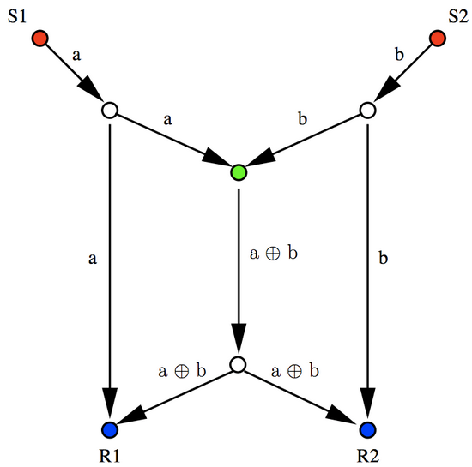
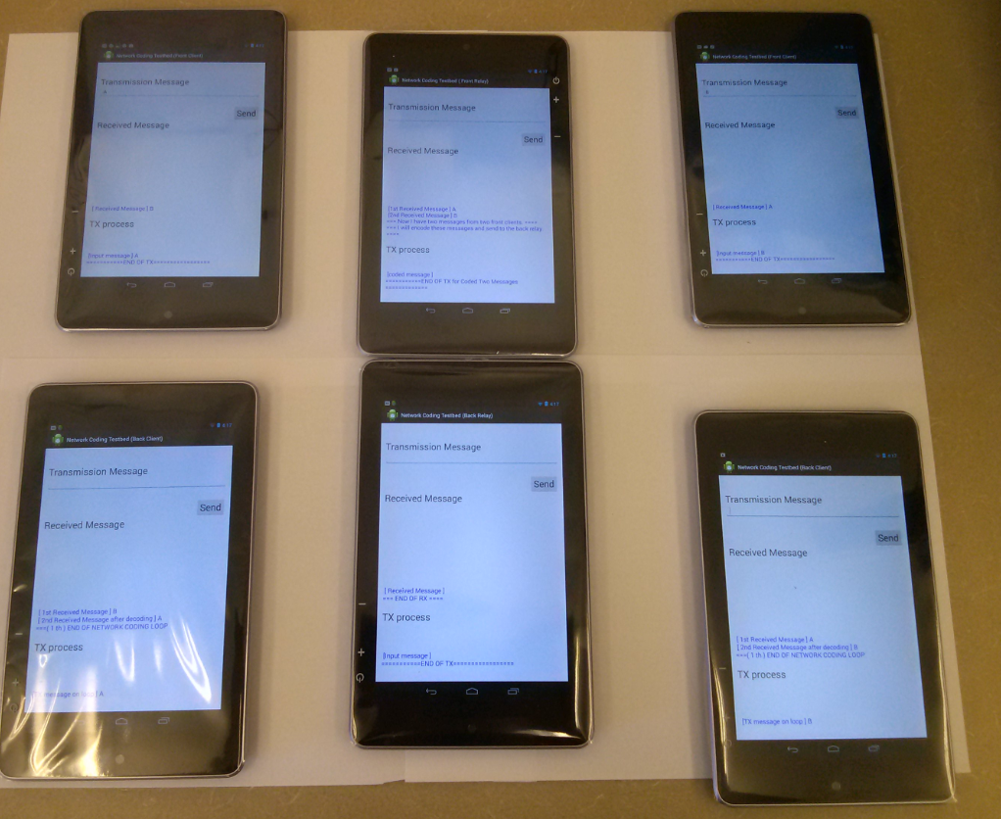
4. Testbed for Network-coding algorithm
Network Algorithms are tested by Android devices.
Demonstration 1

Slide 31
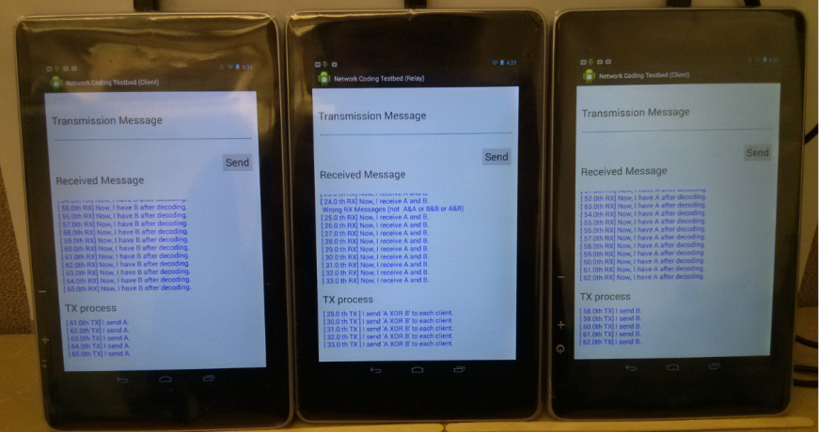
4. Testbed for Network-coding algorithm
Network Algorithms are tested by Android devices.
C1
1) A
R
1) B
C2
2) A (XOR )B
3)
B= A (XOR )B (XOR) A
3)
A= A (XOR )B (XOR) B
Demonstration 2

Slide 32
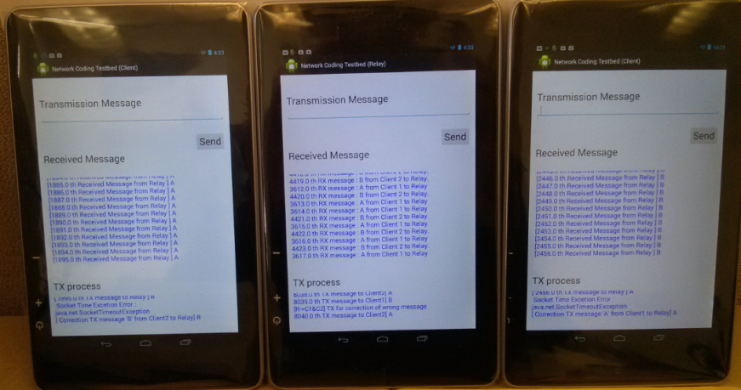
4. Testbed for Network-coding algorithm
Network Algorithms are tested by Android devices.
C1
1) A
R
2) A
C2
4) B
3) B
Demonstration 3

Slide 33
Q&A
Please give me a question which you are interested in or not clear.
Thank you.

Slide 34
References
Qinglong Liu, and Gang Feng “Optimization Based Queue Management for Opportunistic Network Coding” , 2011 6th International ICST Conference on Communications and Networking in China ,2011, pp 1159-1164
S. Katti, H. Rahul, W. Hu, D. Katabi, M. M. Medard and J. Crowcroft, “XORs in the Air”: Practical Wireless Network Coding,” in Proc. of ACM SIGCOMM’06, Pisa, Italy, Sept. 2006.
R. Ahlswede, N. Cai, S. Y. R. Li, and R. W. Yeung, “Network Information Flow”, IEEE Transactions on Information Theory, vol. 46, no. 4, July 2000, pp.1204-1216.
P. Glatz, J. Loinig, C. Steger, and R. Weiss, “A first step towards energy management for network coding in wireless sensor networks,” in 9th IEEE Malaysia International Con-ference on Communications, dec. 2009, pp. 905 – 910.

