Slide 1
More DAC architectures
Current steering DACs

Slide 2
Current-steering DAC
Most suitable candidate so far to combine high speed and high resolution
Realization by an array of matched current sources
Binary-weighted
  No decoding logic
  Monotonicity not guaranteed
  Strict matching
  Large DNL and glitch

Slide 3
Current-steering DAC
Most suitable candidate so far to combine high speed and high resolution
Realization by an array of matched current sources
Unary-coded
  Monotonicity guaranteed
  Relaxed matching
  Reduced DNL and glitch
  Digital logic area

Slide 4
Current-steering DAC
Most suitable candidate so far to combine high speed and high resolution
Realization by an array of matched current sources
Segmented
  Compromise of binary-weighted and unary-coded
  Trade-off between area and linearity
  Two-step segmentation for high resolution DACs

Slide 5
Nonlinearities for current-steering DACs
Static nonlinearities (dc or low frequencies)
  Random mismatch errors
  Gradient effect
  Finite output impedance
Dynamic nonlinearities (high frequencies)
  Dynamic output impedance
  Finite settling time
  Charge injection
  Switch timing errors
Nonlinearities associated with this architecture limit its potential to achieve higher speed

Slide 6
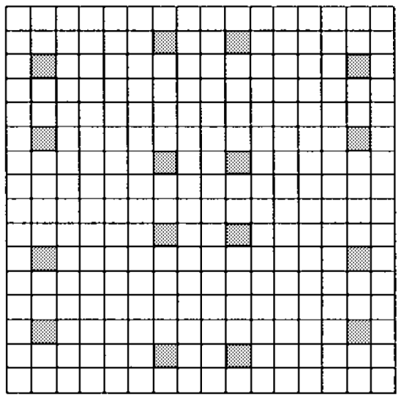
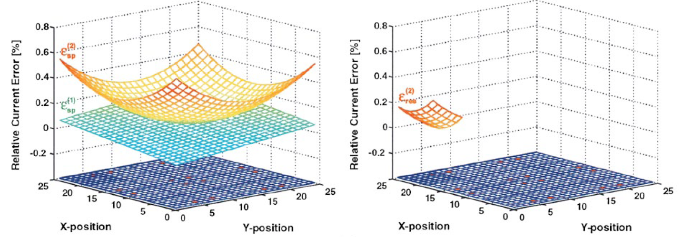
A 14-bit intrinsic accuracy Q² random walk CMOS DAC
Q² random walk is a famous design technique to compensate the process dependent gradient errors
Q² (quad quadrant) refers that each MSB current source consists of four (quad) units in every quadrant
“Random walking” the switching sequence of the current sources make the residual gradient errors “randomized”
Apply Q²
Quadratic gradient
MSB Array
Residual quadratic gradient
No linear gradient
Linear gradient

Slide 7
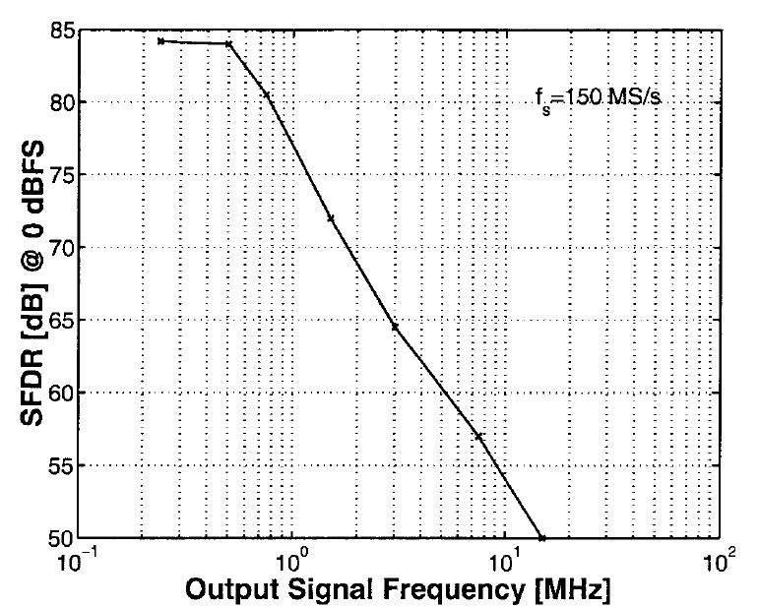
Contributions and limitations
The first published 14-bit intrinsic accuracy DAC
Great gradient error compensation
Large current source area used to compensate random mismatch error
Poor spurious-free dynamic range (SFDR) performance due to large parasitic capacitance
High frequency linearity lacks
G. Van der Plas, J. Vandenbussche, W. Sansen, M. Steyaert, and G. Gielen, “A 14-bit intrinsic accuracy Q2 random walk CMOS DAC,” IEEE J. Solid-State Circuits, vol 34, pp. 1708−1718, Dec. 1999.

Slide 8
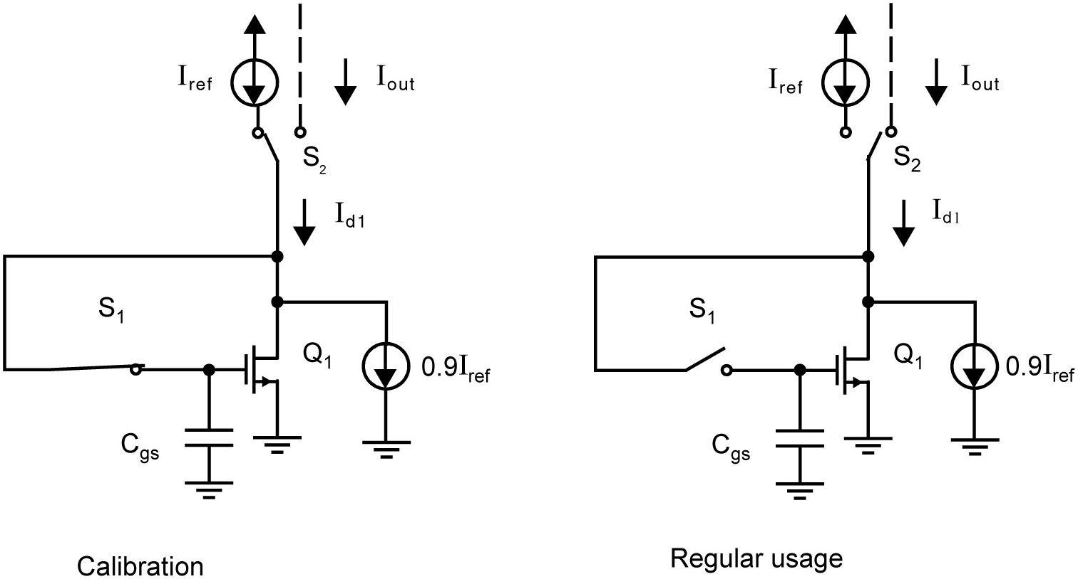
Chapter 16 Figure 20

Slide 9
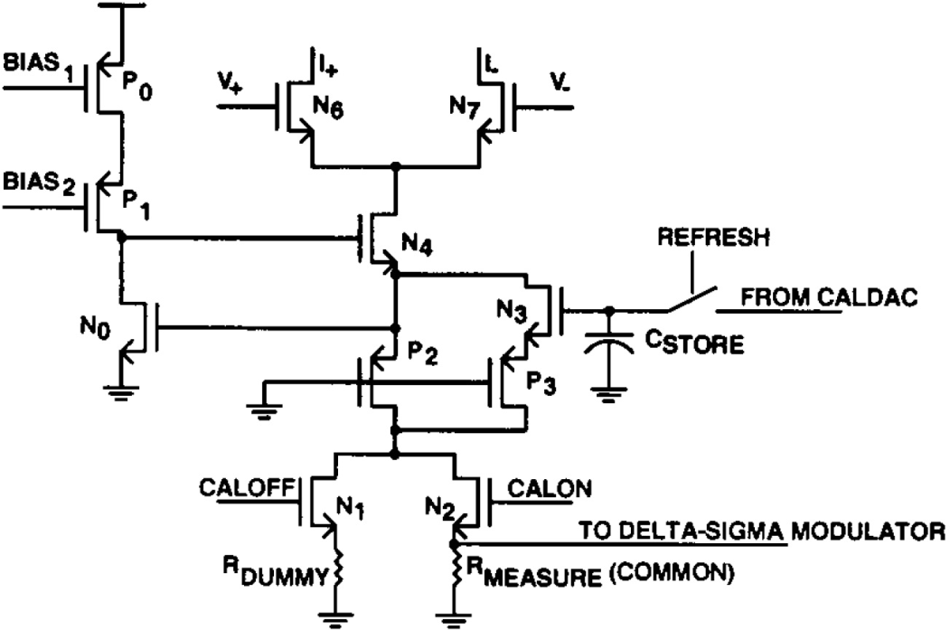
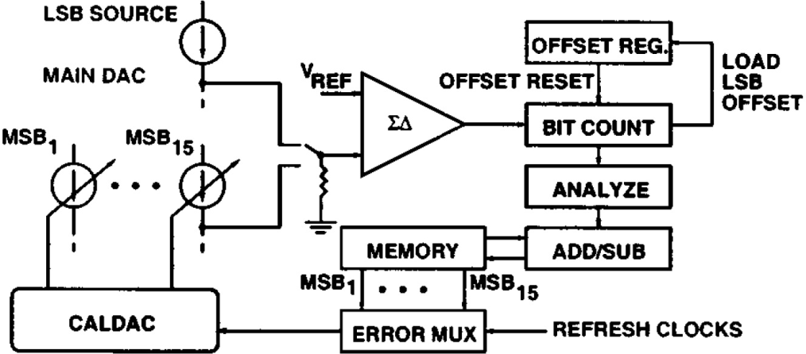
A self-trimming 14-b 100-MS/s CMOS DAC
The self-trimming technique can effectively compensate the random mismatch error among current sources
MSB current source
Self-trimming loop
5% - 10% of I
I
A. R. Bugeja, and B. Song, “A self-trimming 14-b 100-MS/s CMOS DAC,” IEEE J. Solid-State Circuits, vol 35, pp. 1841−1852, Dec. 2000.

Slide 10
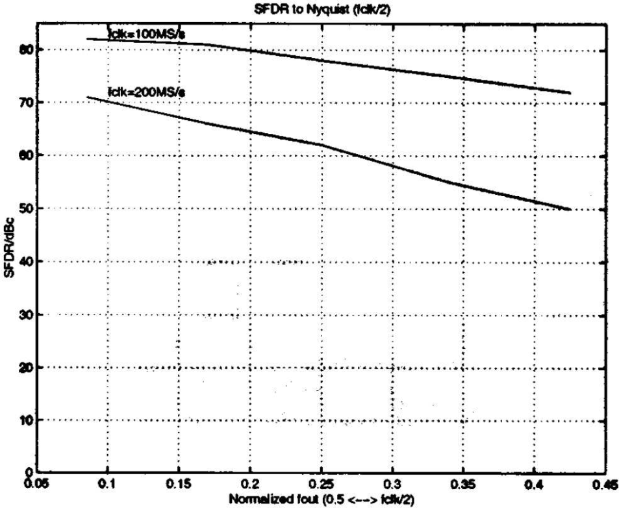
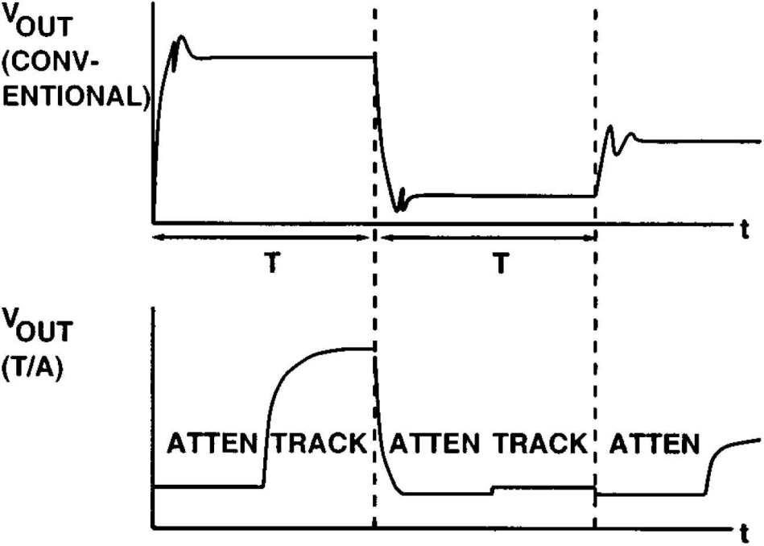
Track/attenuate output stage
The track/attenuate stage can improve the dynamic linearity by reducing the signal dependence at the output
Isolate the nonlinear transition
Remove previous code dependence

Slide 11

Contributions and limitations
Great random mismatch error compensation by using self-trimming
Excellent dynamic linearity enhancement by the track/attenuate output stage
One of the best DACs in high frequency linearity performance
Complicated calibration loop (ADC-DSP-DAC)
Less interest in a newer CMOS technology because of the 5-stacked-transistor current source

Slide 12
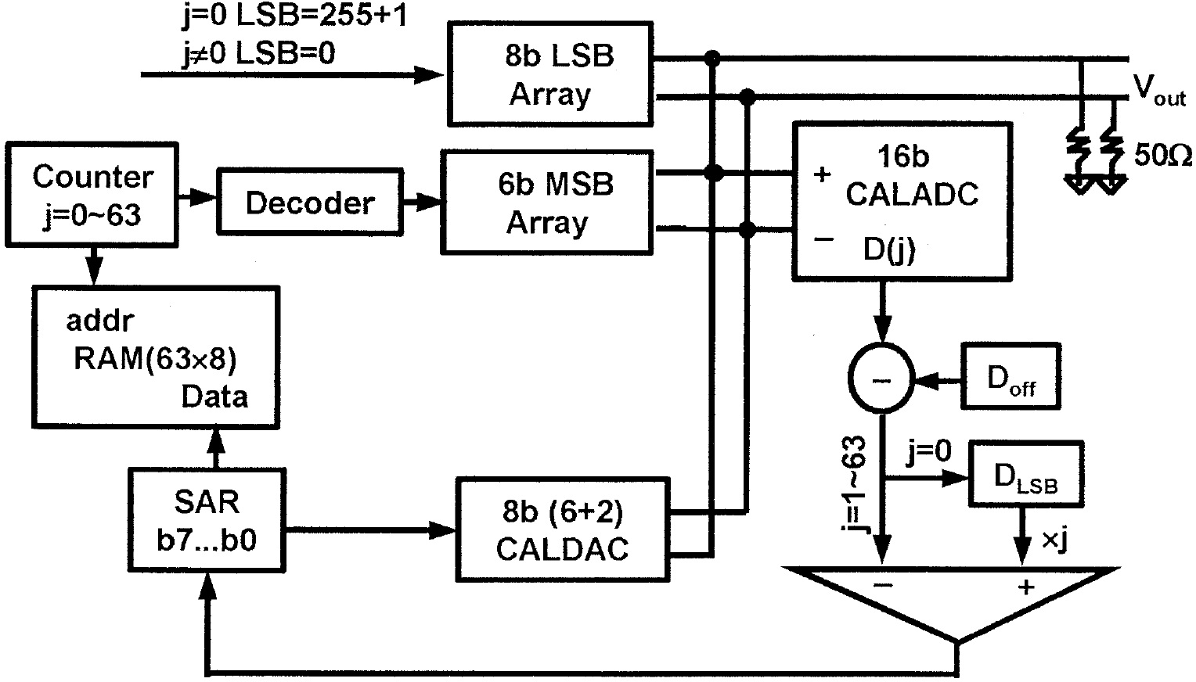
A 1.5-V 14-bit 100-MS/s self-calibrated DAC
The self-calibration technique can successfully calibrate the random mismatch errors in the modern low-voltage CMOS technology
Counter controls MSB inputs
j=0, measure LSB current D_{LSB}
j=1-63, measure MSB current
Obtain error by subtracting j D_{LSB}
Store error code in SAR register
Control CALDAC to correct current
Current errors

Slide 13
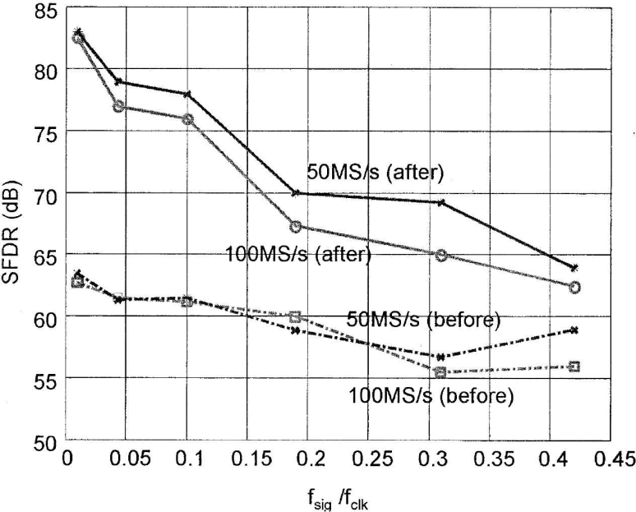
Contributions and limitations
Reduce the gate area by a factor of more than 500 compared to the DAC without any calibration
Achieve the smallest area and power of all published 14-bit DACs by far
Significantly improve the settling rate and dynamic linearity due to dramatic parasitic capacitance reduction
Use complicated calibration loop
(ADC-DSP-DAC)
Y. Cong and R. L. Geiger, “A 1.5-V 14-bit 100-MS/s self-calibrated DAC,” IEEE J. Solid-State Circuits, vol. 38, no.12, pp. 2051 -2060, Dec. 2003.

Slide 14
A 14-bit 200-MHz current-steering DAC with switching-sequence post-adjustment
The SSPA calibration can enhance the matching accuracy by adjusting the switching sequence of current sources after chip fabrication
It uses minimum analog circuits and some digital circuitry instead of the complicated ADC-DSP-DAC loop
T. Chen, and G. Gielen, “A 14-bit 200-MHz current-steering DAC with switching-sequence post-adjustment calibration,” IEEE J. Solid-State Circuits, vol 42, pp. 2386−2394, Nov. 2007.

Slide 15
Switching strategy for SSPA calibration
12
13
12
15
14
11
13
11
10
10
15
14
Step 5 Final sequencing
9
9
Step 4 Sum Resequencing
15
14
Step 3 Summing
Step 1 Sorting
15
13
15
Step 2 Resequencing
14
12
13
13
14
12
12
11
11
10
11
10
10
9
8
9
9
7
6
7
7
8
8
7
4
5
6
6
6
6
7
3
5
5
5
5
4
4
4
1
2
4
3
3
3
3
1
2
2
2
1
1
1
2
Step 1: sort all current sources
Step 4: Group the new smaller current with the new bigger current in neighbor
Step 2: Group smaller current with bigger current in neighbor
Step 5: Break up the summed current sources for the final sequencing
Step 3: Sum two nearby current sources

Slide 16
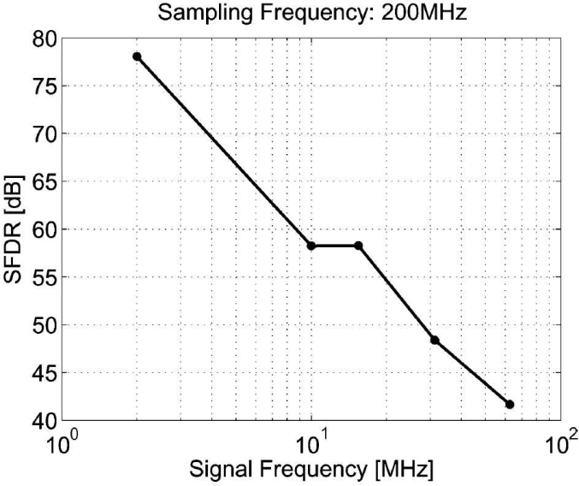
Contributions and limitations
Make the area of current sources only 10% of area required by an intrinsic accuracy DAC
Substantiate the potential of calibrating a DAC with good performance by using only minimum requirement of analog circuits and some digital circuitry
Static performance is not as
good as previous technique
Dynamic linearity deteriorates
at high frequencies

Slide 17
A 12 bit 2.9 GS/s DAC with IM3 < -60 dBc beyond 1 GHz in 65 nm CMOS
This DAC design extends the 70dB and 60dB SFDR bandwidths to 225MHz and 550 MHz with f_{samp} > 1GS/s
They recognize the fact that the switching output impedance is a major error source to the DAC’s output distortion
Modified triple-cascode current source is used to improve the dynamic linearity
C.-H. Lin, F.M.I. van der Goes, J. R. Westra, J. Mulder, Y. Lin, E. Arslan, E. Ayranci, X. Liu, and K. Bult, “A 12 bit 2.9 GS/s DAC with IM3 < 60 dBc beyond 1 GHz in 65 nm CMOS,” IEEE J. Solid-State Circuits, vol 44, pp. 3285−3293, Dec. 2009.

Slide 18
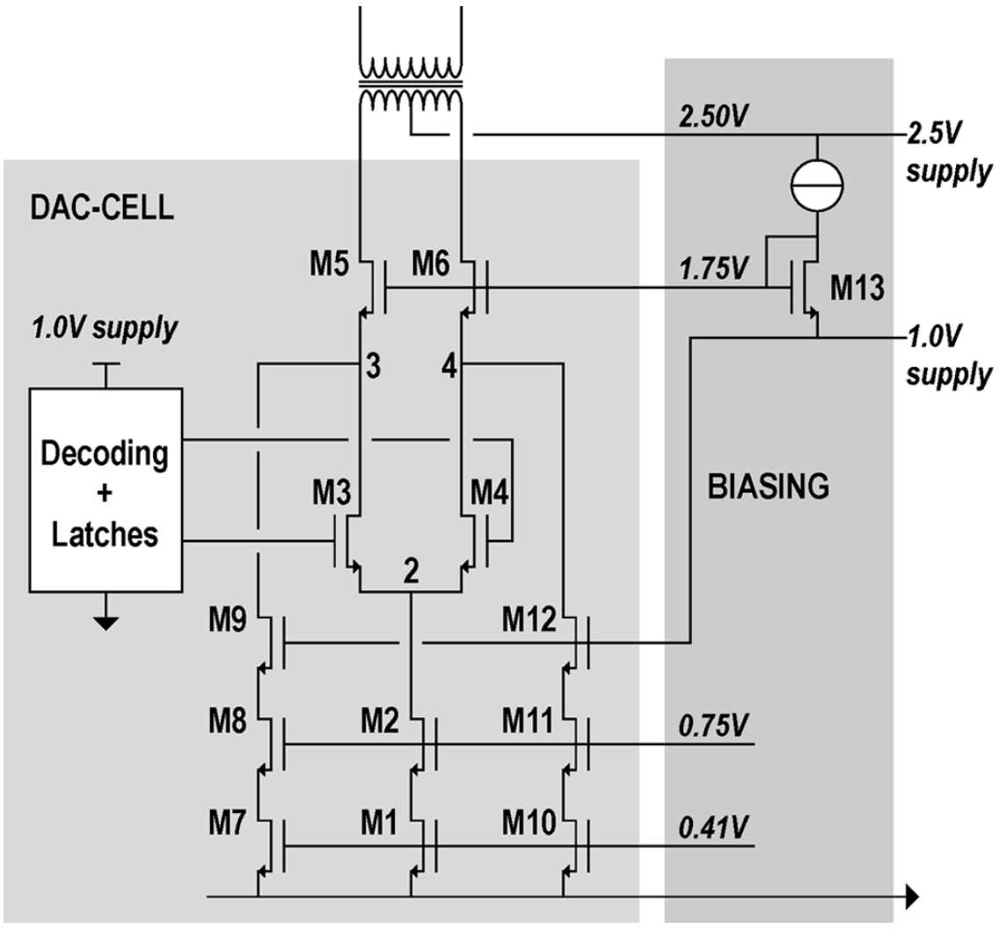
Modified triple-cascode current source
Switch cascode
Triple cascode (I)
A triple cascode current source is used to enhance the output impedance
Two small current sources are added to keep the switch cascodes always in active, and thus eliminating the switching parasitic capacitance
Small current source
Small current source (1-2% of I)

Slide 19
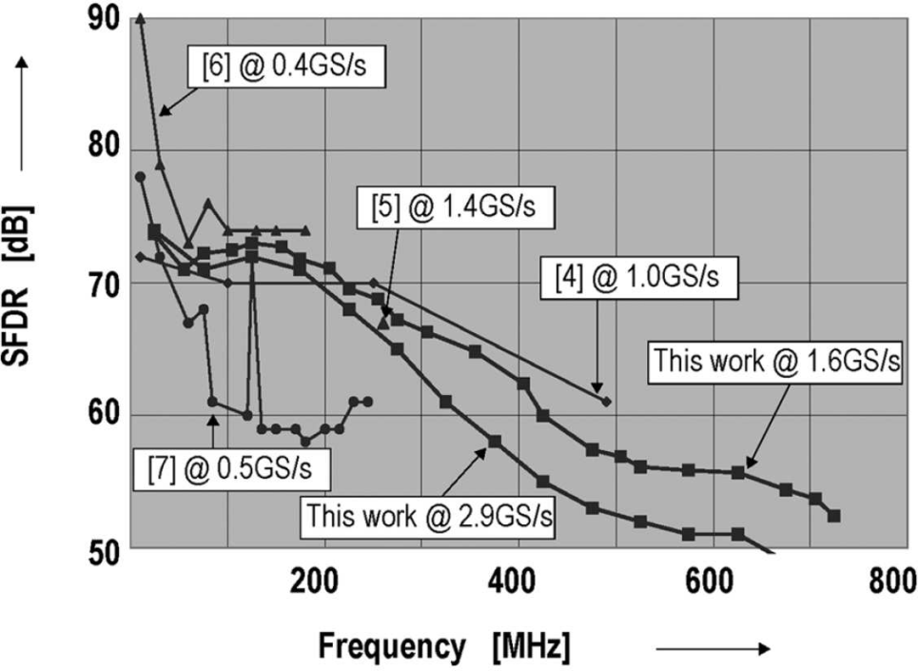
Contributions and limitations
It has tremendous dynamic linearity enhancement
The first DAC achieves such great SFDR bandwidth extension
The switching capacitance is eliminated; however, the switching resistance still remains
Triple-cascode current source
limits its potential in lower
supply voltage cases

Slide 20
Complete-folding calibration
Enhance the matching property by dynamically combining the unary current sources into a fully binary-weighted array based on the current comparisons after chip fabrication
Have better performance in compensating random mismatch errors than state-of-the-art
T. Zeng and D. Chen, “An order-statistics based matching strategy for circuit components in data converters,” IEEE Trans. Circuits Syst. I, Reg. Papers, vol. 60, no. 1, pp. 11-24, Jan. 2013.

Slide 21
Switching strategy with 4-bit unary-code array: 1st time folding
Step 1: sort all the current sources in ascending order
Step 2: group the smaller current with the bigger one
12
13
14
15
10
11
Step 3: sum the nearby two currents with one left
6
7
8
9
3
4
5
1
2
Observation:
The first 7 new currents are about the same
They are almost 2-time bigger than the last one
4-bit unary-coded array is turned into 3-bit unary coded and 1-bit binary-weighted array
15
14
13
12
11
10
3-bit unary-code and 1-bit binary-weighted array
7
9
8
Use for 2nd time folding
3
4
5
6
1
2
1
15
2
14
3
13
4
12
5
11
6
10
7
9
8

Slide 22
Switching strategy with 4-bit unary-code array: 2nd time folding
Step 1 Sort
1
15
2
14
3
13
4
12
5
11
6
10
7
9
7
9
5
11
6
10
2
14
1
15
3
13
4
12
Step 2 Group
2-bit unary-coded and 2-bit binary-weighted array
Use for 3rd time folding
Step 3 Sum
4
7
9
12
3
5
11
13
1
6
10
15
2
14
8
7
9
4
12
5
11
3
13
6
10
1
15
2
14

Slide 23
Switching strategy with 4-bit unary-code array: 3rd time folding
Step 1 Sort
1
6
10
15
3
5
11
13
4
7
9
12
4
7
9
12
1
6
10
15
3
5
11
13
Step 2 Group
Step 3 Sum
4-bit binary-weighted array
3
4
5
7
9
11
12
13
1
6
10
15
2
14
4
7
9
12
3
5
11
13
1
6
10
15
8

Slide 24
General switching strategy
An n-bit unary-coded array can be converted into an (n-1)-bit unary-coded array with 1-bit binary-weighted array by 1-time single-folding
  Example: 1-time single-folding can convert a 4-bit unary-coded array into a 3-bit unary-coded and 1-bit binary-weighted
Complete-folding is to implement (n-1)-time single-folding in an n-bit unary-coded array
  Example: A 4-bit unary-coded array needs 3-time single-folding to ensure complete-folding calibration

Slide 25
Comparison of switching sequence
Original sequence
15
14
12
13
SSPA sequence
11
10
9
8
7
6
4
5
3
1
2
3
4
5
7
9
11
12
13
1
6
10
15
2
14
Proposed sequence
8

Slide 26
Statistical simulation setup
10,000 14-bit current-steering DAC behavioral models were randomly generated
  7-bit unary-coded MSB array
  7-bit binary-weighted LSB array
Implement 3 calibration techniques separately in the MSB array to compare results
  SSPA Calibration + 20 statistical outlier elimination
  Self Calibration
  Complete-folding Calibration + 20 statistical outlier elimination
The LSB array is realized by intrinsic-accuracy method

Slide 27
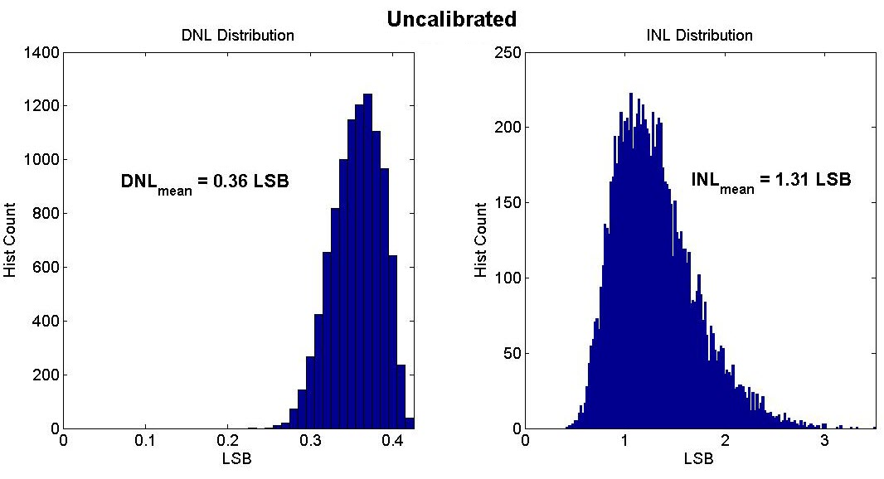
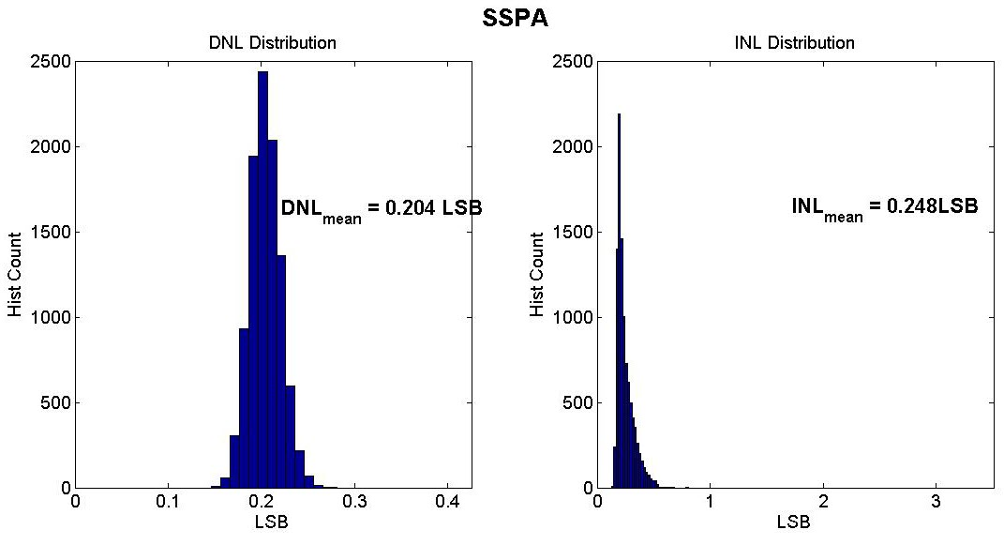
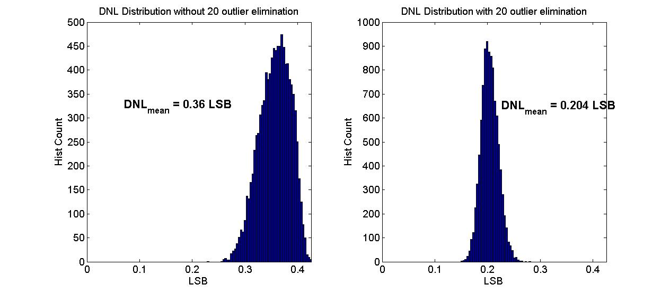
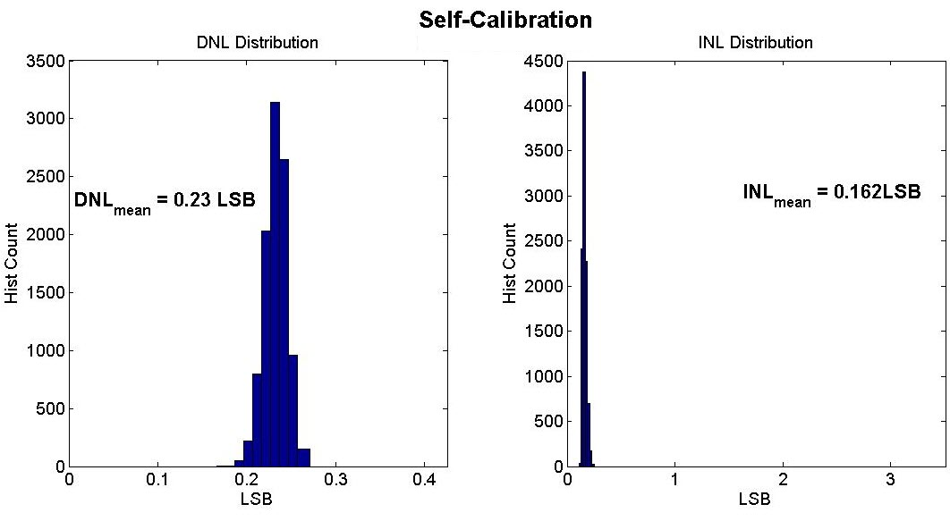
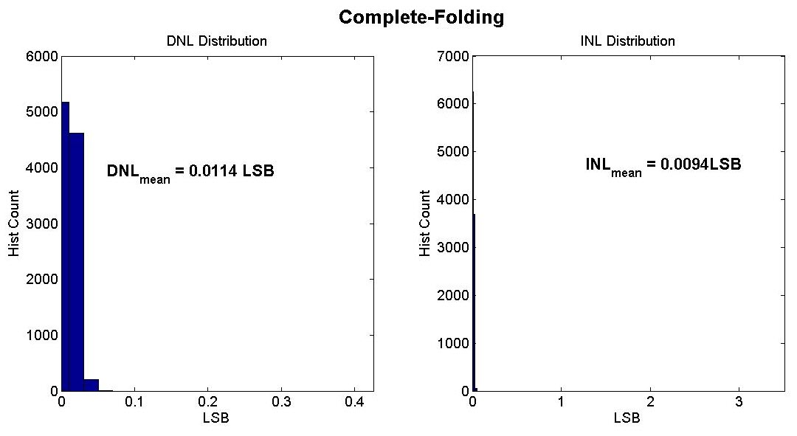
MSB DNL/INL distribution with different calibration techniques

Slide 28
A 15 bit CS DAC with OEMB plus outlier elimination
T. Zeng and D. Chen, “A 15-Bit Binary-Weighted Current-Steering DAC with Ordered Element Matching,” Submitted to CICC, 2013.

Slide 29
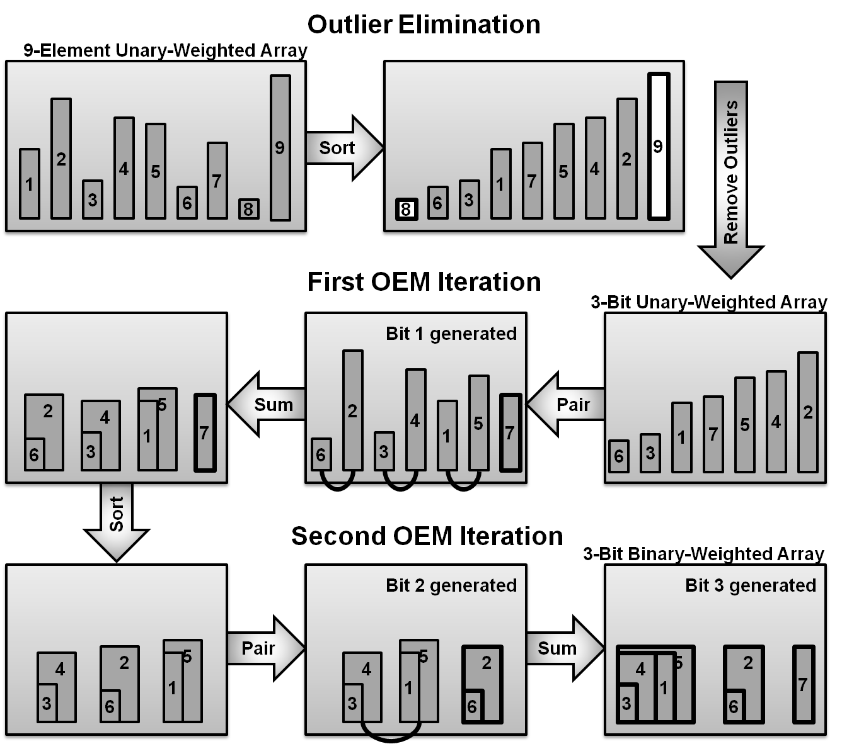
OEMB with outlier elimination

Slide 31
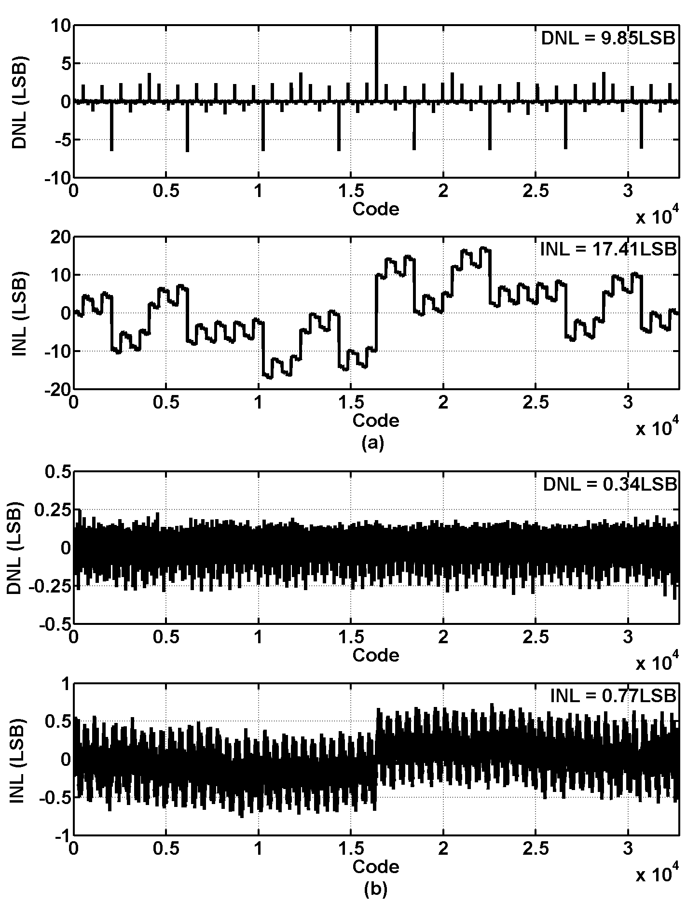

Slide 33
