Slide 1
Steady-state tracking & sys. types
r(s)
+
e
y(s)
C(s)
G(s)
-
plant
controller

Slide 2
d(s)
r(s)
+
e
y(s)
G1(s)
G2(s)
-
B
A

Slide 3
The root locus technique
Obtain closed-loop TF and char eq d(s) = 0
Re-arrange to get
Mark roots of with “o” and roots of with “x”
High light segments of x-axis and put arrows
Decide #asymptotes, their angles, and x-axis meeting place:
Determine jw-axis crossing using Routh table
Compute breakaway:
Departure/arrival angle:

Slide 4
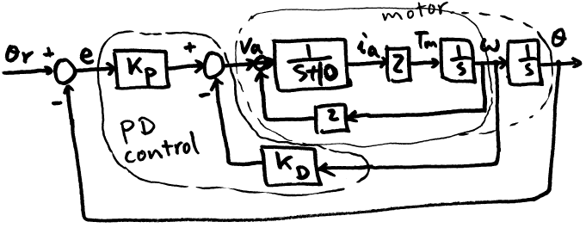
Example: motor control
The closed-loop T.F. from θ_{r} to θ is:

Slide 5
What is the open-loop T.F.?
The o.l. T.F. of the system is:
But for root locus, it depends on which parameter we are varying.
  If K_{P} varies, K_{D} fixed, from char. poly.

Slide 6
  The o.l. T.F. for K_{P}-root-locus is the system o.l. T.F.
  In general, this is the case whenever the parameter is multiplicative in the forward loop.
  If K_{D} is parameter, K_{P} is fixed
  From

Slide 7
What if neither is fixed?
Multi-parameter root locus?
  Some books do this
Additional specs to satisfy?
  Yes, typically
  Then use this to reduce freedom
The o.l. T.F. of the system is:
It is type 1, tracks step with 0 error
Suppose ess_{d} to ramp must be <=1

Slide 8
Since ess to ramp = 1/Kv
Kv = lim_s->0 {sGol(s)} =2KP/(4+2KD)
Thus, ess=(4+2KD)/2KP
In general, want ess <= ess_{d}
Design to just barely meet specs: ess=1
(4+2KD)/2KP = 1
4+2KD=2KP

Slide 9
>> rlocus([2 2], [1 10 0 0]);
>> grid;
>> axis equal;

Slide 10
The grid line rays correspond to ζ
The semi circles corresponds to ω_{n}
If there is a design specification: M_{pd} <= 10 %,
then we need ζ_{d} >= 0.6
Select data point tool, and click at a point on the root locus with ζ >= 0.6

Slide 12
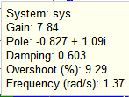
Desired K_{P} = 7.84
Closed loop dominant pole at -0.827+-1.09i
Pole damping ratio is 0.603
Undamped frequency is 1.37
Estimated overshoot is 9.29%

Slide 13
With KP = 7.84
Design specs for ess=1 required 4+2KD=2KP
KD=KP-2 = 5.84
>> roots([1 10 15.68 15.68])
ans =
-8.3464 + 0.0000i
-0.8268 + 1.0932i
-0.8268 - 1.0932i

Slide 14
Closed loop TF is:
>>max(y)
ans =
1.0915
Actual Mp=9.15%

Slide 15
More examples
No finite zeros, o.l. poles: 0,-1,-2
Real axis: are on R.L.
Asymp: #: 3

Slide 16
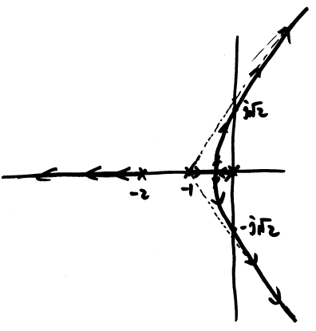
-axis crossing:
char. poly:

Slide 17
>> rlocus(1,[1 3 2 0])
>> grid
>> axis equal

Slide 18
Example:
Real axis:
(-2,0) seg. is on R.L.

Slide 19
For

Slide 20
Break away point:

Slide 21
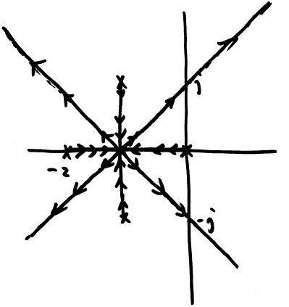
-axis crossing:
char. poly:

Slide 22
>> rlocus(1, conv([1 2 0], [1 2 2]))
>> axis equal
>> sgrid

Slide 23
Example: in prev. ex., change s+2 to s+3

Slide 25
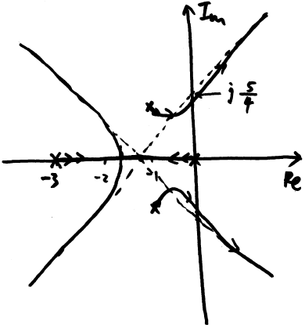
-axis crossing:
char. poly:

Slide 26
>> rlocus(1, conv([1 3 0], [1 2 2]))
>> axis equal
>> sgrid

