Slide 1
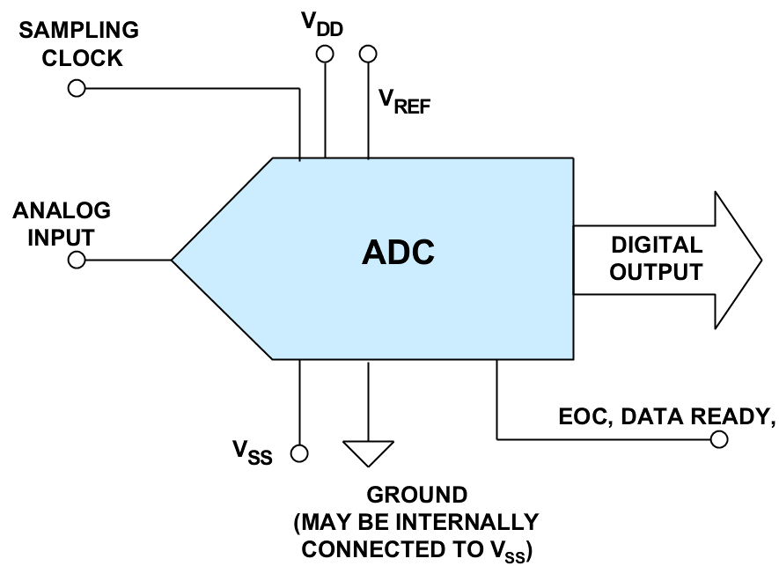

Slide 2
ADC ARCHITECTURES
Dual slope ADC
Counter ramp ADC
Successive Approximations ADC
Pipelined architecture
Algorithmic architecture
Delta - Sigma ADC
Flash ADC
Interpolating Flash ADC
Serial - parallel ADC
Sub ranging ADC
High speed ADC: interleaving - multiplexing

Slide 3
Simplest ADC
A single comparator
One bit ADC
Only one transition voltage, INL = 0
Inherently linear
A few comparators with different Vth
2 comparators, 1.5 bit ADC
3 comparators, 2 bit ADC
7 comparators, 3 bit ADC
6 comparators, 2.5 bit ADC

Slide 4
General ADC Architecture
ADC
ADC
ADC
Vin
ADC
ADC
…
ADC
⁞
⁞
⁞
DAC
ADC
ADC
ADC
DAC
⁞
DAC

Slide 5
ADC ARCHITECTURES
Flash ADC
Very fast, parallel comparison
Power hungry, #comparators grow very fast
Input
Voltage
Comparators
Encode
Logic
ADC
+FS
Reference
DAC
N-Bit
Conversion
Result
Resistive
Divider
-FS
Reference

Slide 6
V_{REF}
2^{N}-1
2^{N}-1
V_{IN}
R/2
φ₁
+
-
D
THERMOMETER DECODER
2^{N}:N PRIORITY ENCODER
R
φ₁
+
2^{N}
N
D
N – BIT
LATCH
-
R
φ₁
+
-
D
R/2
2^{N}
Output code C = k, if Vin ∈ [Vtap(k), Vtap(k+1))
Notes:
Flash ADCs (sometime called parallel ADCs) are the fastest type of ADC and use large numbers of comparators. An N-bit flash ADC consists of 2^N resistors and 2^N –1 comparators arranged as in figure.
Each comparator has a reference voltage which is 1 LSB higher than that of the one below it in the chain.
For a given input voltage, all the comparators below a certain point will have their input voltage larger than their reference voltage and a "1" logic output, and all the comparators above that point will have a reference voltage larger than the input voltage and a "0" logic output.
The 2^N –1 comparator outputs, therefore, behave in a way analogous to a mercury thermometer (see next slide), and the output code at this point is sometimes called a thermometer code.
Since 2^N –1 data outputs are not really practical, they are processed by a decoder to an N-bit binary output.
The input signal is applied to all the comparators at once, so the thermometer output is delayed by only one comparator delay from the input, and the encoder N-bit output by only a few gate delays on top of that, so the process is very fast.
However, the architecture uses large numbers of resistors and comparators and is limited to low resolutions, and if it is to be fast, each comparator must run at relatively high power levels.
Hence, the problems of flash ADCs include limited resolution, high power dissipation because of the large number of high speed comparators (especially at sampling rates greater than 500MSPS), and relatively large (and therefore expensive) chip sizes.
In addition, the resistance of the reference resistor chain must be kept low to supply adequate bias current to the fast comparators, so the voltage reference has to source quite large currents (>10 mA).
In practice, flash converters are available up to 10-bits, but more commonly they have 8-bits of resolution. Their maximum sampling rate can be as high as several GSPS.

Slide 7
“Thermometer”
decoder
output
Notes:
See previous slide.

Slide 8
Thermometer to priority
1
0
0
0
0
0
1
1
0
0
1
0
1
0
1
0
1
1
0
1
Notes:
Example of thermometer decoder that has the purpose to determining the 1/0 transition.
For this an and-gate with a negate input is used. In fact, the and-gate output is at 1 logic
level only if it is on the selection boundary; in all other cases its output is at zero logic
level.

Slide 9
HW: N-bit Flash ADC model
Denote ref-string power by P_{r}, each comparator’s power by P_{c}, let V_{ref}=V_{DD}=1, and assume same V_{od} for all transistors.
Compute I_{R}, R, I_{tail}, and g_{m}.
Compute noise at k-th tap, due to kR||(2^{N}-k)R and due to channel noise
Select P_{r} and P_{c} so that at worst code, each noise sigma is 0.25 LSB. Find total power vs N relationship
Comparator diff pair V_{th} mismatch creates offset voltage. For a given A_{vth}, find total gate area (W*L) if σ(V_{os})=0.25 LSB is desired. (Note: for a given ADC, all individual Vos are different but fixed after fab. Vos can be reduced by auto-zeroing. But noise is different at each conversion.)
Generate thermometer code for each Vin, assuming comparators are ideal beyond noise and offset.
Generate 1 of 2^N code using ideal 2-input NAND.
Convert the 2^N bit signals into an N-bit binary ADC output code. (what if you have more than one “1” bits in the priority code?)
With 0-noise but fab-ed offsets, find the expected transition voltages by sequentially increasing Vin with 0.1 LSB steps.

Slide 10
Interpolating flash ADC
“Interpolating” flash reduces the number of preamplifiers by factor of two
Notes:
The basic interpolation circuit for a “Flash” ADC is shown in figure.
The preamplifiers are low-gain g_{m} stages whose bandwidth is proportional to the tail currents of the differential pairs.
Consider the case for a positive-going ramp input which is initially below the reference to AMP A1, V1.
As the input signal approaches V1, the differential output of A1 approaches zero (i.e., A = Ā ), and the decision point is reached.
The output of A1 drives the differential input of LATCH 1.
As the input signals continues to go positive, A continues to go positive, and begins to go negative.
The interpolated decision point is determined when A = B bar.
As the input continues positive, the third decision point is reached when B = B bar.
This novel architecture reduces the ADC input capacitance and thereby minimizes its change with signal level and the associated distortion.
The input capacitance of the AD9066 is only about 10pF.

Slide 11
TWO STEP FLASH CONVERTER
Serial -Parallel ADC
N/2 –bit
Flash
A/D
+
N/2 –bit
Flash
A/D
N/2
N/2-bit
D/A
-
∑
LSBs
N/2
MSBs
D/A must be N-bit accurate, not N/2 –bit accurate
LSB flash’s Vtaps has Vref/2^N steps
Notes:
The figure show a N bit two step parallel A/D converter, sometimes called a two step flash or half-flash, that uses a subranging approach to the A/D converter architecture.
The converter requires two steps during an analog signal sample to complete a conversion.
At the completion of the first half-cycle of the clock, the N/2-bit parallel MSB A/D converter are available.
The N/2-bit digital-to analog converter would then respond by generating an analog level into the summing junction that is equivalent to the value of the N/2 MSBs.
The output of the summing junction then becomes the difference between the analog input signal and the D/A converter output.
This residue analog signal is then converted by the N/2-bit parallel LSB A/D converter.
At the end of the second half-cycle of clock, all bits of the code word are available.

Slide 12
TWO STEP FLASH CONVERTER
SERIAL-PARALLEL ADC: example
V_{IN} = Full scale
MSBs
overflow
LSBs
overflow
11 , 00
XX , 11
10 , 00
XX , 01
01 , 00
XX , 10
00 , 00
XX , 00
LSB range very small.
Notes:
The second flash converter must be characterised by a resolution 2^{N/2} higher than those required from the first flash converter.
In order to resolve this problem and to use the same flash converter it is possible to amplify the differential signal by a 2^{N/2} factor.
So at second flash input converter, an analog signal is present, that varies in the same range of the first flash converter.
This method is shown in figure for a 4-bit converter.

Slide 13
SUBRANGING ADCs
8-bit Subranging ADC
Residue is gained up so that LSB flash has a large input range
Amp must be fast, DAC must be accurate
Notes:
A block diagram of an 8-bit subranging ADC based upon two 4-bit flash converters is shown in figure.
Although 8-bit flash converters are readily available at high sampling rates, this example will be used to illustrate the theory.
The conversion process is done in two steps.
The first four significant bits (MSBs) are digitized by the first flash (to better than 8-bits accuracy), and the 4-bit binary output is applied to a 4-bit DAC (again, better than 8-bit accurate).
The DAC output is subtracted from the held analog input, and the resulting residue signal is amplified and applied to the second 4-bit flash.
The outputs of the two 4-bit flash converters are then combined into a single 8-bit binary output word.
If the residue signal range does not exactly fill the range of the second flash converter, non-linearities and perhaps missing codes will result.

Slide 14
MORE SUBRANGING INTO PIPELINE ADCs
16
8
4
Notes:
Modern subranging ADCs use a technique called digital correction to eliminate problems associated with the architecture than we have see.
Then, we have considered only two-stage subranging ADCs, as these are easiest to analyze.
There is no reason to stop at two stages, however.
Three-pass and four-pass subranging pipelined ADCs are quite common, and can be made in many different ways, usually with digital error correction.

Slide 15
Latency (pipeline delay)
Notes:
The figure shows the latency for a pipeline ADC architecture.

Slide 16
1-BIT-PER-STAGE PIPELINE ADC
Notes:
Various architectures exist for performing A/D conversion using one stage per bit.
In fact, a multistage subranging ADC with one bit per stage and no error correction is one form.
Figure shows the overall concept. The SHA holds the input signal constant during one conversion cycle.
There are N stages, each of which have one bit output and a residue output. The residue output of one stage is the input to the next.
The last bit is detected with a single comparator as shown.

Slide 17
Notes:
The basic stage for performing a single binary bit conversion is shown in figure.
It consists of a gain-of-two amplifier, a comparator, and a 1-bit DAC. The
comparator detects the zero-crossing of the input and is the binary bit output for
that stage. The comparator also switches a 1-bit DAC whose output is summed with
the output of the gain-of-two amplifier. The resulting residue output is then applied
to the next stage.

Slide 18
3-bit serial ADC with binary output
Notes:
A simplified 3-bit serial-binary ADC is shown in figure, and the residue
outputs are shown in next figure.

Slide 19
Input and residue waveforms of
3-bit binary ripple ADC
Notes:
Each residue output signal has discontinuities which correspond to the point where
the comparator changes state and causes the DAC to switch. The fundamental
problem with this architecture is the discontinuity in the residue output waveforms.
Adequate settling time must be allowed for these transients to propagate through all
the stages and settle at the final comparator input.
The prospects of making this architecture operate at high speed are therefore
dismal.

Slide 20
PIPELINED ADC
Φ1
Φ2
V_{IN}
S1
S3
S/H
2
S/H
2
+
+
+
S2
+
S4
-
∑
-
∑
-
-
V_{REF/2}
-
d
+
Notes:
The first stage of the pipeline ADC converts the most significant bits during the first sampled data time and then passes the residue to the input to the next stage in the pipeline for processing.
Then, during the second analog-signal sampling period, the first stage converts the MSB for the next analog sample while the second stage converts the previous sample’s residue. The residue from this second approximation is passed along to the next stage, and so on until all bit values have been determined.
At the beginning of each analog-signal sampling period, the new sample of the analog signal is entered into the first stage of the converter for its first approximation to digital form. The result is that each sample of the analog signal taken follows the previous sample through the string of partial converters.
The first stage compares Vin and Vref/2 so MSB is determined.
If MSB=1 then S1 open and S2 closed, while the second stage will make the test 2(Vin-(Vref/2))>Vref/2 that is Vin>Vref*3/4.
If MSB=0 then S2 open e S1 closed and second stage will make the test 2Vin>Vref/2,
that is Vin>Vref*3/4.

Slide 21
HW: N-bit pipeline ADC model
Model each comparator with input noise plus input offset followed by an idea comparator
DAC error is modeled by allowing mismatches in the capacitors, which causes the gain != 2, and shift != Vref
Gain stage insufficient gain causes settled value to be incorrect
Gain nonlinearity causes transfer curve to be nonlinear
#bit for each stage is k1, k2, k3,
They can be all 1’s, or the first few being integer.5 and last number being integer
For an integer.5 bit stage, you can do charge re-distribution or charge transfer.

Slide 22
FOLDING ADC
MagAmp stage functional equivalent circuit
Notes:
A much better bit-per-stage architecture was developed by F.D. Waldhauer based on
absolute value amplifiers (magnitude amplifiers, or simply MagAmps™).
This scheme has often been referred to as serial-Gray (since the output coding is in
Gray code), or folding converter. The basic stage is shown functionally in figure.
The comparator detects the polarity of the input signal and provides the Gray bit output
for the stage. It also determines whether the overall stage gain is +2 or –2.
The reference voltage VR is summed with the switch output to generate the residue signal
which is applied to the next stage. The transfer function for the folding stage is also
shown in figure.

Slide 23
3-bit MagAmp (folding) ADC block diagram
Notes:
A 3-bit MagAmp folding ADC is shown in figure, and the corresponding residue
waveforms in the next figure. Notice that there is no abrupt transition in any of
the folding stage output waveforms. The key to operating this architecture at high
speeds is the folding stage. Early designs used discrete op amps with diodes inside
the feedback loop to generate the folding transfer function.
Modern IC circuit designs implement the transfer function using current-steering
open-loop gain techniques which can be made to operate much faster. Fully differential
stages (including the SHA) also provide speed, lower distortion, and yield 8-bit accurate
folding stages with no requirement for thin film resistor laser trimming.

Slide 24
Input and residue waveforms
for 3-bit MagAmp ADC
Notes:
See previous slide.

Slide 25
Circuit Details of MagAmp stage
Notes:
An example of a fully differential gain-of-two MagAmp folding stage is shown in
figure. The differential input signal is applied to the degenerated-emitter differential pair
Q1,Q2 and the comparator. The differential input voltage is converted into a differential
current which flows in the collectors of Q1, Q2. If +IN is greater than –IN,
cascode-connected transistors Q3, Q6 are on, and Q4, Q6 are off.
The differential signal currents, therefore, flow through the collectors of Q3, Q6
into level-shifting transistors Q7, Q8 and into the output load resistors,
developing the differential output voltage between +OUT and –OUT.
The overall differential voltage gain of the circuit is two.
If +IN is less than –IN (negative differential input voltage), the comparator changes
stage and turns Q4, Q5 on and Q3, Q6 off. The differential signal currents flow from
Q5 to Q7 and from Q4 to Q8, thereby maintaining the same relative polarity at the
differential output as for a positive differential input voltage. The required offset
voltage is developed by adding a current I OFF to the emitter current of Q7 and
subtracting it from the emitter current of Q8.
The differential residue output voltage of the stage drives the next stage input, and
the comparator output represents the Gray code output for the stage.

Slide 26
ALGORITHMIC OR CYCLIC ADC
Route the residue to input, and use the same stage again and again
Bn
S1
V_{IN}
2
S/H
+
C1
-
V_{REF}
S2
S3
S4
∑
+
-
V_{REF}
Notes:
In this architecture the pipeline conversion process is implemented through a single stage, by an opportune feed-back.
At first stage, the sampled signal is multiplied by two, while C1 compares 2Vin with Vref, so the MSB is determined. If MSB=1, S4 and S2 are closed and 2Vin-Vref is present into amplifier input. If MSB=0 then S3 and S2 are closed and the signal is reported into amplifier input. The comparison continues until last bit is determined.
The algorithm of conversion can be represented as in the next slide.

Slide 27
ALGORITHMIC ADC: flow diagram
INPUT
V_{IN}
2VIN
2V_{IN}
2V_{IN}>
2V_{REF}
YES
NO
V_{IN} = 2V_{IN} - Y_{REF}
Notes:
In the figure the general algorithm of conversion is shown.

Slide 28
One bit is converted in each cycle
Same 1-bit DAC used in each cycle
Require gain of 2 amp
gain must be very accurate
use high gain op amp in feedback
But feedback op amp is slow
Get rid of gain of 2 amp
But reduce DAC weight by 2 after each cycle
➔successive approximation ADC

Slide 29
SUCCESSIVE APPROXIMATIONS ADC
Analog
Comparator
Successive
Approximation
Register (SAR)
Input
Voltage
N-Bit
Search
DAC
Sample-and-Hold (S/H) Amplifier

Slide 30
SUCCESSIVE APPROXIMATIONS ADC
clock
EOC
SHIFT REGISTER
B1
BN
reset
SAR LATCH
Output
N bits
D/A
+
V_{in}
-
Notes:
This conversion process basically consists of starting with the most significant bit (MSB) in shift register and B1 in SAR latch.
The DAC converts bit string in half of its full scale, then output of the D/A decoder is compared against the input analog signal (see also
following slide). If the D/A output is larger, the ONE is removed from that bit as the process continues and a ONE is tried in the next most significant bit (B2).
At the next clock period the input analog signal is compared whit a quarters of full scale.
If the analog input signal is larger, the ONE remains in that bit.
At the next clock period the input analog signal is compared whit three quarters of full scale.
At the end of the process, after the LSB has been tried, then digital number in the D/A decoder is the digital equivalent of the analog voltage.
This ADC requires n steps for encoding too an n-bit binary value.
The conversion sample rate for this converter is much faster than that of the counter ramp type.the converter need go through only n program steps before the conversion is concluded. Therefore ,the conversion speed of the successive approximation A/D converter is much greater than that of the counter ramp for circuits of the same approximate frequency response.

Slide 31
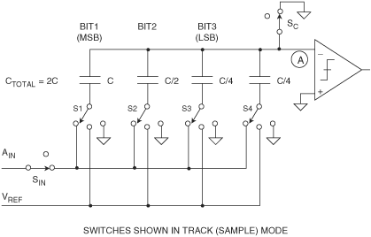
SUCCESSIVE APPROXIMATIONS ADC
Notes:
This conversion process basically consists of starting with the most significant bit (MSB) in shift register and B1 in SAR latch.
The DAC converts bit string in half of its full scale, then output of the D/A decoder is compared against the input analog signal (see also
following slide). If the D/A output is larger, the ONE is removed from that bit as the process continues and a ONE is tried in the next most significant bit (B2).
At the next clock period the input analog signal is compared whit a quarters of full scale.
If the analog input signal is larger, the ONE remains in that bit.
At the next clock period the input analog signal is compared whit three quarters of full scale.
At the end of the process, after the LSB has been tried, then digital number in the D/A decoder is the digital equivalent of the analog voltage.
This ADC requires n steps for encoding too an n-bit binary value.
The conversion sample rate for this converter is much faster than that of the counter ramp type.the converter need go through only n program steps before the conversion is concluded. Therefore ,the conversion speed of the successive approximation A/D converter is much greater than that of the counter ramp for circuits of the same approximate frequency response.

Slide 32
SUCCESSIVE APPROXIMATIONS ADC:
V_{ref}
3-bit counter
1
B₃
1
7/8
1
B₂
0
6/8
0
B₃
1
5/8
Start
convertion
B₁
0
4/8
1
B₃
1
3/8
0
B₂
0
2/8
0
B₃
1
1/8
0
0
Notes:
In figure a successive approximation conversion process, basically for 3 bit, is shown.
Please, note the division in 8 parts of 1/8 of the full scale.

Slide 33
HW: N-bit segmented Cap SAR ADC
N-bit, N1 msb bits, Ctot1 = 2^s*Ctot2
Show that Ron does not affect static performance.
Show that if each branch has the same τ, there is no switching transient.

Slide 34
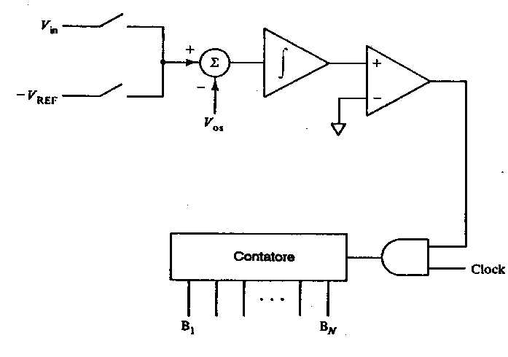
DUAL SLOPE ADC
Counter
Clock
Notes:
In the figure a basic architecture for dual slope integrating A/D converter is shown.
This architecture resolves some errors inherent in single-slope A/D converter. The basic idea of the dual-slope or up-down integrator A/D converter is to generate a pulse width proportional to the analog input voltage by making a time comparison between two integrations. In this way, many of the absolute errors in generating the integrated ramp voltage are cancelled.

Slide 35
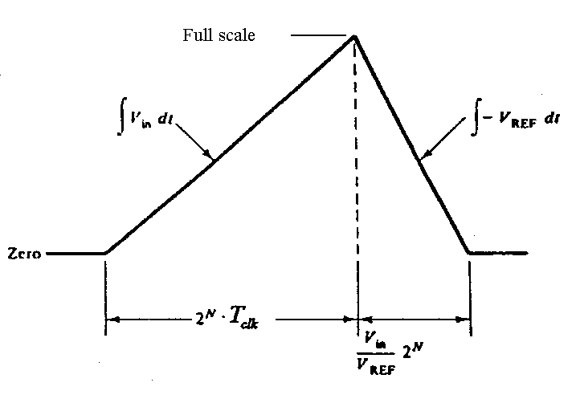
DUAL SLOPE ADC: cycle of convertion
Notes:
The first integration is on the input analog signal.
It proceeds for a fixed interval of time, t=2^{N} xT_{clok}.
The input to the integrating circuit is then switched to a known reference voltage.
The time from this switching until the integrator output reaches some the reference point gives a measure of the analog input voltage.

Slide 36
COUNTER RAMP ADC
Clock
AND
COUNTER
REGISTER
CONTROL
CIRCUIT
1) The counter starts to count the clock pulses when the control circuit enables the AND gate.
2) The DAC output is incremented from zero to V_{FS}, by Q-high steps.
3) The counter is stopped as soon as DAC output becomes equal to V_{x}.
Notes:
The conversion process begins with a reset pulse to the counter. At this time, the counter is reseted to zero, which drives the D/A decoder analog output to 0V. Then, the counter begins to receive and counters clock signals through the AND-gate.
The D/A decoder is slaved to the counter so that, as the counts build up in the counter, the output analog voltage from the decoder Vc increases as shown in the simplified timing diagram in the successive slide. When the count has built up sufficiently so that Vc is slightly greater than the analog input voltage, the comparator changes state, thus inhibiting gate, so that no more clock pulses enter the counter. At this time, the
parallel digital number in the counter is the digital equivalent of the analog input voltage.

Slide 37
COUNTER RAMP ADC
GATE OPEN
GATE CLOSED
Observations:
1) The maximum number of steps is 2^{b}, when V_{x}=V_{FS}. Consequently the max sampling frequency is about f_{S}≅f_{clock}/2^{b}.
2) The ADC errors come from the DAC, in particular from:
- the uncertainty on the reference voltage E_{r}.
- the uncertainty on the resistance values in the R-2R DACs.
Notes:
See previous slide.

Slide 38
DELTA-SIGMA ADC
Low Cost, High Resolution (to 24-bits) Excellent DNL,
Low Power, but Limited Bandwidth
Key Concepts are Simple, but Math is Complex
Oversampling
Quantization Noise Shaping
Digital Filtering
Decimation
Ideal for Sensor Signal Conditioning
High Resolution
Self, System, and Auto Calibration Modes
Notes:
Sigma-Delta Analog-Digital Converters (EO ADCs) have been known for nearly thirty years, but only recently has the technology (high-density digital VLSI) existed to manufacture them as inexpensive monolithic integrated circuits. They are now used in many applications where a low-cost, low-bandwidth, low-power, high-resolution ADC is required.
There have been innumerable descriptions of the architecture and theory of ZA ADCs, but most commence with a maze of integrals and deteriorate from there. In the Applications Department at Analog Devices, we frequently encounter engineers who do not understand the theory of operation of EO ADCs and are convinced, from study of a typical published article, that it is too complex to comprehend easily.
There is nothing particularly difficult to understand about ZA ADCs, as long as you avoid the detailed mathematics, and this section has been written in an attempt to clarify the subject. A ZA ADC contains very simple analog electronics (a comparator, a switch, and one or more integrators and analog summing circuits), and quite complex digital computational circuitry. This circuitry consists of a digital signal processor (DSP) which acts as a filter (generally, but not invariably, a low pass filter). It is not necessary to know precisely how the filter works to appreciate what it does. To understand how a ZA ADC works familiarity with the concepts of over-sampling, quantization noise shaping, digital filtering, and decimation is required.

Slide 39
DELTA-SIGMA ADC
Notes:
If we take a 1-bit ADC (generally known as a comparator), drive it with the output of an integrator, and feed the integrator with an input signal summed with the output of a 1-bit DAC fed from the ADC output, we have a first-order EA modulator as shown in the slide. Add a digital low pass filter (LPF) and decimator at the digital output, and we have a ED ADC: the EA modulator shapes the quantization noise so that it lies above the passband of the digital output filter, and the ENOB is therefore much larger than would otherwise be expected from the over-sampling ratio.
Intuitively, a YEA ADC operates as follows. Assume a DC input at VIN. The integrator is constantly ramping up or down at node A. The output of the comparator is fed back through a 1-bit DAC to the summing input at node B. The negative feedback loop from the comparator output through the 1-bit DAC back to the summing point will force the average DC voltage at node B to be equal to VIN.
This implies that the average DAC output voltage must equal to the input voltage VIN. The average DAC output voltage is controlled by the ones-density in the 1-bit data stream from the comparator output. As the input signal increases towards +VREF, the number of "ones" in the serial bit stream increases, and the number of "zeros" decreases. Similarly, as the signal goes negative towards -VREF, thenumber of "ones" in the serial bit stream decreases, and the number of "zeros“ increases. From a very simplistic standpoint, this analysis shows that the average value of the input voltage is contained in the serial bit stream out of the comparator. The digital filter and decimator process the serial bit stream and produce the final output data.

Slide 40
DELTA-SIGMA ADC: signals
V_{iN}(t)
t
V_{NA}(t)
t
V₁(t)
t
V_{C}(t)
t
V_{U}(t)
t
CLK
t₁ t₂
t
Notes:
Example of input and output signal for various system blocks of the modulator, in the case of a constant signal applied to the input.

Slide 41
DELTA-SIGMA ADC
Rearranging, solving for y:
Notes:
The concept of noise shaping is best explained in the frequency domain by considering the simple EA modulator model in the slide.
The integrator in the modulator is represented as an analog lowpass filter with a transfer function equal to H(f) = 1/f. This transfer function has an amplitude response which is inversely proportional to the input frequency. The 1-bit quantizer generates quantization noise, Q, which is injected into the output summing block. If we let the input signal be X, and the output Y, the signal coming out of the input summer must be X - Y. This is multiplied by the filter transfer function, 1/f, and the result goes to one input to the output summer. By inspection, we can then write the expression for the output voltage Y as:
Y= (X-Y)/f+Q.
This expression can easily be rearranged and solved for Y in terms of X, f, and Q:
Y=X/(f+1)+ Q.f /(f+1)
Note that as the frequency f approaches zero, the output voltage Y approaches X with no noise component. At higher frequencies, the amplitude of the signal component decreases, and the noise component increases. At high frequency, the output consists primarily of quantization noise. In essence, the analog filter has a lowpass effect on the signal, and a highpass effect on the quantization noise. Thus the analog filter performs the noise shaping function in the EO modulator model.
For a given input frequency, higher order analog filters offer more attenuation. The same is true of EO modulators, provided certain precautions are taken.

Slide 42
DELTA-SIGMA ADC
Notes:
By using more than one integration and summing stage in the EO modulator, we can achieve higher orders of quantization noise shaping and even better ENOB for a given over-sampling ratio as is shown in Figure 8.22 for both a first and secondorder
YEA modulator

Slide 43
DELTA-SIGMA ADC
Notes:
The block diagram for the second-order YEA modulator is shown in Figure 8.23. Third, and higher, order ED ADCs were once thought to be potentially unstable at some values of input - recent analyses using finite rather than infinite gains in the comparator have shown that this is not necessarily so, but even if instability does start to occur, it is not important, since the DSP in the
digital filter and decimator can be made to recognize incipient instability and react to prevent it.

Slide 44
DELTA-SIGMA ADC
Notes:
Figure 8.24 shows the relationship between the order of the EA modulator and the amount of over-sampling necessary to achieve a particular SNR. For instance, if the oversampling ratio is 64, an ideal second-order system is capable of providing an SNR of about 80dB. This implies approximately 13 effective number of bits (ENOB).
Although the filtering done by the digital filter and decimator can be done to any degree of precision desirable, it would be pointless to carry more than 13 binary bits to the outside world. Additional bits would carry no useful signal information, and would be buried in the quantization noise unless post-filtering techniques wereemployed.
The ZA ADCs that we have described so far contain integrators, which are low pass filters, whose passband extends from DC. Thus, their quantization noise is pushed up in frequency. At present, most commercially available ZA ADCs are of this type (although some which are intended for use in audio or telecommunications applications contain bandpass rather than lowpass digital filters to eliminate any system DC offsets). Sigma-delta ADCs are available with resolutions up to 24-bits for DC measurement applications (AD77XX-family), and with resolutions of 18-bits for high quality digital audio applications (AD 1879).
But there is no particular reason why the filters of the ZA modulator should be LPFs, except that traditionally ADCs have been thought of as being baseband devices, and that integrators are somewhat easier to construct than bandpass filters. If we replace the integrators in a EA ADC with bandpass filters (BPFs), the quantization noise is moved up and down in frequency to leave a virtually noise-free region in the pass-band If the digital filter is then programmed to have its pass-band in this region, we have a ZA ADC with a bandpass, rather than a lowpass characteristic. Although studies of this architecture are in their infancy,
such ADCs would seem to be ideally suited for use in digital radio receivers, medical
ultrasound, and a number of other applications.
A ZA ADC works by over-sampling, where simple analog filters in the EO modulator shape the quantization noise so that the SNR in the bandwidth of interest is much greater than would otherwise be the case, and by using high performance digital filters and decimation to eliminate noise outside the required passband. Because the analog circuitry is so simple and undemanding, it may be built with the same digital VLSI process that is used to fabricate the DSP circuitry of the digital filter. Because the basic ADC is 1-bit (a comparator), the technique is inherently linear.
Although the detailed analysis of EO ADCs involves quite complex mathematics, their basic design can be understood without the necessity of any mathematics at all.

Slide 45
DELTA-SIGMA ADC
Notes:
Because of the high resolution of these converters, the effects of noise must be fully understood and how it affects the ADC performance. This discussion also applies to ADCs of lower resolution, but is particularly important when dealing with 16-bit or
greater ED ADCs.
The slide shows the output code distribution, or histogram, for a typical high resolution ADC with a DC, or "grounded" input centered on a code. If there were no noise sources present, the ADC output would always yield the same code, regardless of how many samples were taken. Of course, if the DC input happened to be in a transition zone between two adjacent codes, then the distribution would be spread between these two codes, but no further. Various noise sources internal to the converter, however, cause a distribution of codes around a primary one as shown in the diagram.
This noise in the ADC is generated by unwanted signal coupling and by components such as resistors (Johnson noise) and active devices like switches (kT/C noise). In addition, there is residual quantization noise which is not removed by the digital filter. The total noise can be considered to be an input noise source which is summed with the input signal into an ideal noiseless ADC. It is sometimes called input-referred noise, or effectiue input noise. The distribution of the noise is primarily gaussian, and therefore an RMS noise value can be determined (i.e., the standard deviation of the distribution).

Slide 46
DELTA-SIGMA ADC
Notes:
Simultaneous sampling of multiple channels is relatively common in data
acquisition systems. If sigma-delta ADCs are used as shown in the slide, their
outputs must be synchronized. Although the inputs are sampled at the same instant
at a rate Kfs, the decimated output word rate, fs, is generally derived internally in
each ADC by dividing the input sampling frequency by K. The output data must
therefore be synchronized by the same clock at the fs frequency. The SYNC input of
the AD77XX family can be used for this purpose.

Slide 47
HIGH SPEED ADC: interleaving-multiplexing
clock
V_{IN}
fs/M
DL
S/H
A/D
1
DL
S/H
A/D
2
N
DL
S/H
A/D
3
S/H
A/D
M
Notes:
The converter in figure is constituted by M flash ADC each with a S/H circuit.
The clock signal at frequency fs/M is distribute by M delay line at different flash ADC,
so that between two successive stage the delay is 1/fs.
Each group S/H and ADC work at fs/M sample frequency, while full structure at fs
sample frequency.

Slide 48
HIGH SPEED ADC: interleaving-multiplexing
Conversion times
1 2 3 4 5 6 7 8 9 10
1 ns
10 ns
Notes:
The figure represents the working operations of a interleaving-multiplexing ADC
architecture shown in the previous slide.
In this example M=10 and each ADC works at a sample frequency of 100 MHz,
so that full structure works at 1 GHz.

Slide 49
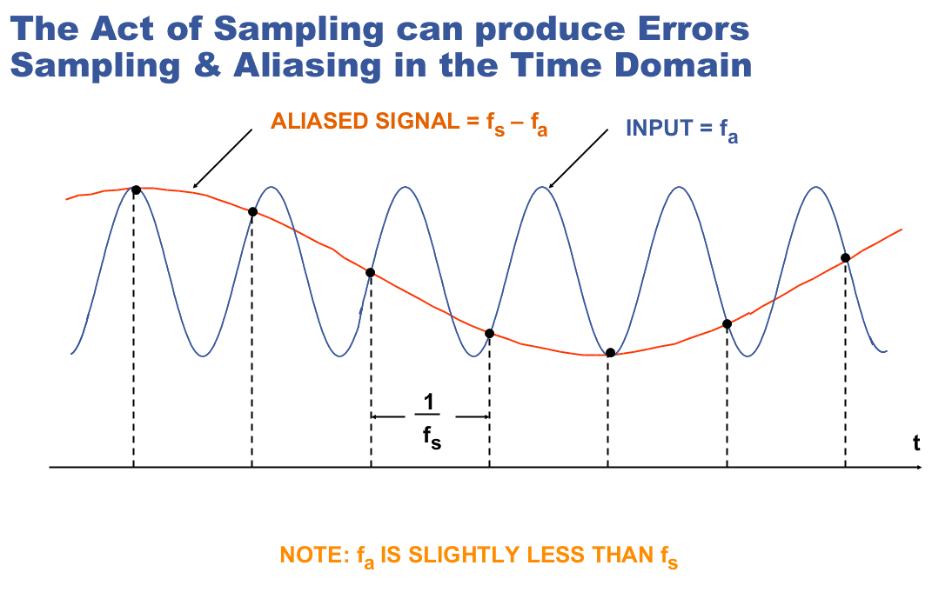

Slide 50
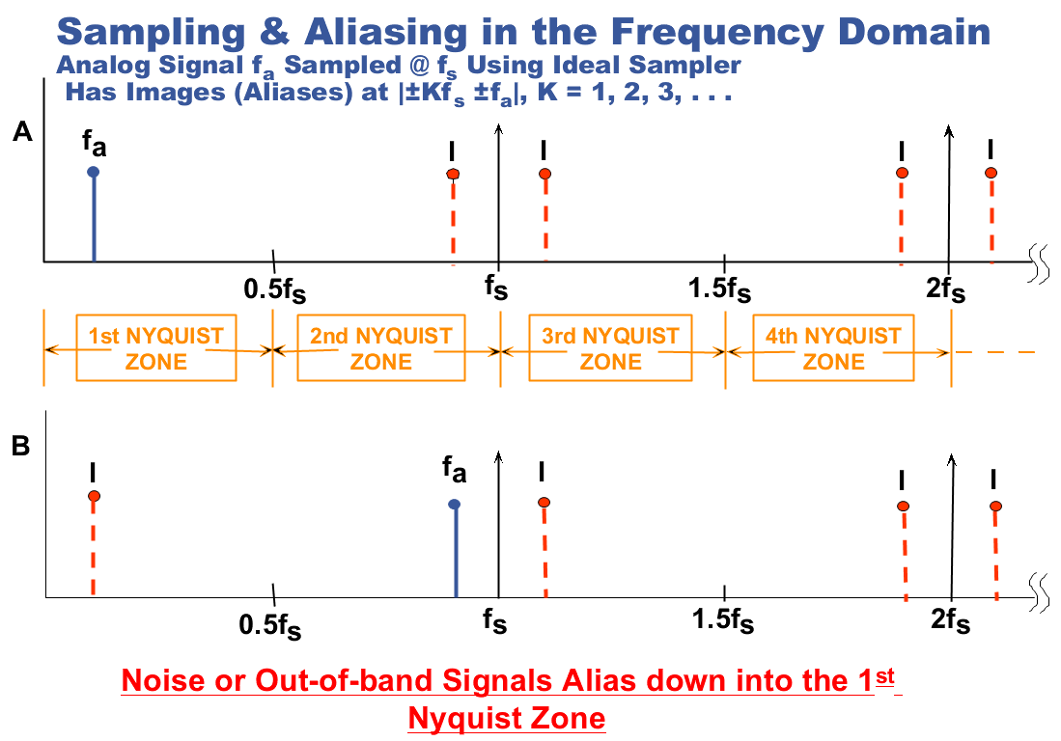

Slide 51
