Slide 1
ADC specs and standard test

Slide 2
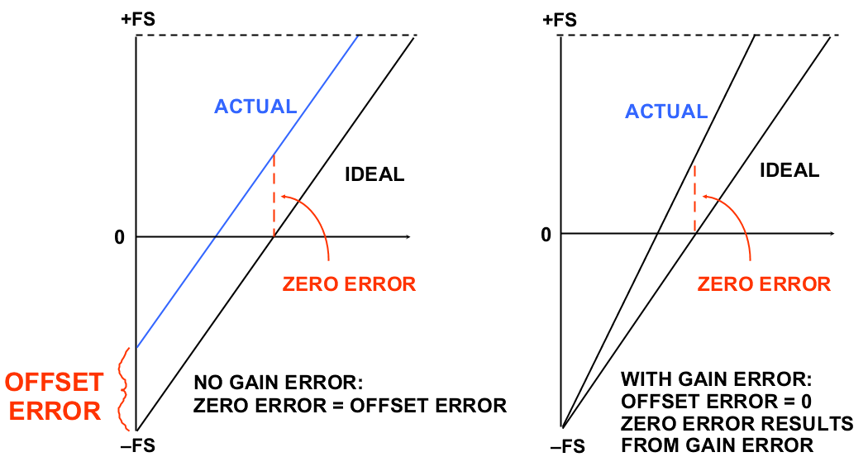
GAIN AND OFFSET ERRORS
Offset is corrected by measuring a reference at one point
Gain error is corrected by measuring at two points

Slide 3
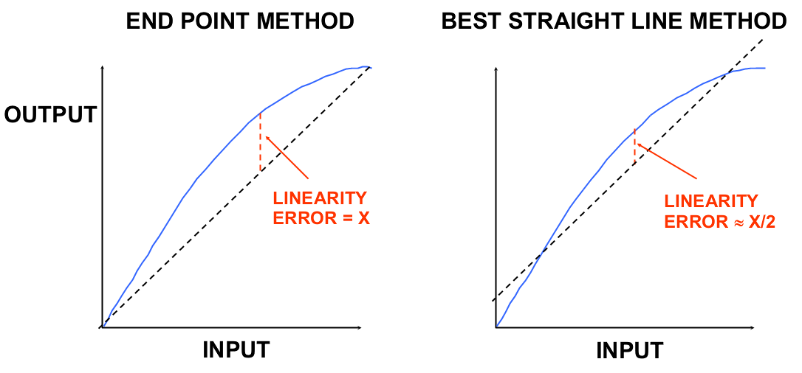
INTEGRAL NONLINEARITY ERRORS
This is the right illustration for DACs: INL_k error is indexed with respect to the input axis, which is code k.

Slide 4
INTEGRAL NONLINEARITY ERRORS
C_{o}
2^{N}−1
k
INL_{k}
For ADCs: INL_k error is indexed with respect to the output axis, which is code k.
0
V_{os}
V_{in}
For ADC INL and DNL plot, it is customary to place output code on the x-axis, INL/DNL on y-axis

Slide 5
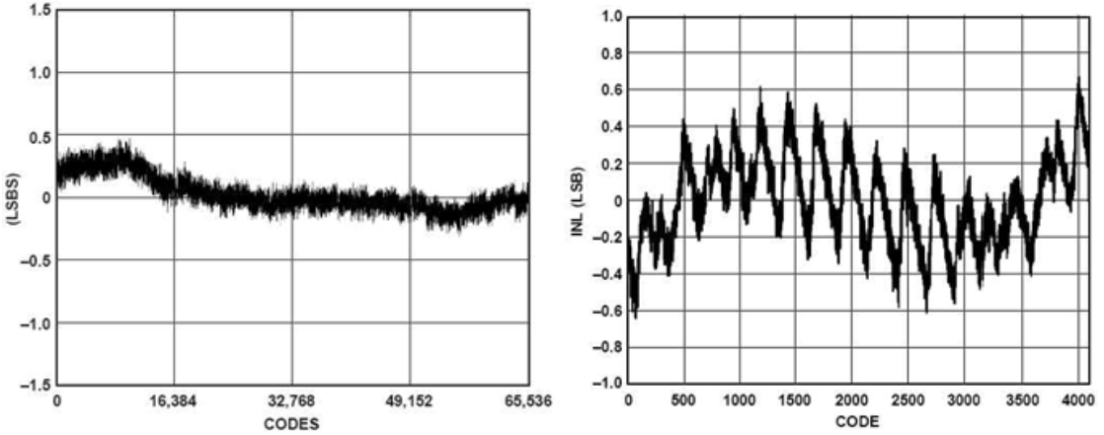
Example ADC INL_{k} Curves
16 bit ADC
Low speed
12 bit ADC
High speed

Slide 6
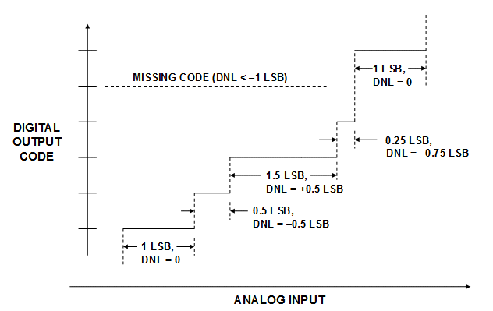
ADC Differential Nonlinearity
=

Slide 7
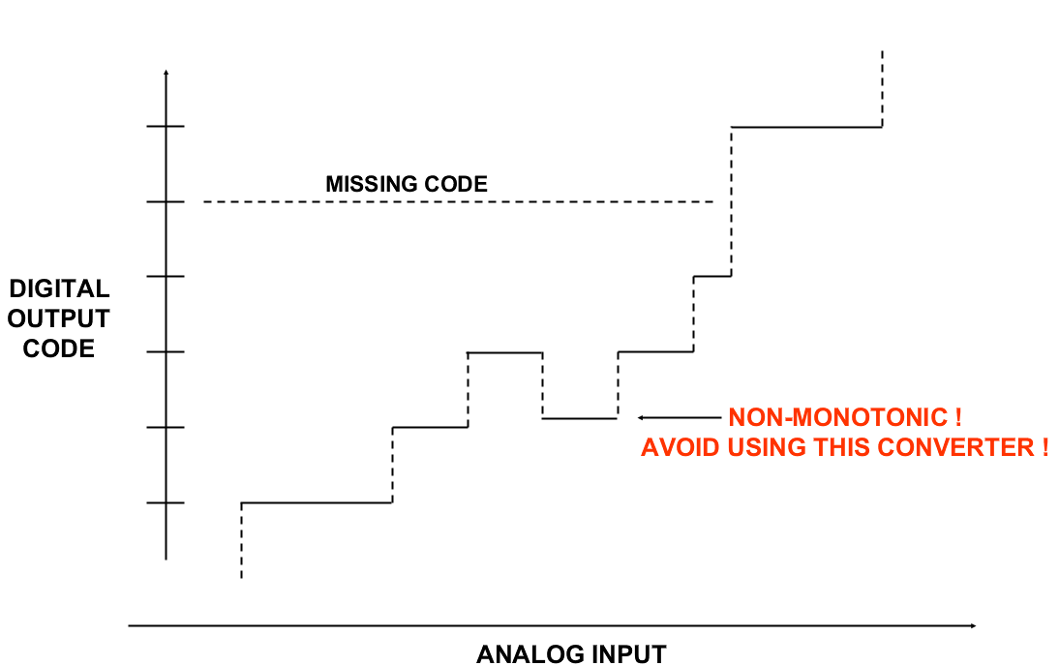
Missing code and nonmonotonicity

Slide 8
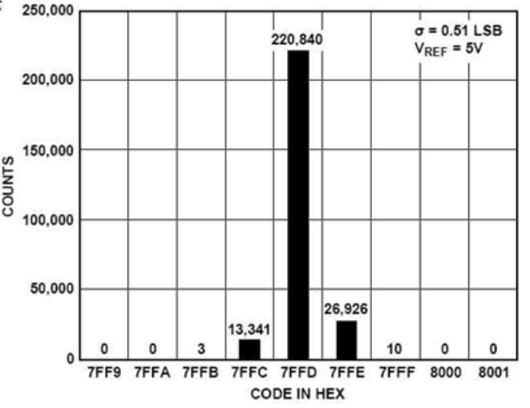
Noise Histogram

Slide 9
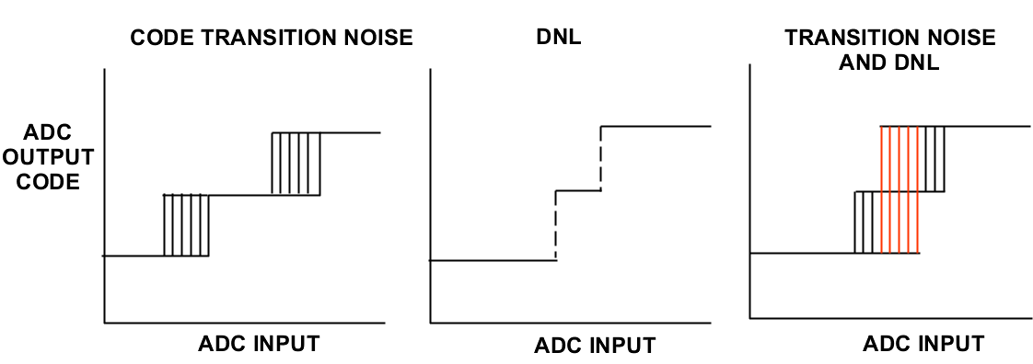
Transition uncertainty
Due to noise, jitter, aperture uncertain, the ADC’s transition points may seem to be uncertain.
It affects measurements of DNL

Slide 10
ADC Decision Levels
Code 1
Code 2
Gaussian
Noise pdf
Input Voltage Probability
Input Voltage (DC Plus Noise)
Average Voltage
(DC Input)

Slide 11
Code 1
Code 2
Area 1 = Probability
for Code 1
Area 2 = Probability
for Code 2
Input Voltage Probability
ΔV
Input Voltage (DC Plus Noise)

Slide 12
Code 1
Code 2
50% Probability for
Code 1
or lower
50% Probability for
Code 2
or higher
Input Voltage Probability
Input Voltage (DC Plus Noise)

Slide 13
7
Noise-Free Transfer Curve
6
Probable Output
Transfer Curve
5
Code Edge Locations
4
Average
Output Code
3
2
Input Noise
Probability Density
(Typically Gaussian)
1
0
0
10
20
30
40
50
60
70
80
90
DC Input Voltage (mV)
ADC Probable Output Code Transfer Curve

Slide 14
HW
Generate a 6 bit ADC with 2^6 – 1 transition voltages dividing Vref into 64 sequential bins with each bin having ideal bin width = Vref/2^6 but having local random variations.
With an ideal linear ramp, generate an input voltage vector, starting at -0.05 Vref, with 1/K LSB step size, and ending at 1.05 Vref.
For each ramp input voltage, use the ADC to convert it L times, each time with a random noise added to the input with noise std of 0.5 LSB. Compute a weighted average of the L output codes.
Plot the weighted average code as a function of input voltage.
Compute the mid-rise voltages. At each transition, use two weighted averages closest to mid-rise and linear interpolation to find the mid-rise input voltage.
Treat these mid-rise input voltages as the measure transition voltages, compute the INLk, DNLk, INL, and DNL.
Sort all the ~2^6 *K*L output codes into 64 histogram counts and use RHT method to compute INLk, DNLk, INL and DNL.
Compare the advantages and disadvantages of each method.

Slide 15
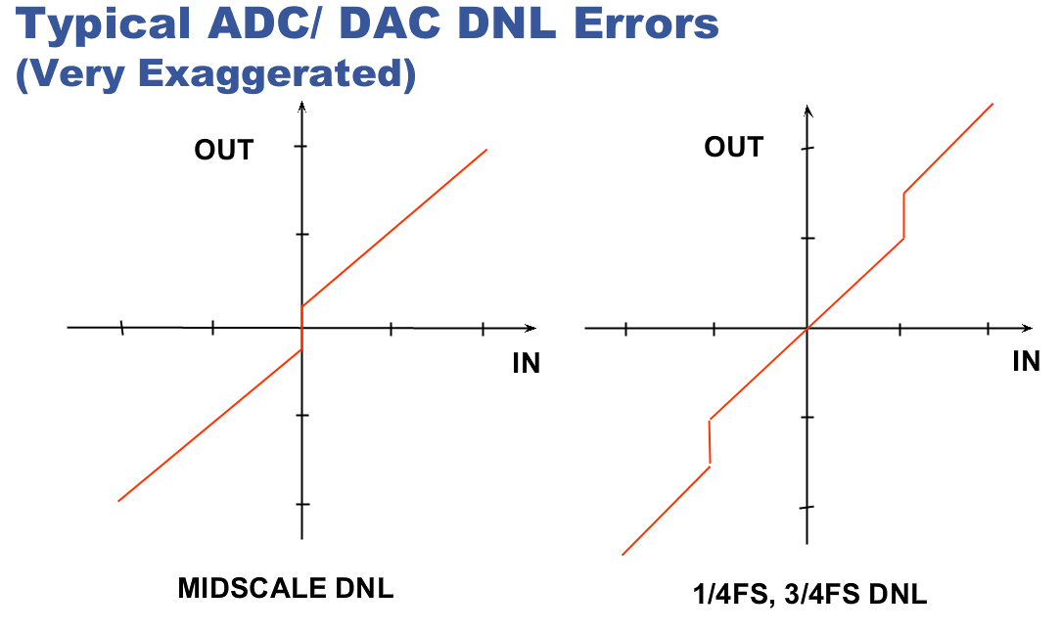
Missing codes near MSB transition
Missing codes near 2nd MSB transitions

Slide 16
HW
Use paper and pen arguments and use capacitive SAR ADC as an example like what we did in class, explain which of the two cases in the left graph has too large or too small an MSB cap. The locations of the flat and the vertical parts of the transfer curve are drawn as symmetric about the vertical axis. When is this true and why? What can cause them to be not symmetric? What are the input voltages and the output codes at the corners (the two codes right before and right after the flat or vertical piece)? How is the flat or vertical piece’s length related to the cap error and to the two corner codes’ difference?
For the graph on the right, draw the corresponding “green” case. Explain whether the MSB cap and second MSB cap are too large or too small? What is the relative errors? Also answer the question about symmetry. What are the input voltages and output codes at the 4 corners?

Slide 17
ADC Input output DC transfer
Ideal ADC: ideal LSB = LSB_{i} = V_{ref}/2^{N}
  Output code C_{out} = 0, for all V_{in} < V_{ref}/2^{N} = 1LSB;
    No offset
  Output code C_{out} = 11…1, for all V_{in} >= V_{ref} – 1LSB
  Output code transitions from k–1 to k, when input voltage increases from V_{in} < to >= k* V_{ref}/2^{N}
  Transition point or trip point: T_{k} = k* V_{ref}/2^{N}
    Ideal line: V_{ideal}(k) = ideal T_{k} = k*LSB_{i} = Gain * k/2^{N}
  For all V_{in} ∈ [T_{k}, T_{k+1}), output code C_{out} = k
    For V_{in} < T₁, output code C_{out} = 0
    For V_{in} >= T_{2N–1}; output code C_{out} = 11…1 = 2^{N}–1
    This defines C_{out} as a piecewise constant function of V_{in}: C_{out}(V_{in}) = k when V_{in} ∈ [T_{k}, T_{k+1})
    By definition C_{out}(T_{k}) = k
    The interval [T_{k}, T_{k+1}) is called the code bin k
    Bin width w_{k} = T_{k+1} – T_{k}

Slide 18
ADC Input output DC transfer
Ideal ADC:
  Ideal Resolution: ideal 1LSB_{i} = V_{ref}/2^{N},
  Code bin k is interval [T_{k}, T_{k+1})
    Code bin width: w_{k} = length of bin k = T_{k+1} – T_{k}
    For ideal ADC: w_{k} = ideal 1LSB_{i} for all k = 1, 2, … 2^{N}–2
    w_{k} not defined for k = 0 or 2^{N}–1
    No DNL error
  C_{o}(V_{in}) satisfies: C_{o}(k*V_{ref}/2^{N}) = C_{o}(T_{k}) = k
    All transition points line up on a perfectly straight line y=x
    No INL error
  Total Gain: T_{last} – T_{first} + 2LSB_{i}
    in ideal LSB: (T_{last} – T_{first} + 2LSB_{i})/(V_{ref}/2^{N})=2^{N}
    Gain error: gain in ideal LSB_{i} – 2^{N} = 0
    No gain error

Slide 19
ADC Input output DC transfer
Actual ADC:
  ADC output code C_{out} is a function of V_{in}
  All those input values that gives output C_{out}=k is the code bin k, bin_{k}
  Assume bin_{k} is a contiguous interval
  The length of bin_{k} is the code bin width w_{k}
  The starting point of bin_{k} is the transition point T_{k}
    bin_k = [T_{k}, T_{k} + w_{k}) = [T_{k}, T_{k+1})
    C_{out}(Vin) = k, when Vin ∈ bin_{k}, ie, Vin ∈ [T_{k}, T_{k+1})
  If a code m never appears at the ADC output,
    this code’s code bin bin_{m} is the empty set
    This code’s bin width w_{m} = 0
    We define its transition point to be the next code’s transition point: T_{m} = T_{m+1}, if there exists next transition

Slide 20
ADC Input output DC transfer
Actual ADC:
  Note that ADC output will be 00…0 for all Vin < first transition point
    C_{out}(Vin) = 0 for all Vin < T₁
  Similarly ADC output will be 11…1 for all Vin larger than the last transition point
    C_{out}(Vin) = 2^{N}–1 for Vin >= T_{2^N–1}
  Resolution: 1LSB = (T_{2^N–1}–T₁)/(2^{N}–2),
  Offset = T₁ – 1LSB_{i}
    Offset in LSB: {T1 – 1LSB_{i}}/1LSB_{i}
  Gain: = (T_{last} –T_{first} + 2LSB_{i})
    Gain in ideal LSB = (T_{last} –T_{first} + 2LSB_{i}) / (V_{ref}/2^{N})
    Gain error = Gain in ideal LSB_{i} – 2^{N}
    = (T_{last} – T_{first})/1LSB_{i} – 2^{N} + 2

Slide 21
ADC Input output DC transfer
Actual ADC
  End-point to end-point fitline:
    V_{fit}(k) = T₁ + (k-1) * 1LSB
    = T₁ + (k-1)* (T_{2^N–1} –T₁)/(2^{N}–2)
    V_{fit}(1) = T₁; V_{fit}(2^{N}–1) = T_{2^N–1}
  INL_{k} = T_{k} – V_{fit}(k) in V = (T_{k} – V_{fit}(k))/1LSB;
  INL = max{abs(INL_{k})}
  Note: INL₁ = INL_{2N–1} = 0 by definition
  DNL_{k} = w_{k}/1LSB – 1; k=1, 2, …, 2^{N}–2
    If DNL_k > 0, code bin k is wide
    If DNL_k < 0 but >–1, code bin k is narrow
    If DNL_k = –1, code k is a missing code
  DNL = max{abs(DNL_k)}

Slide 22
ADC DC transfer HW
For actual ADCs, prove that:
  Offset = {T1 – 1LSB_{i}}/1LSB_{i}
  ~= {T1 – 1LSB}/1LSB = T1/1LSB – 1
  Gain error = {(1LSB)/(ideal 1LSB_{i}) – 1}*2^{N}
  Gain error = 2 + (T_{last} –T_{first})/1LSB_{i} – (C_{last} – C_{first})
  not= 2 + (T_{last} –T_{first})/1LSB – (C_{last} – C_{first})
  V_{fit}(k) = V_{os} + k * 1LSB
  DNL_{k} = differential of DNL_{k} = INL_{k+1} – INL_{k}; k=1, 2, …, 2^{N}–2
  INL_{k} = integral of DNL_{k} or = cumsum of DNL_{k} = DNL₁+DNL₂ + … + DNL_{k–1}; k=1, 2, …, 2^{N}–1
  Total DNL_{k} is zero: DNL₁+DNL₂ + … + DNL₂^{N}_{–2} = 0
  Note that DNL_0 and DNL_(2^{N}-1) are undefined, but can be set to 0 for convenience.

Slide 23
Servo-loop test (SLT)
Use feedback to find and measure T_{k}
Use T_{k} to find W_{k}, INL_{k}, DNL_{k}
Input level converges to
ADC decision level
Search Value
Register
Analog Integrator
∫
ADC
Under
Test
Digital Comparator
DC
Voltmeter
with
Low-Pass Filter
VOH = Ramp Up
VOL = Ramp Down
1 = ADC Output <= Search Value
0 = ADC Output > Search Value
One-Bit
DAC

Slide 24
SLT
SLT takes a long time to finish
Stationarity of the test environment becomes a significant issue
Even partial code test may require a time long enough to cause stationarity concerns
Solution is to repeatedly re-measure offset and gain error throughout SLT, and adjust Tk according to the latest measurement of offset and gain error

Slide 25
Alternative SLT for full code test
fineDAC
mainDAC
ADC
Under
Test
Dedicated computer
±VrefGND

Slide 26
Alternative SLT for full code test
Divide ADC code range into many segments
Choose main DAC, fine DAC and sum op amp so that
  Op amp output over ranges ADC input
  Fine DAC, op amp, to ADC path is small signal linear
  Fine DAC range can always covers one segment of ADC code range
For each code range segment k
  Calibrate offset and gain error by measuring ±Vref and GND
  Search for D_{k} and d_{kL} (near lower end of fine DAC range) that produce transition voltage before segment
  Search for d_{kU} that produce t.v. after segment
  Ramp up and down between d_{kL} and d_{kU} for desired number of samples to achieve sufficient accuracy
  Record I/O curve for this segment, both V_{in} and C_{out}
Combine to get overall ADC I/O transfer curve

Slide 27
Optional HW
Write a Matlab program to implement alternative SLT
  For simplicity, assume single-ended circuit, with ideal GND
  Model Vref as a constant (1) plus a slowly varying component (your choice of model, can have both deterministic and random walk component, 50-100 ppm per minute not uncommon)
  Can have around 1K segments (2^9, 2^10, 2^11, or 2^12)
  Select op amp gain for main DAC so that DAC output over ranges ADC input a little bit
  Main DAC has high resolution (18 bit, 20 bit) with linearity (INL) at the 15-16 bit level
  Op amp gain for main DAC has linearity at 14-15 bit level
  Select op amp attenuation for fine DAC so that DAC output covers about >1.2 segments of ADC
  Fine DAC resolution is sufficient to provide >1K samples per ADC LSB over the >1.2 segment range
  Op amp gain has ideal linearity over the small range of the fine DAC
  But this gain will change as a function of the main DAC output (14-15 bit level)
  After including the last point, the op amp summing action can be assumed linear
  Volt meter can be assumed perfect

Slide 28
Optional HW
Analyze the time savings of the alternative SLT vs SLT
  In terms of ADC clock period (Ts), volt meter settling time (thousands times slower), DAC settling time (same order of magnitude as Ts), and op amp settling time (~Ts).
  Assume similar number of calibrations for Vos and GE
What is the minimum requirement on the resolution and linearity for the main DAC, what is that for the fine DAC, and what is that for the op amp, all in terms of ADC resolution, segments, and target test accuracy?
For a given ADC resolution and target test accuracy, how does segment choice affect answers to the two questions above?

Slide 29
Ramp histogram test (RHT)
7
6
5
ADC Samples
4
Output Code
3
2
W₃=12mV
1
W₂=19mV
0
0
10
20
30
40
50
60
70
80
90
Input Voltage (mV)
h₂=8
h₂=5
Sampl index
7
15
20
Assumption: #hits h_{k} ∝ code bin width w_{k}

Slide 30

8
8
7
LSB
Normalization
7
6
6
5
5
4
4
3
Number
of Code Hits
3
2
2
1
1
0
0
0
0
1
1
2
2
3
3
4
4
5
5
6
6
7
7
Output Code
Output Code
1.412
Average Hits per Code
= (4+8+5+8+5+4)/6
= 5.667
Divide Number of Hits by Average LSB Size to Convert Histogram to Code Widths
(Width of Lowest and Highest Codes are Undefined)
12
1.235
1.059
0.882
0.706
Code
Width
(LSBs)
0.529
0.353
Undefined
Undefined
0.176
0
0
1
2
3
4
5
6
7
Output Code

Slide 31
HW
Write a Matlab function that take as input a set of ADC output codes and
  Sort them into a vector of histogram counts, index with the ADC codes 0 to 2^N – 1 (N can be taken as an input or can be found from the code range)
  Discard suitable number of bins at each ends and use the remaining bins to computer the average bin count, the individual bin width in LSBs, the DNLk in LSBs, the INLk in LSB, and the overal INL/DNL. (This give you the end-point fit-line based INLk/DNLk.)
  Remove a LS best fit line from the INLk data to generate the LS best fit-line based INLk, compute the corresponding DNLk, and the overal INL/DNL.
  Plot the INLk ~ k and DNLk~k plot using subplots so that the INLk plot and the DNLk plot are in the same graphics window. You may have both end-point and best-fit results on the same graph with different colors and self-explanatory legends.

Slide 32
HW
The histogram method is vulnerable to certain issues. Discuss these in terms of
  Nonmonotonic ADC
  ADC with sparkle errors
  ADC with significant input referred noise
  Since the data acquisition time may be long, the test set-up (source, ADC, and Vref) may have some non-stationarity (time dependent drift due to thermal and other variations).
    (there is a simple solution to this, what is it?)
  The ramp may not be a perfect linear ramp

Slide 33
7
Consistent ADC Samples
6
ADC Samples with Uncertainty Caused by Noise
5
4
Output Code
3
2
Possible
Transition Sequence
1
0
0
10
20
30
40
50
60
70
80
90
Input Voltage (mV)

Slide 34
Sinewave histogram test (SHT)
ADC
Decision Levels
Time
Number
of Code Hits
Lower Code
Upper Code
Output Code

Slide 35
      where N1 is the number of times the upper code is hit, N2 is the number of times the lower code is hit, Ns is the number of samples, and N is the converter resolution, in bits.

Slide 36
80
N2
80
70
Measured Histogram
Use N1, N2, C1, and C2 to find offset and mag, and find expected histogram for ideal ADC
70
Expected Histogram
60
N1
60
50
50
Undefined
40
40
Undefined
Number
of Code Hits
30
30
20
20
10
10
0
0
0
2
4
6
8
10
12
14
0
2
4
6
8
10
12
14
Output Code
Output Code
Divide Measured Number of Hits by Expected Number of Hits
1.6
Ratios are Code Widths
12
1.4
Normalized Histogram
1.2
1.0
Code
Width
(LSBs)
0.8
0.6
From these, compute DNLk and INLk
12
0.4
0.2
0
0
2
4
6
8
10
12
14
Output Code

Slide 37
Alternative SHT processing algorithm
ADC
Decision Levels
T_{k}
T_{k-1}
Time
h_{k-1}
s_{k-1}
t_{k}=T_{s}*s_{k-1} (sec) =π*s_{k-1}/N_{s} (rad)

Slide 38
HW
Expand on what we briefly discussed in class, derive an alternative method for sine histogram test.
  Assume input sine wave is pure, its DC value is not necessarily equal to ADC input mid point, and sine peak to peak range may be larger or smaller than ADC input range.
  Assume ADC output histogram counts are available, given in a vector of length 2^N with i-th value corresponding to the histogram count for code i-1.
  Assume sampling times are uniform, so that # of cumulative counts is proportional to time.
  Perform all of your derivations and algorithm procedures symbolically.
Implement both the book’s SHT and your SHT in Matlab.
Use your ADC to test your algorithms.
  Add some input noise to the signal.
  Compare both SHT results against noise free true INL/DNL.
  Try various # hits per code (8, 16, 32, 64, 128, 256) and various noise sigma (0.25, 0.5, 0.75, 1, 1.5).
  Try a few different sine amplitudes and offsets.

Slide 39
HW (optional)
Extend your new SHT INL/DNL test algorithm to a general histogram test (GHT): the input signal is an arbitrary nonlinear strictly monotonic (when unfolded) function of known form but unknown amplitude and offset, that is Vin(t) = A*f(t) + Vos, where f(t) is known for t=0 to 1.

Slide 40
GHT
ADC
Decision Levels
T_{k}
T_{k-1}
Time
h_{k-1}
s_{k-1}
t_{k}=T_{s}*s_{k-1} (sec) =π*s_{k-1}/N_{s} (rad)

Slide 41
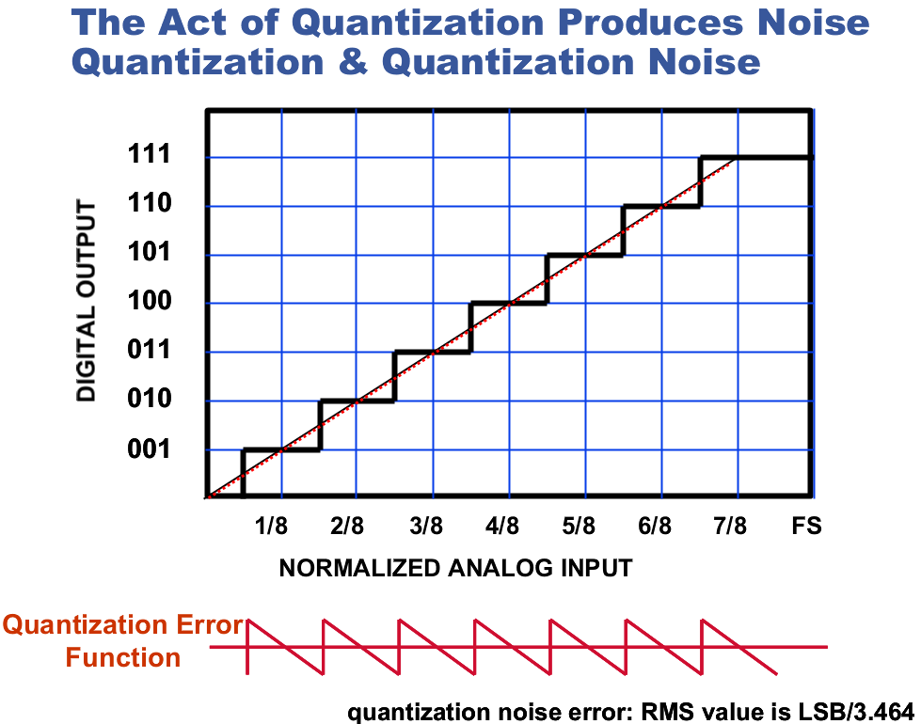

Slide 42
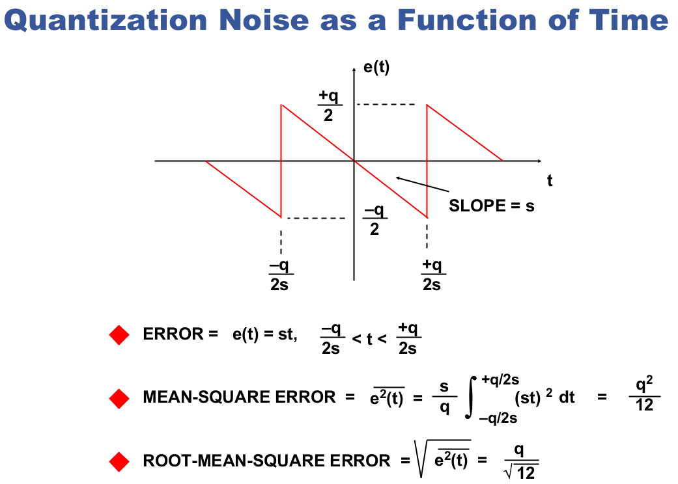
If input is a slow ramp with slop s,

Slide 43
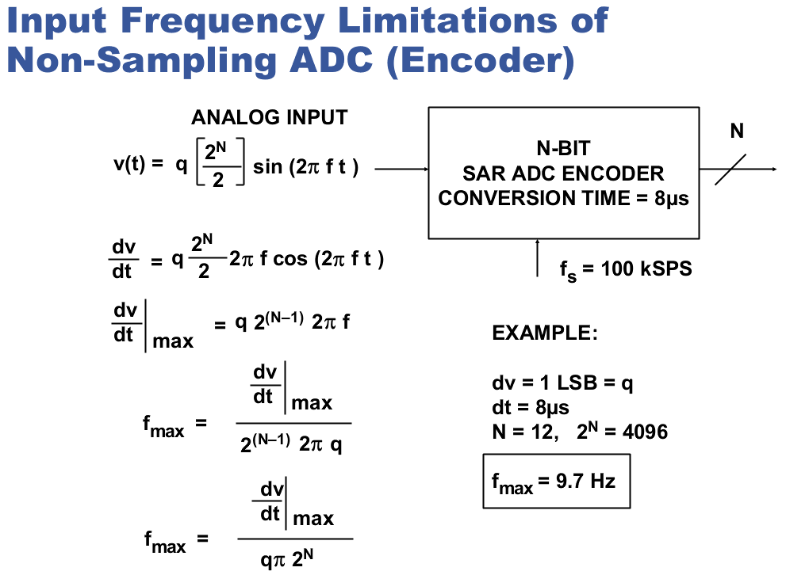

Slide 44
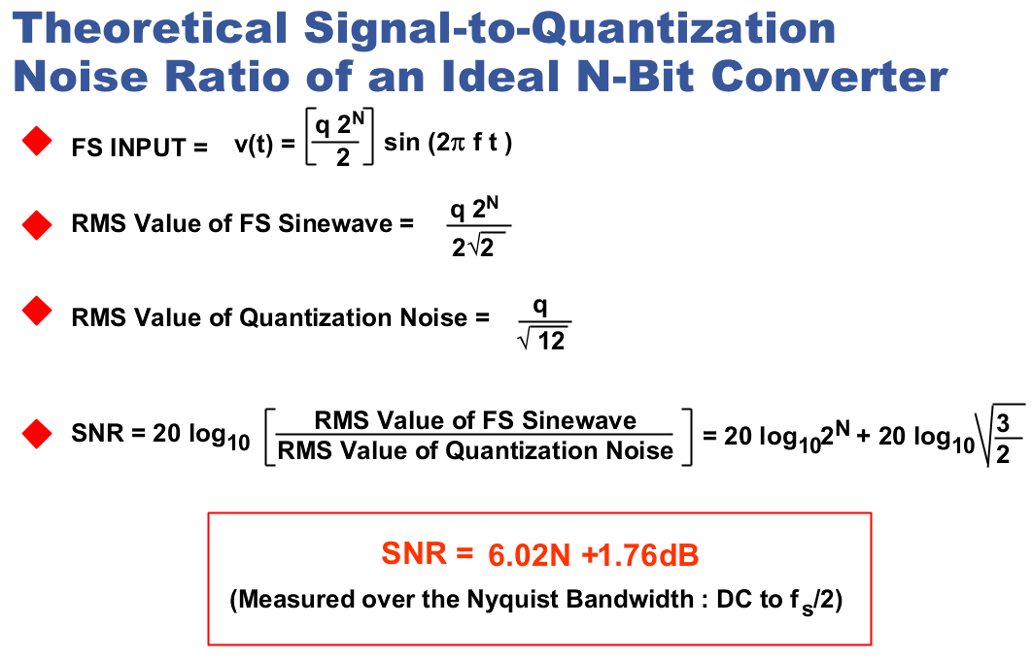

Slide 45
HW
Assume that the ADC is non-ideal. In particular, DNL_k != 0.
Redefined the quantization error as a function of Vin, and define the correct expression of the mean square error.
Approximately estimate the ms error.
Re-compute the noise-free signal to quantization ratio.

Slide 46
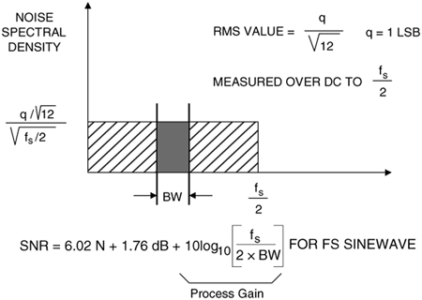
Quantization Noise Spectrum
Noise floor
Total noise power within bandwidth BW is reduced by BW/(fs/2)

Slide 47
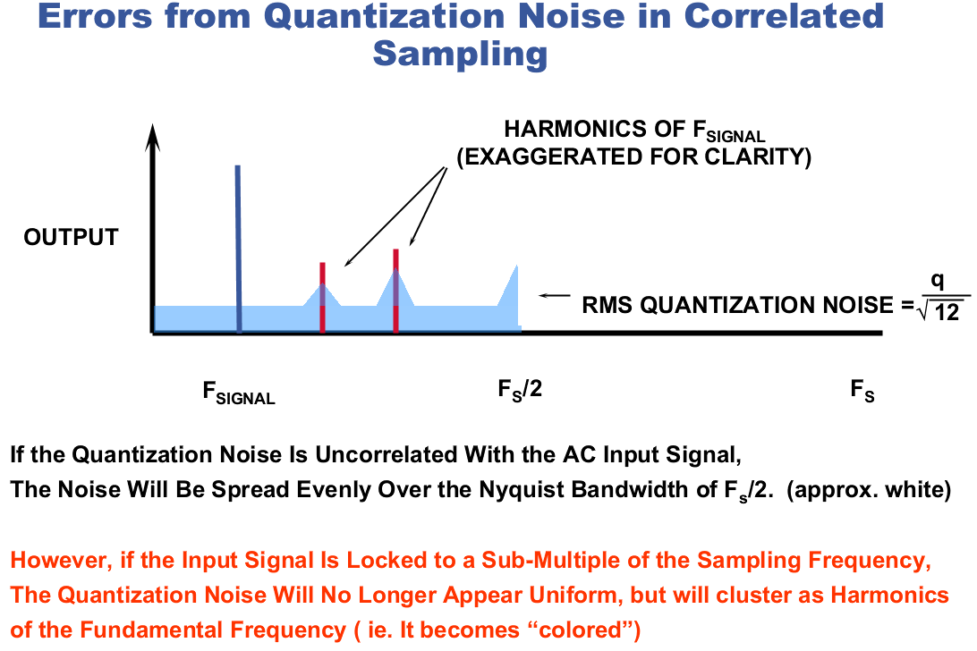

Slide 48
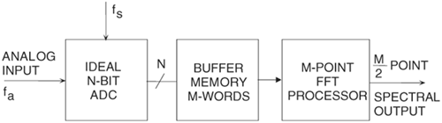
Noise floor on previous slide assumes continuous frequency axis. The shaded area contains the total noise power.
In real implementation:
In DFT/FFT, frequency axis is discrete, with M/2 discrete frequency bins, with total noise power spread among them.
On the average each frequency bin’s noise power is
q²/12 / (M/2)
Matlab default is 1 to M bins, power per bin is then halved.

Slide 49
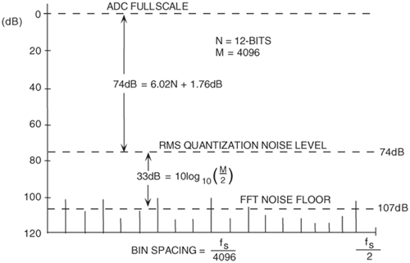
Noise Floor for an Ideal 12-Bit ADC Using 4096-Point FFT

Slide 50
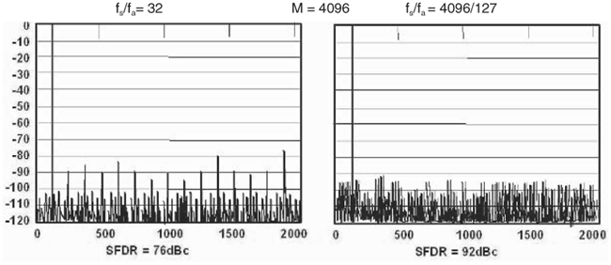
But the M/2 frequency bins may not contain the same amount of noise power!
When fs/fa = 4096/127, quantization noise is spread among 2048 frequency bins, resulting in a quantization noise floor at log10(q2/12/2048) = – 6*N – 1.76 – 33 = – 72 – 1.76 – 33 = -106.76
When fs/fa = 32, quantization noise is spread mostly among 16 frequency bins, resulting in a quantization noise floor at log10(q2/12/16) = – 6*N – 1.76 – 12 = – 72 – 1.76 – 12 = -86
Always choose fs and fa so that fs/fa = M/K, (M,K)=1!
K is the number of signal periods contained in the M data points

Slide 51
HW: theory
Suppose f_in = f_s *K/M, (K,M)=p>1. Show that only M/p distinct phases of the sine wave are sampled, and each of these phases is repeated p times. This is the case regardless the initial phase of the sine wave. If the initial phase = 0, only half plus 1 of these M/p phases give different voltage samples. If the initial phase is not 0, you still have M/2p -1 constraints. For quantization error, its power is then spread among M/2p+1 points. If there is true noise (from the ADC or from the signal source), the noise at each of the M samples are uncorrelated, so the noise power is spread among M/2 frequency bins.

Slide 52

Optional HW
pure sine
–
+
Ideal
ADC
~
+
+
white
noise
Use the above to study the spectrum of quantization errors. Let ADC #bits = 16, 14, 12, 10, 8, 6, 4, or 2. (This has the same effect as reducing sine amplitude.) Let noise sigma = 0, 0.01, 0.035, 0.1, 0.25, 0.5, 0.75, or 1 LSB. Let data record length M be sufficiently large, eg, 2^16. Select f_in = f_s *J/M and f_s = 1 MHz. Make J to be an integer in the 5 to 10% of M range, but J=2^k * J1 with J1 being odd. M/2^k is then equal to the distinctive phases in the M samples. In each case, take the FFT of the output (which has the actual quantization error), examine the total power, average power per bin, average power per those M/2^k bins, power variance among all bins, power variance among those M/2^k bins, largest power in any bins, and any other things of interest to you. Tabulate the results, analyze them, and try to draw some conclusions. You may use Excel for analysis. Also notice how results compare to 6.02N+1.76 + 3.01k.

Slide 53
Coherent sampling
To ensure correct data collection and FFT, the signal frequency, clock frequency, the number of data points M used in FFT, and the number of signal periods K contained in the M points have to satisfy some stringent conditions:
  f_sampling : f_signal has to be rational
  f_s / f_sig = M / K = integer / integer
  M and K should be co-prime
  For efficient FFT, M is typically selected as an integer power of 2
  K is typically selected as an odd integer
  IEEE says K should be at least 5
  This gives a signal frequency choice of f_sig = f_s *K/M

Slide 54
Example: f_samp / f_sig = 4096 / 255; 14 bit ADC

Slide 55
Example: f_samp / f_sig = 4096 / 255.1; 14 bit ADC

Slide 56
Example: f_samp / f_sig = 4096 / 255.01; 14 bit ADC

Slide 57
Example: f_samp / f_sig = 4096 / 255.001; 14 bit ADC

Slide 58
HW
Use a 16 bit ideal ADC, V_{ref} = +-1, M=2^16, J=J_{int}+δ, f_{s}=1, f_{in} =J/M*f_{s}, φ=rand*2π, V_{os}=0, and A = V_{ref}.
For each J_{int}, find d such that P_{leak} ≤ P_{noise}. You can simply take P_{leak} = P_{tot} – P_{sig} – P_{noise}.
For a given J_{int} and δ, how does φ affect P_{leak}?
Repeat the above for J_{int} near M/4, M/8, M/16, M/32, M/64, and M/128, but make sure round(J) is odd. (Use φ=(rand-0.5)*2π)
Based on the above, can you draw a conclusion on the accuracy of frequency control to ensure negligible leakage?

Slide 59
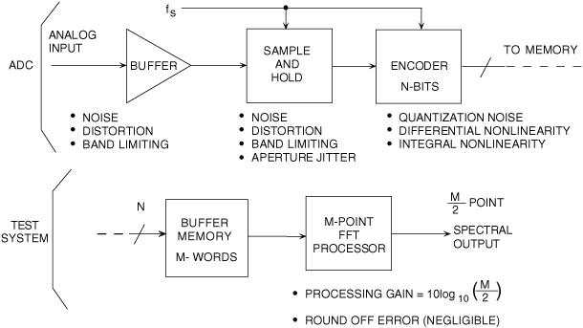
Noise in Practical ADCs

Slide 60
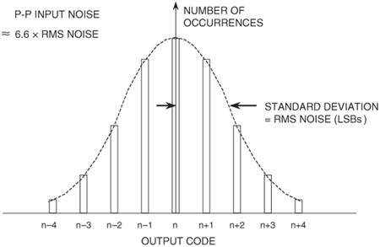
Input referred noise
Wideband ADC internal circuits produce a certain amount of rms noise due to resistor noise and "kT/C" noise. This noise is present even for dc input signals, and accounts for the fact that the output of most wideband (or high resolution) ADCs is a distribution of codes, centered around the nominal value of a dc input. To measure its value, the input of the ADC is either grounded or connected to a heavily decoupled voltage source, and a large number of output samples are collected and plotted as a histogram (sometimes referred to as a grounded-input histogram). Since the noise is approximately Gaussian, the standard deviation of the histogram is easily calculated, corresponding to the effective input rms noise. It is common practice to express this rms noise in terms of LSBs rms, although it can be expressed as an rms voltage referenced to the ADC full-scale input range.

Slide 61
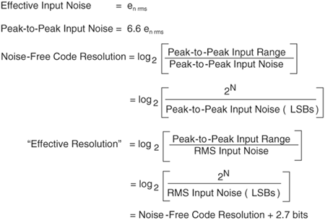
Noise-free code resolution and effective resolution
= ENOB of a linear converter

Slide 62
Dynamic Performance of Data Converters
Harmonic Distortion
Worst Harmonic
Total Harmonic Distortion (THD)
Total Harmonic Distortion Plus Noise (THD + N)
Signal-to-Noise-and-Distortion Ratio (SINAD, or SNDR)
Effective Number of Bits (ENOB)
Signal-to-Noise Ratio (SNR)
Analog Bandwidth (Full-Power, Small-Signal)
Spurious Free Dynamic Range (SFDR)
Two-Tone Intermodulation Distortion
Multitone Intermodulation Distortion
Noise Power Ratio (NPR)
Adjacent Channel Leakage Ratio (ACLR)
Noise Figure
Settling Time, Overvoltage Recovery Time

Slide 63
Distortion Analysis
X_{IN}(t)
X_{OUT}(t)
Nonlinear
System
If

Slide 64
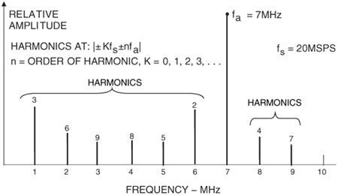
Harmonic distortion
1st = 7MHz
2nd = 2*7 = 14 = 14 – 20
= – 6 = 6 MHz
3rd = 3*7 = 21 = 21 – 20
= 1 MHz
4th = 4*7 = 28 = 28 – 20
= 8 MHz
5th = 5*7 = 35 = – 5
= 5 MHz
6th = 6*7 = 42 = 42 – 40
= 2 MHz
7th = 7*7 = 9 MHz
Harmonic distortion is normally specified in dBc (decibels below carrier).
Generally specified with an input signal near full-scale (generally 0.5 to 1 dB below full-scale to prevent clipping).

Slide 65
Distortion Analysis
Total Harmonic Distortion, THD
Signal to noise ratio:
Signal to noise and distortion ratio:
ENOB = (SINAD-1.76)/6.02

Slide 66
Distortion Analysis
Spurious free dynamic range:
In most cases, input signal is near full scale, and the largest spurious component is one of the harmonic distortion components:
In dB, it is equal to the height difference between signal and the largest spur

Slide 67
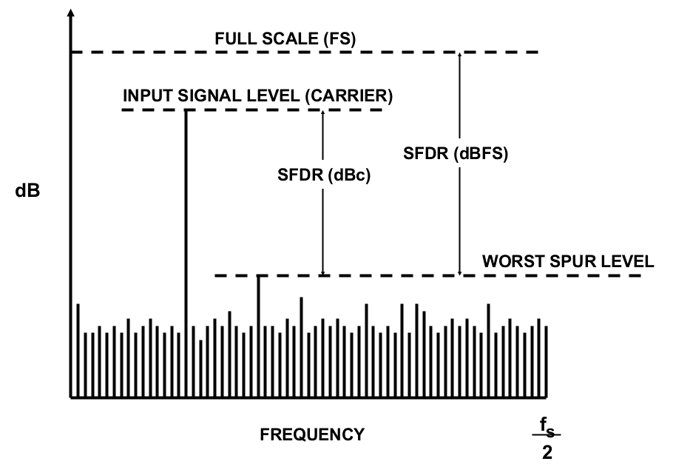
Spurious Free Dynamic Range (SFDR)
Probably the most significant specification for an ADC used in a communications application is its spurious free dynamic range (SFDR).
SFDR of an ADC is defined as the ratio of the signal power to the largest spurious component power..
For input signal near full-scale, SFDR is generally determined by the largest harmonics
For small input signals, other spurs, which are not direct harmonics of the input signal, may become larger that the harmonic distortion components.
Therefore, SFDR considers all spurs, regardless harmonic or not.

Slide 68
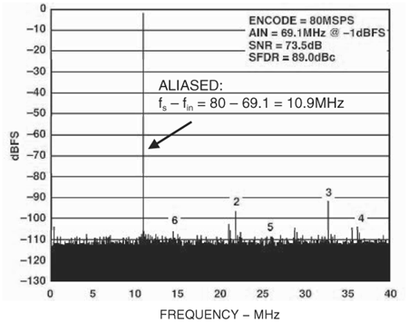
14 bit ADC SFDR with fs=80 MHz and fa=69.1 MHz
14-bit, 80 MSPS wideband ADC designed for communications applications
single-tone SFDR for a 69.1 MHz input 89 dBc SFDR

Slide 69
HW
Write a Matlab function for single tone coherent spectral testing. The input is a vector of ADC output, containing M=2^m samples.
It should compute and plot the whole spectrum, normalized with respect to (±Vref)^2. This is so as to easily show if the input sine wave is at attenuated power levels by displaying the signal power. When computing the signal power, you should include a few bins on each side of the fundamental.
It should also compute and list the 2nd to 10th harmonic frequencies and harmonic distortion powers. In computing the harmonic distortion powers, you can include one or two extra bins on each side of the harmonic bin so as to capture the possible small amount of power leakage due to imperfect coherency.
It should compute and display the SFDR and indicating if it is spurious, or if it is harmonic (and which one).
In computing the THD, it should include up to the 20th harmonic distortion powers.
In computing the total noise power, the bins used for distortion powers should be excluded, and the remaining total noise power should be scaled up to correspond to M noise bins.
Also display SNR, SINAD, ENOB.

Slide 70
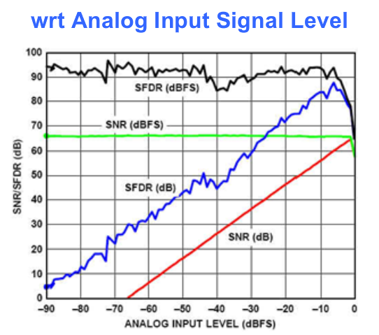
SNR SFDR vs input signal amplitude
SFDR in dBc drops as signal amplitude decreases
But SFDR in dBFS does not
In fact, SFDR dBFS generally improves, since ADC linearity is better for small signals

Slide 71
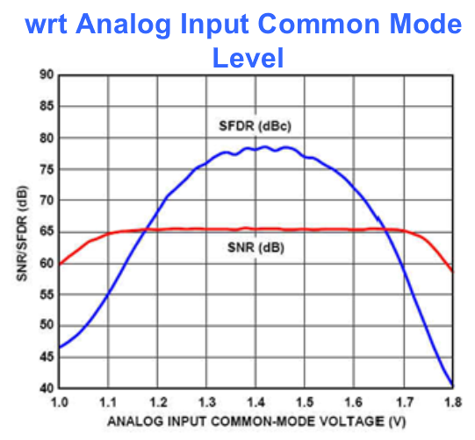
Effects of input common mode

Slide 72
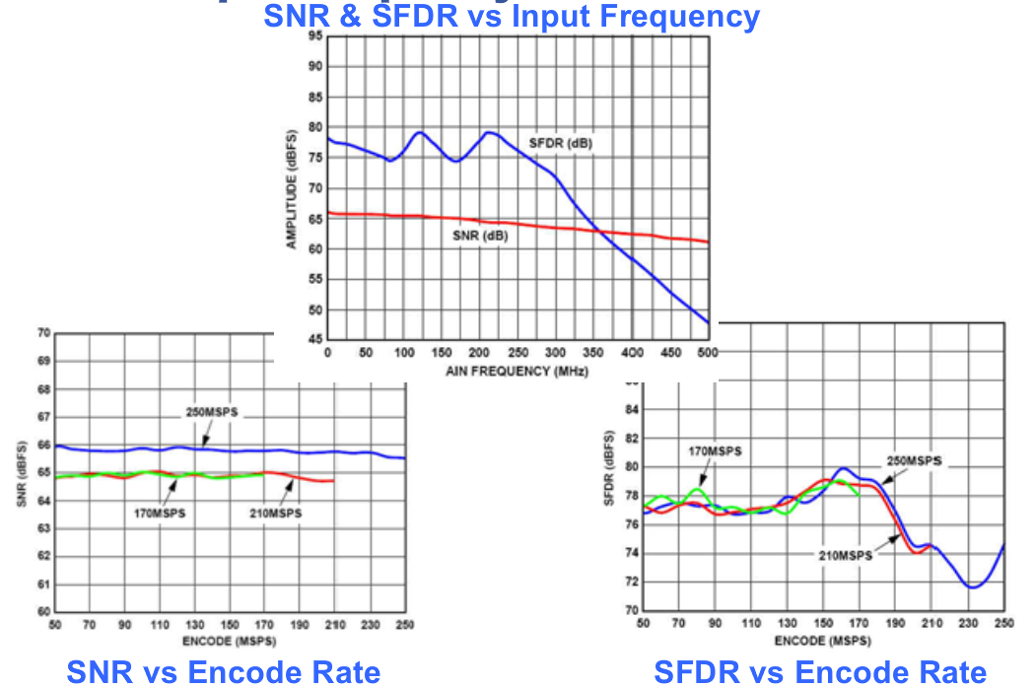
Effects of input freq and sampling freq

Slide 73
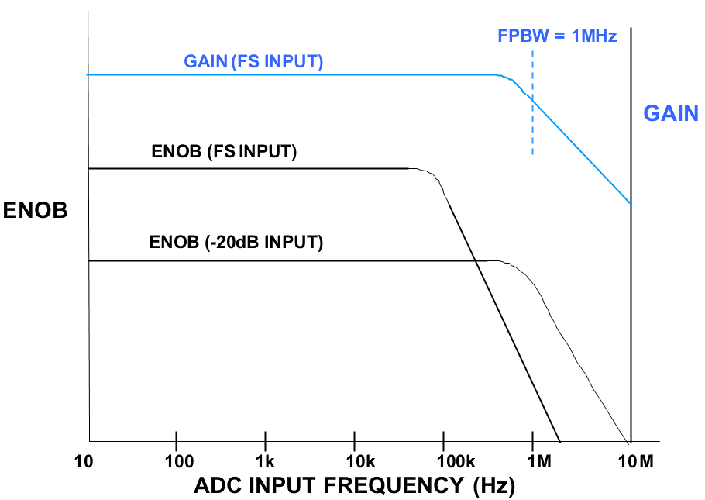
Analog Bandwidth
The analog bandwidth of an ADC is that frequency at which the spectral output of the fundamental swept frequency (as determined by the FFT analysis) is reduced by 3 dB. It may be specified for either a small signal (SSBW—small signal bandwidth), or a full-scale signal (FPBW—full power bandwidth).
the SINAD (or ENOB) of most ADCs will begin to degrade considerably before the input frequency approaches the actual 3 dB bandwidth frequency.

Slide 74
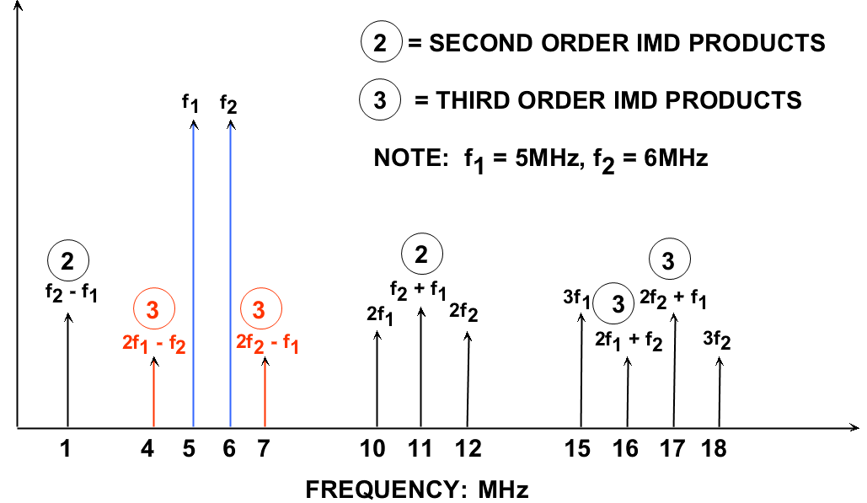
Two-Tone Intermodulation Distortion (IMD)
Two-tone IMD is measured by applying two spectrally pure sinewaves to the ADC at frequencies f1 and f2, usually relatively close together. The amplitude of each tone is set slightly more than 6 dB below full scale so that the ADC does not clip when the two tones add in-phase.
the second-order products fall at frequencies that can be removed by digital filters. However, the third-order products, 2f2 – f1 and 2f1 – f2, are close to the original signals and more difficult to filter. Unless otherwise specified, two-tone IMD refers to these third-order

Slide 75
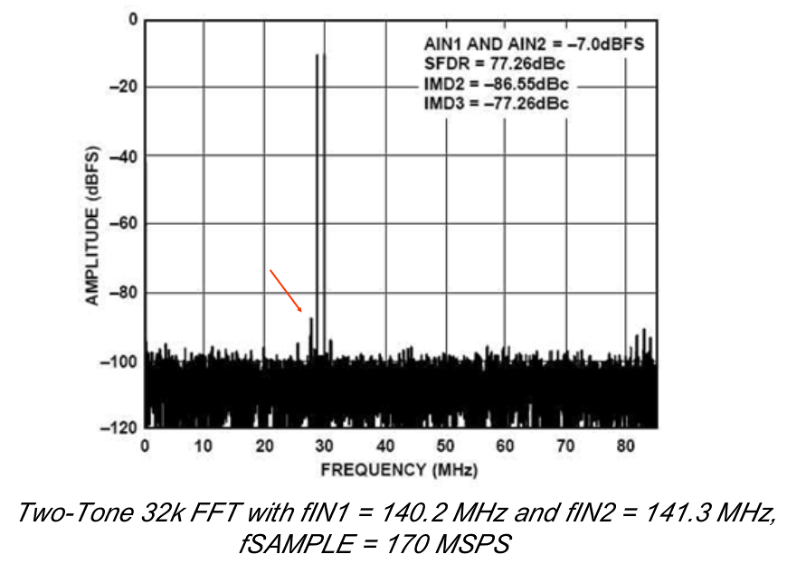
Two tone 3rd IMD example

Slide 76
HW
Write a Matlab function that takes as input a vector of ADC outputs sampled coherently in a two tone test, compute and plot its spectrum, and compute and display the k-th harmonic and intermodulation spectral components for k=0 to 10. (k=0 is DC) For the spectrum plot, normalize with respect to the total signal power. Set the lower limit of the vertical axis to 10dB below the total noise floor (rounded to the nearest dB). Your program should also check if any of the two rails of the ADC was hit and give an warning if it was. Finally, the peak positive amplitude and peak negative amplitude should be computed and compared to the rms value.

Slide 77
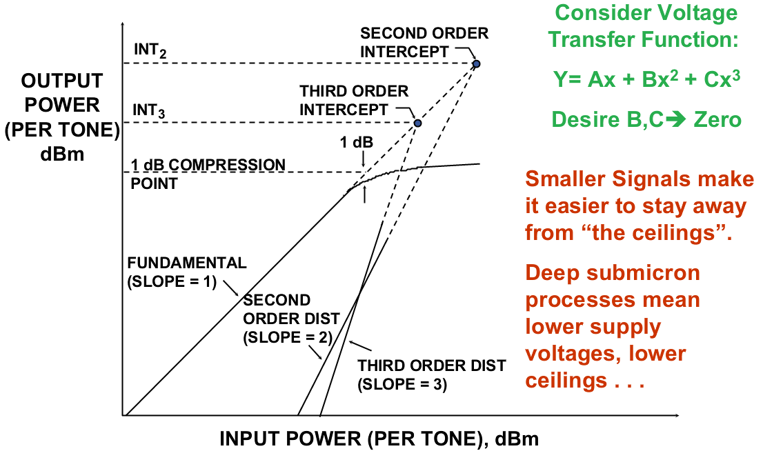
Second- and Third-Order Intercept Points, 1 dB Compression Point
IIP3
IIP2
Input referred 3rd order intercept point

Slide 78
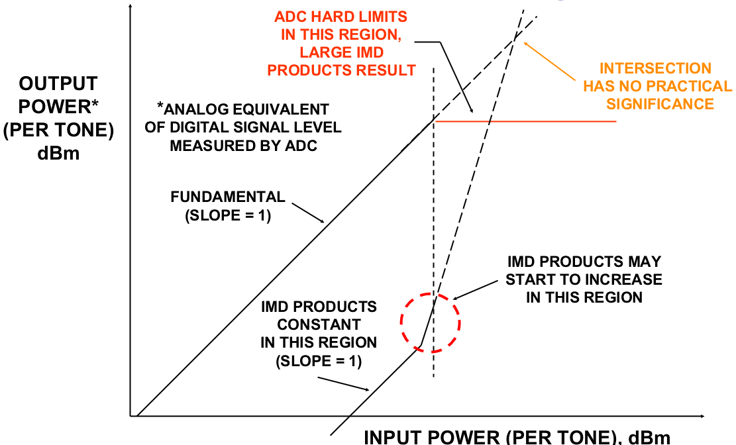
Intercept Points for Data Converters
These are too complex
Don’t normally talk about intercept points for data converters
Intercept points are widely use for LNA and PA

Slide 79
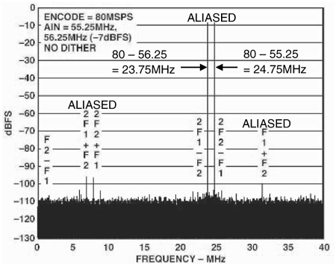
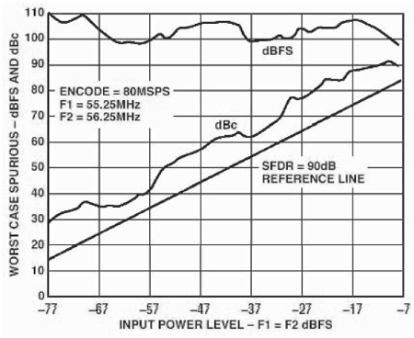
Multitone Spurious Free Dynamic Range
Two-tone and multitone SFDR is often measured in communications applications. The larger number of tones more closely simulates the wideband frequency spectrum of cellular telephone systems

Slide 80
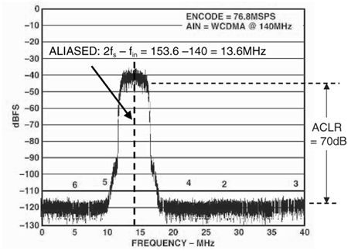
Adjacent Channel Power Ratio (ACPR) and Adjacent Channel Leakage Ratio (ACLR)
The ratio in dBc between the measured power within a channel relative to its adjacent channel is defined as the adjacent channel power ratio (ACPR)
The ratio in dBc between the measured power within the channel bandwidth relative to the noise level in an adjacent empty carrier channel is defined as adjacent channel leakage ratio (ACLR)

Slide 81
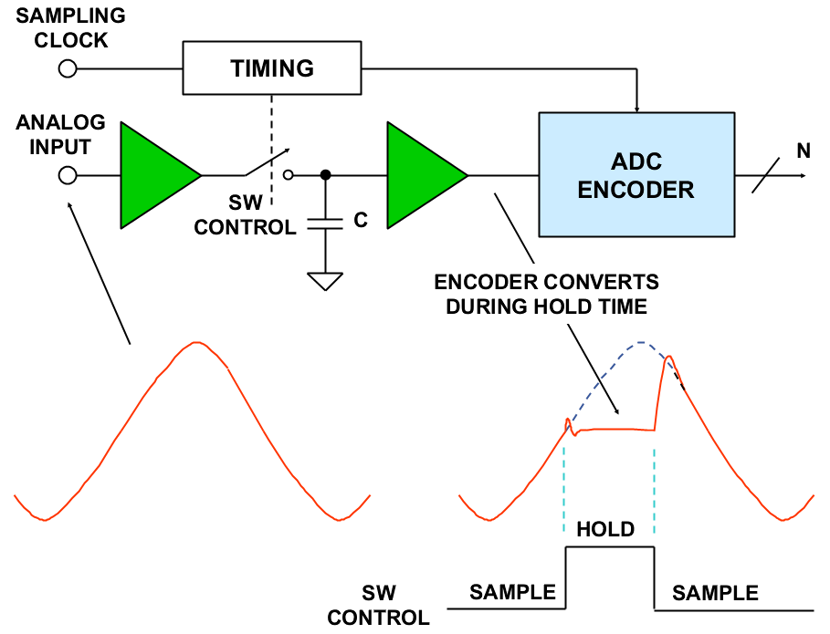
Sample-and-hold

Slide 82
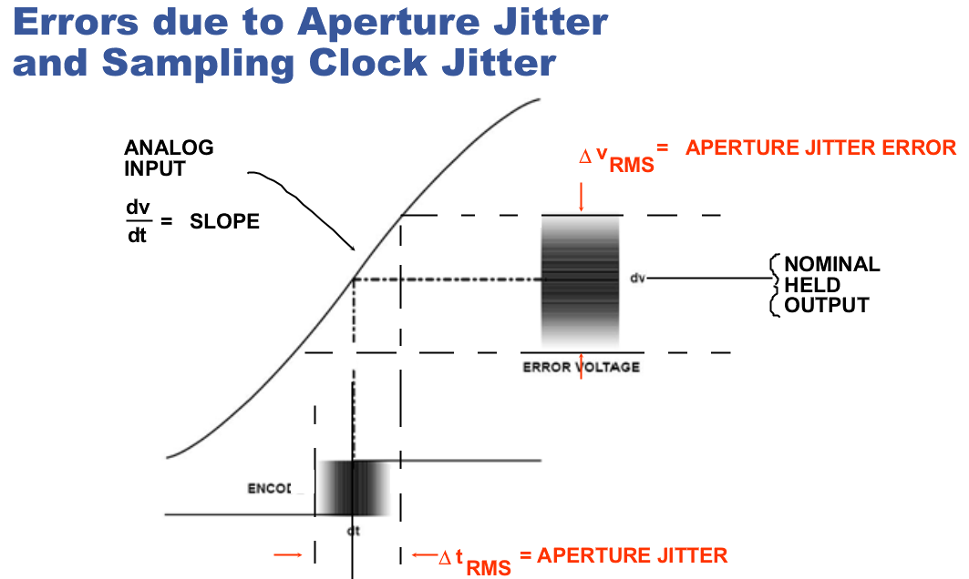
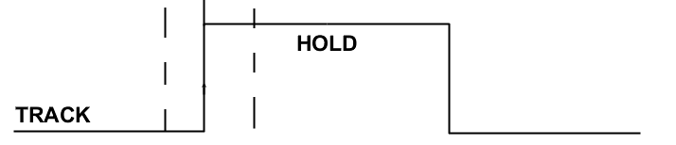
sample-to-sample variation in aperture delay
produces a corresponding voltage error
The amplitude of error depends on input rate-of-change
phase jitter on external sampling clock produce the same type of error

Slide 83
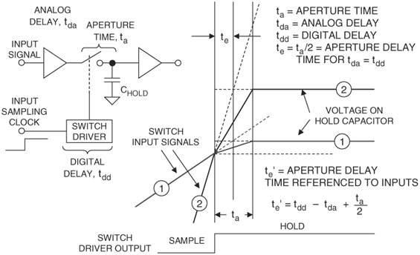
Aperture Time, Aperture Delay Time

Slide 84
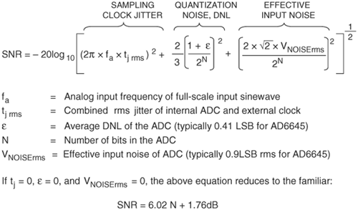
Relationship Between SNR, Sampling Clock Jitter, Quantization Noise, DNL, and Input Noise

Slide 85
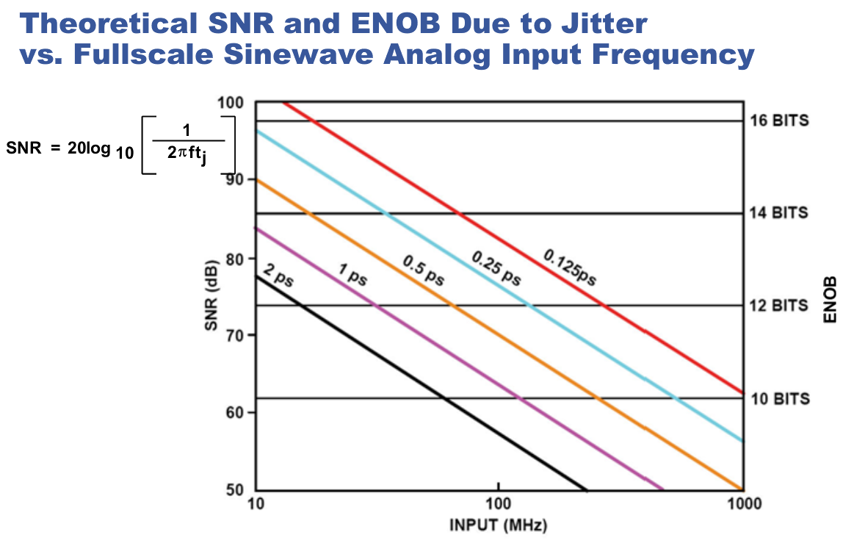

Slide 86
HW
Use an ideal high resolution ADC (rounding at 10^-9 is about 30 bits), with sampling frequency of 2GHz (No body has such an ADC, and no body will). Use an ideal sine wave input with full scale, no offset, and no noise. The sampling clock has independent clock jitter at each sampling instant.
Generate a graph that is similar to the previous slide. Make the horizontal axis from 100KHz to 1 GHz, and the vertical axis 50 to 120 dB and 8 bits to 20 bits. Use the same 5 jitter amounts.

Slide 87
HW
Spend some time with Matlab’s Help facility.
Find out a list of all the available built-in window functions, make a plot of the time domain and spectral domain shape of each window in its default form, find the dB difference between the peak of the main lobe and the peak of the secondary lobes, find the critical things one needs to pay attention to in order to use each window correctly, and find the limitations on the SNR and THD measurement accuracies of each window.

Slide 88
HW
Write a Matlab program to demonstrate the use of the Blackman-Harris window in high resolution ADC spectral testing.
Use your SAR ADC with 16, 18, or 20 bit resolution.
Use a data record length of 2^14, 2^15, or 2^16.
Use a pure input sine wave, with correct DC and -0.5 dBFS.
Use a randomly generated frequency so that the number of signal period in the data record is in the range of 1/20 to 1/3 of the number of samples.
For each test case, test the ADC with perfectly coherent sampling, test again with non-coherent sampling plus windowing, and compare the test results in SNR, THD, and SFDR.

Slide 89
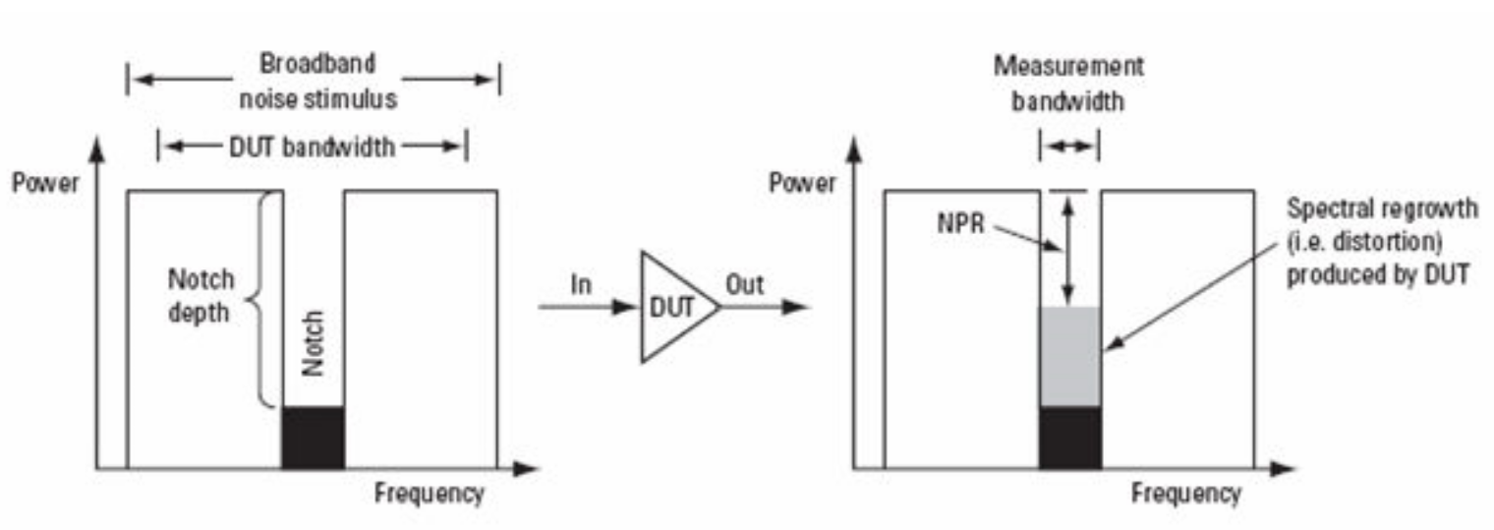
ADC Noise Power Ratio
Generate Gaussian noise
Notch filter it
Amplify it, but avoid clipping
Analyze spectral contents of ADC output data

Slide 90
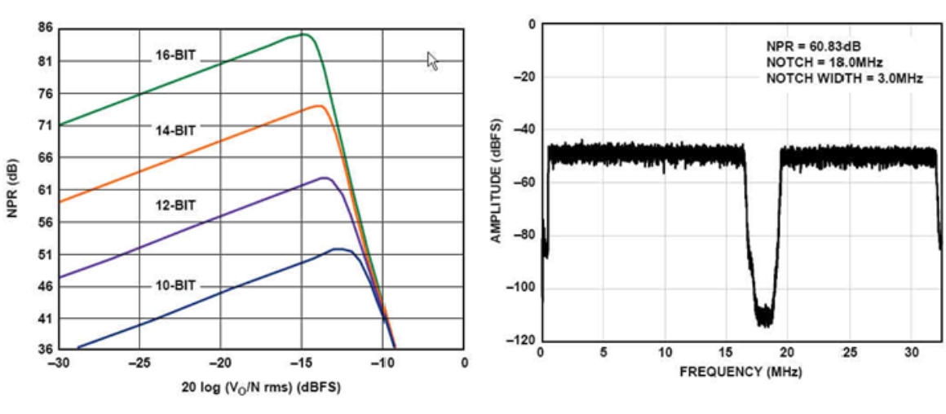
Typical NPR

Slide 91
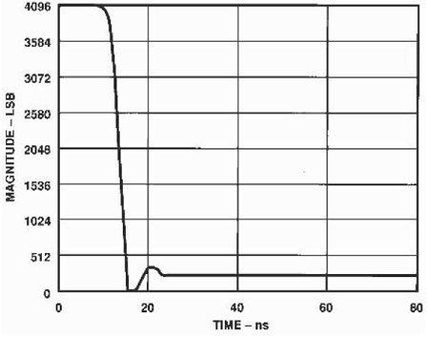
ADC Transient Response (Settling Time)
Most ADCs have settling times which are less than 1/fs max, even if not specified.
Sigma-Delta’s ST may be important

Slide 92
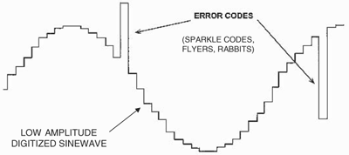
Sparkle Codes, Metastability
Random unexpected codes with large errors are called sparkle codes, or rabbits, or flyers
If the input to a comparator is too close to the threshold, the comparator may not reach a valid logic level in given time: this phenomenon is known as metastability.

Slide 93
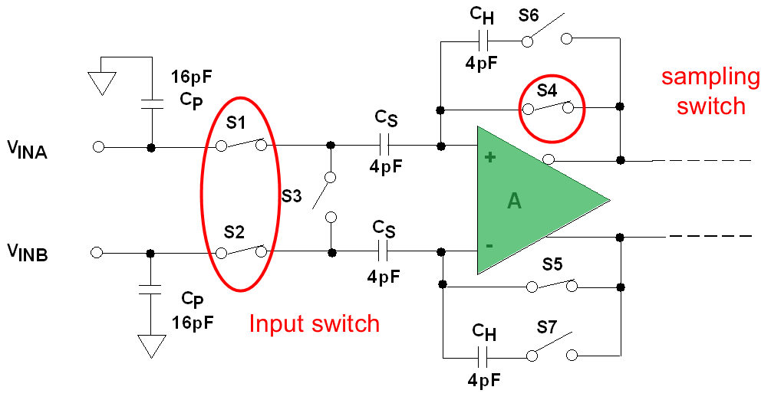
Sample and hold
Also called track and hold, or acquire and hold
Switch positions in track mode are shown
Sampling happens at the instant when switches change positions
Opposite positions are for hold mode

Slide 94
Errors
During tracking
  There is a voltage drop across op amp + and ─ terminal
  There is voltage drop across S1 and S2 as long as Vin is not constant, i.e., there is current
  Both of the above cause Vcap ≠ Vin
  Ron of S1 and S2 is also signal level dependent, making the above error non linear
  This nonlinear error is also slope dependent, making it a dynamic error

Slide 95
Errors
During tracking
  The two voltage drops also change when there are power supply variations, ground bounces, temperature variations, and 1/f noise.
  These effects are common mode
  Differential structures, such as the one shown, are much more robust with respect to such errors than single ended structures

Slide 96
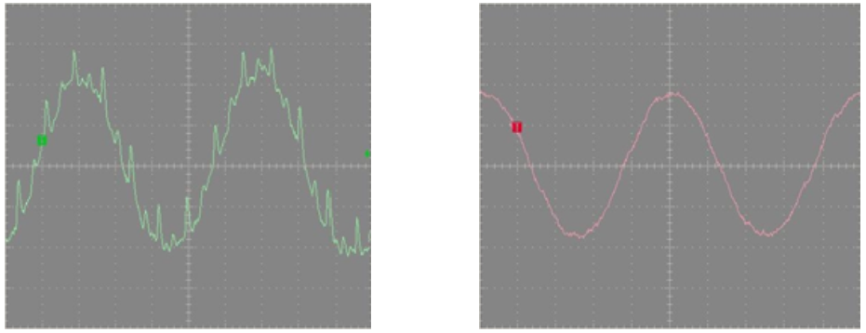
Cap voltage in the presence of supply variations and ground bounces
Single ended structure
Differential structure
Use differential signaling whenever possible
Single ended input may need to be converted first

Slide 97
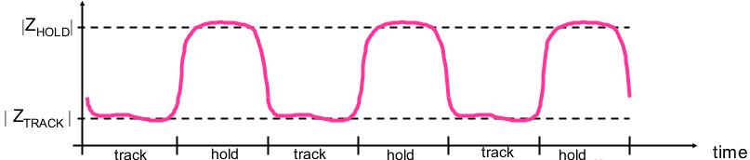
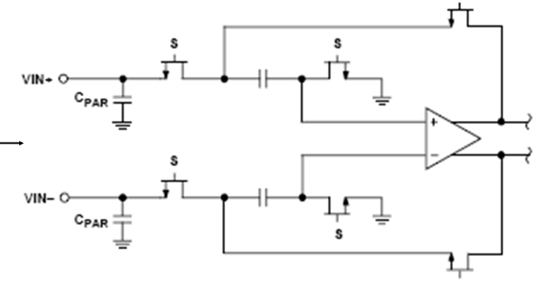


Slide 98
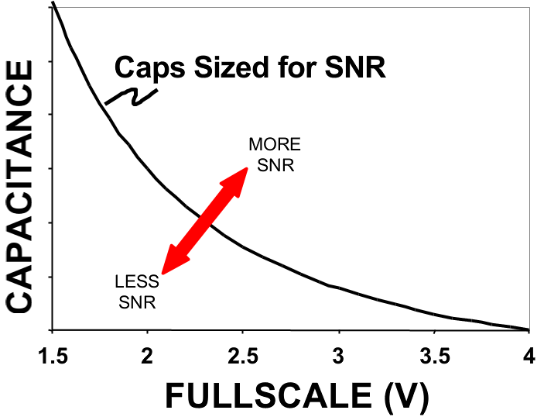

Slide 99
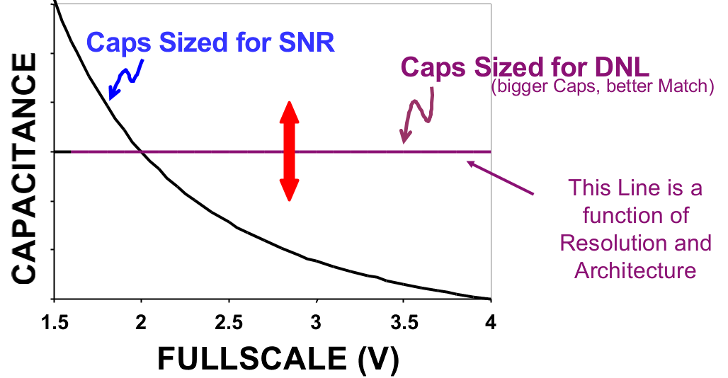


Slide 100


Slide 101


Slide 102


