Slide 1
Analog Channel Testing

Slide 2
Overview
Types of Analog Channels
Any non-sampled circuit with analog input and analog outputs
continuous time filters
amplifiers
analog buffers
programmable gain amplifiers
single-ended to differential converters
differential to single-ended converters
cascaded combinations of any of the above.

Slide 3
Overview
Types of Analog Channels
Combination analog circuits can be broken down into subsections using DfT test modes.
Filter input
(test mode)
Single-ended
to differential
power amp
TESTIN
PGA
Digital
samples
DAC
Low-pass
filter
OUTP
OUTN
Volume
control
DAC
reference
voltage
TESTOUT
PGA output
(test mode)
=
Normal
mode
Force
input
Monitor
output
Analog Bus DfT for a DAC Mixed-Signal Channel

Slide 4
Overview
Types of AC Parametric Tests
Analog and sampled channels share many AC parametric tests - mainly in the following categories
Gain, Phase, Distortion, Rejection, and Noise
A major trick to making accurate AC measurements is proper use of software calibrations
For now, we assume perfect digitizers and Arbitrary Waveform Generators - a naïve assumption

Slide 5
Gain and Level Tests
Absolute Voltage Levels
Simply the RMS voltage of the signal under test, evaluated at the test tone’s frequency.
DSP based test allows other sources of noise to be eliminated easily - conventional analog measurement tools measure total signal RMS.
Absolute level specs can be applied to any single tone or multitone signal.
The purpose of absolute level test is to detect “first order” defects such as resistor or capacitor mismatch, DC reference voltage errors, or clipping or other distortions.
Offer a good way to detect grossly defective circuits very quickly.

Slide 6
Defective
low-pass
filter
Input signal
Clipped output signal
Quickly detects gross circuit defects

Slide 7
Gain and Level Tests
Absolute Voltage Levels - cont.
Loading is critical in performance of AC circuits
Test engineer’s job is to determine the worst case loading conditions for a given AC test.
The load must be designed into the DIB. In most cases, the load must be removable so that tests like continuity and leakage can be performed.
Units of measure are:
RMS volts, peak Volts, peak-to-peak Volts, dBV (decibels relative to 1.0 Volt RMS) and dBm (decibels relative to 1.0 mW)
In ATE testers, absolute voltage levels are measured using a general purpose digitizer and DSP based testing

Slide 8
Gain and Level Tests
Absolute Voltage Levels - cont.
It is critical that the test engineer communicates these units without ambiguity
Using the appropriate units will eliminate a great amount of confusion - especially if communication between different groups is required.
1.0 V
1.0 V
OUTP
OUTN
Gain = 2
1.0 V
Input signal:
1.0 V Peak
2.0 V Peak-to-peak
0.707 V RMS
Output signal:
1.0 V Peak, single ended
2.0 V Peak-to-peak, single ended
0.707 V RMS, single-ended
2.0 V Peak, differential
4.0 V Peak-to-peak, differential
1.414 V RMS, differential

Slide 9
Gain and Level Tests
Absolute Voltage Levels - cont.
Decibels can be abused as well
The decibel unit represents a ratio of values, and as such it is inappropriate to refer to an absolute voltage level using dB without a reference level.
Decibels is commonly referenced as dBV or dBm
A specified load impedance must be linked to the dBm specification

Slide 10
Example:
Given the peak value of one side
Compute dBV of differential signal
500 mV one side, → 1V differential
→ 0.707 V rms diff
dBV: 20*log10(0.707 Vrms / 1 Vrms) = -3.01 dBV
500 mV
OUTP
OUTN
500 mV

Slide 11
Example:
Convert a 250 mV single ended RMS measurement into dBm units at 600 Ohms.
Convert voltage level to a power level using:
Power = V²/R
Then the power is compared to the 1mW reference using:
10*log (Power / 1mW))
The total equation is therefore:
Signal Level (dBm) = 10*log (V²/(R*1mW))
Converting the 250 mV signal into dBm at 600 Ohms:
10*log((250mV)2/(600*1mW))=-9.823 dBm at 600 Ohms

Slide 12
Gain and Level Tests
Absolute Gain and Gain Error
Simply the ratio of output signal level divided by the input signal level at a particular frequency.
G = Vo/Vin in value, or 20log10(Vo/Vin) in dB
Sometimes a channel’s gain is specified in terms of error relative to the ideal absolute gain - Gain error.
Gain error is defined as the actual (measured) gain of a channel, divided by its ideal (expected) gain.
Gain errors are frequently the result of component mismatch in the DUT.
Gain tests are commonly performed at levels below the maximum allowed signal - to distinguish between distortion and gain errors.

Slide 13
8 kHz sampling rate,
256 samples
DUT
low-pass
filter
OUTP
FFT
1.25 V RMS
AWG
Digitizer
In bin 37
OUTN
Ideal gain: -1.5 dB
Input frequency =?
16 kHz sampling rate,
1024 samples
DUT
low-pass
filter
OUTP
FFT
1.025 V RMS
AWG
Digitizer
OUTN
In which bin?
Actual gain = ?
Gain error:

Slide 14
Gain and Level Tests
Gain Tracking Error
The variation in the gain of a channel as the signal amplitude changes.
Although a perfect analog circuit has no gain tracking error, small circuit defects can cause non-linearities in gain over changing input voltage.
A major source of gain tracking error comes from quantization errors in DAC or ADC - usually most severe in low amplitude signals.
Gain tracking is calculated by measuring the gain at a reference level. Gain tracking error is calculated at each signal level by subtracting the reference dB from the measured gain at that level.
Gain tracking error is specified in decibels.

Slide 15
Gain and Level Tests
PGA Gain Tests
A PGA can be set to multiple gain settings using a digital control signal.
250
200
PGA
150
1.5 dB
per step
Gain
(V/V)
100
Gain setting
50
0
-50
0
5
10
15
20
25
30
35
Gain setting (0-31)

Slide 16
Gain and Level Tests
PGA Gain Tests
A PGA can be set to multiple gain settings using a digital control signal.
Usually used as a volume control in cellular telephones, televisions etc.
PGAs are specified with an absolute gain at the first setting, a total gain difference between the highest and lowest setting, and the gain step size from each gain setting to the next.
PGA specifications are usually tested at a particular frequency.
The absolute gain, gain step size, and gain range can all be measured by setting the PGA into each of its gain settings and measuring the output voltage level divided by its input voltage level.

Slide 17
Gain and Level Tests
PGA Gain Tests - cont.
Possible measurement techniques:
The absolute gain of each step can be measured by leaving the input signal unchanged and observing the output voltage.
This eliminates the need for a focussed calibration on the source
Also, it is possible to adjust the input level at each step to produce a fairly constant output level at least 3 dB lower than the full scale output to avoid clipping.
This produces a strong output signal level which is easier to measure.
Finally, if the PGA is designed correctly, a binary weighted PGA allows six measurements to be made for a 32 step PGA, once superposition is verified in characterization.

Slide 18
Gain and Level Tests
PGA Gain Tests - cont.
The question of superposition:
How tight or loose are the test limits?
If the limits are loose, some error is tolerable and guardbanding can be used to insure the chip passes the gain test.
Conclusions about superposition should be made from a fairly large set (statistically significant) of results not from a single chip.

Slide 19
Gain and Level Tests
Frequency Response
Similar to Gain tracking error, since it is a measurement of gain under varying signal conditions, relative to a reference gain.
Usually used to measure the transfer curve of a filter
Sometimes used to measure the bandwidth of a circuit
op amp to verify the gain bandwidth product.
Measures the variation in gain of the circuit as the signal frequency is varied.
One frequency is chosen as the reference gain, all other gains are measured relative to the reference. All non-reference gains are called relative gains.

Slide 20
5
0
5
Upper limit
mask
Lower limit
mask
-10
Gain
(dB)
-15
-20
-25
-30
Typical
frequency
response
-35
-40
10
100
1000
1⋅10⁴
Frequency (Hz)
An ideal band pass filter’s frequency response
And the gain mask for this filter

Slide 21
Problem
areas
Problem
areas
Problem
areas
Problem areas
In multi-tone test, place tones at these problem areas.

Slide 22
Gain and Level Tests
Frequency Response - cont.
Frequency response is usually measured using a coherent equal-level multi-tone signal so that all signal frequencies can be measured simultaneously.
Sometimes the test must be broken down into an in-band and out-of-band test due to the large difference in signal amplitudes.
Out-of-band test requires an amplifier stage on the DIB to insure signal strength.
Settling time of an AC system is determined by the characteristics of the DUT, AWG, Digitizer and Filters.
In general, the lower the frequency being tested, the longer the settling time.

Slide 23
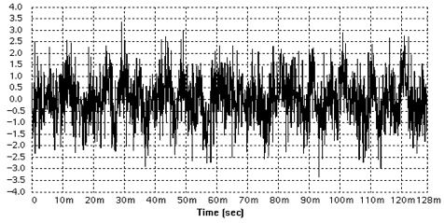
Multi tone input signal in time domain

Slide 24
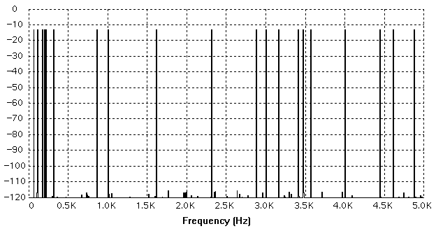
Multi tone input signal in frequency domain

Slide 25
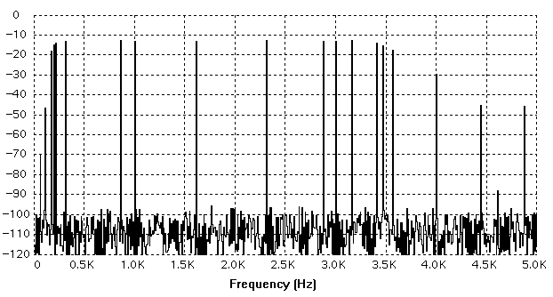
Multi tone output signal in frequency domain

Slide 26
Gain and Level Tests
Frequency Response - cont.
Using DSP, frequency response is easy to calculate:
Perform a DFT or FFT on the waveform collected at the DUT input and output.
Gain at each frequency is calculated
The reference gain is the subtracted from each of the other gains to normalize them to the reference frequency gain.
The absolute gain of the filter at the reference frequency is usually tested as a separate specification to guarantee the overall filter specification.

Slide 27
Gain and Level Tests
Frequency Response - cont.
Frequency response can also be measured by applying a narrow impulse to the circuit under test and observing the filter’s impulse response.
The Fourier transform of the impulse response is the filter frequency response.
The advantage is that this gives the full frequency response at all frequencies in the FFT spectrum.
The problem with impulse response is that you can not measure the response at a particular frequency with any great accuracy.
Energy in a narrow impulse is very small - makes the measurement susceptible to noise
Also, frequency overlap and distortion may corrupt the gain at any single frequency.

Slide 28
HW
Consider M-point multi-tone tests. Determine the minimum and maximum frequencies, and maximum number of frequencies that can be included.
For a high-gain op amp, how can its frequency response be tested efficiently?

Slide 29
Phase Tests
Phase Response
The transfer function of a circuit is defined not only by the magnitude information - it also can give the frequency or phase shift information - just like a Bode Plot.
Phase can be obtained from either the exponential version of the DFT/FFT or from the sine/cosine pair coefficients.
Please study the description of discrepancy in the phase calculation caused by notations given on page 365
Also, phase for a signal with negative sine and cosine components gives the same answer as phase with positive sine and cosine components (this is called wrap around)
Finally, the phase calculation can not have zero in the denominator or it causes a singularity.

Slide 30
A
t
B
A leads B by φ
P
Delay
Line
T=1/4 P
Output
Input
Input Signal
¼ P = 90º or π/2 delay

Slide 31
Phase Tests
Phase Response - cont.
The phase shift in a multitone test signal is calculated by subtracting the input signal phase shift from the output signal phase shift, and then correcting for any wrap-around.
A negative phase shift indicates a positive time delay (i.e. the output lags the input), while a positive phase shift indicates the opposite.
Using multitone DSP, all phase shifts can be calculated from the same set of sampled data, reducing test time.

Slide 32
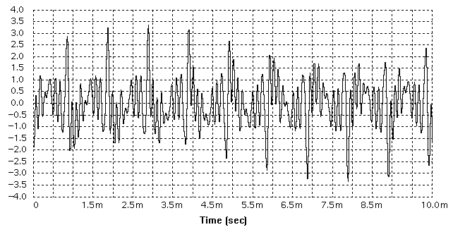
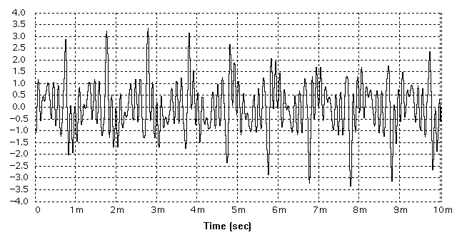
10 tone input
10 tone output
Take FFT of both input and output, keep complex values,
compute phase difference., or
compute phase of ratio

Slide 33
Phase Tests
Group Delay
A measurement of time shift versus frequency.
Defined as the change in phase shift divided by the change in frequency.
In reality it is extremely difficult to resolve tiny changes in phase.
Typically measured with tone pairs centered around the frequency of interest.
Multiple tone pairs can be measured simultaneously using DSP based Test techniques.

Slide 34
Phase Tests
Group Delay Distortion
In a simple delay line, the phase shift is directly proportional to the frequency.
Indicated by a circuit that shifts each signal component by a constant amount of time.
If on the other hand, group delay varies over frequency, and the circuit shifts various signal components relative to one another, this results in a change in shape as well as a shift in time. This is called Group Delay Distortion.
This is important mainly in data communications, since phase carries important information, leading to corrupted data.

Slide 35
Phase Tests
Group Delay Distortion - cont.
Group Delay is calculated by dividing the change in phase (degrees) between two test tones by the change in frequency (degrees per second). Leaving the units of seconds.

Slide 36
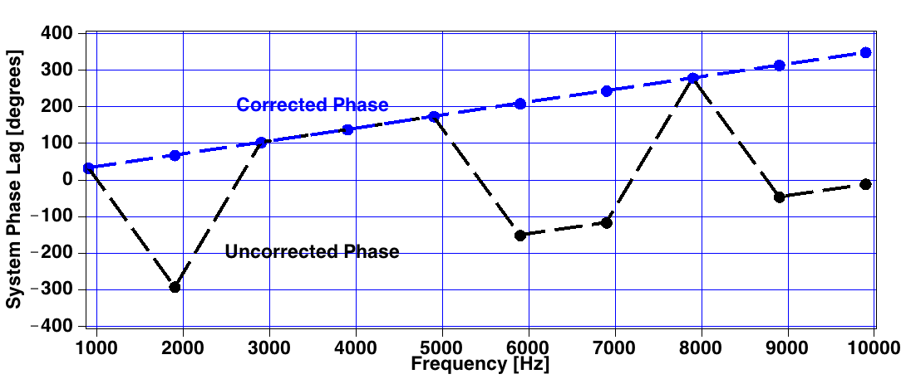
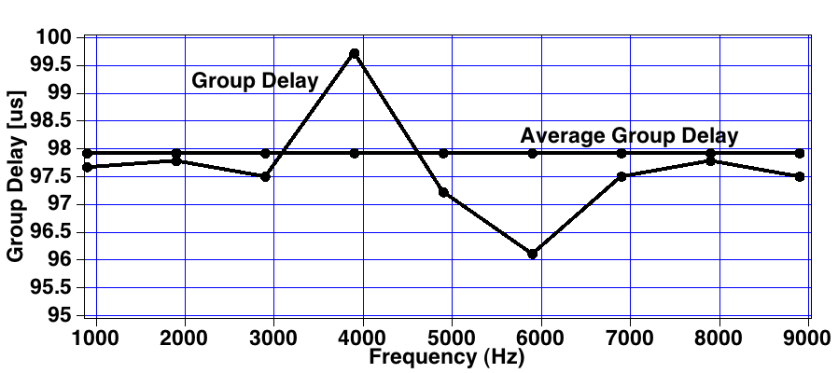

Slide 37
Distortion Tests
Signal to Harmonic Distortion
Arises when a signal passes through a non-linear circuit
to save test time, the distortion can be measured simultaneously with the gain using the FFT.
when passing a single tone through a DUT, the harmonic distortion appears at integer multiples of the test tone, called harmonics.
signal to total harmonic distortion is defined as the ratio of the RMS signal level of the test tone divided by the total RMS of the odd and even harmonic distortion components - expressed in dB.
the spec sheet usually calls for signal to 2nd or 3rd harmonic distortions tests as well as the total harmonic distortion

Slide 38
Distortion Tests
Signal to Harmonic Distortion - cont.
Low distortion levels can be very time consuming to measure, especially if the value is close to the noise floor of the DUT or ATE tester.
Solved by averaging a large number of samples with the ATE digitizer, causing long test times.
Low levels of distortion are inherently very costly to test, especially when they are close to failing test limits.

Slide 39
Distortion Tests
Intermodulation Distortion
Very similar to signal to harmonic distortion testing, except that two test tones are applied to the DUT at once.
Distortion components may appear at any sum or difference of any multiple of the test tones.
v
F₁
F₂
-F₁ +F₂
F₁ +F₂
2F₁ -F₂
-F₁ +2F₂
2F₁ +F₂
F₁ +2F₂
freq

Slide 40
Distortion Tests
Intermodulation Distortion
Intermodulation distortion is expressed as a ratio of the signal RMS of any one test tone to the signal RMS of the intermodulation components.
Usually with a limited number of intermodulation components given in the spec sheet.

Slide 41
Distortion Test Definitions
Signal-to-Noise-Plus-Distortion (SNRD)
The ratio of the signal power to the total noise and distortion power from DC to the Nyquist frequency. DC is not counted as noise. The result is in dBs, and it is usually a positive number.
Total Harmonic Distortion (THD)
The ratio of the sum of the powers of nine harmonically related frequencies to the power of the signal frequency. The result is in dBs and it is usually a negative number. This number is an indication of nonlinearity (for instance in a DAC).

Slide 42
Distortion Test Definitions
Signal-to-Noise Ratio (SNR)
The ratio of the signal power to the total noise power. It is similar to the SNRD, however, harmonically related frequencies and DC are not considered as noise in the SNR measurements. The result is in dBs and is usually a positive number.
Spurious Free Dynamic Range (Spur)
The power ratio of the signal to the worst spur (largest 2nd - 9th harmonic). The result is in dBs and is usually a positive number.

Slide 43
Adjacent channel and noise power ratio test
Channel A
Channel B
Channel C
Channel A
Channel B
Channel C
c_{k} (V-RMS)
c_{k} (V-RMS)
freq
freq
Channel A
Channel A
c_{k} (V-RMS)
c_{k} (V-RMS)
freq
freq
Notch Region
Notch Region

Slide 44
HW
Write a Matlab program to performance the NPR test for an arbitrarily generated ADC.
You should implement both method described in class:
Notch filtered noise: generate a sequence of Gaussian random noise, take FFT, notch out a narrow band using ideal notch filters (remember both + and – frequencies), take IFFT and take real part to go back to time domain, scale the amplitude to cover the full ADC input range but never clip, use the ADC to convert the samples, perform FFT, and compute NPR.
Use multi-tone test as shown on the last slide. Take about 10 tones in each adjacent channel. Make each channel band width to be a small fraction of the Nyquist band.
You can vary the ADC structure, resolution, and linearity level.

Slide 45
Rejection Tests
Common Mode Rejection Ratio (CMRR)
A measurement of how well a channel with a differential input can reject a common mode signal.
Due to mismatched components in the input stage, a small amount of common mode signal usually feeds through to the output.
Defined as the AC gain of a channel with common mode input divided by the gain of the channel with a normal, differential input.
Differential gain of the channel is calculated in other sections of the test protocol and can be reused in this test without re-measuring.
CMRR is expressed in decibels.

Slide 46
Rejection Tests
Power Supply Rejection (PSR) and Power Supply Rejection Ratio (PSRR)
Similar to CMRR, yet the interference signal is applied to the power supply rather than through normal inputs.
Specified for both analog and digital power supplies
Tested through applying a single or multi-tone sinusoidal “noise” on top of the power supply and measuring the output feedthrough.
Similar to CMRR, PSRR is expressed in decibels.
V_{ac}
Gain = G
PSR = gain from supply to Vo
PSRR = PSR/G_{id}
V_{DD}
V_{I} = V_{ID}
V_{out}

Slide 47
Rejection Tests
Channel to Channel Crosstalk
Unlike CMRR and PSRR, crosstalk has no exact definition.
Generally crosstalk is the gain from one channel to a second supposedly independent channel.
In analog, crosstalk is defined as the gain from one channel’s input to another channels output, divided by the gain of the second channel.
Nevertheless, the definition is vague, so the test engineer needs to be able to clarify the definition for each DUT.
Crosstalk is measured at several frequencies using DSP based multi-tone testing.

Slide 48
DUT
V_{rl}
G_{r}
V_{out-r}
V_{r}
X_{rl}
X_{lr}
V_{lr}
G_{l}
V_{out-l}
V_{l}

Slide 49
Three tone Multi-tone test
Input frequencies approx. 300, 1020, and 3400 HZ
Calculate Fourier Frequency (31.25 HZ)
Determine appropriate Spectral Bins for each side
Right Channel = 11,31,109
Left channel = 9, 35, 107
Look for 9, 35 and 107 on right channel output
Look for 11, 31 and 109 on left channel output
16-kHz sampling rate,
512 samples
16-kHz sampling rate,
512 samples
Right
audio
channel
FFT
Right signal
plus L-to-R
crosstalk
AWG1
Digitizer1
L-to-R
crosstalk
R-to-L
crosstalk
Left
audio
channel
FFT
Right signal
plus R-to-L
crosstalk
AWG2
Digitizer2
16 kHz sampling rate,
512 samples
16 kHz sampling rate,
512 samples

Slide 50
Rejection Tests
Clock and Data Feedthrough
Another very ambiguous term with no clear definition.
Clock and data feedthrough is measured by digitizing the output of a channel and then applying one of several calculations on the resulting waveform.
Digital feedthrough has a very “spiky” appearance
Clock feedthrough often has a signal bandwidth well into the Megahertz range.
Specified in maximum spurious tone, relative to the carrier tone (dBc)
Also specified in terms of total RMS voltage, excluding the DC offset
Often it is not specified as a separate parameter - it is considered a part of the noise in a signal to noise test.

Slide 51
Noise Tests
Noise
Noise is generated by every real world circuit.
Thermal noise (Johnson Noise) in resistors
1/f (Flicker Noise) in CMOS
Quantization noise in DACs and ADCs
Light falling onto a bare die
electromagnetic interference
Noise is the leading contributor to long test times, due to averaging required to remove the non-repeatability caused by random noise.
Spectral density is often referred to in terms of colors

Slide 52
Noise Tests
Noise - cont.
White noise, like white light has RMS voltage constant in any band of frequencies. Pink noise, by contrast, is noise that is weighted more heavily at low frequencies.
Sometimes noise is defined as any signal component other than the primary test tone. This lumps all other distortions and noises into one measurement, which allows very limited debug-ability.
A better solution is to identify all failure modes independently and test for each individually
A combined Noise measurement can always be calculated as a measure of quality for the DUT from separate results.

Slide 53
Noise Tests
Idle Channel Noise
A measurement of the noise generated by the circuit itself, plus noise injected from external circuits or sources through a variety of coupling mechanisms.
Inputs are usually shorted or grounded. Ideally, the output should be placed into low noise state.
Using DSP based testing, output noise is measured by digitizing the output of the circuit and performing a noise calculation on the captured samples.
Idle channel noise can be expressed in many different units.
Simplest is to calculate the RMS voltage level from the captured samples

Slide 54
Noise Tests
Idle Channel Noise - cont.
It is important to remember that the bandwidth of the digitizer is extremely important - the larger the bandwidth, the larger the RMS of the noise, so it is critical to express the noise in terms of RMS voltage over a specified bandwidth.
Idle channel noise is also specified in V/√Hz - the RMS voltage is divided by the square root of the frequency span of the bandwidth of the digitizer or voltmeter. - This number is referred to as the spectral density and allows back-calculation of the idle channel noise over a different bandwidth.

Slide 55
Noise Tests
Signal to Noise and Signal to Noise and Distortion
Signal to noise ratio is another way to measure the noise in an analog or mixed-signal channel
Different from idle channel noise in that it measures noise in the presence of a test signal, usually a sine wave.
In a purely analog channel, this should not change the noise value - if an ADC or DAC are present, quantization noise is introduced into the calculation.
Signal to noise ratio is often measured using the same data collected during the gain and signal to distortion tests.
Defined as the ratio of the primary signal divided by all non-signal components.

Slide 56
Noise Tests
Spurious Free Dynamic Range
Spurious free dynamic range is a specification that is critical to audio circuits as well as telecom circuits that must pass FCC certifications.
A spur is defined as a noise component that is confined to a single frequency.
Caused by clock feedthrough, sigma-delta converter self tones, stray oscillations etc.
Spurs are much more noticeable by the human ear than other types of noise.
Also, spurs are mixed with transmitted signals in cellular phones which may interfere with calls on other cellular phones.

Slide 57
Noise Tests
Spurious Free Dynamic Range - cont.
A spur shows up on the FFT or on a spectrum analyzer as a spike in the frequency domain.
Spurious free dynamic range is defined as the difference in decibels between the 0 dB signal level (the carrier level) and the maximum spur in the frequency domain.

Slide 58
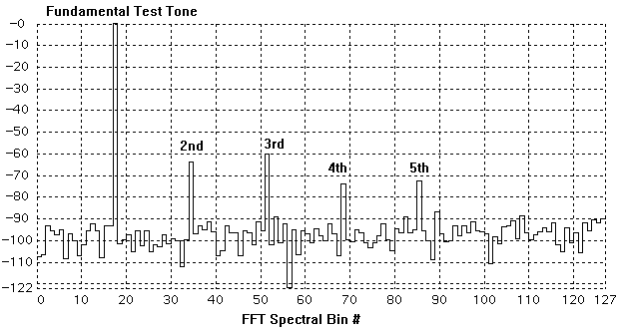

Slide 59
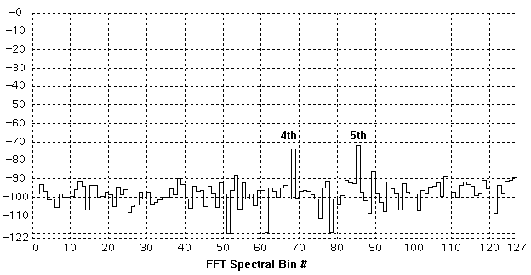

Slide 60
Weighting filters
Weighting filters can be applied to any FFT output before calculations are performed.
Usually designed to mimic the final application - like the human ear for cellular phones.
ANSI A-weighting filter
psophometric filter
C-message weighting filter
Since the filters are only specified at certain frequencies, some interpolation is required - usually a straight line approximation on a log-log plot
To save test time, weighted filter gain values should only be calculated once, during the first execution of the test program and stored for future use.

