Slide 1
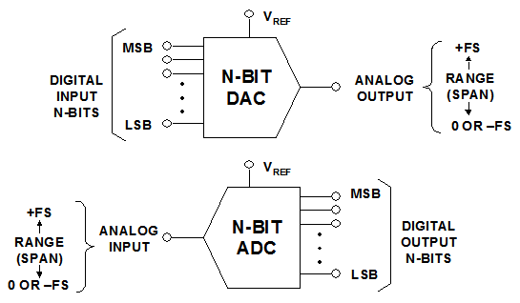
Digital-to-Analog Converter (DAC)
Analog-to-Digital Converter (ADC)

Slide 2
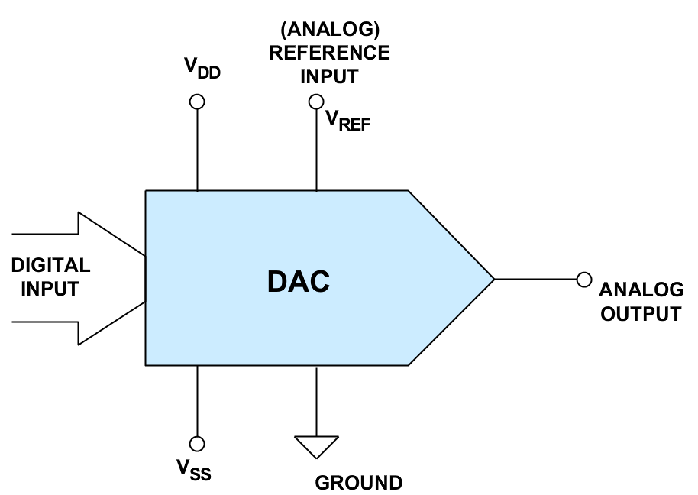
D
n
V_{o}
DAC
D
V_{o}
DAC
D
V
There may be a separate –V_{REF} also.

Slide 3
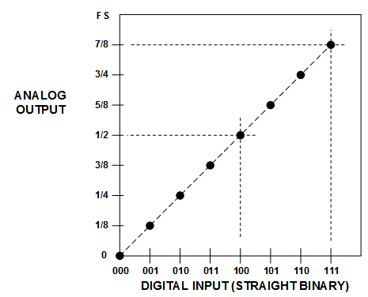
Transfer Curve for Ideal Unipolar 3-bit DAC
V_{Ref}
FSR
V_{LSB}
DAC transfer curve has only finite # of discrete points!

Slide 4
Ideal DAC

Slide 5
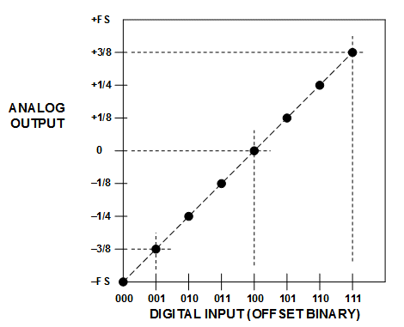
Offset binary code for 3-bit DAC
V_{Ref}
FSR
V_{LSB}
-V_{Ref}
V_{REFP} = +V_{Ref} , V_{REFN} = –V_{Ref}

Slide 6
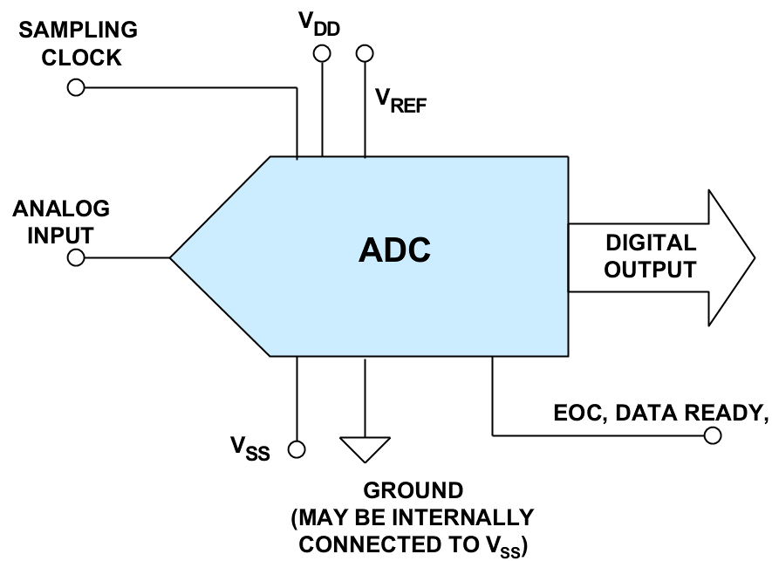
There may be a separate –V_{REF} also.

Slide 7
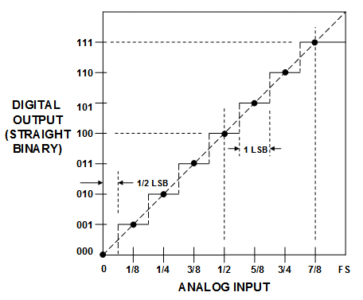
Transfer Curve for Ideal Unipolar 3-bit ADC
V_{Ref}
ADC transfer curve is a connected curve.

Slide 8
Ideal ADC

Slide 9
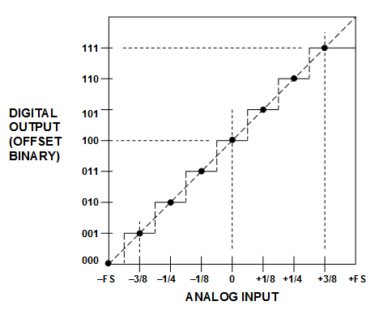
Offset binary code for 3-bit ADC
-V_{Ref}
V_{Ref}

Slide 10
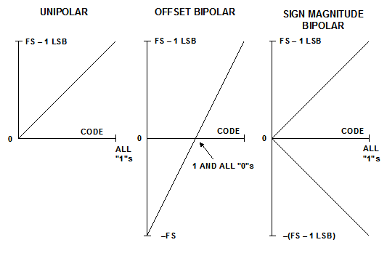
Ideal transfer curve of high resolution converters

Slide 11
HW: DAC modeling
Every student group will create a Matlab model of a DAC
To be shared with all students
Talk among all, but select your own architecture
For static models, V_{o}=V_{o}(D_{in})
Model consists of a vector of V_{o}’s, indexed with the DAC input code D_{in}.

Slide 13
Vo
t
4
6
3
5
1
Din

Slide 15
HW: DAC modeling
For dynamic models, include only the previous code dependence
For each code transition, the output is not a single value, but a waveform made of a select number of samples
For the first value in D_{in}, just get the static V_{o}
Beginning from the second values in D_{in}, the waveform depends on both the previous code and the current code

Slide 16
HW: DAC modeling
For each of these transitions, we can model it with a 1st or 2nd order step response of an RC circuit
The R and C values corresponding to each Din can be computed with the static model
The RC parameterized step responses are used to interpolate between the static Vo to create the dynamic waveform
Details will be discussed for each DAC

Slide 17
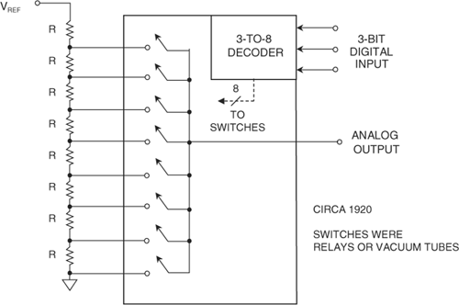
The Kelvin Divider (String DAC)
V7
3-bit string DAC:
Vref and gnd
8 unit resistors
8 tap voltages
3 digital input
3 to “1 of 8” dec
analog Vout
Vout buffer
V6
V5
V4
V3
+
V2
–
V1
V0
N-bit version consists of 2^{N} equal resistors in series and 2^{N} switches
Need N-bit binary to 1 of 2^{N} decoder
If input code = k, analog output the k^{th} tap voltage.

Slide 18
Model in Matlab
Vref can also be normalized to 1
Unipolar V range: 0 to 1
Alternatively can have two resistors of R/2 at Vref and gnd, shift tap voltages by 0.5 V_{LSB}
Bipolar V range: -1 to 1
Resistor can also be normalized to have nominal value of 1
R_{k} = R_{nom}*(1+ε_{k})
ε_{k} randomly generated
Make sure R_{k} >= R_{min}.

Slide 19
The standard deviation of ε_{k} depends on both the process and the area
Explore how this standard deviation is related to the errors in the transfer curve
For a given DAC, once fabricated,
The R_{k} values are fixed
The tap voltages are fixed
The static transfer curve is fixed
➔an array containing V_{k} at k-th entry

Slide 20
When DAC code goes from k1 to k2, DAC output does not go from Vk1 to Vk2 instantaneously.
A simple crude model involves RC settling.
kR||(2^{N}-k)R
R_{on}
R_{ink}
R_{onk}
Vo
V_{k}
Cd
Co
May even ignore Cd for simplicity.

Slide 21
A simple linear RC model
From k₁ to k₂:
Use target code k₂ for RC value
R_{o} ~= k₂*R_{N} // (2^N – k₂)*R_{N} + R_{on}
C_{o} ~ constant if transmission gates used
Initial value is V_{k1}, on C_{o}
Final value is V_{k2}, on C_{o}
1st order RC settling ➔ closed form solution of waveform

Slide 22
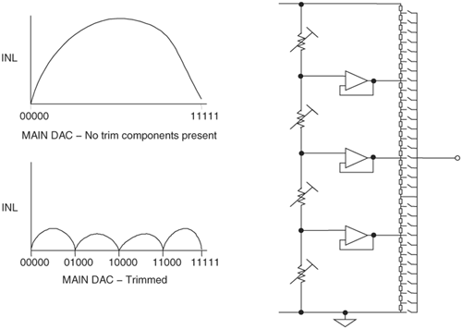
If trimming points are included:
After fabrication trimming to make the 3 major nodes to be at approximately the correct voltages
Model as a single string but 4 voltage dividers

Slide 23
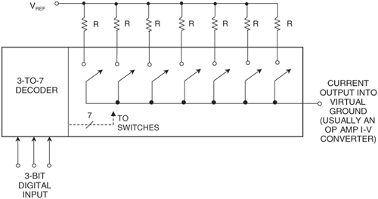
Thermometer current DACs
Output node at virtual ground
Each resistor contributes either 0 or Vref/R
If input digital code = k, k of the 2^{N} – 1 switches will be turned on
I_out =I1 + I2 + … +Ik ≈ k*Vref/R
Inherently monotonic

Slide 24
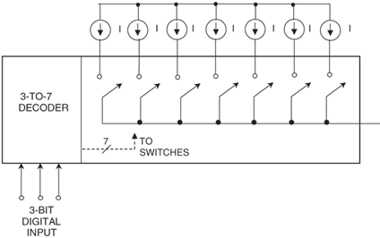
Use Matched Current Sources
Current mirrors to create identical current sources
CMOS current sources are compact
Cascode current mirrors to increase output impedence
I_out =I1 + I2 + … +Ik ≈ k*I
Inherently monotonic

Slide 25
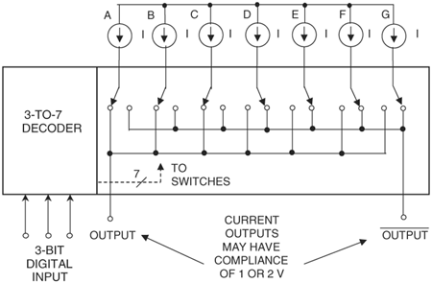
Use Complementary outputs
Each current source and the two switches form a differential pair
Differential pair input Vinh and vinl are just enough to steer all tail current clearly to left or right
All tail currents in current mirror connection
The on side diff pair transistor and tail current transistor in cascode
Can cascode tail current source, to achieve double cascode R_out

Slide 26
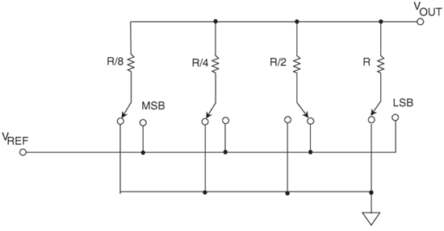
Voltage-Mode Binary-Weighted Resistor DAC
R

Slide 27
HW for everyone
Generalize the previous page to an N-bit structure
Assume all resistors have ideal values as you specify
Let MSB be controlled by b₁, …, and LSB be controlled by b_{N}
Show that V_{out} = sum{ b_{i} * Vref/2^i} for i=1 to N

Slide 28
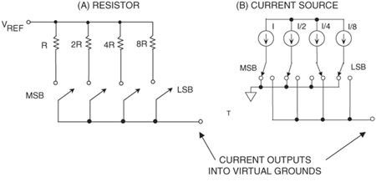
Current-Mode Binary-Weighted DACs

Slide 29
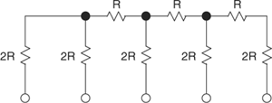
4-Bit R-2R Ladder Network
One of the most common DAC building-block structures
Uses resistors of only two different values with ratio 2:1
An N-bit DAC requires 2N resistors, easily trimmable
two ways in which the R-2R ladder network may be used as a DAC

Slide 30
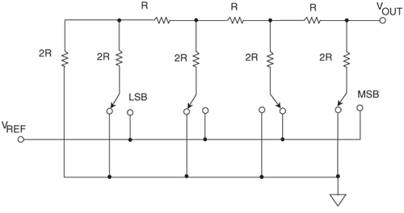
Voltage-Mode R-2R Ladder
"rungs" or arms of the ladder are switched between V_{REF} and ground
Output node has output impedance = R, may need to buffer

Slide 31
HW for everyone
Generalize the previous page to an N-bit structure
Let MSB be controlled by b₁, …, and LSB be controlled by b_{N}
Show that V_{out} = sum{ b_{i} * Vref/2^i} for i=1 to N

Slide 32
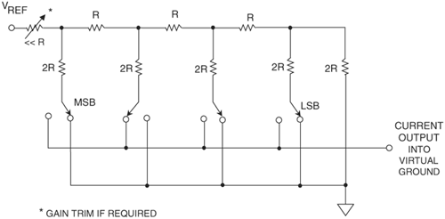
Current-Mode R-2R Ladder
Vref/R
Series R can be used to adjust gain of DAC
R_out is code dependent, leading to DAC nonlinearity

Slide 33
HW for everyone
Generalize the previous page to an N-bit structure
Take the resistor at Vref to be 0
Let MSB be controlled by b₁, …, and LSB be controlled by b_{N}
Show that I_{out} = V_{ref}/R * sum{ b_{i} /2^i} for i=1 to N

Slide 34
Equal Current Sources Switched into an R-2R Ladder Network
R
R
DAC output impedance is constant and equal to R
Used in high speed video DAC
Low output impedance may be problem
Can add unit cell MSBs to form segmented structure
Can replace the gnd node by an identical R-2R to form differential structure, which has much better linearity

Slide 35
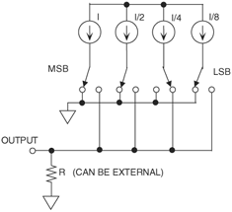
Binary-Weighted Current Sources Switched into a Load
Can replace the LSB current source by this binary array

Slide 36
Capacitive Unary-Weighted DAC
gnd / Vo
……
C
C
C
gnd
Vref
When input code is k, k of the caps are switched to Vref.

Slide 37
Capacitive Binary-Weighted DAC
gnd / Vo
……
C
C/2
C/2^N
C/2^N
gnd
Vref
The first N caps are controlled by the N bits
Last cap is dummy, always connected to gnd

Slide 38
Segmented binary Cap DAC
gnd / Vo
LSB
Cap
DAC
MSB
Cap
DAC

Slide 39
HW for one group
Create an N-bit segmented CDAC model, with in the 12 to 16 range
MSB segment having 6 bits
The LSB segment N-6 bits
Can have total areas for both segments being equal
Compute appropriate C_bridge to make the total effective cap of the LSB seg equal to the unit cap in the MSB array

Slide 40
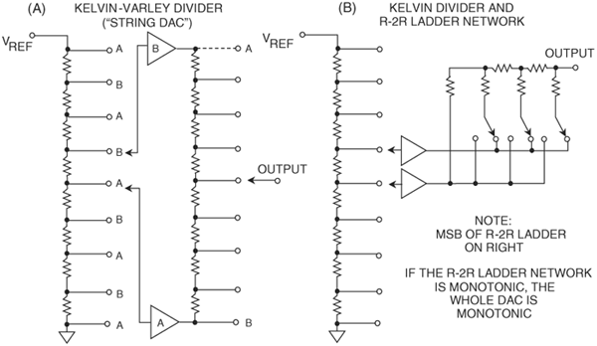
Segmented Voltage-Output DACs
LSB
MSB
LSB
MSB
Coarse string has 2^{M} equal resistors, must be accurate to M+K bit level
Fine stage K-bit DAC must have K-bit accuracy
Fine stage could be string DAC or R-2R DAC
Use buffers to isolate the two stages, buffers need to be accurate to the M+K bit level

Slide 41
HW for one group
Model an R DAC, with string coarse DAC and R2R interpolating fine DAC
MSB string segment has 5 or 6 bits
LSB R2R segment has 6 to 10 bits
Include buffer errors:
Offset, at 1 mV level random
Gain error, at 0.1% level random

Slide 42
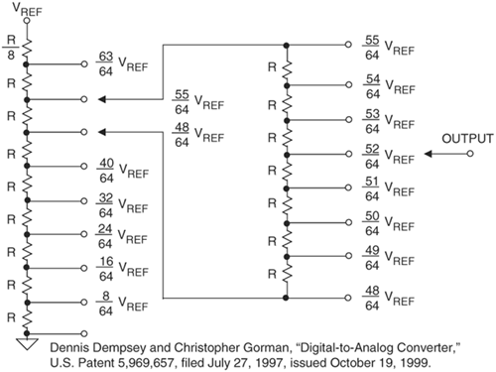
Unbuffered String DACs
Fine string // R ➔ 7R/8
Total resistance = 8R, current = Vref/8R
Voltage across fine string = Vref/8R * 7R/8 = 7Vref/64
Each resistor in fine string has voltage = Vref/64

Slide 43
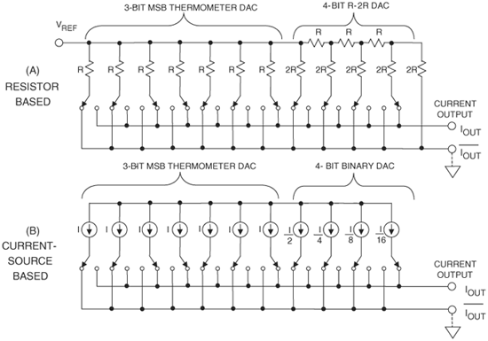
Segmented Current-Output DACs
Instead of turning on and off current, use current steering;
Current steering is much faster, suited for high speed
Use differential pair as steering switch
Use just enough diff voltage to steer the current completely

Slide 44
HW for one group
Model the thermometer plus R2R current DAC
Make the MSB to be 5 or 6 bits
Make the LSB to be 6 to 10 bits
That is: 5 + {6, 7, 8}; or 6+{8, 9, 10}
Add the option of a voltage DAC:
I_out ant I_out_bar goes to an I→V buffer

Slide 45
HW for one group
Model a thermometer plus R2R voltage DAC by applying Vref and gnd at Iout and Iout_bar and taking Vout at Vref node
Make the MSB to be 5 or 6 bits
Make the LSB to be 6 to 10 bits
That is: 5 + {6, 7, 8}; or 6+{8, 9, 10}

Slide 46
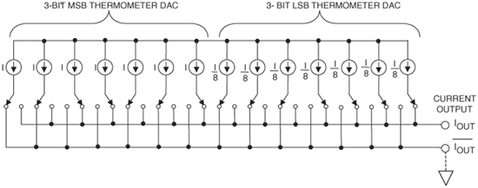
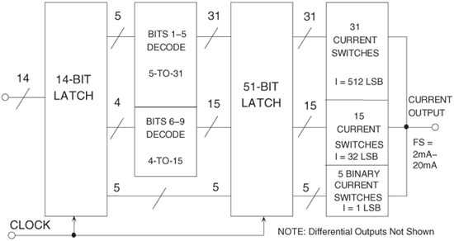
Thermometer + thermometer segmentation
Example use

Slide 47
HW for one group
Model the multi-segmented current steering DAC as shown on the last page’s example use
Make the output to be differential with I_out ant I_out_bar
Each unit is a PMOS current source with with a differential switch
Consider two cases at the output node:
I_out ant I_out_bar goes through RL to gnd
I_out ant I_out_bar goes to an I→V buffer

Slide 48
DAC standard test
Chapter 6 of book
Offset, gain error
INL, DNL
AC test
Settling

Slide 49
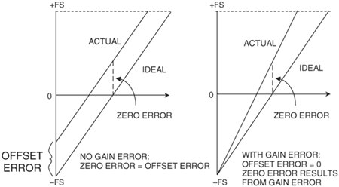
Offset and Gain Error

Slide 50
Offset and Gain Error
Both are absolute errors, measured wrt ideal LSB
LSB_{i} = ideal range / 2^N
Offset in V = V_{a}(C₀) – V_{i}(C₀)
Offset in LSB_{i} = (V_{a}(C₀) – V_{i}(C₀))/LSB_{i}
C₀ could be 0…0, or first code whose output is not at the lower rail
GE = (V_{a}(C₁) – V_{a}(C₀))/LSB_{i} – (C₁ – C₀)
C₁ could be 1…1, or last code whose output is not at the upper rail

Slide 51
Offset and Gain Error
The previous slide is end-point fit line based offset and gain error
Re-write GE equation:
V_{a}(C₁) = V_{a}(C₀) + (C₁ – C₀ + GE)*LSB_{i}
Fit line connects (C₀, V_{a}(C₀)) and (C₁, V_{a}(C₁)), is:
V_{fit}(C) = V_{a}(C₀) + (C₁ – C₀ + GE)*LSB_{i} *(C – C₀)/(C₁ – C₀)
= (C – C₀)*LSB_{i} + V_{a}(C₀) + GE*LSB_{i} *(C – C₀)/(C₁ – C₀)
ideal offset gain error

Slide 52
Offset and Gain Error
Alternative: gain adjusted mean V_{os}
Adjust V_{a}(C) for gain error:
V_{adj}(C) = V_{a}(C) – GE*(C – C₀)/(C₁ – C₀)*LSB_{i}
Note: V_{adj}(C₀) = V_{a}(C₀),
V_{adj}(C₁) = V_{a}(C₀) + (C₁ – C₀)*LSB_{i}
V_{os,avg}=mean{V_{adj}(C) – (C-C₀)*LSB_{i}}, over C₀ to C₁

Slide 53
Offset and Gain Error
Another Alternative:
find best fit line through I/O curve
V_{fit}(C) = V_{os} + Gain*LSB_{i} *(C – C₀)/(code range)
Define a formula to find offset and gain error, e.g., LS best fit line:
Seek optimal Vos and Gain to solve:
min∑{V_{a}(C) – V_{os} – Gain*LSB_{i} *(C – C₀)/(code range)}²

Slide 54
Linearity errors
Errors that measure the deviation from a “linear” converter
These are all relative errors
Static linearity errors:
Integral non-linearity errors
Measure deviation of the transfer curve from a straight fit line
Differential non-linearity errors
Measure non-uniformity of how the tap voltages are distributed

Slide 55
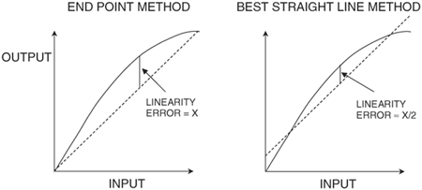
Methods of Measuring INL

Slide 56
Measuring INL/DNL: end point
Actual LSB = (V_{a}(C₁) – V_{a}(C₀))/(C₁ – C₀)
= average step size
End point fit line:
V_{epfl} is V_{a}(C₀) when input is C₀
V_{epfl} is V_{a}(C₁) when input is C₁
V_{epfl}(k) = V_{a}(C₀) + (k – C₀)*LSB
INL(k) = (V_{a}(k) – V_{epfl}(k))/LSB
Overall INL = max (abs(INL(k))
DNL(k) = (V_{a}(k) – V_{a}(k-1))/LSB – 1
= step size error
Overall DNL = max (abs(DNL(k))
INL_{max}=max{INL(k)}
INL_{min} = min{INL(k)}
=max of

Slide 57
Measuring INL/DNL: end point
Note: INL(C₀)=INL(C₁)=0
INL(k) before C₀ and after C₁ not defined
DNL(k) not defined for C₀, before C₀, and after C₁
DNL(k) = INL(k) – INL(k-1)
INL(k) = sum DNL(j), j=C₀+1 to k
To make DNL(k) to have the same k range as INL(k), can let DNL(C₀)=0

Slide 58
HW
Prove the properties listed on the previous page.
Use least square error sum as criteria, define the fit line for the best straight line method, and the corresponding INL(k) and DNL(k). What happens to the properties listed on the previous page?

Slide 59
Measuring INL/DNL: in computer
Suppose tap voltages are in vector V, and the corresponding codes 0..0. to 1…1 are sequentially contained in C
Throw away some initial and last points in V and correspondingly in C
Vdiff = diff(V);
LSB = mean(Vdiff);
DNLk = Vdiff/LSB – 1; DNLk=[0;DNLk];
INLk = cumsum(DNLk);
DNL = max(|DNLk|); INL = max(|INLk|);

Slide 60
HW
Show that the last page corresponds to the end point fit line INL(k), DNL(k)
Show that the following modification produces the LS best fit line INL(k).
A = ones(size(INLk));
A = [A cumsum(A)];
X = A\INLk;
INLk1 = INLk – A*X;
How do you obtain best fit line DNLk?

Slide 61
Non-monotonic DAC
If V_{a}(k)<V_{a}(k-1), non-monotonic at code k

Slide 62
HW
Show that a converter is non-monotonic at code k if and only if DNL(k) < – 1.

Slide 63
Example:
A 4-bit two’s complement DAC produces the following set of voltage levels, starting from code –8 and progressing through code +7:
-780 mV, -705 mV, -530 mV, -455 mV, -400 mV, -325 mV, -150 mV, -75 mV, 120 mV, 195 mV, 370 mV, 445 mV, 500 mV, 575 mV, 750 mV, 825 mV.

Slide 64
The first derivative values are: 75 mV, 175 mV, 75 mV, 55 mV, 75 mV, 175 mV, 75 mV, 195 mV, 75 mV, 175 mV, 75 mV, 55 mV, 75 mV, 175 mV, 75 mV.
The average value of these gives an end-point LSB of 107mV. The LS best-fit line calculation gives LSB=109.35 mV. Dividing by the LS LSB size yields the normalized derivative curve (in LSBs): 0.686, 1.6, 0.686, 0.503, 0.686, 1.6, 0.686, 1.783, 0.686, 1.6, 0.686, 0.503, 0.686, 1.6, 0.686.
Subtracting one from each of these values gives us the LS best line DNL curve for this DAC: -0.314, 0.6, -0.314, -0.497, -0.314, 0.6, -0.314, 0.783, -0.314, 0.6, -0.314, -0.497, -0.314, 0.6, -0.314.

Slide 65
shows the DNL curve for this DAC. The maximum DNL value is +0.783 LSB, while the minimum DNL value is –0.314. The minimum value is greater than –½ LSB, but the maximum DNL value is greater than ½ LSB. Therefore, this DAC fails the DNL specification of +/- ½ LSB.

Slide 66
Using an endpoint calculation method, the INL curve for the 4-bit DAC of the previous examples is calculated by subtracting a straight line between the –FS voltage and the +FS voltage from the DAC output curve. The difference at each point in the DAC curve is divided by the average LSB size, which in this case is calculated using an endpoint method. As in the endpoint DNL example, the average LSB size is equal to 107 mV.
The results of the INL calculations are listed below. Again, these values are expressed in LSBs.
0, -0.299, 0.336, 0.037, -0.449, -0.748, -0.112, -0.411, 0.411, 0.112, 0.748, 0.449, -0.37, -0.336, 0.299, 0

Slide 67
The figure shows the endpoint INL curve. The maximum INL value is +0.748 LSB, and the minimum INL value is –0.748. This DAC does not pass an INL specification of +/- ½ LSB

Slide 68
Best Fit Solution
Using a best-fit calculation method, the INL curve for the 4-bit DAC of the previous examples is calculated by subtracting the best-fit line from the DAC output curve.
Each point in the difference curve is divided by the average LSB size, which in this case is calculated using the best-fit line method. As in the best-fit DNL example, the average LSB size is equal to 109.35 mV. The results of the INL calculations are listed below, expressed in LSBs.
0.161, -0.153, 0.448, 0.133, -0.364, -0.678, -0.077, -0.392, 0.392, 0.077, 0.678, 0.364, -0.133, -0.448, 0.153, -0.161
The best-fit INL curve is shown for comparison with the endpoint INL curve. The maximum value is +0.678 and the minimum value is –0.678.

Slide 69
The best-fit INL results are better than the endpoint INL values, but still do not pass a +/- ½ LSB test limit. The two INL curves are somewhat similar in shape, but the individual INL values are quite different.
The choice of calculation technique is much more important for INL curves than for DNL curves.
A best-fit curve will usually give better INL results than an endpoint INL calculation

Slide 70
HW
In general, how does the end point INL compare to the LS best line INL? What’s the relationship among them? Can you quickly provide a reasonable guess? Can you quantitatively show or prove your guess?

Slide 71
Partial Transfer Curves
A customer or systems engineer may request that a portion of the transfer curve meet certain detailed specifications.

Slide 72
Major Carrier Testing
For binary weighted DACs, ideally if the weight of each bit is known, the whole transfer curve can be computed
For DAC input code, D₀, D₁, ... D_{n}. The DAC’s output value is = D₀*W₀+D₁*W₁+...+D_{n}*W_{n} + DC Base
where: DAC code bits D₀-D_{n} take on the value of 1 or 0; W₁ = 2*W_{0;} W₂ = 2*W₁ … W_{n} = 2*W_{n}-1
DC Base is the DAC output value with a -FS input code

Slide 73
Major Carrier Testing
Measure the DC Base, with minus full scale code
Measure step size at major carrier transitions
V₀ = W₀
V₁ = W₁ – W₀
V₂ = W₂ – (W₁+W₀)
V₃ = W₃ – (W₂+W₁+W₀)
...
V_{n} = W_{n} – (W_{n-1}+W_{n-2}+W_{n-3}...W₀)
Solve these equations for the weights

Slide 74
Other Selected-Code Techniques
Besides the major carrier method, other selected-codes techniques have been developed to reduce the test time associated with all-codes testing.
The simplest of these is the segmented method. This method only works for certain types of DAC and ADC architectures.
Alternatively, “trouble codes” can be identified during characterization. These codes together with certain segments are to be tested in production.

Slide 75
DAC AC test
DAC input: digital sine wave
D(k) = round( (A sin(2 pi J k / M) + 1)/2 * 2^N)
where A is amp, Vref or slightly less
M is the number of DAC output samples to generate
J is the number of sine periods in M points
k is time index ranging 0, 1, 2, to M-1
DAC output: treat as analog
Use an “ideal” ADC to capture DAC output
Or an ADC with >10X speed, and >3 extra bits

Slide 76
If ADC is sampling at integer H times DAC clock rate
Samples per DAC clock period is H
Total ADC samples to capture is H*M
Captured data will be coherent
If H is not an integer
You still have H*M points in captured data
But coherent sampling may be lost
Non-coherent sampling FFT may be needed

Slide 77
HW
In your DAC model, make sure output switches and capacitors are included.
For simplicity, only model first order RC effects
Assume ADC with infinite resolution and a sampling rate that is an integer times the DAC rate
Select M to be an power of 2, and select J to be odd and J/M in the range of 5-10%.
Plot the ADC output spectrum.

Slide 78
DAC transient test
Conversion Time (Settling Time)
The straightforward approach to testing settling time is to digitize the DAC’s output as it transitions from one code to another and then use the known time period between digitizer samples to calculate the settling time.
We measure the final settled voltage, calculate the settled voltage limits (i.e. +/- 1/2 LSB) and then calculate the time between the digital signal transition that initiates a DAC code change and the point at which the DAC first stays within the error band limits

Slide 80
Overshoot, Undershoot
Overshoot and undershoot can also be calculated from the samples collected during the DAC settling time test. These are defined as a percentage of the voltage swing or as an absolute voltage. Below is a DAC output with 50% overshoot and 10% undershoot on a –FS to +FS transition

Slide 81
Rise/Fall Time
Rise and fall time can also be measured from the digitized waveform collected during a settling time test. Rise and fall times are typically defined as the time between two markers, one of which is 10% of the way between the initial value and the final value and the other of which is 90% of the way between these values.

Slide 82
DAC to DAC Skew
Some types of DACs are designed for use in matched groups.
For example, a color palette RAM DAC is a device that is used to produce colors on video monitors. A RAM DAC uses a random access memory (RAM) lookup table to turn a single color value into a set of three DAC output values, representing the red, green, and blue intensity of each pixel. These DAC outputs must change almost simultaneously to produce a clean change from one pixel color to the next.
The degree of mismatch between the three DAC outputs is called DAC-to-DAC skew. It is measured by digitizing each DAC output and comparing the timing of the 50% point of each output to the 50% point of the other outputs. There are three skew values (R-G, G-B, and B-R) as illustrated in the next slide.

Slide 84
Glitch Energy
Glitch energy is another specification common to high frequency DACs, especially video DACs. It is defined as the total area of the glitches in a DAC’s output as it transitions across the largest major transition (i.e. 01111111 to 10000000 in an 8-bit DAC) and back again.
The parameter is expressed in picosecond-volts (psV).
One area of ambiguity in this specification: is area under the negative-going spike considered negative area, to be subtracted from the area under the positive spike, or is it positive area to be added?

Slide 86
HW
Suppose a DAC is tested and the vectors of input C and output V are available. Vrefb and Vreft are also given for the bottom and top of the reference range. Write a Matlab function to generate the offset, gain error, INLk/DNLk, and INL/DNL, and plot INLk~k, DNLk~k plots.
Suppose the waveform of the DAC output transient (as on the previous page) for two conversions is captured and recorded in V and t vectors. Write a Matlab function to compute the settling time, rise time, overshoot, and glitch energy.

Slide 87
Food for thought
Typically in a given technology, available DAC performance is better than available ADC performance (could be quite bit better).
How do you use an ADC to capture the DAC transient waveform?

Slide 88
Possibilities
Pedestal DACs
Under-sampling

Slide 89
HW
Vref=1V, P=1mW, T=27C, BW=10MHz.
Determine R values.
Determine σ for 18 bit matching.
Generate a 18 bit DAC and fix it.
Add a noise V-source for each R.
Use a 20 bit linear ADC to measure Vout. ADC has input additive noise σ=1LSB.
Sequentially sweep DAC input code from 0 to 2^18 – 1, with SPS = 0.1BW.
For each code, take H samples of Vout. Start with H=10, for example.
Create a big matrix, with the following columns
Sample index
DAC input code
Ideal DAC output
Expected DAC output (output if noise-free and infinite resolution ADC)
Actual measured DAC output (20 bit ADC output code in the presence of noise, interpreted in V)
TUE (total unadjusted error, = 5) – 3) ) in ideal LSB’s
Plot 3)~6) vs 1), or vs 2). zoom in to see details.
Use 5) to compute end-point fit line, and LS best fit line. Note: line is V_{out} vs D_{in}
Compute INL and DNL. (both epfl and LSbfl)
Compute gain error. (either epfl or LSbfl)
Compute V_{os}: from code C₀, or from gain adjusted average error
Repeat for 10H, and/or 10P, 0.1P, and/or 10BW, 0.1BW; and conclude

Slide 90
HW
Show that, regardless how a net work of resistor are connected, the total noise contribution from all resistor to the output node is equal to the noise of an equivalent resistor looking into the output node.
Show that, if we replace all resistors by their nominal values, the noise rms will only change by a negligible amount.
With the above two, a single voltage noise source with psd = 4kTR in series with Vout is sufficient.

