Slide 1
Feedback Loops and Trojan States: Hardware Threats to Cyber Security and Trusted Electronics
Degang Chen

Slide 2
Outline
Introduction and Problem Statement
  Hardware security
  Feedback induced multi-state vulnerability
Existing Approaches
Proposed Method
  Loop Identification and break
  Replica method to avoid breaking NFL
  Computationally efficient verification
Summary

Slide 3
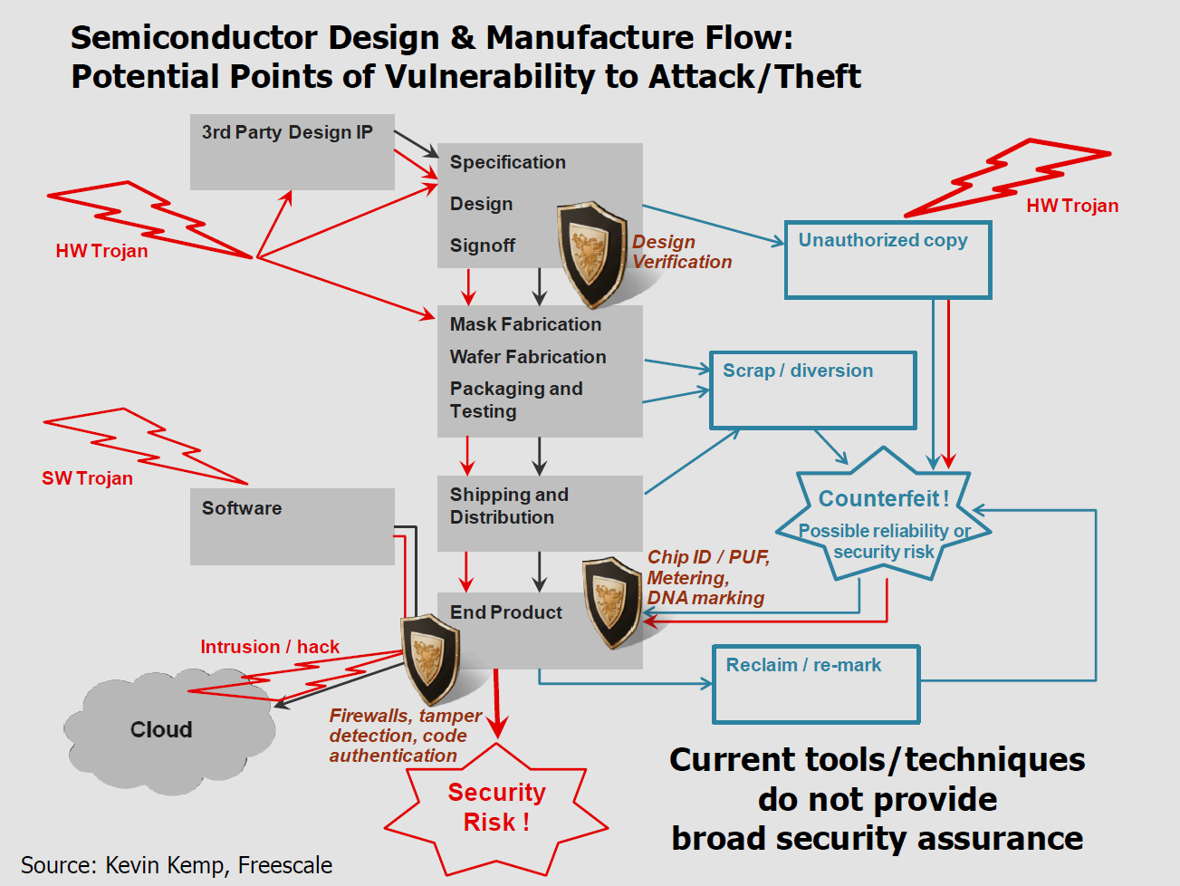

Slide 4
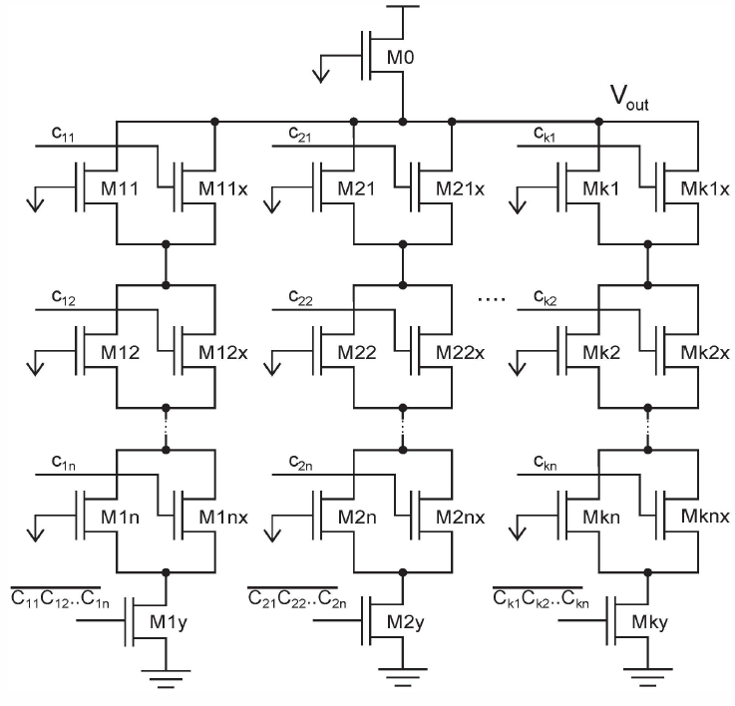
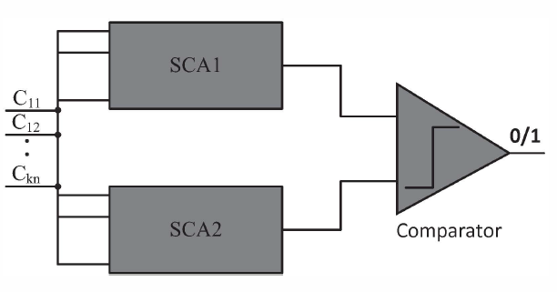
Physically Unclonable Functions

Slide 6
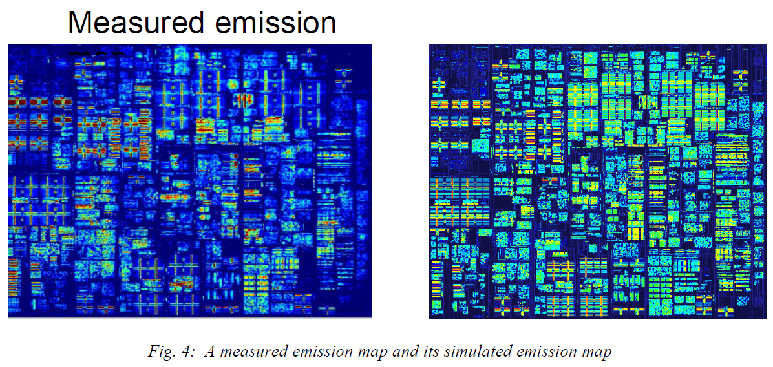
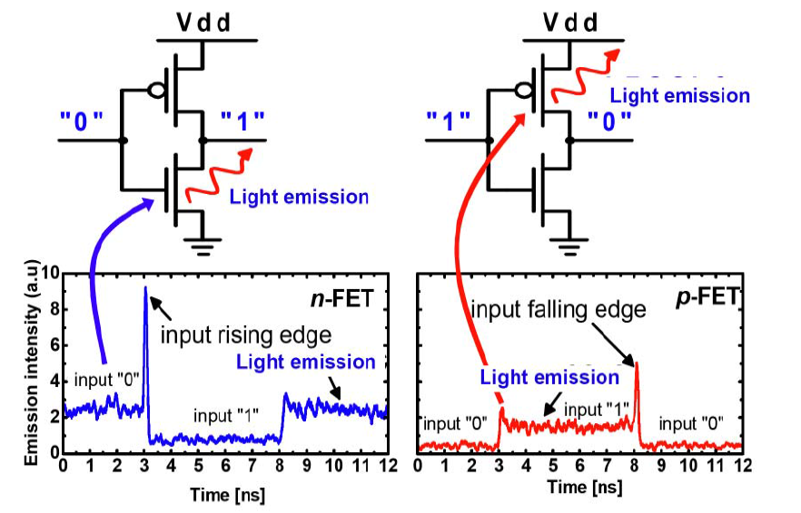
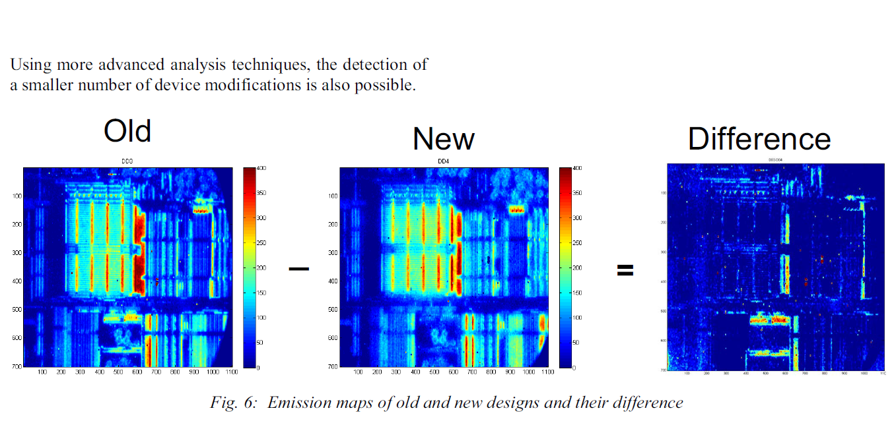
Malicious Alteration Recognition and Verification by Emission of Light: MARVEL of IBM

Slide 8
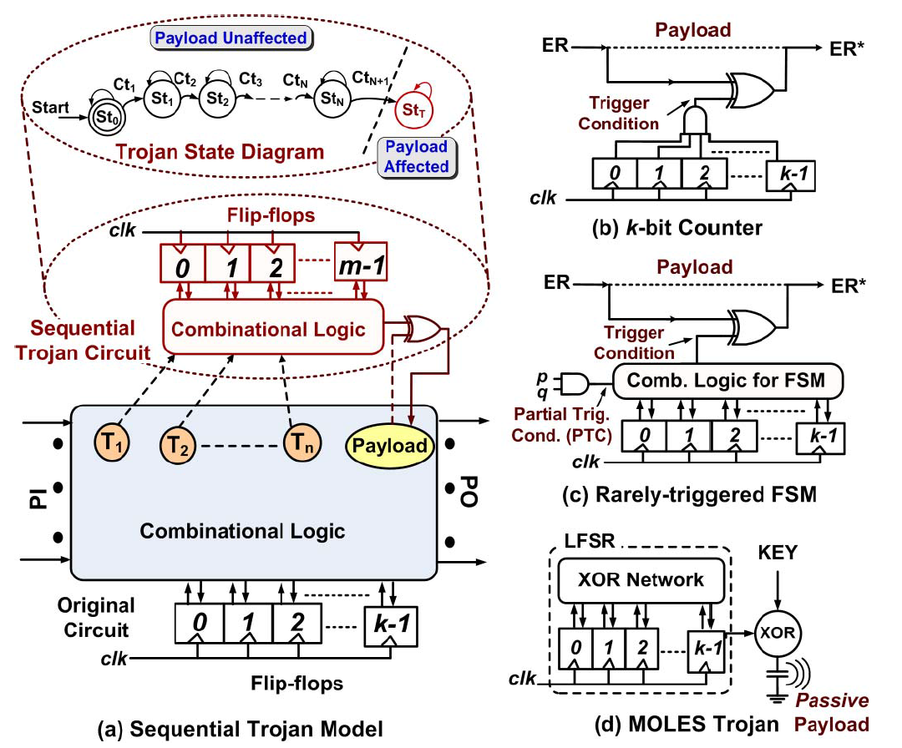

Slide 10
Feedback and multi-state vulnerability
Feedback is a very powerful technique
  Regulates voltage, current, frequency, …
  De-sensitizes PVT, disturbance, …
  Enhances performance, linearity, …
  Enables learning, healing, adaptation, …
Feedback also creates problems
  Causes instability
  Introduces extra operating points
  Creates startup issues
  Unpredictably kicks system into undesired states
3 states
Trojan states

Slide 11
Security Risk of Analog Trojan States
All non-trivial circuits vulnerable
  If containing analog blocks with feedback loops
Increasingly widespread
  Young, inexperienced analog desigers
  “Smarts” are becoming prevalent
Consequences very severe
  Huge performance degradation or total failure
  Recovery only by power off and power on
Truly insidious
  No existing tools can catch all Trojan states
  Even if existence is known, extensive standard simulation may still miss them

Slide 12
Outline
Introduction and Problem Statement
Existing Approaches
Proposed Method
  Loop Identification and break
  Replica method to avoid breaking NFL
  Computationally efficient verification
Summary

Slide 13
Traditional methods
  Experience and intuition used to identify start-up problems
  Occasionally need for start-up missed
  Often attempt to verify start-up effectiveness with transient simulation
    Heuristic
    Time consuming
    Multiple operating points may still exist !!!

Slide 14
Traditional Transient Simulation
DC simulation
V_{DD}=1.8V
V_{OL}=0.5V
Transient simulation
A threshold based temperature sensor
Everything looks fine with this approach. But it has multi-states!
3 OP V_{OL}: 0.5V 80mV 7mV
V_{OH}: 1.16V 0.2V 18mV
Wang, Yen-Ting, Degang J. Chen, and Randall L. Geiger. "Effectiveness of Circuit-level Continuation Methods for Trojan State Elimination Verification." In Circuits and Systems (MWSCAS), 2013 IEEE 56th International Midwest Symposium on, pp. 1043-1046. IEEE, 2013.
Wang, Yen-Ting, Degang Chen, and Randall L. Geiger. "Practical methods for verifying removal of Trojan stable operating points." In Circuits and Systems (ISCAS), 2013 IEEE International Symposium on, pp. 2658-2661. IEEE, 2013.

Slide 15
Methods finding operating points
Homotopy- Green, Trajkovic, Tadeusiewicz
  Linear Homotopy
  Arc-length continuation
  Newton methods
  Finds most operating points for simple circuits
Piecewise linear approximation– Chua
  Finds all operating points (in infinite time)
  Interval algorithm- Yamamura
  Simplex algorithm Yamamura
  Practically applicable to only small circuits
Finding all operating points is an open problem

Slide 16
DC OP Analysis by Formal Approach
Problem: Verifying the start-up of Oscillator
Proposed method
  Locate all equilibrium points
    ODE model
    SAT (satisfiability) (NP-complete problem)
  2. Test the stability of all equilibrium points by find the eigenvalue of Jacobian matrix
  Oscillator should have no stable operating point
[1] M. H. Zaki, I. M. Mitchell, and M. R. Greenstreet, “DC operating point analysis - a formal approach,” in Proceedings of Formal Veriﬁcation of Analog Circuits (FAC), 2009.

Slide 17
SAT-based Formal Analog Verification
Tiwary
Problem
  SPICE based simulators are often hard to verify the circuit across a range of process, environmental conditions, etc. They also suffer from the deficiency to identify the circuits over a range of operating conditions.
Proposed method
  Replace the nonlinear analog models with discretized device I-V tables
  Combine the I-V tables with the KCL constraints to formulate SAT problems
[1] S. Tiwary, A. Gupta, J. Phillips, C. Pinello, R. Zlatanovici, "First Steps Towards SAT-based Formal Analog Verification," IEEE/ACM ICCAD, Nov. 2009.

Slide 18
Simulation-Assisted Formal Verification
Peng Li
Problem
  In terms of transient verification, the SMT solvers is computationally intensive to verify dynamic properties of nonlinear AMS circuits.
Proposed method
  Randomly sampled transient simulations are first applied to quickly explore the reachable state space and then SMT solver is invoked to ensure the conservativeness.
  Bayesian inference based on random simulation history is used as tradeoff between the runtime costs of simulation and SMT solving.
[1] L. Yin, Y. Deng and P. Li, “Simulation-Assisted Formal Verification of Nonlinear Mixed-Signal Circuits with Bayesian Inference Guidance” IEEE Trans.on CAD, July 2013

Slide 19
State Space Approach
S. Youn and J. Kim
Avoids NP-complete SAT problem
Two major steps in the method:
  Take a certain number of samples from the initial state space of a circuit, perform multiple steps of transient simulations
  Cluster Splitting Detection after transient simulation:
    examine the distributions of the resulting circuit states using clustering analysis;
    if more than one clusters are formed, global convergence failure.
[1] S. Youn, J. Kim, M. Horowitz, "Global convergence analysis of mixed-signal systems," Design Automation Conference (DAC), 2011 48th ACM/EDAC/IEEE , vol., no., pp.498,503, 5-9 June 2011
[2] S. Youn, J. Kim, "Preventing Global Convergence Failure in Mixed-Signal Systems via Indeterminate State (‘X’) Elimination," Circuits and Systems I: Regular Papers, IEEE Transactions on , vol.60, no.10, pp.2561,2571, Oct. 2013

Slide 20

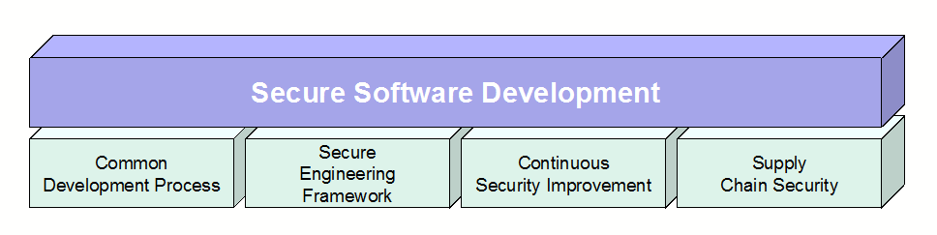
Lessons from Software Engr
Microsoft: Security Development Lifecycle (SDL)
IBM’s Secure Engineering Framework
The Building Security In Maturity Model (BSIMM)
Framework + requirements + verification

Slide 21
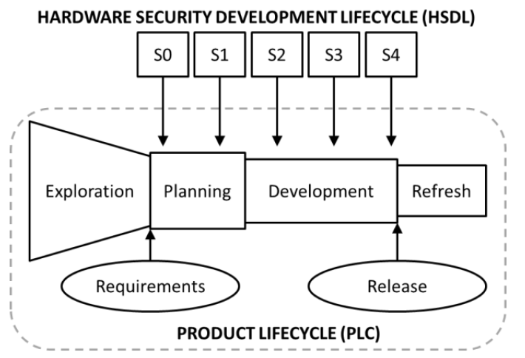
Intel’s HSDL:
hardware security development lifecycle

Slide 22
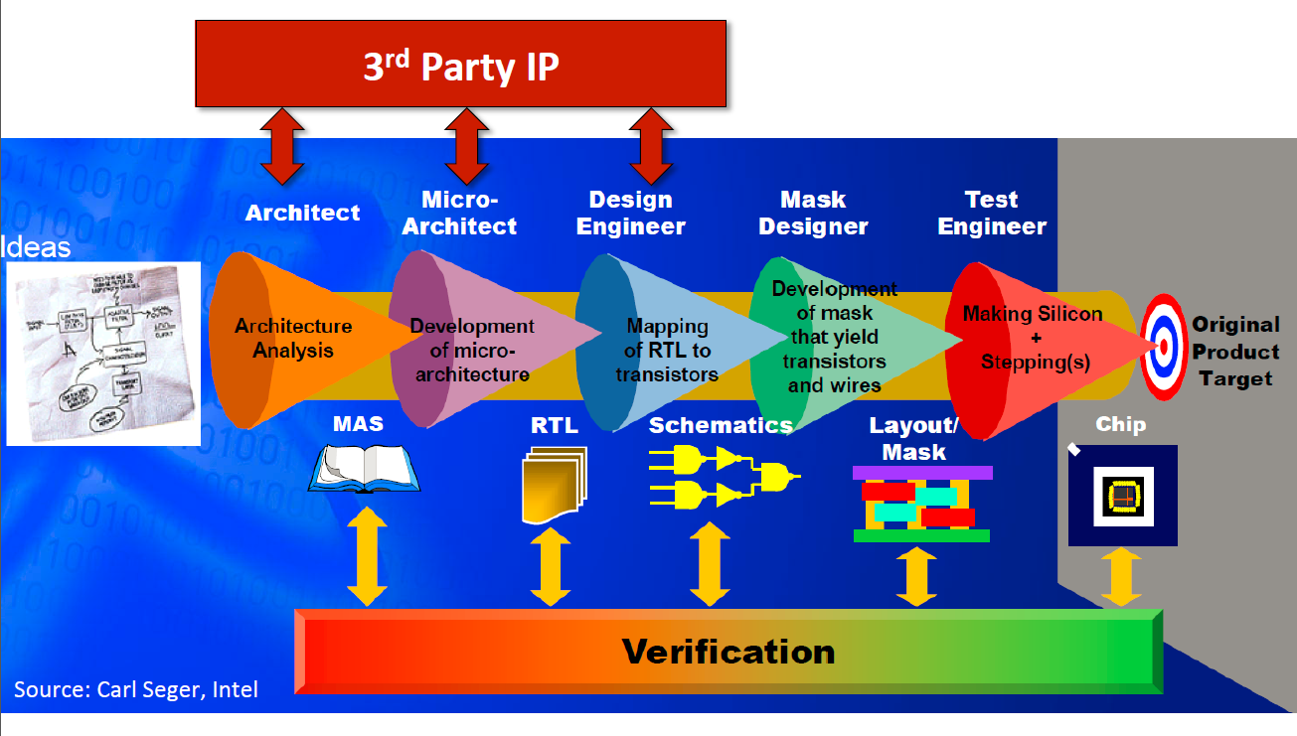

Slide 23
Outline
Introduction and Problem Statement
Existing Approaches
Proposed Method
  Loop Identification and break
  Replica method to avoid breaking NFL
  Computationally efficient verification
Summary

Slide 24
Integrated Design and Verification for hardware security
In the long run: A security/verifiability aware framework for comprehensively dealing with specification, design, verification, validation, and testing
Short term:
  Design requirements to ensure verifiability
  Design guidelines to reduce verification challenge
  Efficient verification tools for verifiable circuits
Never design non-verifiable circuit
Guaranteed verification when rules followed

Slide 25
Proposed Approach
Convert circuit netlist N to Directed Dependency Graph (DDG)
Identify all Positive Feedback Loops (PFLs)
Break the PFLs
Apply Homotopy Methods at Break-points (insert sources to drive broken PFLs and analyze return map), DC operating points where : f(x)=x
  Apply Divide and Contraction Algorithms: finding intervals containing Trojan states which is efficient
  Find more than 1OP, stop=>Trojan States
Loop Identification & break
Divide &Contraction
DDG
Return map
x
f(x)
PFL

Slide 26
Proposed Approach
Loop Identification and Break
  Computationally Efficient Divided and Contraction

Slide 27
Outline
Introduction and Problem Statement
Existing Approaches
Proposed Method
  Loop Identification and break
  Replica method to avoid breaking NFL
  Computationally efficient verification
Summary

Slide 28
Directed Dependency Graph (DDG)
DDG(V,E):
  Vertices → Path Current(PI) or Controlling Voltage(CV)
  Edges→ Dependency between PI and CV
DDG
DDG captures the critical relationships among Path currents and node voltages

Slide 29
Converting netlist N to DDG(V_{D},E_{D})
Circuit Netlist
Channel list: the part of any instance which conducts current
Details in [1]
  A→I₁, B→I_{2,} C→I₁
  I₁→B, I₂→A, I₂→C
Path current: a sequence consist of alternating nets and channels from vdd to gnd
Dependency
DDG
[1] Z.Q. Liu, Y. Li, R.L. Geiger, D. Chen, " Auto-identification of Positive Feedback Loops in Multi-state Vulnerable Circuits,“ IEEE VLSI Test Symposium (VTS), April 2014.

Slide 30




N→DDG computational complexity
$$O\left(|N|\right)$$
$$O\left(|N|\right)$$
Circuit Netlist
Channel list:
$$O\left(|N|\right)$$
  A→I₁, B→I_{2,} C→I₁
  I₁→B, I₂→A, I₂→C
Path current
Dependency
DDG
  ➔ Complexity bound: $O\left(\left|N\right|\right)$
  Graph size: |V_{D}|, |E_{D}| < |N|

Slide 31
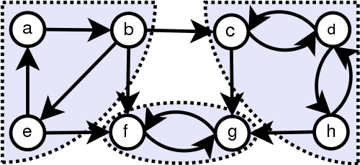
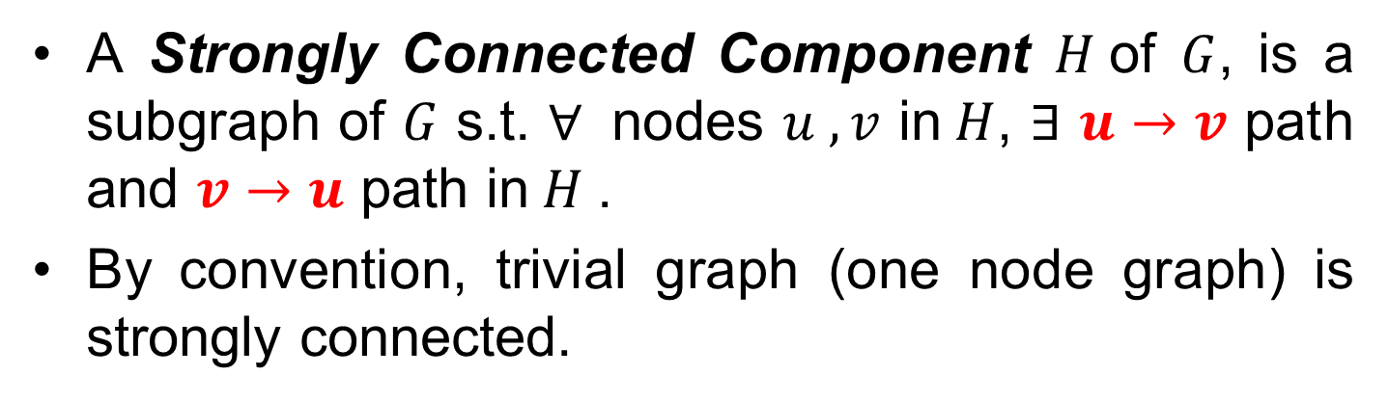



Strongly Connected Components(SCCs)
A Strongly Connected Component $H$of $G$, is a subgraph of $G$ s.t. $∀$ nodes $u ,v$ in$H$, $∃$ $u→v$ path and $v→u$ path in$H$.
By convention, trivial graph (one node graph) is strongly connected.
Example
$$H_{1}$$
$$H_{3}$$
$$H_{2}$$

Slide 32
Decompose DDG to SCCs
Motivation
  Easier for identifying loops
  Easier for detecting break-points
  Allow homotopy method to apply to SCCs independently or sequentially
_{DDG}
Two SCCs (H₁, H₂) are detected in this DDG

Slide 33
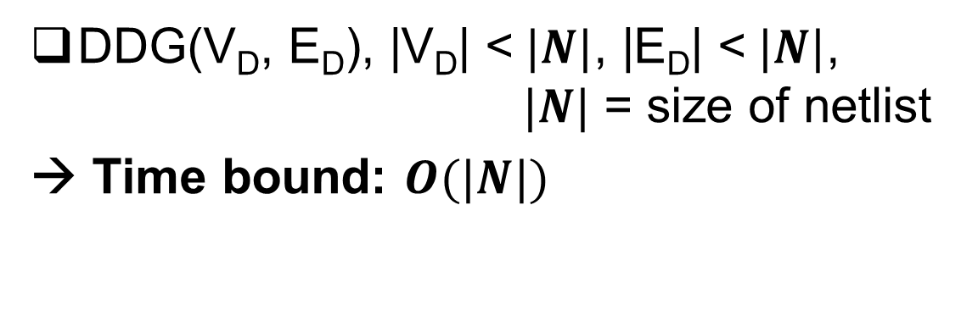
DDG → SCCs computation complexity
Tarjan’s algorithm [1]:
Given graph G(V,E), time bound:$O(|V|+|E|)$
In our case:
DDG(V_{D}, E_{D}), |V_{D}| <$|N|$, |E_{D}| <$|N|$, $|N|$ = size of netlist
→ Time bound: $O(|N|)$
[1] R. Tarjan, “Depth-first search and linear graph algorithms,” SIAM J. Comput., pp. 146–160, 1972

Slide 34
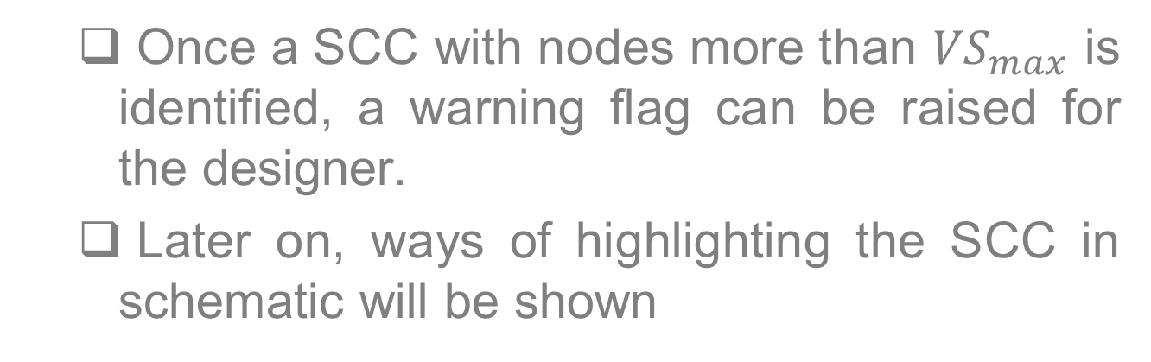
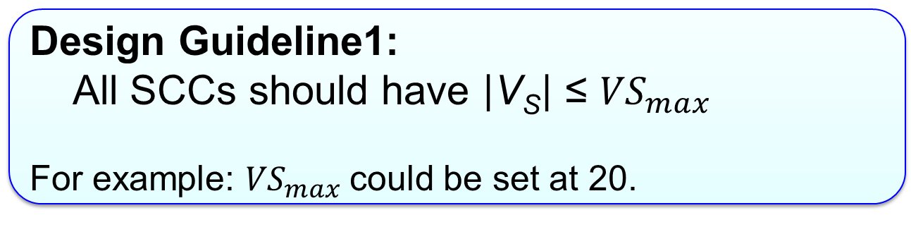
SCC(V_{S}, E_{S}) properties
Design Guideline1:
All SCCs should have $\left|\text{V}\text{S}\right|$ ≤ ${VS}_{max}$
For example: ${VS}_{max}$could be set at 20.
Remark:
  Once a SCC with nodes more than ${VS}_{max}$ is identified, a warning flag can be raised for the designer.
  Later on, ways of highlighting the SCC in schematic will be shown

Slide 35
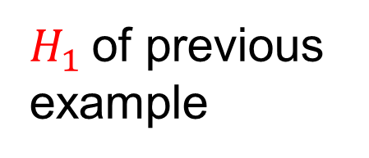
Loop Identification in SCCs
Feedback loop: connected subgraph involving at least four nodes s.t. each node has only one arc leaving and one arc entering.
Graph theory techniques
$H_{1}$ of previous example
Two loops are detected

Slide 36
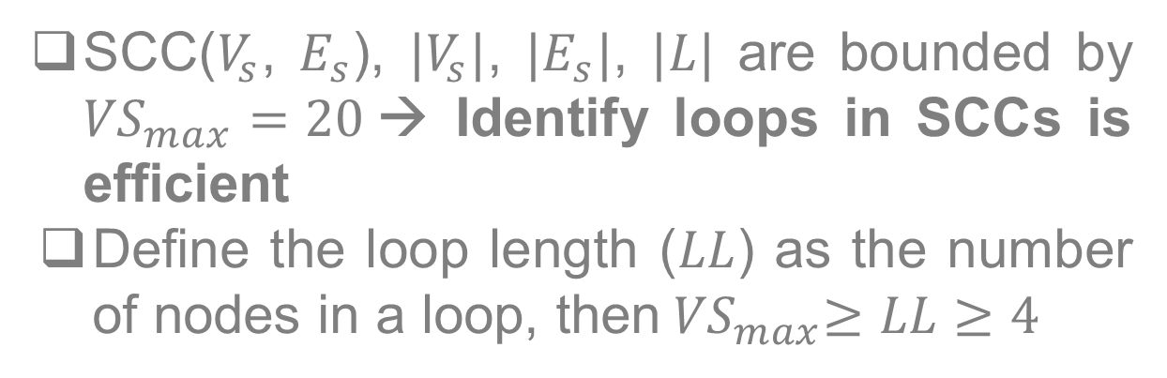
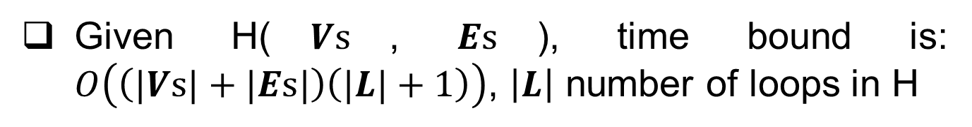
Computation complexity: loop identifying
Johnson algorithm [1]:
      Given H($Vs$, $Es$), time bound is: $O\left(\left(|Vs|+|Es|\right)\left(|L|+1\right)\right)$, $\left|L\right|$ number of loops in H
In our case:
SCC($V_{s}$, $E_{s}$), $|V_{s}|$, $|E_{s}|$, $|L|$ are bounded by ${VS}_{max}=20$→ Identify loops in SCCs is efficient
Define the loop length ($LL$) as the number of nodes in a loop, then${ VS}_{max}≥LL≥4$
[1] D. B. Johnson, “Finding all the elementary circuits of a directed graph,” SIAM J. Comput., vol. 4, pp. 77–84, Mar. 1975

Slide 37

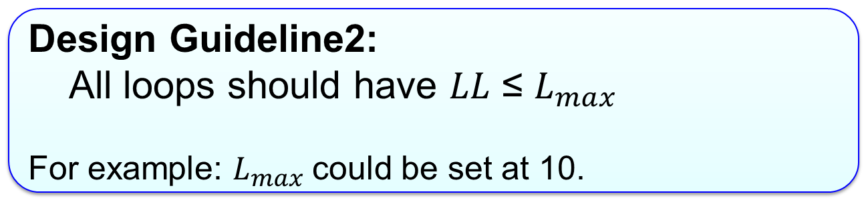
SCC(V_{S}, E_{S}) properties
Design Guideline2:
All loops should have $LL$ ≤ $L_{max}$
For example: $L_{max}$could be set at 10.
Remark:
  When a loop with LL > $L_{max}$ is identified, raise a warning flag for the designer.

Slide 38
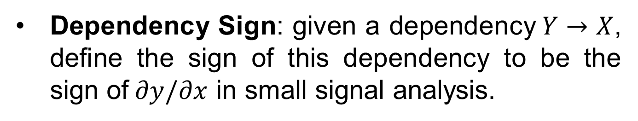
Loop Sign: Dependency Sign
Dependency Sign: given a dependency$Y→X$, define the sign of this dependency to be the sign of$∂y/∂x$ in small signal analysis.

Slide 39
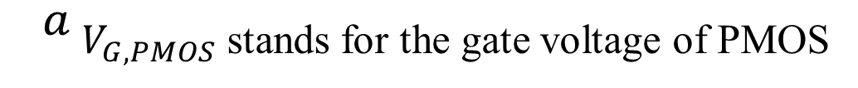
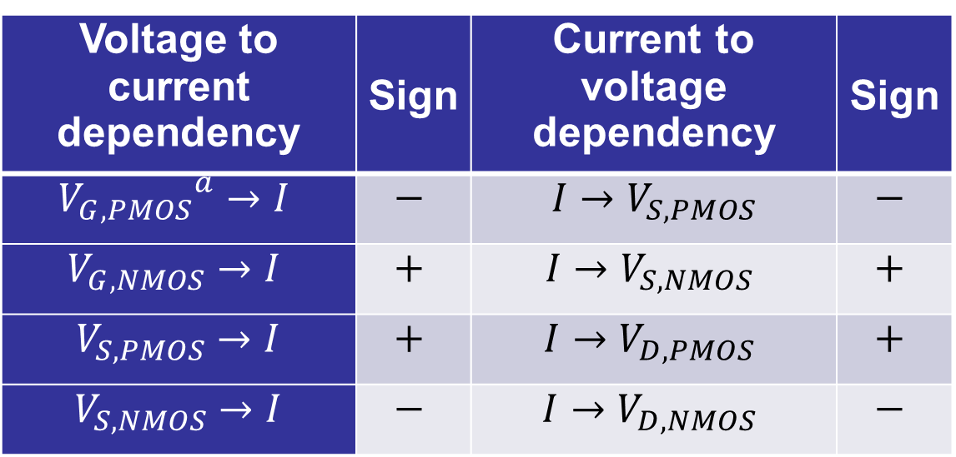
Loop Sign: Dependency Sign
Table for dependency sign
Voltage to current dependency | Sign | Current to voltage dependency | Sign
$${V_{G,PMOS}}^{a}→I$$ | $$−$$ | $I{→V}_{S,PMOS}$ | $$−$$
$$V_{G,NMOS}→I$$ | $$+$$ | $$I{→V}_{S,NMOS}$$ | $$+$$
$V_{S,PMOS}→I$ | $$+$$ | $$I{→V}_{D,PMOS}$$ | $$+$$
$V_{S,NMOS}→I$ | $$−$$ | $$I{→V}_{D,NMOS}$$ | $$−$$
${}^{a}$ $V_{G,PMOS}$ stands for the gate voltage of PMOS
Notice: need to know the Drain/Source for MOSFET

Slide 40
Loop Sign: Determine Drain/Source
D/S can be determined by following the path-current
S of M₄
S of M₁
D of M₁/M₄
Path current

Slide 41
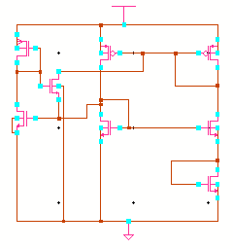
Loop Sign: Determine Drain/Source
D/S of transistor M₁ not well-defined← M₁ in more than one paths with diff directions
M₁
M₁

Slide 42
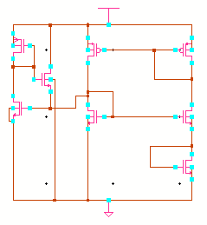
Loop Sign: Determine Drain/Source
Better change to
Design Requirement:
The drain/source must be robustly well-defined for any transistor in a loop requiring verification.
  Comment: When a MOST D/S not well-defined, raise a flag, and, if in a loop, request revision.

Slide 43
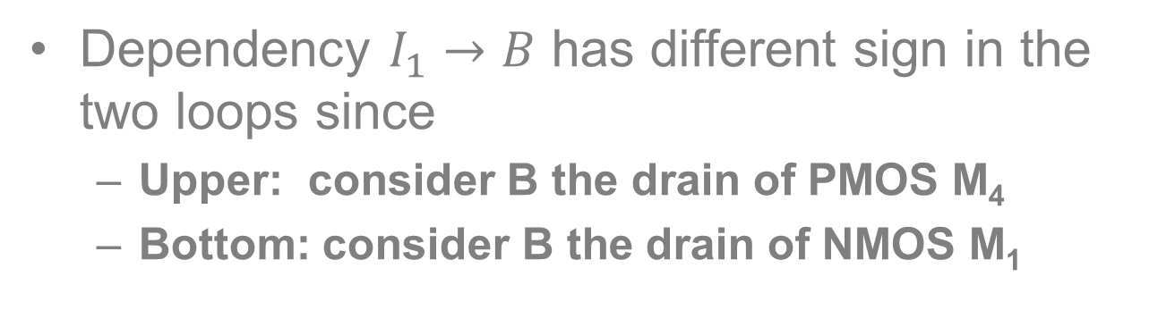
Loop Sign Determine
Dependency $I_{1}→B$ has different sign in the two loops since
  Upper: consider B the drain of PMOS M₄
  Bottom: consider B the drain of NMOS M₁
PFL: even number of negative dependencies
NFL: odd number of negative dependencies

Slide 44
Break-points set: Feedback vertex set
Break-points set: minimum set of nodes which open all the PFLs if removed, e.g. {A} or {B}
Feedback vertex set (FVS): a set of vertices containing at least one vertex of every PFLs in the graph
Find the break-points set is equivalent to find the minimum FVS

Slide 45
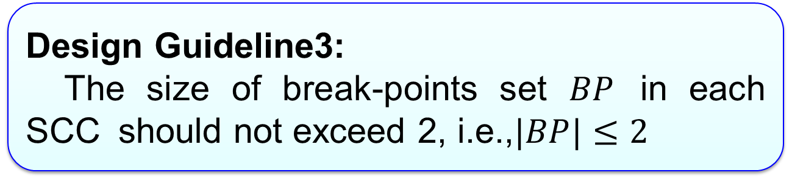
Break-points set: minimum FVS
Design Guideline3:
The size of break-points set $BP$ in each SCC should not exceed 2, i.e.,$|BP|≤2$
Remark:
  When |𝐵𝑃| exceed 2 for a SCC, raise a flag for the designer.

Slide 46
Benchmark Circuits
Type I circuits2: ${\left|BP\right|}_{max}=1$for all SCC

Slide 47
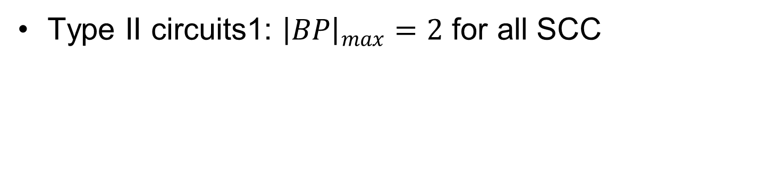
Benchmark Circuits
Type II circuits1: ${\left|BP\right|}_{max}=2$ for all SCC

Slide 48
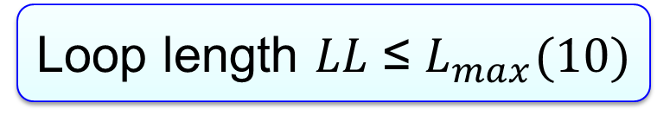
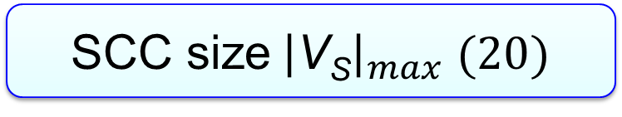

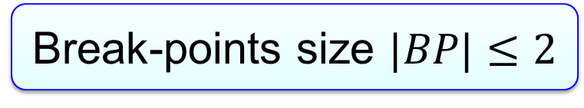
Loop Identification and Break
  Summary: systematic and automatic
  discover design weak spots
SCC size${\left|\text{V}\text{S}\right|}_{max} (20)$
Loop length $LL$ ≤ $L_{max}(10)$
$$\text{W}\text{ell}\text{−}\text{defined} \text{D}\text{/}\text{S}$$
Break-points size $|BP|≤2$
Violation of these rules →Warning flag

Slide 49
Outline
Introduction and Problem Statement
Existing Approaches
Proposed Method
  Loop Identification and break
  Replica method to avoid breaking NFL
  Computationally efficient verification
Summary

Slide 50
Motivation for Replica method
Wish to only break PFLs since
  Break only PFLs→ loop return map is monotonic (verification will be very efficient)
  Break both PFLs and NFLs → loop return map is non-monotonic (verification much more difficult)
But
  Case 1: No Break-points set for breaking only PFLs (Type II circuits2)
  Case 2: To minimize FVS we have to NFLs (Type II circuits1)

Slide 51
Replica method
Implementation complexity is linearly related to the number of components
shared by PFL and NFL.

Slide 52
Wilson

Slide 53
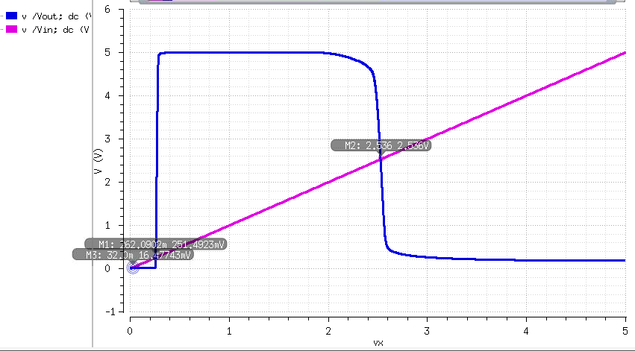
T=100

Slide 54
Wilson

Slide 55
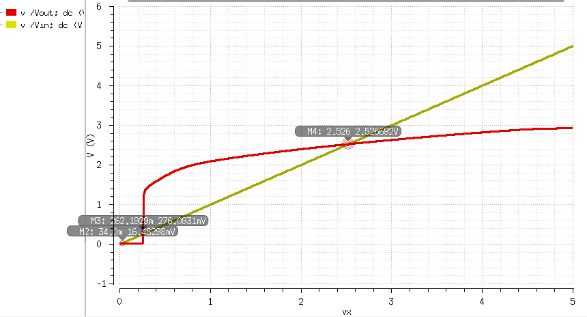
T=100

Slide 56
Banba

Slide 57
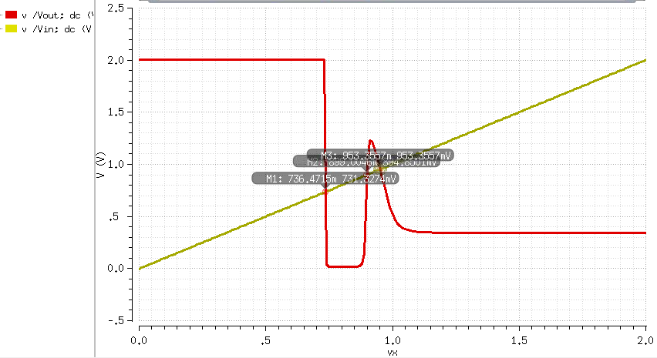
T=0

Slide 58
Banba

Slide 59
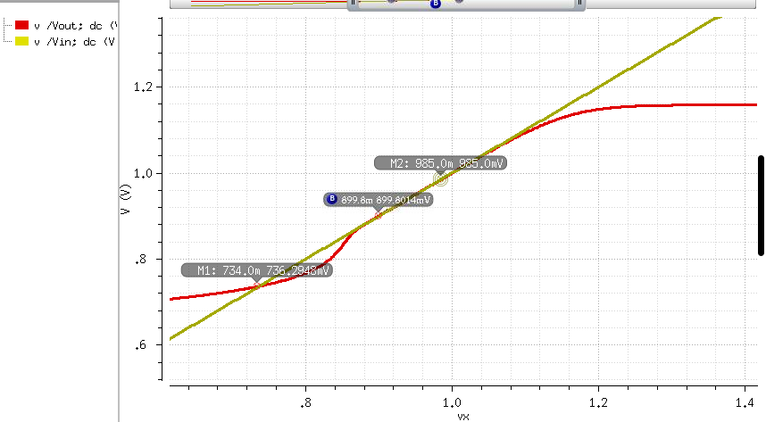
T=0

Slide 60
Outline
Introduction and Problem Statement
Existing Approaches
Proposed Method
  Loop Identification and break
  Replica method to avoid breaking NFL
  Computationally efficient verification
Summary

Slide 61
Computationally Efficient Verification
  Divide and contraction^{[1]}
  Loop Identification and break
Goal: Improve the computation efficiency in Homotopy methods
[1] Y. Li, D. Chen, " Efficient Analog Verification Against Trojan states Using Divide and Contraction Method ", IEEE International Symposium on Circuits and Systems (ISCAS), May 2014 (to appear).
61

Slide 62
  Divide and Contraction Homotopy
Contraction interval :
  An interval is a contraction interval (CI) of the Positive Feedback Loop (PFL) if and where f(x) is the homotopy return map of the PFL.
Theorem 1: There is at least one stable operating point in any CI of a homotopy return map
Example:
  If [0, V_{DD}] is CI
  f(0)>0
  f(V_{DD})<V_{DD}
  At least one stable operating point in [0, V_{DD}]

Slide 63
  User-defined-monotonic Divide and Contraction Algorithm (UMDC)
Initialize
Test Interval Queue (TIQ) and CI queue (CIQ) is defined by user
No Trojan state Report and exit
Y
N
Y
Search - Insert [a,c] and [c, b] into TIQ
N
Drop SDI in [a,c] and [c,b]
N
[a,c] is CI?
or
[c,b] is CI?
Y
Trojan state found Report and exit

Slide 64
EX: Banba Bandgap Reference
AMI 0.5um, Vdd=2V
Circuit Graph
x=V_{A}’
f(x)=V_{A}”
PFL
With Start-up circuit
Break at node V_{A}
VDD=2V | Temp(c) | User-define CI | Number of simulation | Error tolerance/ step size | Operating points
Linear sweep | 0 | NA | 20000 | 0.1mv | 3 OP: 0.1172, 0.2943 and 0.5727(desired)
UMDC algorithm | 0 | [0.5441, 0.6013] | 8 | 0.1mv | (0.0012,0.3134) are found beside User-defined CI
VDD=2V | Temp(c) | User-define CI | Number of simulation | Error tolerance/ step size | Operating points
Linear sweep | 0 | NA | 20000 | 0.1mv | 1 OP: 0.5727
UMDC algorithm | 0 | [0.5538, 0.6121] | 8 | 0.1mv | No Trojan state

Slide 65
2D Return map
2D Return map of NPFL
y
f2(x, y)
f1(x, y)
x
Operating point at where x= f1(x, y) and y= f2(x, y).
Here, f(f1(x, y), f2(x, y)) is defined as a two-dimensional return map of
this nested loop.

Slide 66
  2D Contraction Interval
2D Contraction Interval :
  An interval is a 2D contraction interval (2DCI) of the Nested Positive Feedback Loop (NPFL) if
  , ,
  and
  where f(x, y) =[ f1(x, y), f2(x, y)] is the two-dimensional return map of this NPFL.
Example:
  [0, V_{DD}]X[0, V_{DD} ] is 2DCI
Notes:
F2(x,b0)could be larger than b1, F2(x,b1)could be less than b0

Slide 67
  Theorem 1
Theorem 1: There is at least one stable operating point in a 2DCI
There is a curve L1 across [a0,a1] where f2(x, y)=y;
Similarly, there is a curve L2 across [b0, b1] where
f1(x, y)= x;
There is at least one cross point of L1 and L2, i.e.
f1(x, y) =x, f2(x, y)= y (stable operating point)
L2
L1

Slide 68
  2D marginal monotonicity
Marginal-monotonic increasing: along one axis
  f(x) is marginal-monotonic increasing in X dimension of , if
  f(x) is marginal-monotonic increasing in Y dimension of , if
  f(x) is marginal-monotonic increasing in 2 dimensions of
  , if . and
  where f(x,y) =[ f1(x,y), f2(x,y)] is the two-dimensional return map of this NPFL.

Slide 69
  Monotonic Divide and Contraction Algorithm
Initialize
2D Test Interval Queue (TIQ) and CI queue (CIQ)
Y
No Trojan state Report and exit
N
Search-Insert sub-intervals into TIQ
is any sub-interval a CI?
N
Drop SDIs
Y
Update CIQ
Trojan state found
Report and exit
N
Y

Slide 70
  Monotonic Divide and Contraction Algorithm (2DMDC)

Slide 71
  Monotonic Divide and Contraction Algorithm (2DMDC)

Slide 72
  Monotonic Divide and Contraction Algorithm (2DMDC)

Slide 73
  Monotonic Divide and Contraction Algorithm (2DMDC)

Slide 74
  Monotonic Divide and Contraction Algorithm (2DMDC)

Slide 75
  Monotonic Divide and Contraction Algorithm (2DMDC)

Slide 76
  Monotonic Divide and Contraction Algorithm (2DMDC)

Slide 77
Banba with Inv-Widlar

Slide 78
Simulation result
Error Tolerance | Have TS? | Result (VX1 , VX2) | DC times | DC Sweep time
1mV | Yes | [3.556,3.639] X [0.718,0.785] [3.581,3.682]X [1.001,1.104] | 5 | 52
1mV | No | [3.785,3.786]x[0.742,0.742] | 30 | 308

Slide 79
Comparison: Banba Bandgap Ref
 | State Space Approach | Contraction Homotopy
Dimensionality | effective dimensionality =3.3 at t=100ps | break-point = 1
Computation bound, tol=VDD/2^n 10-bit resolution
 | requires k*1024⁴ transient simulations | only needs 10 DC simulations
Reported example | 3-bit res, 1 step 8⁴ transient sim | 14-bit resolution: 8 DC sim
With false negative
Guaranteed Trojan free

Slide 80
Outline
Introduction and Problem Statement
Existing Approaches
Proposed Method
  Loop Identification and break
  Replica method to avoid breaking NFL
  Computationally efficient verification
Summary

