Slide 1
Measurement Basics

Slide 2
Accuracy and precision
Measurements are said to be accurate if their tendency is to center around the actual value of the entity being measured.
Measurements are precise if they differ from one another by a small amount.
What can you say about the causes relating to each type?

Slide 3
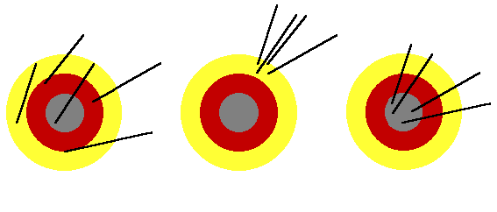
Example: Evaluate whether the following are precise, accurate or both.
Accurate
Not Precise
Not Accurate
Precise
Accurate
Precise

Slide 4
Measurement error
Measurement error is considered to be the difference between a value measured and the true value.

Slide 5
Other forms of accuracy
The maximum measurement error of a physical quantity in terms of the output of an instrument
The maximum of maximum error over the entire output range
The degree of conformance of a test instrument to absolute standards.
The ability to produce an average measured value which agrees with the true value or standard being used.

Slide 6
Precision
A measure of the reproducibility of the measurements.
Given a fixed value of a variable, precision is a measure of the degree to which successive measurements differ from one another.
The degree to which repeated measurements of a given quantity agree when obtained by the same method and under the same conditions.
Also called repeatability or reproducibility.
The ability to repeatedly measure the same product or service and obtain the same results.

Slide 7
Repeatability vs Accuracy
Accuracy - refers to the overall closeness of an averaged measurement to the true value.
Repeatability - the consistency with which that measurement can be made.
The word precision will be avoided.
Accuracy takes all error sources into account
Systematic Errors
Random Errors
Resolution (Quantization Errors)

Slide 8
Accuracy
Difference between the true value and the
observed average.
(True value may be known, may be defined by international standard, or may be obtained by using a more accurate measuring tool)
Accuracy or
mean bias
True value
Observed
average

Slide 9
Systematic Errors
Errors that appear consistently from measurement to measurement
Ideal Value = 100mV
Measurements : 101mV, 103mV, 102mV, 101mV, 102mV, 103mV, 103mV, 101mV, 102mV
Average Error : 2mV
Caused by DC offsets, gain errors, non-linearities in the DVM
Systematic errors can often be reduced through calibrations.

Slide 10
Random Errors
Notice that the list of numbers in the last slide vary from 101mV to 103mV.
All measurement tools have random errors even $2 Million Automated test instruments
Random Errors are perfectly normal in analog and mixed-signal measurements.
Big challenge is in determining whether the random error is caused by a bad DIB design, bad DUT design or by the tester itself.

Slide 11
Resolution (Quantization Errors)
Notice that in the previous list of numbers, the measurement was always rounded off to the nearest milivolt.
Limited resolution results from the fact that continuous analog signals must be converted to digital format (using ADC’s) before a computer can evaluate the test results.
The inherent error in ADCs and measurement instrumentation is called Quantization Error.
Quantization error is a result of the conversion from an infinitely variable input voltage to a finite set of possible outputs from the ADC.

Slide 12
Repeatability
Non-repeatable answers are a fact of life for mixed-signal test engineer
Could be caused by random noise or other external influences
If a test engineer gets the same value multiple times in a row, it should raise the question of ranging of the measurement tool.
Repeatability is desirable, but it does not in itself guarantee accuracy.

Slide 13
Repeatability
The random variation in measurements when one operator uses the same instrument to measure the same part several times.
Observed Average
True value
Repeatability

Slide 14
Stability
The degree to which a series of supposedly identical measurements remains constant over time, temperature, humidity, and all other time varying factors is referred to as stability.
Testers are equipped with temperature sensors to allow recalibration if a certain change in temperature occurs.
Caution must be exercised in the power-up of the tester, since temperature of tester electronics must stabilize before calibrations are accurate
Also, if the test cabinet or test head are opened, the temperature must stabilize before any calibrations can be performed.

Slide 15
Stability
The difference in the average, or in the sample distribution of at least 2 sets of measurements obtained with an instrument over time.
Stability
Time 1
Time 2

Slide 16
Correlation
The ability to get the same answer using different pieces of hardware or software.
Tester - to - Bench Correlation
Tester - to - Tester Correlation
Program - to - Program Correlation
DIB - to - DIB Correlation
Day - to - Day Correlation

Slide 17
Reproducibility
Reproducibility is often incorrectly used interchangeably with repeatability
Reproducibility is defined as the statistical deviations between a particular measurement taken by any operator on any group of testers on any given day using any DIB board.
Repeatability is used to describe the ability of a single tester and DIB board to get the same answer multiple times as the test program is repeatedly executed.
If a measurement is highly repeatable, but not reproducible, then the test program may consistently pass a particular DUT one day but then may consistently fail the same DUT on another day or on another tester.

Slide 18
Reproducibility
Variation in average of measurements made by different operators using the same guage measuring the same part.
True value
Operator C
Operator B
Operator A

Slide 19
Calibration and Checkers
Traceability to Standards
National Institute of Standards and Technology (NIST)
Thermally stabilized standardized instrument
periodically replaced by a freshly calibrated source
Hardware Calibration
Any mechanical process which brings a piece of equipment back into agreement with calibration standards
usually not a convenient process
Robotic manipulations can be used to automate the process, but it is still not optimal

Slide 20
Estimates and examples
Parameter estimates
Unbiased estimates
Minimum variance estimates
Maximum likelihood estimates

Slide 21
Parameter estimate
Let X be a random variable following a certain distribution
Let the distribution be parameterized by certain parameter(s) θ
Let X₁, X₂,…, X_{n} be a set of measurements (samples, observations, realizations, …) of X
A function of X₁, X₂,…, X_{n} intended as a guess of θ is called an estimate for θ

Slide 22
Example: measuring a voltage
n
e
True signal
V
X
Instrument
Noise carried by signal: n
Instrument noise: e
Instrument output: X
X is a random variable.
Repeated readings give: X₁, X₂, …, X_{n}

Slide 23
If n+e has zero mean, total variance σ², then X is a random variable with mean = V and variance σ².
And if n+e has approximate normal distribution, then

Slide 24
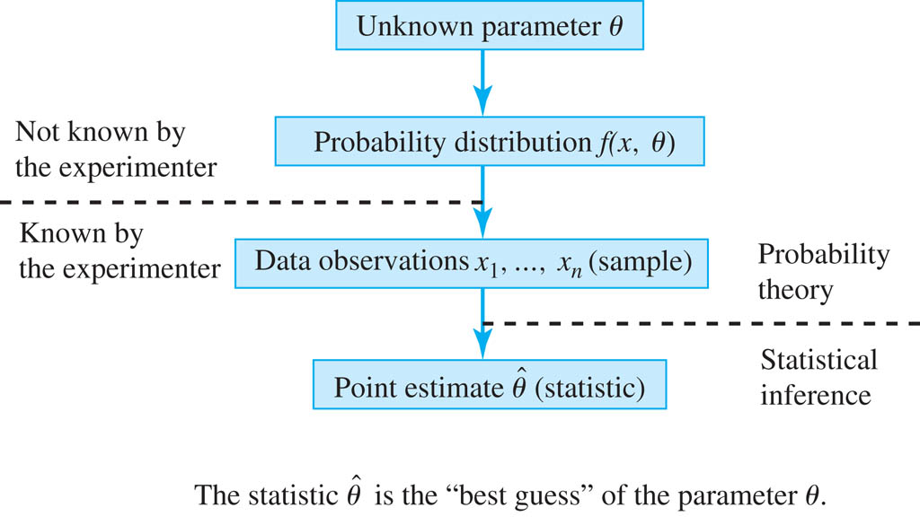
Typical steps for estimating a parameter

Slide 25
Unbiased Estimates
Definitions
- A point estimate for a parameter is said to be
unbiased if
- If a point estimate is not unbiased, then its bias is defined to be

Slide 26
The actual difference between and θ is not the bias. It is an estimation error.
If is not persistent, or if it has zero mean, then is unbiased.

Slide 27
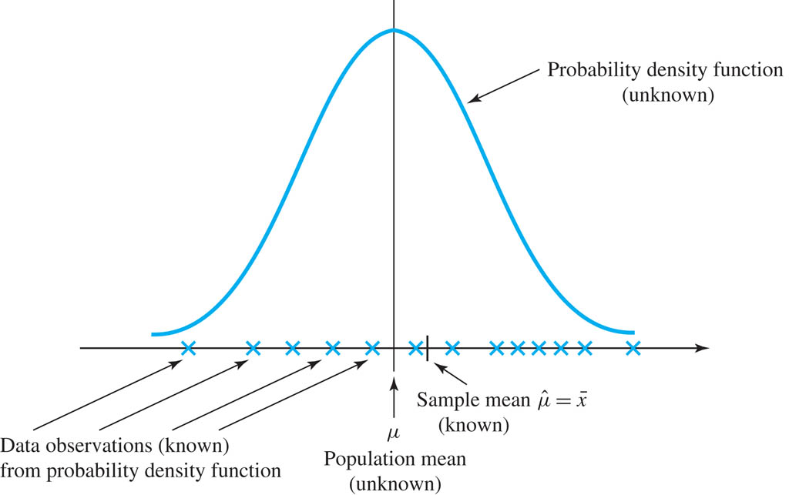
Sample means is used as an estimate for the distribution mean.
The difference is an estimation error.
It was shown that this estimate is unbiased

Slide 28
Theorem
Proof:

Slide 29
The variance of Sample Mean

Slide 30
Distribution of Sample Mean
Note that we did not make any assumptions on the original distribution of X.
But the CLT says that the sample mean follows normal distribution.

Slide 31
Theorem
Hence, sample variance has mean = dist variance.

Slide 32
Proof of Unbias
constant

Slide 33
Sample Variance
Distribution of Sample Variance
That is, S²/σ² has chi-square distribution with n-1 degree of freedom.

Slide 34
Standard error of the sample mean

Slide 36
Sample Variance

Slide 37
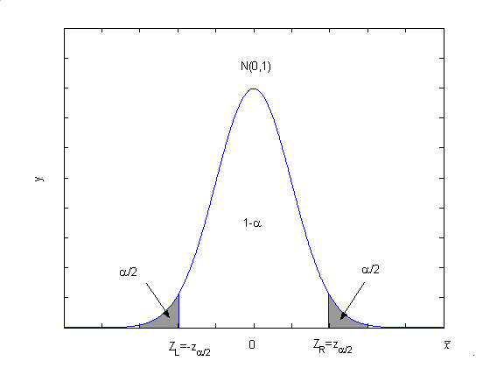
Confidence interval
With 1 - α confidence, μ is in such an interval.

Slide 38
Minimum Variance Estimate
Which is the better of two unbiased point estimates?

Slide 39
Minimum Variance Estimate

Slide 40
Minimum Variance Estimate
An unbiased estimate whose variance is smaller than any other unbiased estimate: minimum variance unbised estimate (MVUE)
Relative efficiency
Mean squared error (MSE)
How is it decomposed ?
Why is it useful ?

Slide 41
Is Minimum Variance always better?

Slide 42
The Method of Moments
For one parameter estimation

Slide 43
The Method of Moments
For two parameters estimation

Slide 44
Examples
-
-
What if the distribution is exponential with the parameter ?

Slide 45
Maximum Likelihood Estimates
Maximum Likelihood Estimate for One Parameter

Slide 46
Example
-
-
-

Slide 47
Maximum Likelihood Estimate for Two Parameters

Slide 48
Example

