Slide 1
Maximum Likelihood Estimation
MLE problem statement
MLE examples
Fisher information & CR bound
Gaussian case

Slide 2
Maximum Likelihood Estimation
Most statistical methods are designed to minimize error.
Choose the parameter values that minimizes predictive error:
Maximum likelihood estimation seeks the parameter values that are most likely to have produced the observed data.
Introduced by Ronald Fisher

Slide 3
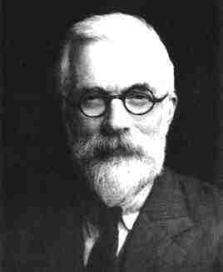
Ronald Aylmer Fisher (1890~1962)
Known for :
1912 : Maximum likelihood
1922 : F-test
1925 : Analysis of variance (Statistical Method for Research Workers )
Notable Prizes :
Royal Medal (1938)
Copley Medal (1955)
This is not how he looked like when he introduced MLE.
He looked like …
you!

Slide 4
Basic setup
θ : an unknown parameter
Θ : The set of all possible values of θ
X is a random variable with p.d.f. parameterized by θ
X₁ ,…, X_{n} : i.i.d. observations of X
Joint p.d.f. of the random variables X₁ ,…, X_{n}

Slide 5
Likelihood Function
Once the observations X₁ ,…, X_{n} have been made, they are fixed values.
For different values of θ, the probability of such observations would happen is different.
Likelihood Function of θ given the observations X₁ ,…, X_{n} is defined as:

Slide 6
Joint p.d.f. vs. Likelihood Function
Identical quantities
Different interpretation
Joint p.d.f. of X₁ ,…, X_{n} :
A function of χ₁,…,χ_{n} for given θ
Probability interpretation
Likelihood Function of θ :
A function of θ for given X₁ ,…, X_{n}
No probability interpretation

Slide 7
Example : Normal Distribution
Suppose X₁, …, X_{n} is a random sample from a normal distribution with p.d.f.:
a vector parameter:
Likelihood Function:

Slide 8
MLE Problem Statement
Given the parameter space Θ, and observations {X₁, …, X_{n}} = {x₁, x₂, …, x_{n}}
Determine by solving the optimization problem:

Slide 9
Example: Bernoulli distribution

Slide 10
MLE for Vector Parameters

Slide 11
Example

Slide 12
Asymptotically unbiased
An estimate is called asymptotically unbiased if it is unbiased when n → ∞.
The MLE estimate of σ² is asymptotically unbiased.

Slide 13
Example
Defective circuits on a wafer
- The method of moment

Slide 14
MLE:

Slide 15
MLE for uniform distribution
For some distribution, the MLE cannot be solved by taking derivatives.
If X is uniformly distributed on [0, θ], what is the MLE estimate of q when a set of samples x₁, x₂, …, x_{n} have been obtained?

Slide 16
Mean time to failure
n chips have been tested to have failure times t₁,…,t_{n}
hypothesis: failure time has an exponential p.d.f. with mean

Slide 17
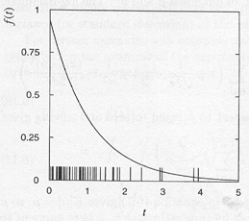
Mean time to failure
50 failure
times

Slide 18
Maximum likelihood
How about using as a parameter?
given
unbiased estimator for when n→∞

Slide 19
Delta Method for Approximating the Variance of an Estimator
To estimate a nonlinear function a(θ). Suppose that: and is a known function of θ
Delta Method:

Slide 21
Maximum likelihood
Variance of ML estimators
many experiments (same n): spread of ?
analytically (exponential)
Therefore we have:
But this # is unknown.
Can we use ?

Slide 22
Maximum likelihood
Variance: Monte Carlo method
For cases too difficult to solve analytically: MC method
simulate a large number of experiments
compute the ML estimate each time
distribution of the resulting values
S² unbiased estimator for the variance of a p.d.f.
S from MC experiments: statistical errors of the parameter estimated from real measurement

Slide 23
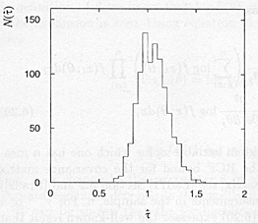
Maximum likelihood
1000 experiments
50 obs/experiment
sample standard
deviation
s = 0.151

Slide 24
Fisher Information:
Alternative expression
MLE is trying to take out all information.

Slide 27
for an i.i.d. sample:

Slide 28
for k-dimensional vector parameter

Slide 29
Cramér-Rao Lower Bound
A random sample X₁, X₂, …, X_{n} from p.d.f f(x|θ).
Let be any estimator of θ with where B(θ) is the bias of If B(θ) is differentiable in θ and if certain regularity conditions holds, then
(Cramér-Rao inequality)
The ratio of the lower bound to the variance of any estimator of θ is called the efficiency of the estimator, which is always <=1.
An estimator has efficiency = 1 is called the efficient estimator. In this case, the equality sign holds.

Slide 30
Maximum likelihood
If efficient estimators exist for a problem, the ML will find them.
ML estimators: always efficient in the large sample limit.
Ex: exponential (mean time to failure)
MLE is unbiased. ➔B=0.
equal to exact result
Therefore efficient estimator

Slide 31
Large Sample Inferences
To make Large sample inference on unknown parameter θ (Single Parameter), we need to estimate :
nI(θ) is estimated by:
This estimate does not require evaluation of the expected value.
An approximate large sample CI for 100(1-α)% confidence on θ is:

Slide 32
The regularity condition:
The necessary and sufficient condition for achieving the lower bound is that there exist I_{n} and g such that:
In this case, the minimum variance unbiased estimator is:

Slide 33
In the Gaussian case
Right form.
Wrong form!

Slide 34
Graphical method
single parameter θ
logL_{max}
later
68.3% central confidence
interval

Slide 37
To find a minimum variance estimate that is unbiased, we need to see if we can get:

Slide 38
Two issues here:
The coefficient has x_{n} in it.
In the parenthesis, we have tan(φ) not φ.
For the first issue, can we take the expectation to get rid of x_{n}?
For the second, can we just set the inside of the parenthesis to zero and solve for φ?
This would correspond to treating tan(φ) as the parameter.

Slide 39
HW
Show that the following is true iff Nf_{sig}T_{s} is integer.
Now redo what we did on the last few slides for the three parameter sine fitting problem:
where C, A, and φ are all unknown. Other conditions are as before, including coherency. Use C, Asinφ and Acosφ as parameters.

Slide 40
For multidimensional θ
Then the CRLB is given by:
In particular:

Slide 41
The inverse of the information matrix forms a lower bound.
Since:
The lower bound of estimate var. decreases with 1/n.
Standard error decreases with 1/sqrt(n).

Slide 43
Simplification: large data sample
Evaluating the second derivative with the measured data and the ML estimates
Use these for estimating the covariance matrix when the likelihood function is maximized numerically
Instead of running MC to generate covariance matrix.

Slide 44
ML example with two parameters
If a voltage sample x is taken from a unit ramp signal with uniformly time distribution.
x is supposed to be uniformly distributed on [-1, +1]. But the distribution is actually nonlinear, as parameterized below.
normalized -1≤ x ≤+1
realistic measurements only in x_{min} ≤ x ≤ x_{max}
Example: α = 0.5, β = 0.5, x_{min} = −0.95, x_{max} = 0.95,
generate n = 2000 events with Monte Carlo.

Slide 45
Cannot be solved easily by hand. Have to use numerical tools.

Slide 46
Instead of performing expectation, can use estimated values of α and β, together with observed values of xi, to estimate I₁₁, I₂₂, and I₁₂.
From I⁻¹, we get estimate of var(α), var(β), and covariance between α and β.

Slide 47
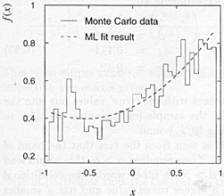
ML example with two parameters
True values:
2000 events
Estimated values:
var(α) = 0.052
var(β) = 0.108
cov(α, β) =0.0026
Note that α and β are correlated with ρ = 0.463

Slide 48
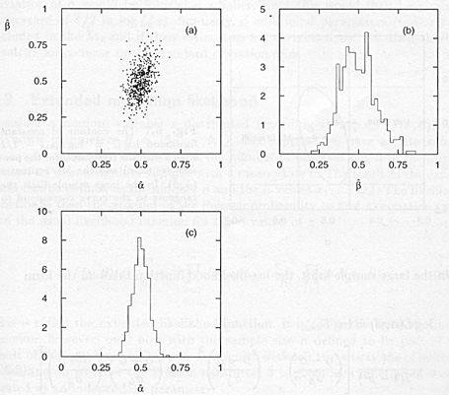
MC simulation to verify MLE
500 MC exper.
2000 evts/exp.
Both marginal
pdf’s are aprox.
gaussian
cov =0.0024
ρ = 0.43

Slide 49
The lnL contour

Slide 50
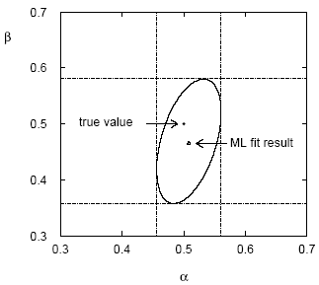
(Co)variances from ln L contour
The α, β plane for the first
MC data set
→ Tangent lines to contours give standard deviations.
→ Angle of ellipse φ related to correlation:
Correlations between estimators result in an increase
in their standard deviations (more statistical errors).

Slide 51
Linear models

Slide 52
Linear models

Slide 53
Linear models

Slide 54
Linear models

Slide 55
ADC spectral testing
v_{noise}(t)
v_{HD}(t)
Q(t)
V_{in}(t)
x(t)
ADC under test
V_{in}(t) is an ideal sine wave input
v_{noise}(t) represents ADC input referred noise
v_{HD}(t) represents ADC added harmonic distortion
Q(t) represents quantization noise
x(t) is the ADC output code at time t

Slide 58
HW
Assume w_{n} are iid N(0, σ²). Formulate the estimation of a_{i}’s and b_{i}’s as a multi-parameter MLE problem as on page 32. Write down H, find H^{T}H, (H^{T}H)⁻¹, estimates of a_{i}’s and b_{i}’s , and variance of a_{i}’s and b_{i}’s .
Show that in the complex number notation, the estimates coincide with the DFT formula.

