Slide 1
Linearity Testing of Precision
Analog-to-Digital Converters Using Stationary Nonlinear Inputs
Based on Le Jin’s 2003ITC paper
Two journal papers are linked at: https://class.ece.iastate.edu/djchen/ee509/2018

Slide 2
Purpose
Provide cost-effective high-accuracy SoC test solutions for AMS functionalities
Notes:
Our goal on this research initiative is to provide a cost-effective high-accuracy test solution for AMS functions. The most recent International Technology Roadmap for Semiconductors identified the “Development of SoC test methodology with needs including test reusability and analog/digital BIST” as one of four most daunting challenges. The 2002 update to the roadmap included in the Grand Challenges the mandate “To simplify both test interface requirements and the slow but ever increasing instrument capability trends, analog DFT and BIST techniques must be more fully developed.” Unfortunately, the roadmap provided little insight into how these challenges will be met. I will describe a new approach to analog and mixed-signal testing today that approaches the analog and mixed-signal testing problem in a way that deviates significantly from that of almost all other researchers. We believe this approach is applicable to production testing, to built-in self test, and to the testing of SoC scale circuits. We will demonstrate the effectiveness of this approach by using linearity testing of high precision analog to digital converters as test vehicle.

Slide 3
Purpose
Provide cost-effective high-accuracy SoC test solutions for AMS functionalities
  ITRS identified as one of the four “most daunting SoC challenges”

Slide 4
Purpose
Provide cost-effective high-accuracy SoC test solutions for AMS functionalities
  ITRS identified as one of the four “most daunting SoC challenges”
  Demonstrate effectiveness of a new proposed approach with high precision ADC linearity testing as a vehicle

Slide 5
Outline
AMS built-in self-testing (AMS BIST): an ultimate challenge for SoC
Bottleneck: high accuracy signal generation
SEIR algorithm: a cost-effective approach for high precision ADC testing
Simulation and experimental results
Conclusion
Notes:
This is the outline of my talk. I will first review existing approaches to analog and mixed-signal testing and identify the bottleneck most researchers are facing. I will then propose a new approach to analog and mixed signal testing and describe one method for following this approach based upon a Stimulus Error Identification and Removal Algorithm. We call this algorithm the SEIR algorithm. I will then discuss both simulation and experimental results using this approach to test high-resolution analog to digital converters.

Slide 6
Standard Approach to AMS
Production Testing
Precision testing instruments
Expensive testers
High testing costs for precision high-end functions
Difficult to do de-embeding in SoC testing
Notes:
This slide depicts the standard approach to production testing of analog and mixed-signal integrated circuits. A device under test is excited by precision instruments internal to a production tester. The tester monitors the output of the circuit and then makes a decision on whether to accept the part and qualify it for delivery to a customer or to condemn the part to scrap. Precision circuits are often used to monitor the output of the DUT as well. For high-end parts, the cost of making this test is high because of both the high costs of the tester and because of long test times that are often required. Most believe this approach will not provide a viable solution in many SoC scale circuits. High-end emerging parts are presenting challenges to ATE vendors to provide a test solution at any cost.
Most researchers focusing on built-in self-test are attempting to replicate the performance of this production testing approach on silicon. The challenges of achieving the performance of a multi-million tester on sacrificial silicon is most significant with little industrial adoption of existing BIST approaches in production environments. These factors are likely responsible for identifying analog and mixed-signal testing as a grand challenge in the international technology roadmap for semiconductors.

Slide 7
Efforts towards AMS Testing for SoC
S. Max, Fast accurate and complete ADC testing, ITC 1989.
T.M. Souders and G.N. Stenbakken, A comprehensive approach for modeling and testing analog and mixed-signal devices, ITC 1990.
M.F. Toner and G.W. Roberts, A BIST scheme for an SNR test of a sigma-delta ADC, ITC 1993.
P.D. Capofreddi and B.A. Wooley, The use of linear models for the efficient and accurate testing of A/D converters, ITC 1995.
T. Yamaguchi and M. Soma, Dynamic testing of ADCs using wavelet transforms, ITC 1997.
S. Cherubal and A. Chatterjee, Optimal INL/DNL testing of A/D converters using a linear model, ITC 2000.
M. Hafed, N. Abaskharoun, and G.W. Roberts, A stand-alone integrated test core for time and frequency domain measurements, ITC 2000.
S.Max, Ramp testing of ADC transition levels using finite resolution ramps, ITC 2001.
A. Roy, S. Sunter, A. Fudoli, and D. Appello, High accuracy stimulus generation for A/D converter BIST, ITC 2002.
……
Notes:
There has been a major research effort on analog and mixed-signal testing throughout the past decade and much of this work has been reported at ITC. Strong research groups from around the world have been making good contributions to what has become recognized as a very challenging problem. Here is a brief listing of some of these efforts. Most of this work follows the common theme of trying to implement the testing function with excitations and measurements that are much more accurate than those required of the DUT. Unfortunately, this typically makes the problem of generating the test capabilities more challenging than the problem of designing the DUT itself. This becomes particularly challenging when focusing on BIST solutions.

Slide 8

Conventional Philosophy for AMS Testing
DUT
Notes:
This slide depicts the approach most are following and identifies the major bottleneck the test community is facing. A very precise and costly excitation, the diamond in this slide, is generally thought essential to providing good data, the gold, from which a decision on the performance of the DUT can be made. The

Slide 9
Conventional Philosophy for AMS Testing
DUT
Major challenge in most existing approaches: the cost-effective generation of a precision excitation

Slide 10
Outline
AMS testing: an ultimate challenge for SoC
Bottleneck: high accuracy signal generation
SEIR algorithm: a cost-effective approach for high precision ADC testing
Simulation and experimental results
Conclusion

Slide 11
Bottleneck in Existing Approaches
Cost-effective generation of precision excitation (and/or precision measurement)
Notes:
Testing generally requires precision excitations and precision measurements. When either the input or the output is a digital signal, the testing problem often reduces to providing either a precision excitation or a precision measurement. Throughout the remainder of this presentation I will concentrate on the issue of excitations used for testing and, specifically, on excitations that can be used to test precision ADCs. Of course, there are three obvious ways for researchers to approach the excitation problem. One is to focus on enhanced cost-effective generation of precision excitations. A second is to look for ways to use excitations that have accuracy comparable to that of the DUT. The third is to work with very imprecise input signals, signals that have accuracy much less than that of the DUT. If success can be demonstrated with the third approach, the impact on both production test and on BIST could be most significant. In what follows, we will describe an approach to testing based upon using very imprecise input signals for testing.

Slide 12
Bottleneck in Existing Approaches
Cost-effective generation of precision excitation (and/or precision measurement)
Methods to overcome the bottleneck

Slide 13
Bottleneck in Existing Approaches
Cost-effective generation of precision excitation (and/or precision measurement)
Methods to overcome the bottleneck
  Breakthroughs in precision signal generation

Slide 14
Bottleneck in Existing Approaches
Cost-effective generation of precision excitation (and/or precision measurement)
Methods to overcome the bottleneck
  Breakthroughs in precision signal generation
  Test with performance-comparable instruments

Slide 15
Bottleneck in Existing Approaches
Cost-effective generation of precision excitation (and/or precision measurement)
Methods to overcome the bottleneck
  Breakthroughs in precision signal generation
  Test with performance-comparable instruments
  Test with imprecise instruments

Slide 16


Conventional Wisdom on Using Imprecise Excitations for Testing
DUT
“Garbage In, Garbage Out”
Notes:
This test engineer with the orange tie depicts what we are tying to do. Instead of using a very precise and very expensive excitation, we will try to use a very imprecise and correspondingly low cost excitation for the DUT. Of course, we must address the BIG question about what we will get at the output. When we started on this project, we were told by several experienced test engineers that what we are trying to do is impossible. We would like to express our thanks to the Semiconductor Research Corporation who funded this work for giving us the opportunity to try this approach.
Conventional wisdom suggests that the output of the DUT from an imprecise excitation will be corrupted by the highly nonideal performance of the excitation and thus there is little information in the output that is useful for testing. One might be tempted to use the slang term “Garbage in, Garbage Out” to characterize this approach to testing and, indeed, most involved with testing struggle to maintain adequate precision in their signal sources.

Slide 17
Can We Do This?
DUT

Slide 18
Can We Do This?
DUT
Inexpensive signals generally have
  High resolution
  Repeatability
  Low spatial frequency

Slide 19

Proposed Approach
DUT
Inexpensive, information rich
Notes:
In our approach, we will use a very imprecise input signal that can be cost-effectively generated in either a production test environment or on silicon. Actually, we will use two imprecise excitations that have a known functional relationship that is easy to generate. The outputs from these two related excitations will serve as inputs to a signal processing algorithm. The signal processing algorithm will first identify the nonidealities in the excitations and once this is identified, determine the performance of the DUT. There will thus be two outputs. One is the inconsequential information about the input signal which will be discarded and the other is the desired test results. We will assume that the characteristics of the imprecise excitation are not known to the test algorithm. We term this test approach the Stimulus Error Identification and Removal method, or SEIR for short. To make this approach practical, not only must a signal processing algorithm provide reliable test results, but it must do so in a computationally efficient way. We will address both issues in what follows.

Slide 20
Outline
AMS testing: an ultimate challenge for SoC
Bottleneck: high accuracy signal generation
SEIR algorithm: a cost-effective approach for high precision ADC testing
Simulation and experimental results
Conclusion

Slide 21
Histogram Testing for ADC Linearity
x(t)
C_{k}
Input to an ADC
Linear ramp: x(t) = ηt
Output from an ADC
Bin count C_{k}: # of hits for code “k”
ADC
t
k
Notes:
The conventional approach to ADC testing involves using precise stimulus signals to excite the ADC. Counts of the number of hits of each output code are tallied. From the resultant histogram data, characteristics such as the INL and DNL can be readily obtained. Two types of signals are often used for excitations. One is the sine wave and the other is the linear ramp. This work is based on ramp testing but the conclusions can be easily applied to sine wave testing with minimal modifications.

Slide 22
DC Characteristics of an ADC
Transition points: T_{k}, k =0, 1 … N-2
I/O characteristic
D(x) = k, if T_{k-1}< x ≤ T_{k}
Integral Non-Linearity
INL_{k} = (N – 2)(T_{k} – T₀)/(T_{N-2} – T₀) – k
INL = max_{k}{| INL_{k} |}
Differential Non-Linearity
DNL_{k} = (N – 2)(T_{k} – T_{k-1})/(T_{N-2} – T₀) – 1
DNL = max_{k}{| DNL_{k} |}

Slide 23
Linearity Metrics for ADC
D
Actual transfer curve
Fit-line transfer curve
k+2
k+1
INL_{k}
I_{LSB}
k
W_{k}
I_{k-1}
I_{k}
I_{k+1}
T_{k-1}
T_{k}
T_{k+1}
x
Notes:
This plot shows a segment of the transfer characteristics of an ADC where the horizontal axis is the input to the ADC and the vertical axis is the digital output code. . T_{k-1}, T_{k} and T_{k+1} are three successive transition points of the DUT corresponding to the digital output codes T_{k}, T_{k+1} and T_{k+2} respectively. . Corresponding to each transition point are the uniformly spaced points on an end-point fit line designated as I_{k-1}, I_{k} and I_{k+1}. The difference between the actual transition points and the fit-line points is the INLk as shown here. Mathematically, the INK_{k} is given by the expression shown here where the parameter I_{LSB} corresponds to 1 LSB and iobtained from the fit line. The INL is the maximum over k of the individual INLk’s.
Why is there a tilda under the Tk? Make the plot smaller and put the equation under the horizontal axis. I have put the equation in but it is in black and I don’t know how to change it to white.

Slide 24
Histogram Testing Using A Linear Ramp
Notes:
The INL_{k} are generally estimated from histogram data. As long as the number of samples per code is reasonably large, the estimate of the code density from the histogram data is quite good and is given by the expression shown here where C_{AVG} is the average number of occurrences of the intermediate codes, that is, the average number of occurrences of all codes except the first and last code.

Slide 25
What Happens When Ramp is Nonlinear?
Notes:
The question naturally arises about what happens to the INL_{k} estimate if nonlinearities in the input are present but not unaccounted for. Unfortunately, the expression that was previously used to estimate the INL_{k} from the code density information no longer provides a good estimate of the INL and even modest nonlinearities in the excitation will cause significant errors in the measurement.

Slide 26
Effects of Nonlinear Ramp
A realistic ramp signal
x(t) = ηt + F(t) + x_{os}
Normalization without affecting linearity testing
x(t) = (T_{N-2} – T₀)t + F(t) + T₀
F(0) = F(1) = 0
Transition time t_{k} and the estimation
T_{k} = x(t_{k}) = (T_{N-2} – T₀)t_{k} + F(t_{k}) + T₀
t_{k} =Σ^{k}C_{i} / Σ^{N-2}C_{i}, t₀ = 0, t_{N-2} = 1
Estimated INL_{k} with a nonlinear ramp
INL_{k}’ = (N – 2 )t_{k} – k = INL_{k} – F(t_{k})

Slide 27
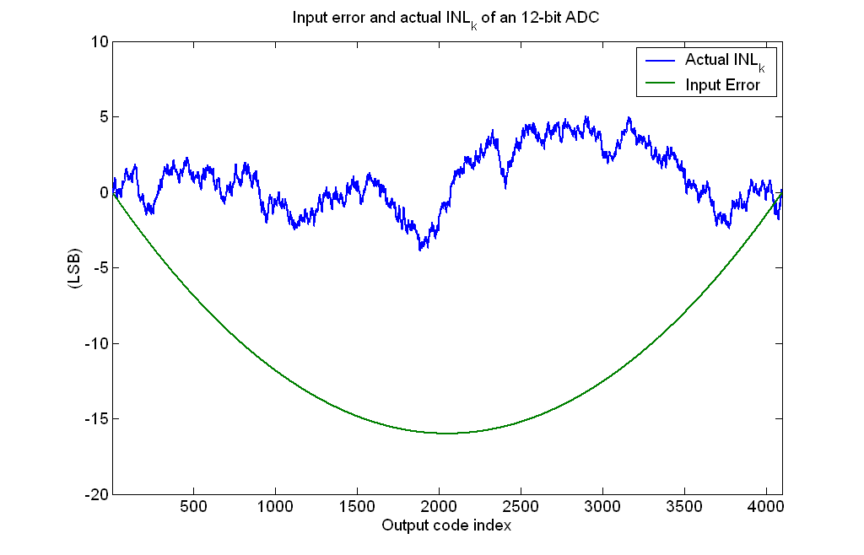
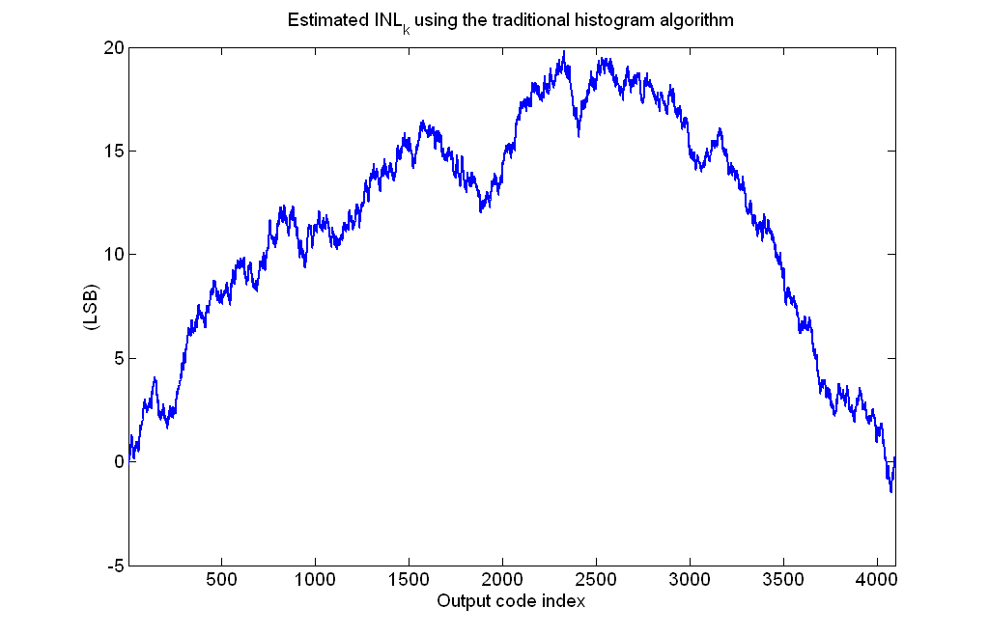
Input Nonlinearity and INL_{k} estimation
Actual INL_{k}
Ramp
Nonlinearity
Measured INL_{k}
12-b ADC, 8-b linear ramp
5 LSB INL tested as 20 LSB
Notes:
This simulation shows a 12-bit ADC with 5 LSB INL tested with a signal with a second-order 15 LSB non-linearity under the assumption that the nonlinearity in the excitation could be ignored. The standard histogram approach was used for estimating the INL of the DUT. The measured INL of the ADC is 20 LSB which is due to the combined nonlinearities of the DUT and those of the excitation. In this example, the nonlinearities in the input added to those of the DUT making it look much woorse than it actually was. Of course, the nonlinearities of the excitation could also mask those of the DUT thus making a bad part look better than it actually was.

Slide 28
ADC Testing Using Nonlinear Stimuli
x₁(t)
C_{k,1}
ADC
x₂(t)
C_{k,2}
SEIR
ADC INL measurement
Notes:
This slide depicts our approach. Two highly nonlinear input signals that are shifted by a fixed but unknown amount are applied to the ADC. Two separate histograms are generated and these two histograms serve as inputs to the SEIR algorithm. The SEIR algorithm is used tok estimate all transition points of the ADC. From these transition point measurements, the INL and DNL can be readily obtained.

Slide 29
Transition Point Estimation with Two Nonlinear Excitations
x
x₁(t)
α
x₂(t)
T_{k+1}
T_{k}
x₂(t) = x₁(t) – α
T_{k-1}
C_{k,2}
t_{k,2}
C_{k,1}
t
t_{k,1}
Notes:
Consider now the case of two nonlinear excitations separated by a fixed distance alpha. It can be seen that the transition point T_{k} is related to both the functions x1(t) and x2(t). Corresponding to the same transition are two code density counts coming from the two nonlinear excitations. Our strategy will be to develop the mathematical relationship between the code density counts and the transition points for the two excitations. Then, by equating the two functions, an estimate of the input nonlinearity will be obtained. Once the input nonlinearity is estimated, either the first or the second histogram data can be used to estimate the transition points. Once the transition points are estimated, the INL and DNL can be readily calculated.

Slide 30

Stimulus Error Identification and
Removal (SEIR) algorithm
Error
Removal
Accurate
ADC
Characterization
Stimulus
Identification
Notes:
It will now be assumed that the unknown excitation can be expanded in a series with the nonlinearities characterized by a set of M orthonormal basis functions Fj(t). Neither the choice of the basis function set nor the exact value needed for M is critical. The coefficients a1 through aM are the weights associated with the correspoinding basis functions. Since the nonlinearities of the excitation are not known, the values for the “a” coefficients are also unknown. It should be apparent, however, that if by some means the a coefficients can be obtained, then either the first or the second equation can be used to estimate the transition points of the DUT.

Slide 31

Some Details for SEIR Algorithm
Input nonlinearity parameterization
F(t) = Σa_{j}F_{j}(t), j from 1 to M
  Sinusoidal basis functions
  F_{j}(t) = sin(jπt)
  Polynomial basis functions
  F₁(t) = t(t – 1), F₂(t)= t(t – 1)(t – 0.5) …
Estimates of transition time

Slide 32
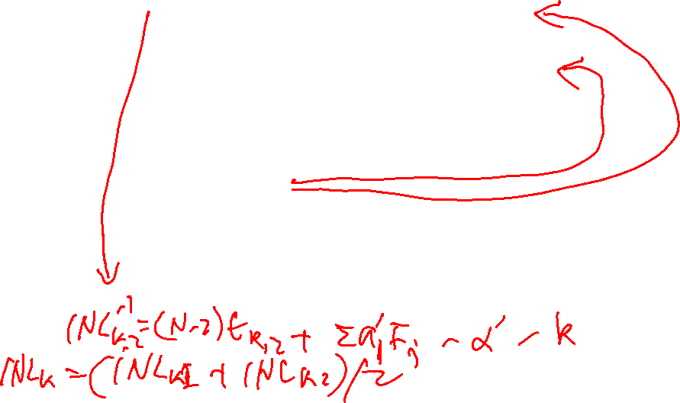
Some Details for SEIR Algorithm
Estimates of transition point
T_{k} = x₁(t_{k,1}) = (T_{N-2} – T₀)t_{k,1} + Σa_{j}F_{j}(t_{k,1}) + T₀
T_{k} = x₂(t_{k,2}) = (T_{N-2} – T₀)t_{k,2} + Σa_{j}F_{j}(t_{k,2}) + T₀ – α
Equating two estimates
(T_{N-2} – T₀)t_{k,1} + Σa_{j}F_{j}(t_{k,1} ) = (T_{N-2} – T₀)t_{k,2} + Σa_{j}F_{j}(t_{k,2} ) – α
Least Squares estimation using LSB as a unit
{a’_{j}, j=1, 2… M, α’}
= arg min{Σ[(N-2)(t_{k,1} – t_{k,2}) + Σa_{j}(F_{j}(t_{k,1}) – F_{j}(t_{k,2}))+α]²}
INL_{k} estimation
INL_{k} = (N – 2)t_{k,1} + Σa’_{j}F_{j}(t_{k,1} ) – k

Slide 33
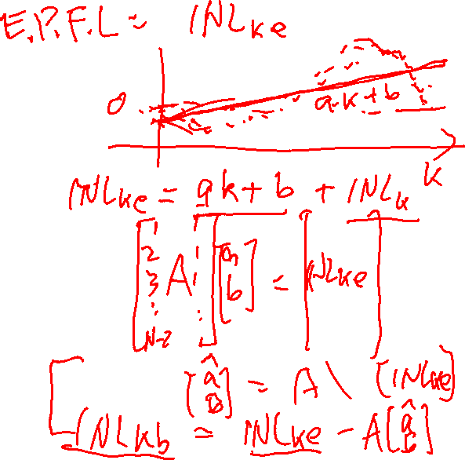
Changes in Physical Environment
Temperature
Lumen level
Humidity
Pressure
Causes
  HVAC
  Operation of nearby instrument
  Power supply fluctuation
  Human activity
  Lighting

Slide 34
Key Requirements of SEIR
Signal source has good repeatability
Offset remains constant

Slide 35
Key Requirements of SEIR
Signal source has good repeatability
Offset remains constant

Slide 36
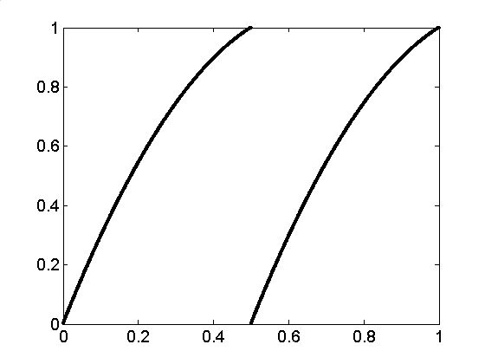
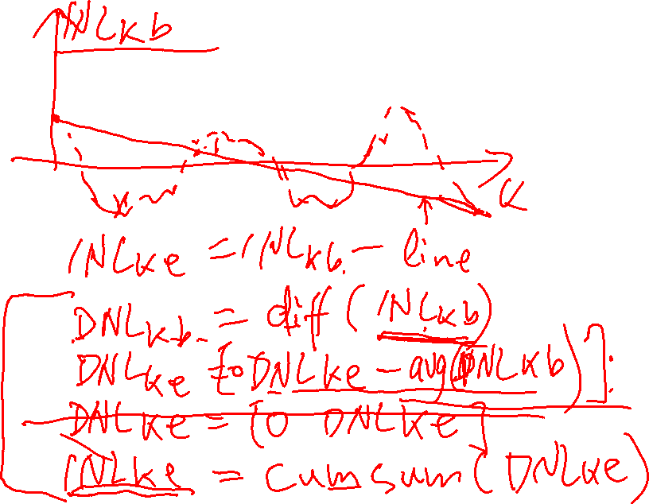
Signal Non-Stationarity
x₁
x’₁

Slide 37
Signal Non-Stationarity
x’₁(t)
x₁(t)
N₁(t) = x₁(t) – x’₁(t)
t

Slide 38
Key Requirements of SEIR
Signal source has good repeatability
Offset remains constant

Slide 39
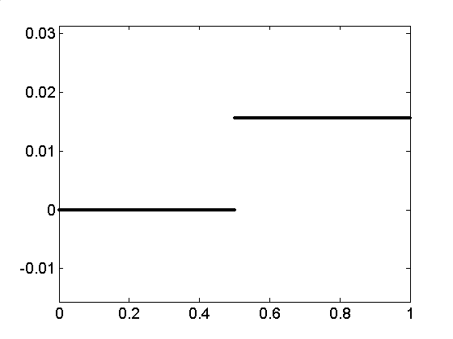
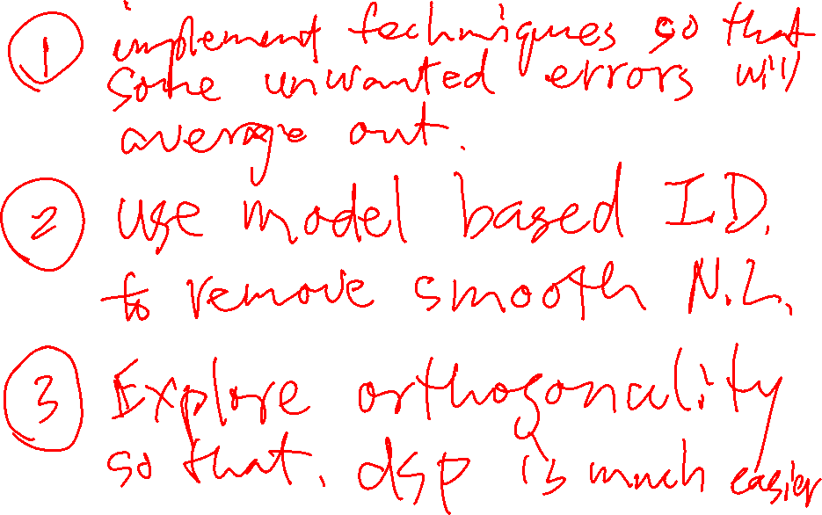
Non-Constant Offset
0
α’(t)

Slide 40
Non-Constant Offset
α’(t)
α
N₂(t) = α’(t) – α
t

Slide 41
Effects of Non-Stationarity
Total deviation in test signals
  N(t) = N₁(t) + N₂(t) = Σb_{l}t^{l}
Transition level estimation error
  T_{k} = T_{k} + F_{δ}(t_{k})
Eg: 50 ppm linear drift and 1% offset will cause 40 LSB error at 16-bit level

Slide 42
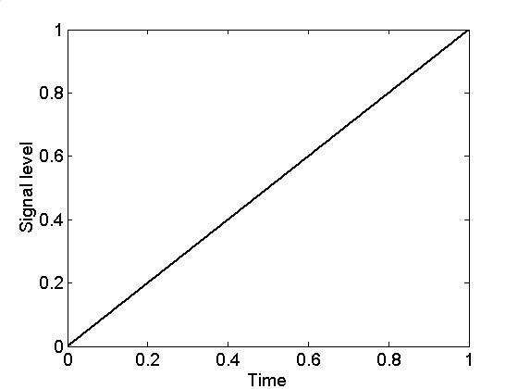
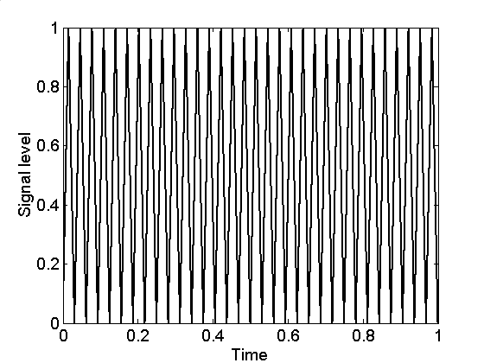
Two Useful Techniques
Common-centroid layout
Triangle signals in “ramp” test

Slide 43
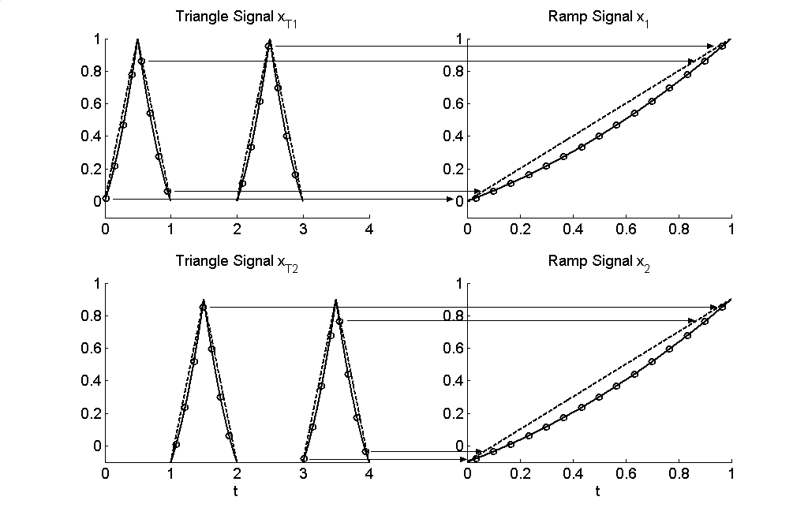
Interleaving of Test Signals

Slide 44
Center-Symmetric Interleaving (CSI)
0th
1st
2nd
3rd
4th
Time
“0”: no offset added
“1”: offset added

Slide 45
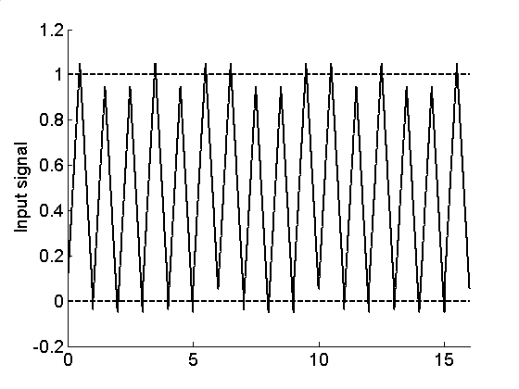
Test Signal with 3rd-Level CSI
0110100110010110

Slide 46
SEIR Test with CSI
Theorem:
Lth level CSI cancels all Lth and lower order non-stationarity effects in test environment
Corollary:
Residue error has (L+1)-th or higher order
Remark:
We observed that Lth level CSI reduces offset errors by about a factor of 2^{L}

Slide 47
Key Requirements of SEIR
Signal source has good repeatability
Offset remains constant

Slide 48
Outline
AMS testing: an ultimate challenge for SoC
Bottleneck: high accuracy signal generation
SEIR algorithm: a cost-effective approach for high precision ADC testing
Simulation and experimental results
Conclusion

Slide 49
Simulation Setup
ADC: flash structure with mismatch
R_{k} = R₀(1+δ_{k}), δ_{k} with 0.02 std
Stimulus: 7-bit linearity, 2nd and 3rd order error
Code density: 8 to 32 samples / bin
Additive noise: std deviation 0.1 to 1 LSB
Offset: 0.1 to 1 % ADC input range
All above unknown to the testing program
Notes:
Simulations are done to validate the performance of the proposed approach. Flash ADCs with resistor mismatch errors are used to introduce as many error sources as the number of transition levels. Input signals have a third order polynomial non-linearity. Realistic values are chosen for the sample density, the additive noise and the offset, respectively.

Slide 50
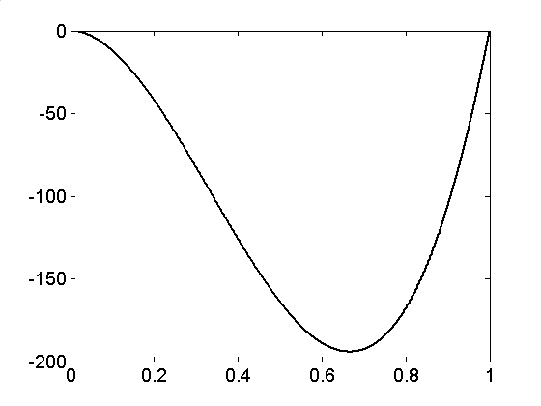
Input Nonlinearity
Stimulus is only
7 bit linear!
Notes:
The input signal is only 7 bit linear with about 100 LSB errors Its shape is unknown to the testing algorithm and blindly identified using the proposed basis function parameterization.

Slide 51
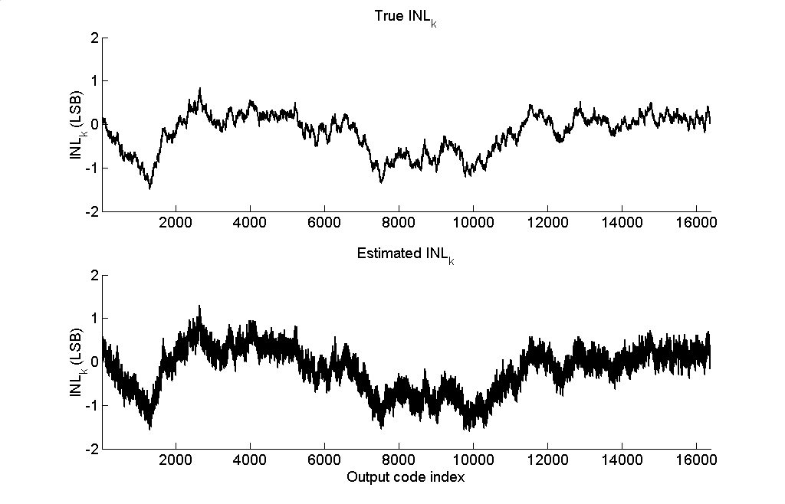
INL_{k} Estimation for a 14-b ADC
Notes:
With the identified 7 bit linear input signals, the ADC non-linearity can be characterized to a very high accuracy. From the plot we can observe that the estimated and actual INL-k are nearly identical.

Slide 52
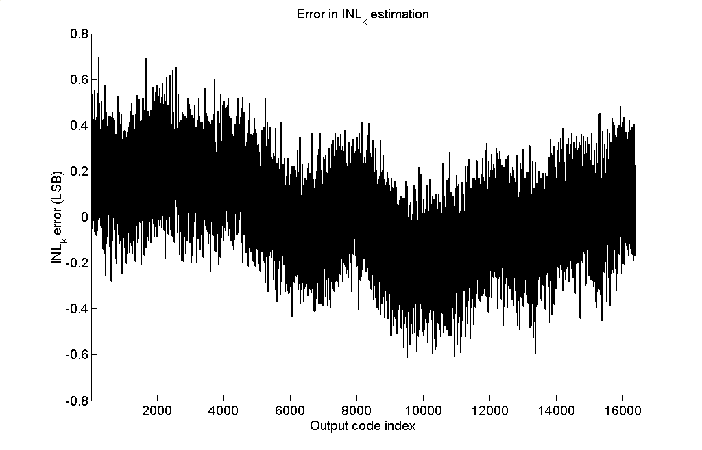
INL_{k} Estimation Error
Error < 0.8 LSB
Notes:
There difference between the estimated and actual INL-k is less than 0.6 LSB for a 14- bit ADC.

Slide 53
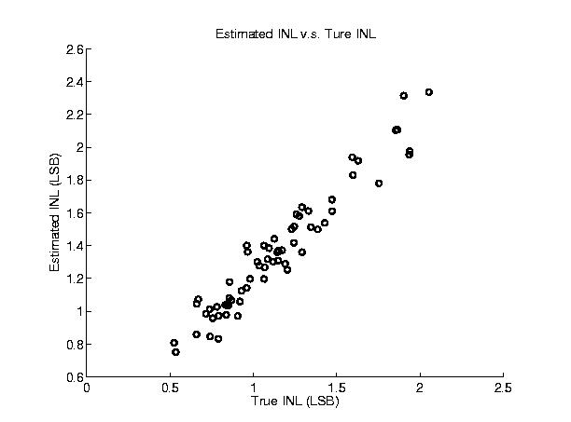
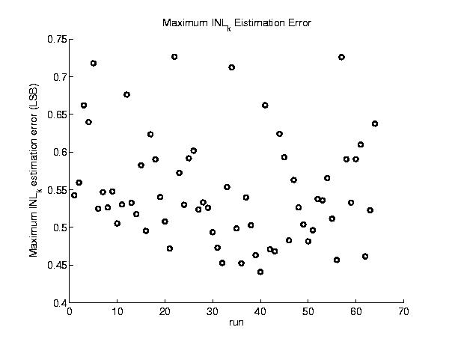
Results for 64 14-b ADCs
Estimated INL v.s. True INL
Max Error in INL_{k} Estimation

Slide 54
Performance Analysis

Slide 55
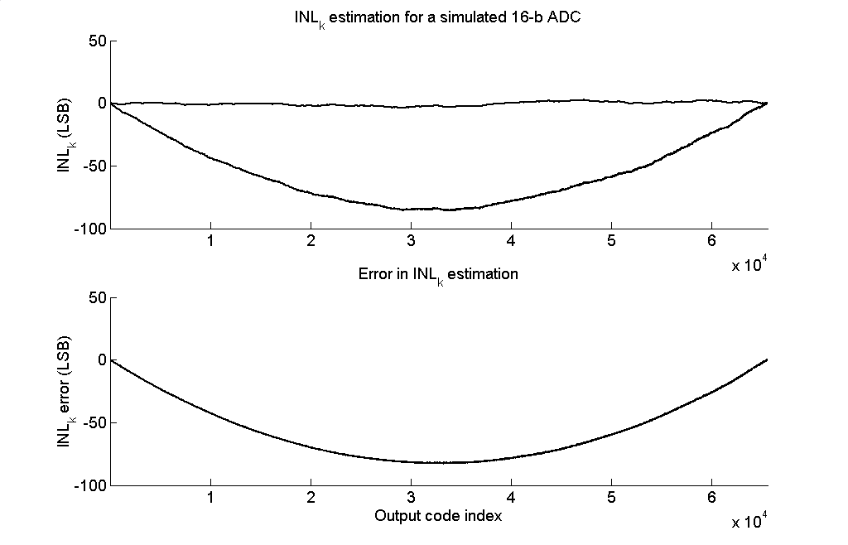
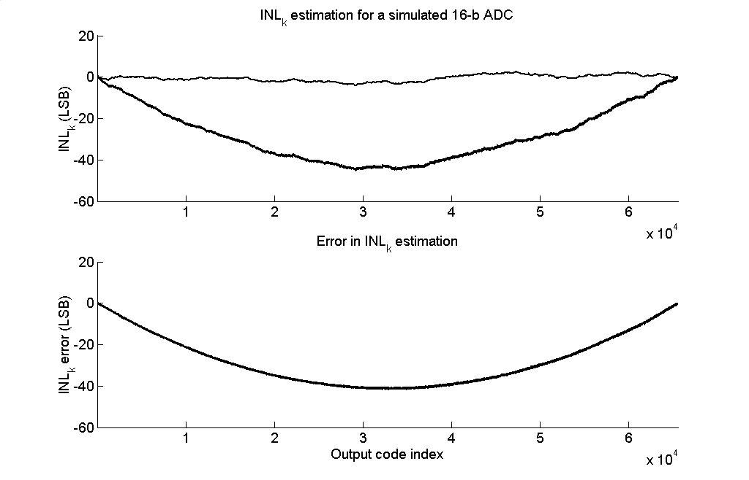
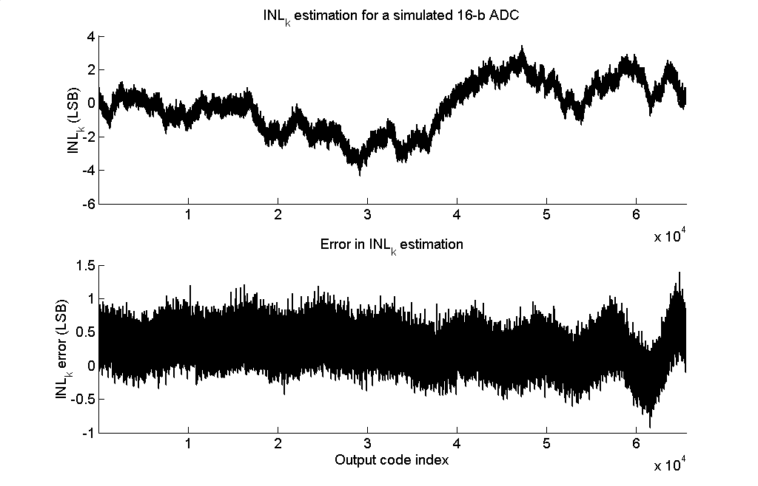
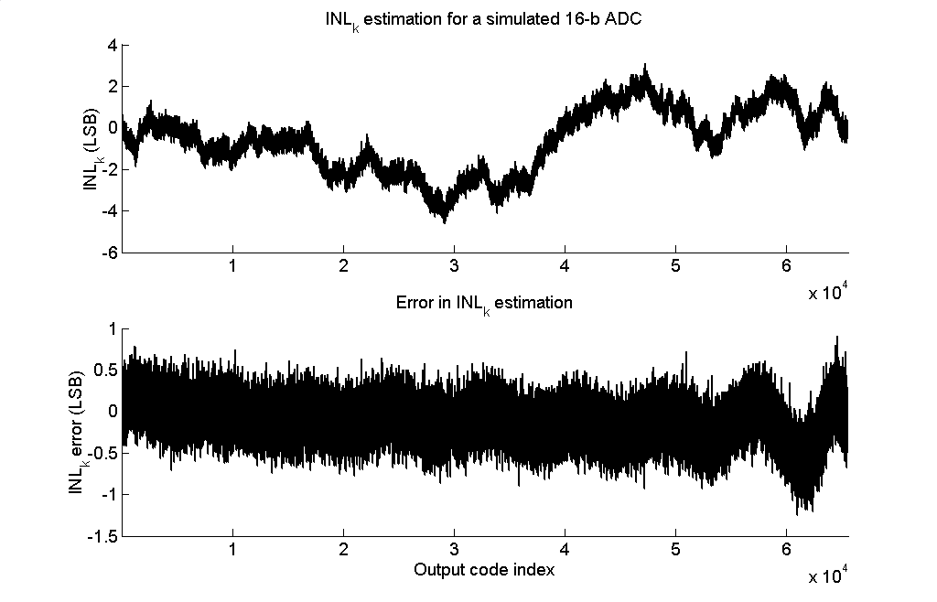
Reference Voltage with Linear Drift
0th level CSI
α = 0.5%, 100 ppm drift
α = 1%, 100 ppm drift
3rd level CSI
α = 0.5%, 100 ppm drive
α = 0.5%, 500 ppm drift

Slide 56
Experiment Setup
DUT: 16-bit high precision SAR ADC
Input: synthetically generated with 7-bit linearity
Test platform: Teradyne A580
Industrial production test environment
Double-blind collaboration
  Histogram data collected at Texas Instrument
  SEIR algorithm implemented at Iowa State University

Slide 57
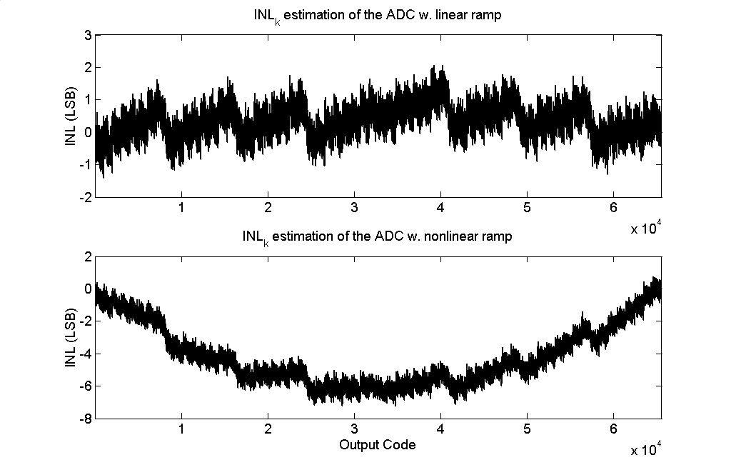
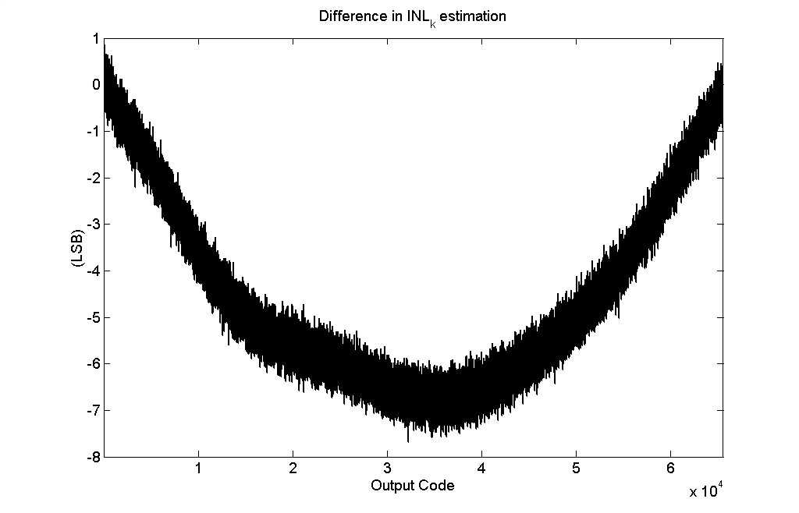
No Interleaving
α = 0.1%, 10 basis functions

Slide 58
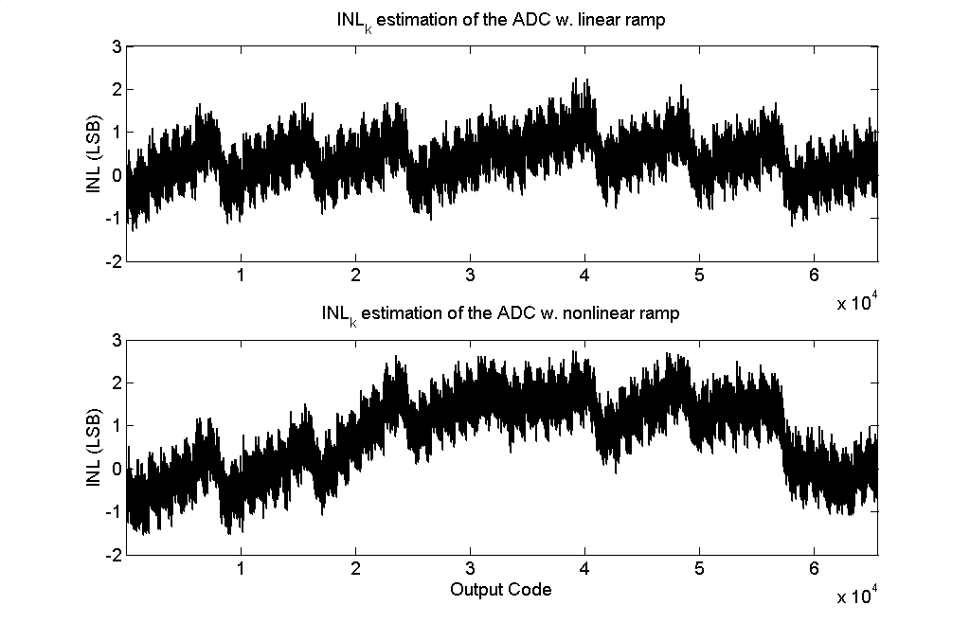
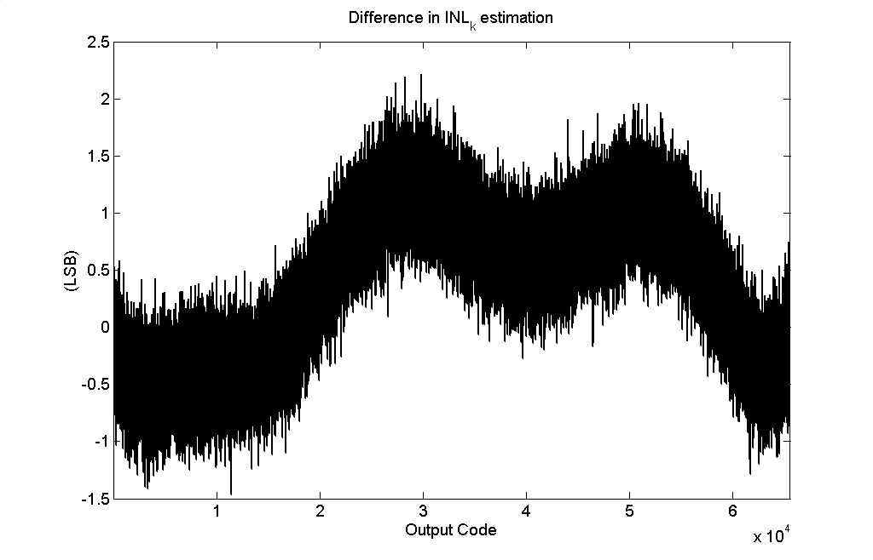
Evenly Interleaving
α = 0.1%, 10 basis functions

Slide 59
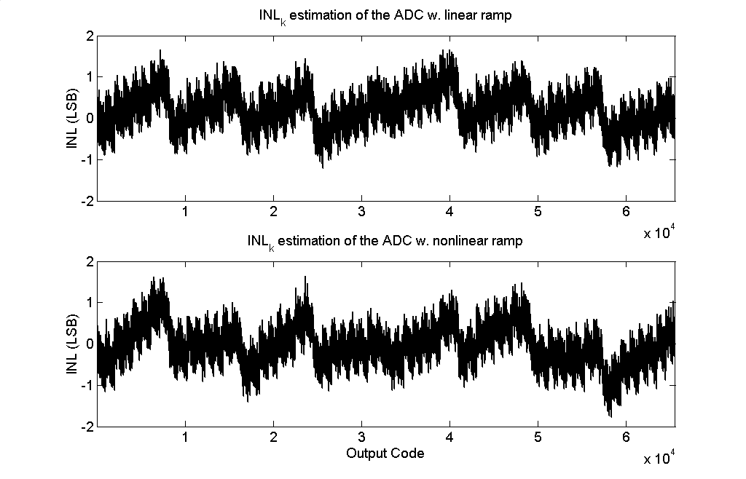
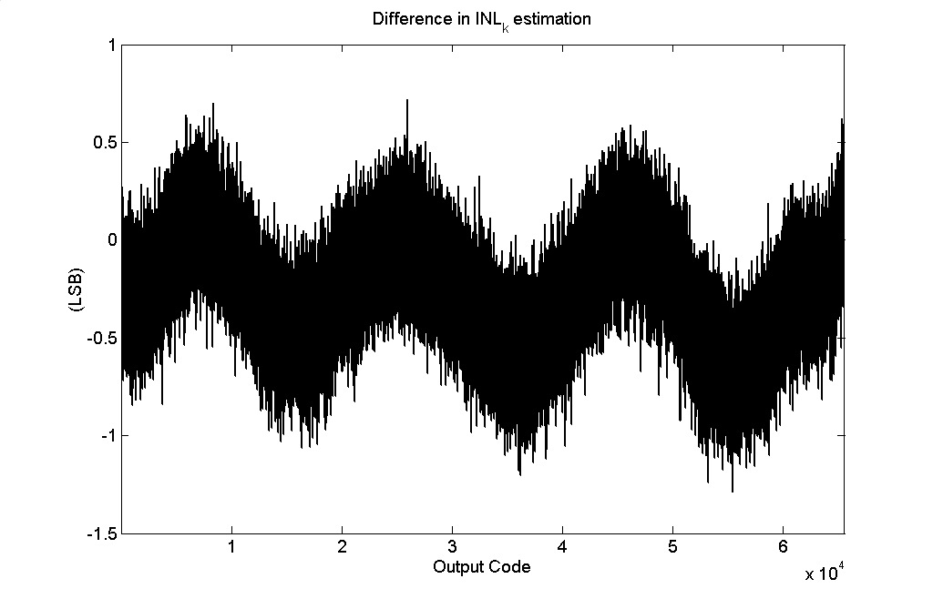
5th Level CSI
α = 0.05%, 10 basis functions

Slide 60
Summary of SEIR Algorithm with CSI
1-LSB accuracy at 16 bit resolution
7 bit linear signals
100 ppm environment drift in simulation
Validated in realistic industry environment

Slide 61
Conclusions
Introduced a cost-effective SEIR methodology for AMS
testing
  Inexpensive testing instruments
  Short test time
  High accuracy
  Applicable to high resolution and high speed ADCs
  Extendable to other AMS functions
  Promising for SoC implementation
  Achieved 16 bit performance using 7 bit linear signals in industry testing environment

