Slide 1
Sampled Channel Testing

Slide 2
What are Sampled Channels?
  Sampled channels are similar to analog channels in many ways
    Sampled channels operate on discrete waveforms rather than continuous ones
  Examples of sampled channels include
    digital-to-analog converters (DACs)
    analog-to-digital converters (ADCs)
    switched capacitor filters (SCFs)
    sample-and-hold (S/H) amplifiers
    comparators
    cascaded combinations of these and other circuits

Slide 3
Example of Sampled Channels
XMIT
RECV
Base station
XMIT
RECV
MIC
EAR
Voice-band interface (ADC, DAC, PGAs, filters)
Digital
signal
processor
(DSP)
Base-band/
RF
interface
RF section
(mixers, low-noise amp, power amp)
Display
Control
μ-processor
Frequency synthesizer
Keyboard
A digital cellular telephone contains at least six sampled channels
– three for the transmit channel and three for the receive channel.

Slide 4
PGA
XMIT channel
ADC audio samples
(to DSP)
Microphone
input
Low-pass
filter
ADC
Mic. volume
Voice Band XMIT (ADC) Channel
RF cosine
I-channel
XMIT IF samples
(from DSP)
Antenna
DAC
Low-pass
filter
Q-channel
XMIT IF samples
(from DSP)
DAC
Low-pass
filter
RF
upconverter
RF sine
XMIT I-Channel and Q-Channel

Slide 5
RF cosine
Antenna
I-channel
RECV IF samples
(to DSP)
Low-pass
filter
ADC
RF
Down converter
Low-pass
filter
ADC
Q-channel
RECV IF samples
(to DSP)
RF sine
RECV I-Channel and Q-Channel
RECV channel
DAC audio samples
(from DSP)
PGA
DAC
Low-pass
filter
Earpiece
output
Ear volume
Voice Band RECV (DAC) Channel

Slide 6
Other Example of Sampled Channels
Disk drive read/write channels
Digital audio record/playback devices
Digital telephone answering devices
Touch screen detection and display systems
Remote control devices for your TV etc

Slide 7
Types of Sampled Channels
  Sampled channels fall into four basic categories:
    digital in / analog out (DIAO),
      DAC and cascaded combinations of DACs and other circuits
    analog in / digital out (AIDO),
      ADCs and cascaded combinations of ADCs and other circuits
    digital in / digital out (DIDO),
      digital filter
    analog in / analog out (AIAO)
      switched capacitor filter

Slide 8
Analog loopback
multiplexer
Microphone
input
PGA
Low-pass
filter
ADC channel
audio samples
ADC
Mic. volume
Loopback mode
digital output
Analog Loopback Path
Loopback mode
digital input
PGA
Earpiece
Output
Low-pass
filter
DAC channel
audio samples
DAC
Ear volume
Loop-back test mode for an audio system

Slide 9
Sampling Considerations
  DUT Sampling Rate Constraints
      When making a coherent DSP-based analog channel test, we only need to make sure that the Fourier frequency of the AWG is related to the Fourier frequency of the digitizer by an integer ratio (usually a ratio of 1/1), and that the various Nyquist frequencies are above the maximum frequency of interest. Other than these constraints, we are fairly free to choose whatever sampling frequencies we want. Once we begin testing sampled channels, however, we are often saddled with very specific sampling rate constraints placed upon us by the DUT specifications.

Slide 10
Sampling Considerations
  DUT Sampling Rate Constraints
    Sampling rates must be coherent including both the DUT and the tester
      transmit channel,
      receive channel,
      digital pattern frame syncs,
      digital source data rate,
      digital capture data rate,
      AWG,
      digitizer

Slide 11
Sampling Considerations
  Digital Signal Source and Capture
    When testing mixed-signal devices, the tester must apply digital signal samples to the DUT’s inputs and collect digital signal samples from its outputs.
      The DUT usually requires these samples to be applied and captured at a particular sampling rate.
      A repeating digital pattern, called a sampling frame, is often also required by the DUT to control the timing of the digital signal samples.

Slide 12
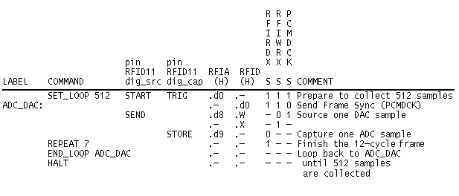
Mixed-signal digital pattern example

Slide 13
Sampling frame timing diagram
MCLK
FSYNC
16 master clocks
between frame syncs
DAC7-DAC0
DAC sample 1
DAC sample 2
ADC7-ADC0
ADC sample 1
ADC sample 2

Slide 15
Digital pattern with repeating frame loop
Combined
digital vectors
(DUT stimulus)
Source memory
waveform
samples
00000001
00000010
00000011
…
00000000 00 LABEL:LOOP1
WWWWWWWW 10 SEND
XXXXXXXX 01 JUMP LOOP1
…
00000000 00
00000001 10
XXXXXXXX 01
00000000 00
00000010 10
XXXXXXXX 01
00000000 00
00000011 10
XXXXXXXX 01
…

Slide 16
Digital vectors
(DUT stimulus and output samples)
Digital pattern with repeating frame loop
Capture memory
waveform
samples
00000000 00
00100100 10
11111111 01
00000000 00
10010010 10
11111111 01
00000000 00
11101001 10
11111111 01
…
00000000 00 LABEL:LOOP1
XXXXXXXX 10 STORE
11111111 01 JUMP LOOP1
…
00100100
10010010
11101001
…

Slide 17
MCLK
WRSYNC
SDATA
0 0
D7
D0
D13
D8
D13 D12 D11 D10 D9 D8 D7 D6 D5 D4 D3 D2 D1 D0

Slide 18
Sampling Considerations
  Simultaneous DAC and ADC Channel Testing
      When a DUT contains two or more channels that can be tested simultaneously, the test engineer will often test both channels at once to save test time
        For example, the absolute gain, distortion, and signal to noise of the DAC channel can be tested while the same tests are being performed on the ADC channel
      In addition to the digital source and capture memories the digital subsystem must also provide any necessary reset functions, initialization patterns, master clocks, frame syncs, etc.

Slide 19
  Simultaneous DAC and ADC Channel Testing
AWG
Waveform
source
memory
anti-
imaging
filter
DAC
DUT
ATE digital
DUT anti-
aliasing
filter
Waveform
capture
memory
DUT ADC
ATE digital
Waveform
source
memory
DUT anti-
imaging
filter
DUT DAC
Digitizer
Anti-
aliasing
filter
Waveform
capture
memory
ADC

Slide 20
Sampling Considerations
  Simultaneous DAC and ADC Channel Testing
      The AWG is one sampling system and the digitizer is another. The third sampling system is formed by the source memory and the DAC channel. The fourth sampling system consists of the ADC and the capture memory.
      Coherence requires that the DAC and source memory must have a Fourier frequency that is compatible with that of the ATE tester’s digitizer. Also, the ADC and capture memory must have a Fourier frequency that is compatible with the tester’s AWG
        NAWG Ff = ADC Ff
        Digitizer Ff = DAC Ff
        Ff = Fourier Freq. = Sampling Rate / # of Samples

Slide 21
Sampling Considerations
  Mismatched Fourier Frequencies
      ADC and AWG (or a DAC and digitizer) don’t really have to use the same Fourier frequency. They can be related by a ratio of M over N where M and N are integers. We simply have to take the difference in Fourier frequency into account when calculating spectral bin numbers
      Example:
        DAC Sampling Rate = 8 kHz
        Number of DAC samples = 512
        DAC Ff = 8 kHz / 512 = 15.625 Hz
        Digitizer Sampling Rate = 8 kHz * (3/2) = 12 kHz
        Number of Digitizer Samples = 512
        Digitizer Ff = 8 kHz * (3/2) / 512 = 15.625 Hz * (3/2) = 23.4375 Hz
        so:the DAC channel’s bin number is 3/2 times the digitizer’s bin number because of the 3/2 ratio in Fourier frequencies

Slide 22
HW
In the previous example, if coherent sampling is to be achieved, what constraints must be maintained on the input signal frequency? That is, it must be integer multiples of what?
What is the maximum number of distinct phases we can get in the sampled set?
If the minimum number of periods in a data record must be >= 5 and <= M/2 – 5, and if we don’t want to further reduce that max # phases, how many frequency choice do we have?
If we do a single tone test and want the first 20 harmonics to be in those frequencies, how does that change our frequency choices?
If we want to do 2 tone test, how will our frequency choices change?
From this example, what lessons do we learn regarding the DAC frequency, digitizer frequency, #samples for DAC, and #samples for digitizer?

Slide 23
Sampling Considerations
  Undersampling
      Undersampling is a technique that allows a digitizer or ADC to measure signals beyond the Nyquist frequency. A digitizer sampling at a frequency of Fs has a Nyquist frequency equal to Fs/2. Any input signal frequency, Ft, which is above the Nyquist frequency will appear as an aliased component somewhere between 0 Hz and the Nyquist frequency
      We may remove the filter if we want to allow our digitizer or DUT to collect samples from a signal that includes components above the Nyquist frequency. This technique is called undersampling

Slide 24
1/F_{s}
1/F_{s,eff}
1/f_{T}
N/F_{s} = M/f_{T}
N/F_{s,eff} = M_{alias}/f_{T}
Undersampled Waveform
Reconstructed Waveform
2
15
15
1
8
8
2
9
14
1
9
3
7
16
14
16
0
7
3
4
0
10
10
13
17
13
6
17
4
6
11
12
18
19
11
19
5
12
5
18
Undersampled Waveform
Reconstructed Waveform
(not to scale)

Slide 25
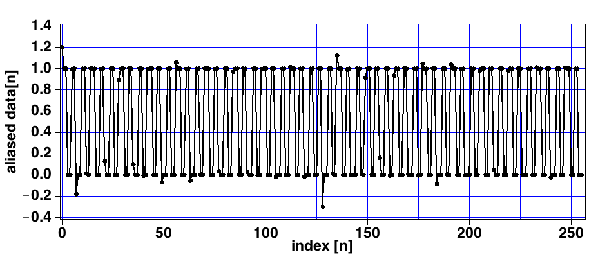
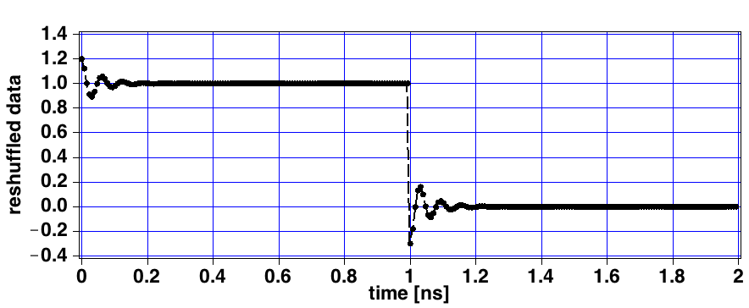

Slide 26
HW
Tao Zeng designed a 15-bit high speed current steering DAC that in simulation can operate up to 500 MSPS. But he noticed significant “glitches” at major transitions. There seem to have two major components of glitch transients, one is a normal-looking step response type settling with about 20% overshoot and a settling time constant about 10~12 times shorter than the 2ns clock period, and the other component is an “undershoot” of about 30% at the starting point but going in the opposite direction with an initial slope about 10~15 times faster than the correction direction ramping up slope.
To capture the transient, how fast the digitizer must work, what resolution the digitizer must have?
As a minimum, he would like to capture the glitches going from mid rail by +- ¼ Vref and back, and from ¼ Vref to ¾ Vref and back. What is the minimum #of clock periods he should reconstruct?
To achieve the resolution level he wants, the digitizer is quite a bit slower than the DAC. Suppose the best we can use is at 40MSPS. Devise a strategy for generating the DAC input codes and processing the ADC output to reconstruct the transient waveforms.

Slide 27
Sampling Considerations
  Reconstruction Effects in AWGs, DACs, and Other Sampled Circuits
      Discrete samples are converted into a stepped waveform using an AWG, DAC, switched capacitor filter, or other sampled-and-held process. The conversion from discrete samples (i.e. impulses) into sampled-and-held steps introduces images and sin(x)/x roll-off (pronounced sine-x-over-x)
      Imaging follows the same rules as aliasing in that it will create undesirable signals.
      Low pass filtering will eliminate images (anti-imaging filter)
|V_{DAC}|
0.998
0.032
0.030
0.016
0.015
f (kHz)
1
31
33
63
65
0
16
32
48
64

Slide 28
v_{SH}(t)
v(t)
v[nT_{s}]
t
0
T_{s}
2T_{s}
3T_{s}
4T_{s}
5T_{s}
6T_{s}
S/H
ADC
t
t
0
T_{s}
2T_{s}
3T_{s}
4T_{s}
5T_{s}
0
6T_{s}
Continuous-Time Signal
Clock
F_{S}=1/T_{S}
Discrete-Time
Signal
Clock
F_{S}=1/T_{S}
v_{SH}(t)
v[nT_{s}]
v_{R}(t)
t
T_{s}
2T_{s}
3T_{s}
4T_{s}
5T_{s}
DAC
6T_{s}
Reconstruction Filter
t
t
0
T_{s}
2T_{s}
3T_{s}
4T_{s}
5T_{s}
6T_{s}
0
Discrete-Time
Signal
Clock
F_{S}=1/T_{S}
Clock
F_{S}=1/T_{S}
Continuous-Time Signal

Slide 29
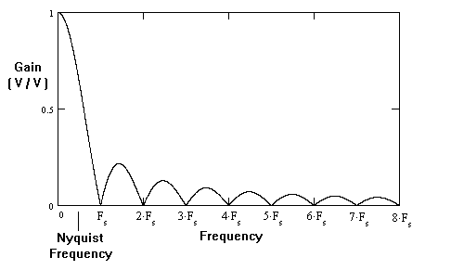
Sampling Considerations
  Reconstruction Effects in AWGs, DACs, and Other Sampled Circuits
      When a discrete signal is converted into a stepped waveform, this is equivalent to convolving the impulses by a square pulse with a width equal to one over the sample rate. This time domain convolution corresponds to a multiplication in the frequency domain by a sin(x)/x function with its first null at Fs.

Slide 30
Encoding and Decoding
  Data Formats
      Encoding formats for ADCs and DACs
        unsigned binary,
        sign/magnitude,
        two’s complement,
        one’s complement,
        mu-law, and
        a-law.
        One common omission in device spec sheets is DAC or ADC data format. The test engineer should always make sure the data format has been clearly defined in the spec sheet before writing test code.

Slide 31
Encoding and Decoding
  Intrinsic Error
      Whenever a sample set is encoded and then decoded, quantization errors are added to the signal
      In low resolution converters, or in signals that are very small relative to the full scale range of the converter, the quantization errors can make a sine wave appear to be larger or smaller than it would otherwise be in a higher resolution system.
      This signal level error is called intrinsic error
      Intrinsic error can be removed from an encoding process by calculating the gain error of a perfect ADC/DAC process as it encodes and decodes the signal under test
      Unfortunately, intrinsic error is dependent on the exact signal characteristics, including signal level, frequency, offset, phase shift, and number of samples

Slide 32
Encoding and Decoding
  Intrinsic Error
      ADCs are a problem, since we have to determine the signal amplitude, offset and the phase of the signal relative to the sampling points before we can calculate the intrinsic error of an ideal converter at that signal level and phase. Since signal level can’t be accurately determined without knowing the intrinsic error, this gives rise to a circular calculation.
      Intrinsic error is the result of consistent quantization errors. In general, intrinsic error is less of a problem with higher resolution converters and/or larger sample sizes

Slide 33
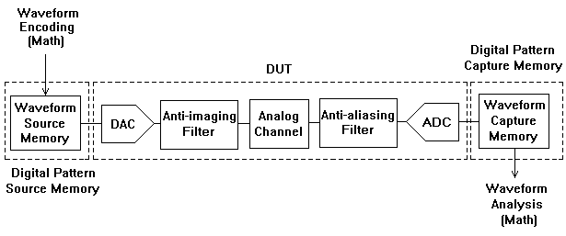
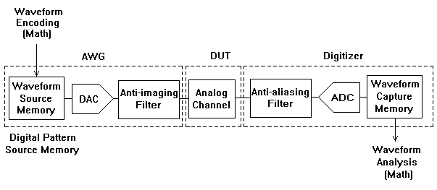
Sampled Channel Tests
  Similarity to Analog Channel tests

Slide 34
Sampled Channel Tests
  Similarity to Analog Channel tests
      We could also show how DAC channels, ADC channels, switched capacitor filters, and any other sampled channel can be reduced to a similar measurement system.
      The only difference is that the location of DACs, ADCs, filters, and other signal conditioning circuits may move from the ATE tester to the DUT or vice versa.
      Unfortunately, this means that we have to apply more rigorous testing to sampled channels, since all the effects of sampling (aliasing, imaging, quantization errors, etc.) vary from one DUT to the next.
      These sampling effects are often a major failure mode for sampled channels

Slide 35
Sampled Channel Tests
  Absolute Level, Absolute Gain, Gain Error, and Gain Tracking
      The process for measuring absolute level in DACs and other analog output sampled channels is identical to that for analog channels.
      The only difference is the possible compensation for intrinsic DAC errors as mentioned in the previous section. Otherwise, absolute voltage level measurements are performed the same way as any other AC output measurement.
      ADC absolute level is equally easy to measure.
      The difference is that we measure RMS LSBs (or RMS quanta, RMS bits, RMS codes, or whatever terminology is preferred) rather than RMS volts

Slide 36
Sampled Channel Tests
  Absolute Level, Absolute Gain, Gain Error, and Gain Tracking
      In sampled channels, such as switched capacitor filters and sample-and-hold amplifiers, gain is measured using the same voltage-in / voltage-out process as in analog channels.
      Mixed-signal channels are complicated by the fact that the input and output quantities are dissimilar. Gain in mixed-signal channels is defined not in volts per volt, but in bits per volt, where the term “bit” refers to the LSB step size.
      Converter gain can’t be specified in decibels, because it is a ratio of dissimilar quantities (bits/volt)
      Converter gain error, however, can be expressed in decibels. Gain error is equal to the actual gain, in bits per volt, divided by the ideal gain, in bits per volt

Slide 37
Sampled Channel Tests
  Frequency Response
      Frequency response measurements of sampled channels differ from analog channel measurements mainly because of imaging and aliasing considerations.
      Sampled channels often include an anti-imaging filter, the quality of this filter determines how much image energy is allowed to pass to the output of the channel.
      Frequency response tests in channels containing DACs, switched capacitor filters, and S/H amplifiers should be tested for out-of-band images that appear past the Nyquist frequency.

Slide 38
Sampled Channel Tests
  Frequency Response
      Notice that the digitizer used to measure these frequencies must sample at a high enough frequency to allow measurements past the Nyquist rate of the sampled channel.
      Also notice that each sampling process in a sampled channel has its own Nyquist frequency.
        An 8 kHz DAC followed by a 16 kHz switched capacitor filter has two Nyquist frequencies, one at 4 kHz and the other at 8 kHz.
        The images from the DAC must first be calculated.
        These images may themselves be imaged by the 16 kHz switched capacitor filter.
        Each of the primary test tones and the potential images should be measured

Slide 39
Sampled Channel Tests
  Phase Response
      This is one of the more difficult parameters to measure in a mixed-signal channel (AIDO or DIAO).
      The problem with this measurement is that it is difficult to determine the exact phase relationship between analog signals and digital signals in most mixed-signal testers.
      The phase relationships are often not guaranteed to any acceptable level of accuracy.
      Also, the phase shifts through the analog reconstruction and anti-imaging filters of the AWGs and digitizers are not guaranteed by most ATE vendors
      Fortunately, phase response of mixed-signal channels is not a common specification.

Slide 40
Sampled Channel Tests
  Group Delay and Group Delay Distortion
      These tests are much easier to measure than absolute phase shift, since they are based on a change-in-phase over change-in-frequency calculation.
      We can measure the phase shifts in a mixed-signal channel in the same way we measured them in the analog channel.
      The only difference between analog channel group delay measurements and mixed-signal channel measurements is a slight difference in the focused calibration process for this measurement

Slide 41
Sampled Channel Tests
  Signal to Harmonic Distortion, Intermodulation Distortion
      These tests are also nearly identical to the analog channel tests, except for the obvious requirement to work with digital waveforms rather than voltage waveforms. Sin(x)/x attenuation is usually considered part of the measurement in distortion tests.
      In other words, if our third harmonic is down by an extra 2 dB because of sin(x)/x rolloff, then we consider the extra 2 dB to be part of the performance of the channel.

Slide 42
Sampled Channel Tests
  Crosstalk
      Crosstalk measurements in sampled systems are virtually identical to those in analog channels.
      The difference is that we have to worry about the exact definition of signal levels.
      If we have two identical DAC channels or two ADC channels, then we can say the crosstalk from one to the other is defined as the ratio of the output of the inactive channel divided by the output of the active channel. But what if the channels are dissimilar?
      If we have one DAC channel that has a differential output and it generates crosstalk into an ADC channel with a single ended input, then what is the definition of crosstalk?
      The point is that the test engineer has to make sure the spec sheet clearly spells out the definition of crosstalk when dissimilar channels are involved.

Slide 43
Sampled Channel Tests
  CMRR
      DACs do not have differential inputs, so there is no such thing as DAC CMRR.
      ADC channels with differential inputs, on the other hand, often have CMRR specifications.
      ADC CMRR is tested the same way as analog channel CMRR, except that the outputs are measured in RMS LSBs and gains are measured in bits per volt.
      Otherwise the calculations are identical

Slide 44
Sampled Channel Tests
  PSR and PSRR
      Unlike analog channels, DAC and ADC channels do not have both PSR and PSRR specifications.
      A DAC has no analog input, and therefore no V/V gain.
      For this reason, it has PSR, but no PSRR. For similar reasons, ADCs have PSRR but no PSR.
      ADC PSRR is typically measured with the input grounded or otherwise set to a midscale DC level.
      However, like crosstalk, the ripple from a power supply may not be large enough to appear at the output of a grounded, low resolution ADC.
      It is important to realize that DACs may be more sensitive to supply ripple near one end of their scale, usually the most positive setting. PSR specs apply to worst-case conditions, which means the DAC should be set to the DC level that produces the worst results

Slide 45
Sampled Channel Tests
  Signal to Noise Ratio (SNR) and ENOB
      Signal to noise ratio in sampled channels is again tested in a manner almost identical to that in analog channels. The output of the converter is captured using a digitizer or capture memory. The resulting waveform is analyzed using an FFT and the signal to noise ratio is calculated as in an analog channel.
      The apparent resolution of a converter based on its signal to noise ratio is specified by a calculation called the equivalent (or effective) number of bits (ENOB). The ENOB is related to the SNR by the equation:
        ENOB = (SNR(dB) - 1.761 dB) / 6.02 dB

Slide 46
Sampled Channel Tests
  Idle Channel Noise (ICN)
      Idle channel noise in DAC channels is measured the same way as in analog channels, except the DAC is set to midscale, positive full scale, or negative full scale, whichever produces the worst results
      Like analog channel ICN, DAC channel ICN is usually measured in RMS volts over a specified bandwidth
      Correlation can be a nightmare in ADC ICN tests. Extreme care must be taken to provide the exact DC input voltage specified in the data sheet during an ICN measurement due to sensitivity to the DC offset.

Slide 47
Summary
      DSP-based measurements of sampled channels are very similar to the equivalent tests in analog channels. The most striking differences relate to bit/volt gains and scaling factors, quantization effects, aliasing, and imaging. We also have to deal with a new set of sampling constraints, since the DUT is now part of the sampling system. Coherent testing requires that we interweave the DUT’s various sampling rates with the sampling rates of the ATE tester instruments. Often this represents one of the biggest challenges in setting up an efficient test program
      Another difference between analog channel tests and sampled channel tests is in the focused calibration process, which we have only mentioned briefly

