Slide 1

Fast and accurate linearity test for DACs with various architectures using segmented models
Shravan K. Chaganti*, Abalhassan Sheikh†, Sumit Dubey†, Frank Ankapong†, Nitin Agarwal†, and Degang Chen*
*Iowa State University, Ames, USA
†Texas Instruments Inc.
2018 International Test Conference
10/31/18
Notes:
The slide guide is available in the following file:
LDSlidesV21.1.ppt Slide guide for light detail on a dark background.
Note: We have saved this presentation in the older 2003 format, because PowerPoint 2003, 2007 through 2016 can read it.
For this year’s test conference we will use PowerPoint (Office) 2016 in our projection computers.

Slide 2
Purpose
Cost of build for analog and mixed signal products
  Production test of parametric specifications
Data Converters (ADCs and DACs)
  Critical components of ICs used in control and sensing applications
  Production test time often dominates SoC test time
Focus on optimizing static linearity test time for DACs
  Architecture-aware test methods combined with best-in-class fast linearity test concepts

Slide 3
Outline
Conventional linearity testing of DACs
Motivation for segmented testing
uSMILE for DACs
Extrapolated Reconstruction (ER) for DACs
Modifications for Interpolated DACs
Test results
Notes:
The Outline slide is an outline for the major areas of your presentation -- what you’re going to talk about. You should not include the title, introduction or conclusion in your outline. Just highlight the major areas of your talk.
The outline slide you are seeing is an outline for our ITC presentation guide.

Slide 4
Outline
Conventional linearity testing of DACs
Motivation for segmented testing
uSMILE for DACs
Extrapolated Reconstruction (ER) for DACs
Modifications for Interpolated DACs
Test results

Slide 5
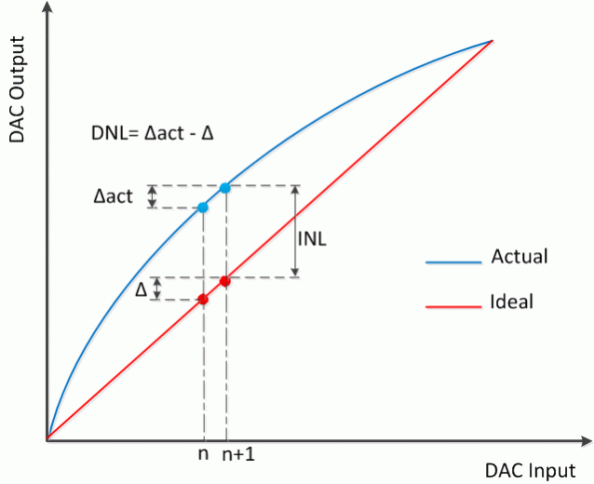
Conventional linearity testing of DACs
Sweep 0 to max code, measure the output voltages using a digitizer, subtract from end-point fit/best fit line to get INL
The digitizer: Digital Voltmeter or a higher resolution ADC with significantly better specifications.

Slide 6

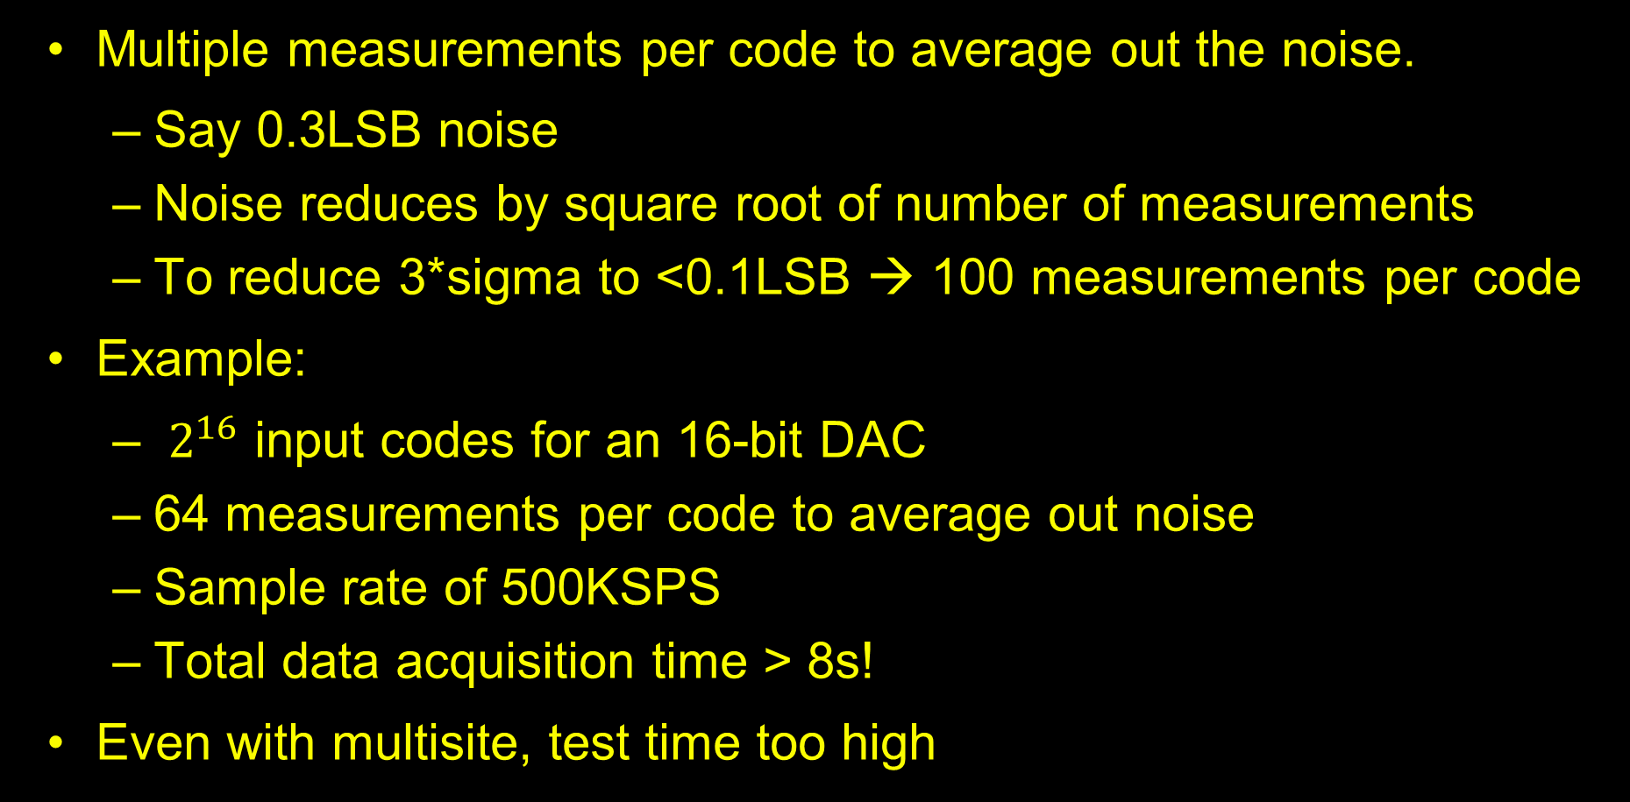
Conventional linearity testing of DACs
Multiple measurements per code to average out the noise.
  Say 0.3LSB noise
  Noise reduces by square root of number of measurements
  To reduce 3*sigma to <0.1LSB → 100 measurements per code
Example:
  $2^{16}$ input codes for an 16-bit DAC
  64 measurements per code to average out noise
  Sample rate of 500KSPS
  Total data acquisition time > 8s!
Even with multisite, test time too high
Notes:
Even with multi-site testing, significant test time and cost

Slide 7
Outline
Conventional linearity testing of DACs
Motivation for segmented testing
uSMILE for DACs
Extrapolated Reconstruction (ER) for DACs
Modifications for Interpolated DACs
Test results

Slide 8
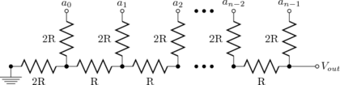
Motivation for segmented testing
Conventional method:
  Treat INL at each code as uncorrelated
  No. of variables to estimate = No. of DAC codes
Segmented testing:
  No. of truly independent error sources<< No. of DAC codes
Example: 16-bit R-2R DAC
  No. of resistors with mismatches=2*16=32 << 2^16= 65,536

Slide 9
Motivation for segmented testing
True: Many other sources of nonlinearity exist
Also true: non-idealities (mismatches, voltage coefficients, etc.) of a limited number of analog components determines the errors in the input output transfer curve of the DAC.
INL/DNL = func(small no. of independent errors)
For ADCs, uSMILE [1]
Same idea ported to DACs

Slide 10
Outline
Conventional linearity testing of DACs
Motivation for segmented testing
uSMILE for DACs
Extrapolated Reconstruction (ER) for DACs
Modifications for Interpolated DACs
Test results

Slide 11

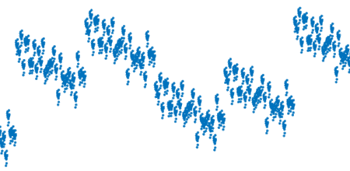
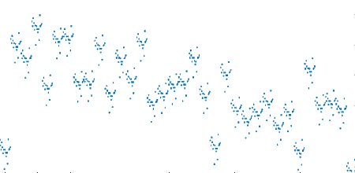








uSMILE: ultrafast Segmented Model Identification of Linearity Errors
INL curve broken into “segments”
Assign segmented errors to MSB/ISB/LSB codes
Example: 16-bit DAC segmented as 6-5-5
$$C=23,334$$
$$\left.INL(C)=e_{M}(C_{MSB})+e_{I}(C_{ISB})+e_{L}(C_{LSB}\right)$$
$$e_{M}(22)$$
010110 11001 00110
$$e_{M}(23)$$
$$e_{I}(25)$$
$$C_{MSB}=22$$
$$C_{ISB}=25$$
$$C_{LSB}=6$$
ISB errors
$$e_{M}(24)$$

Slide 12
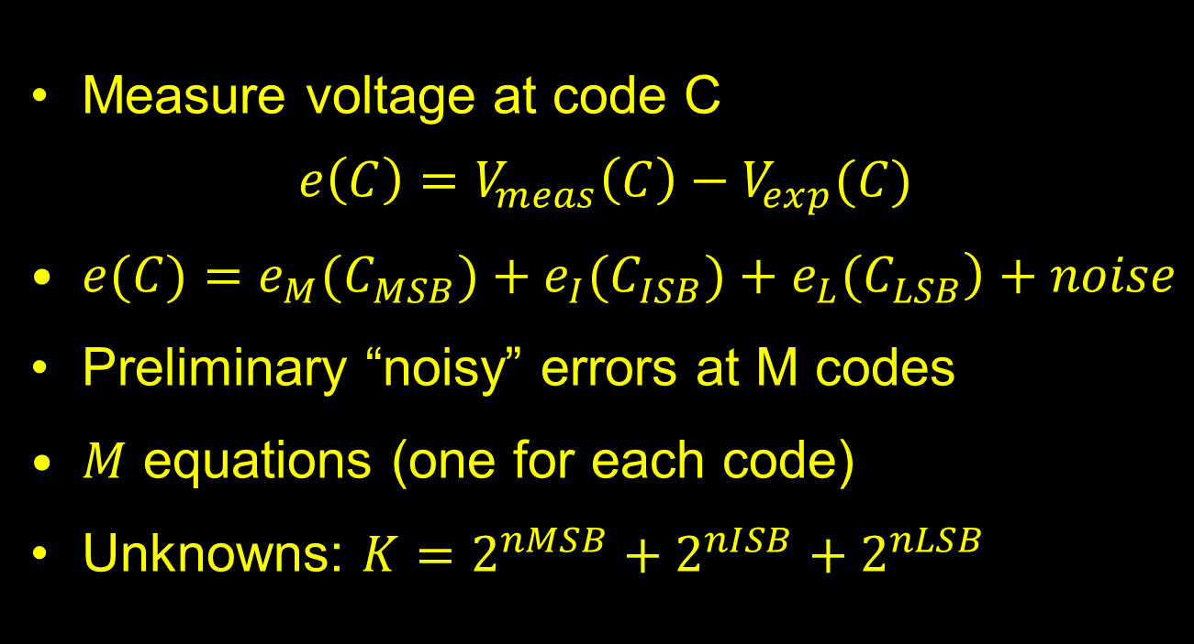
uSMILE
Measure voltage at code C
$e\left(C\right)=V_{meas}\left(C\right)−V_{exp}(C)$
$\left.e(C)=e_{M}(C_{MSB})+e_{I}(C_{ISB})+e_{L}(C_{LSB}\right)+noise$
Preliminary “noisy” errors at M codes
$M$ equations (one for each code)
Unknowns: $K=2^{nMSB}+2^{nISB}+2^{nLSB}$

Slide 13


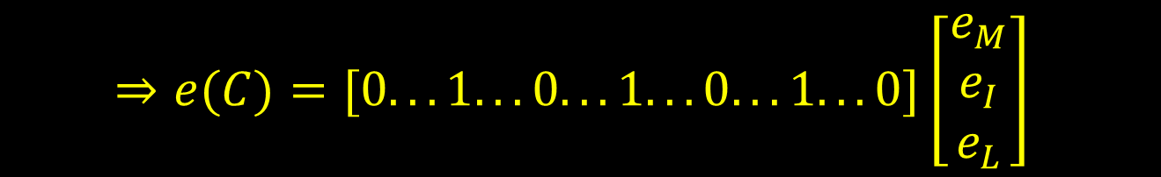
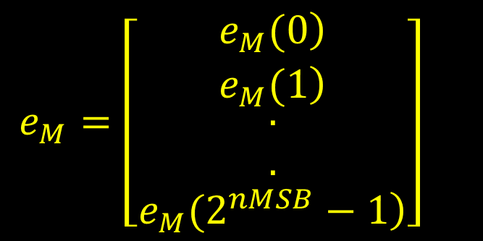
uSMILE
$\left.e(C)=e_{M}(C_{MSB})+e_{I}(C_{ISB})+e_{L}(C_{LSB}\right)+noise$
Write all equations in matrix form
$$e_{M}=\left[\begin{matrix}\left.e_{M}(0\right) \\ \left.e_{M}(1\right) \\ \begin{matrix}. \\ .\end{matrix} \\ \left.e_{M}(2^{nMSB}−1\right)\end{matrix}\right]$$
$$e_{M}(C_{MSB})=[0 0 ... 1 ... 0]e_{M}$$
$$⇒e(C)=[0...1...0...1...0...1...0]\left[\begin{matrix}e_{M} \\ e_{I} \\ e_{L}\end{matrix}\right]$$
Equation for one code
“noisy” errors at all codes
$$⇒ P=H×e+noise$$
Coefficient matrix
(0s and 1s)
Unknowns

Slide 14

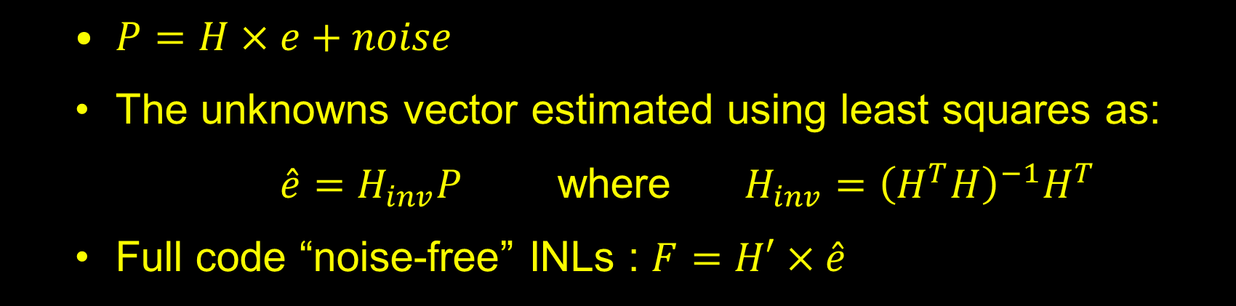
uSMILE
$P=H×e+noise$
The unknowns vector estimated using least squares as:
$\hat{e}=H_{inv}P$ where $H_{inv}={\left(H^{T}H\right)}^{−1}H^{T}$
Full code “noise-free” INLs : $F=H′×\hat{e}$

Slide 15
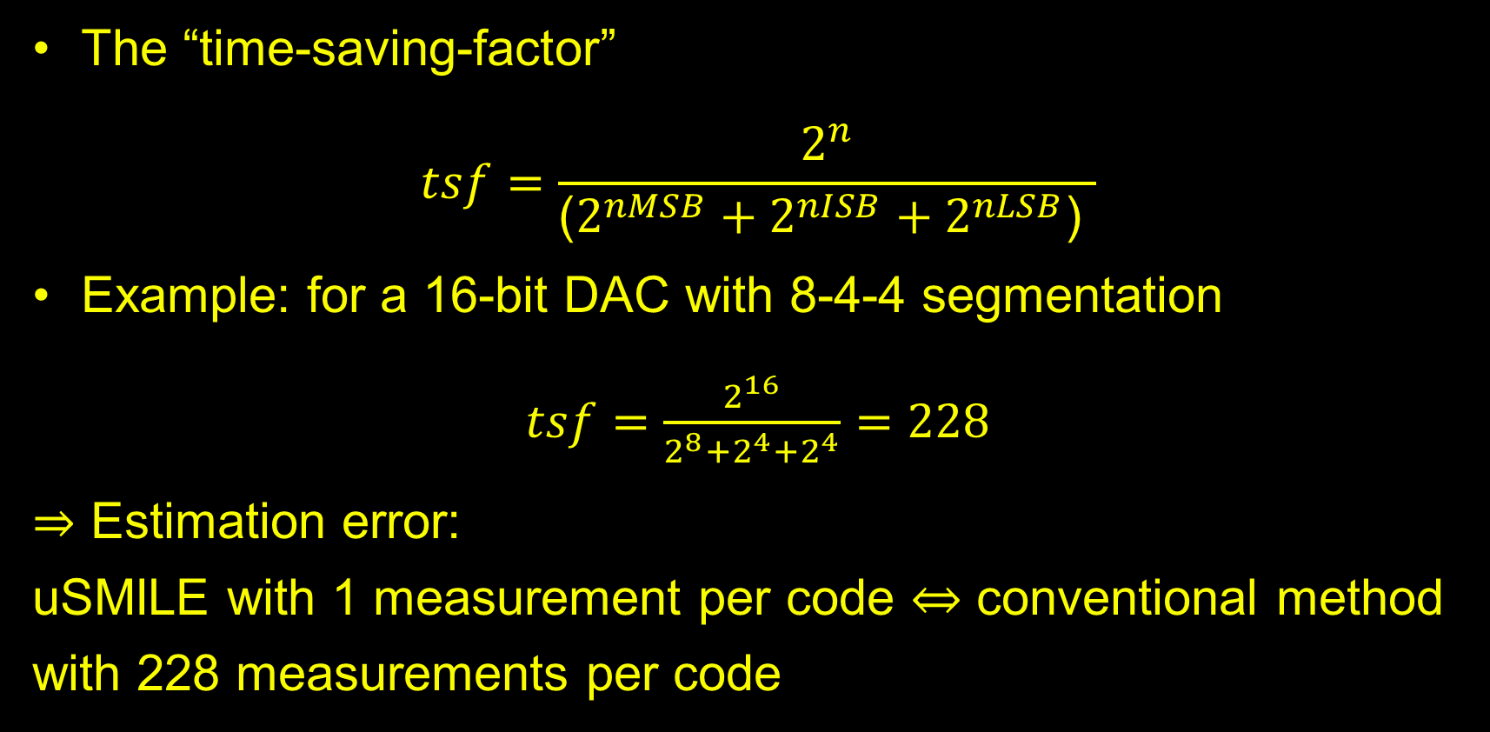
uSMILE
The “time-saving-factor”
$$tsf=\frac{2^{n}}{\text{(}2^{nMSB}+2^{nISB}+2^{nLSB}\text{) }}$$
Example: for a 16-bit DAC with 8-4-4 segmentation
$tsf=\frac{2^{16}}{2^{8}+2^{4}+2^{4}}=228$
$⇒$ Estimation error:
uSMILE with 1 measurement per code $⇔$ conventional method with 228 measurements per code

Slide 16
Outline
Conventional linearity testing of DACs
Motivation for segmented testing
uSMILE for DACs
Extrapolated Reconstruction (ER) for DACs
Modifications for Interpolated DACs
Test results

Slide 17


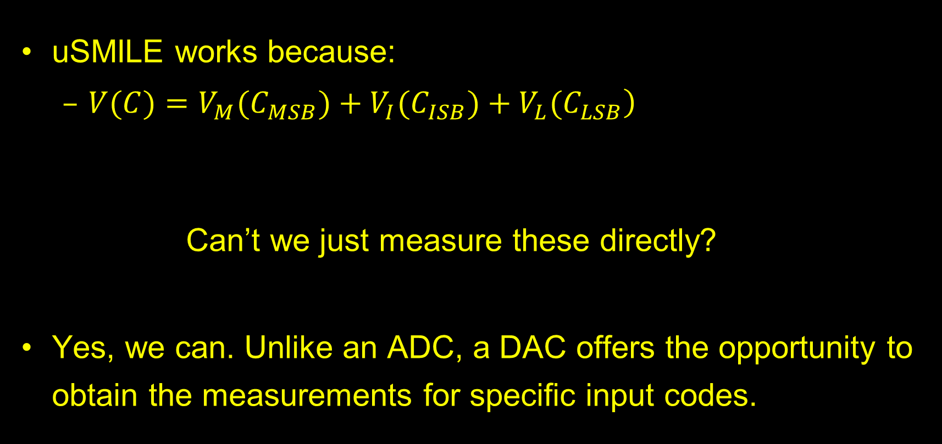
Extrapolated Reconstruction (ER)
uSMILE works because:
  $\left.V(C)=V_{M}(C_{MSB})+V_{I}(C_{ISB})+V_{L}(C_{LSB}\right)$
  Can’t we just measure these directly?
Yes, we can. Unlike an ADC, a DAC offers the opportunity to obtain the measurements for specific input codes.

Slide 18
Extrapolated Reconstruction (ER)
Example: 12-bit DAC with 7-5 segmentation
Measured voltages
Measure DAC output for
1 MSB segment (32 codes: 0,1,2,3,…,31) and
MSB points (0,32,64,….,4032,4064)
with multiple hits for each code (say 128)
Extrapolated voltages
“Extrapolate” and “Reconstruct” output curve
Subtract from end-point/best fit line and calculate INLs and DNLs
Notes:
For equivalent accuracy, total number of samples are equal for uSMILE and ER

Slide 19
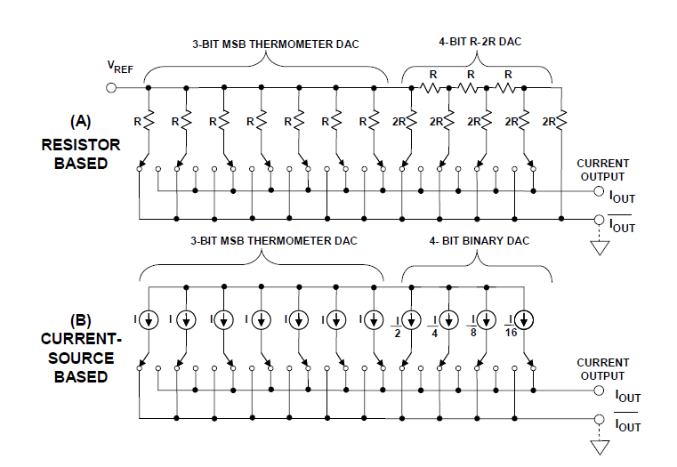
Application to various architectures
For higher resolution DACs, segmented architectures are used to avoid the exponential growth of components.
  Ex: Thermometer-binary DAC, Thermometer-R2R DAC [2]
Additionally, some architectures are inherently segmented bit-by-bit
  Ex: R-2R DAC, binary DAC

Slide 20
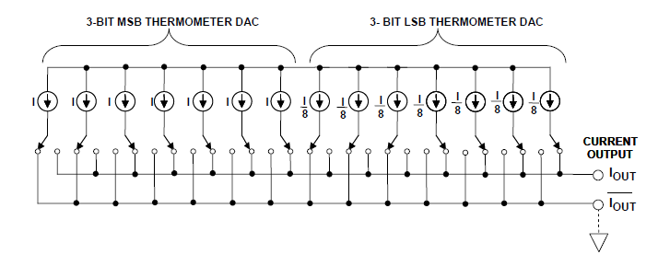
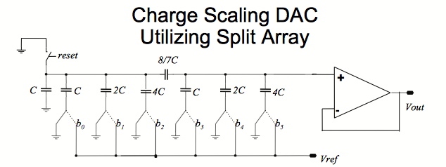
Application to various architectures
For higher resolution DACs, segmented architectures are used to avoid the exponential growth of components.
  Ex: Thermometer-thermometer DAC [2]
Additionally, some architectures are inherently segmented bit-by-bit
  Ex: C-DAC

Slide 21
Application to various architectures
Model not valid for string or thermometer-coded type architectures [2]
  Ex:15-bit DAC implemented as a 7-bit thermometer coded resistor DAC and an 8-bit R-2R DAC
  7-4-4 → valid
  8-3-4 → valid
  6-5-4 → invalid

Slide 22
Simulation results for an R-2R DAC
Simulation results of a 16b R-2R DAC
(8-8 segmentation)
(tsf = 128)
(a) INL estimations using uSMILE and ER
(b) DNL estimations

Slide 23
Simulation results for a segmented hybrid DAC
Simulation results of a 16b Segmented Hybrid DAC
(8-bit thermometer coded resistor DAC and an 8-bit R-2R DAC)
(tsf = 128)
(a) INL estimations
(b) DNL estimations

Slide 24
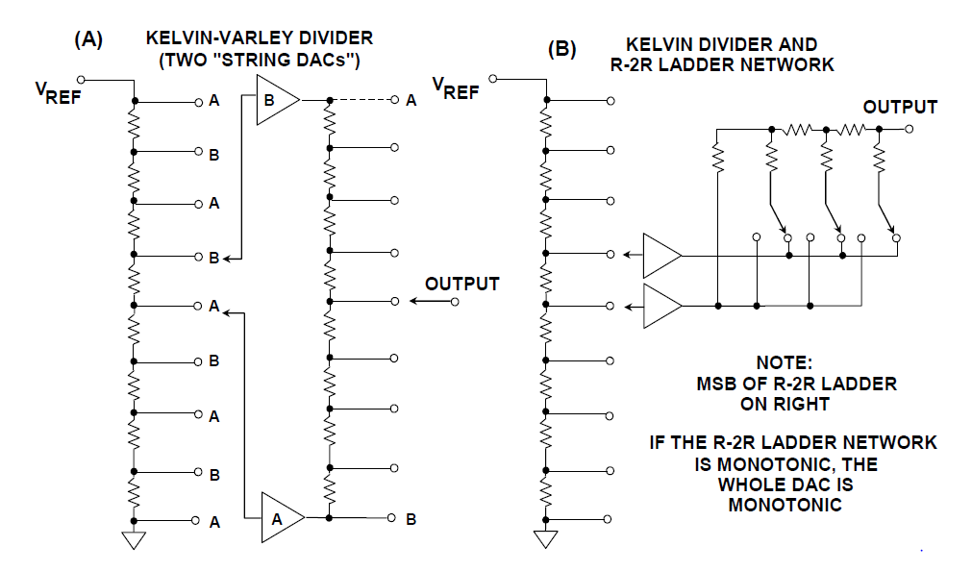
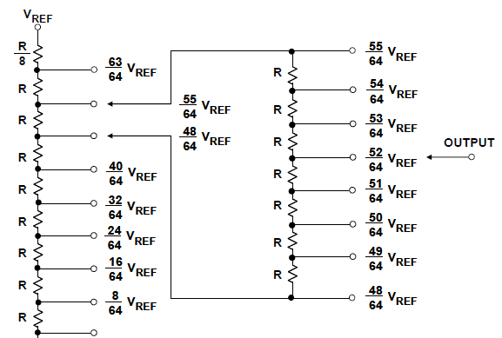
Application to various architectures
Some DACs have interpolation [2]
  Reduces DNL jumps
uSMILE and ER do not account for interpolation in their model.

Slide 25
Simulation results for an interpolated DAC
Simulation results of a 16b interpolated DAC
(8-bit LSB R-2R DAC interpolating between the output voltages of an 8-bit MSB string DAC)
(a) INL estimations
(b) DNL estimations
Spikes in DNL estimations at MSB codes
Notes:
The DNL estimations have spikes at MSB segment transitions because interpolation is not accounted for
DNL specs are more stringent than INL
Estimation error will cause DUT to falsely fail, leading to yield loss

Slide 26
Simulation results for an interpolated DAC
Simulation results of a 16b interpolated DAC
(8-bit LSB R-2R DAC interpolating between the output voltages of an 8-bit MSB string DAC)
(a) INL estimations
(b) DNL estimations
Spikes in DNL estimations at MSB codes
Notes:
The DNL estimations have spikes at MSB segment transitions because interpolation is not accounted for
DNL specs are more stringent than INL
Estimation error will cause DUT to falsely fail, leading to yield loss

Slide 27
Simulation results for an interpolated DAC
Simulation results of a 16b interpolated DAC
(8-bit LSB R-2R DAC interpolating between the output voltages of an 8-bit MSB string DAC)
(a) INL estimations
(b) DNL estimations
Spikes in DNL estimations at MSB codes
Notes:
The DNL estimations have spikes at MSB segment transitions because interpolation is not accounted for
DNL specs are more stringent than INL
Estimation error will cause DUT to falsely fail, leading to yield loss

Slide 28
Simulation results for an interpolated DAC
Simulation results of a 16b interpolated DAC
(8-bit LSB R-2R DAC interpolating between the output voltages of an 8-bit MSB string DAC)
(a) INL estimations
(b) DNL estimations
Spikes in DNL estimations at MSB codes
Notes:
The DNL estimations have spikes at MSB segment transitions because interpolation is not accounted for
DNL specs are more stringent than INL
Estimation error will cause DUT to falsely fail, leading to yield loss

Slide 29
Simulation results for an interpolated DAC
Simulation results of a 16b interpolated DAC
(8-bit LSB R-2R DAC interpolating between the output voltages of an 8-bit MSB string DAC)
(a) INL estimations
(b) DNL estimations
Spikes in DNL estimations at MSB codes
Notes:
The DNL estimations have spikes at MSB segment transitions because interpolation is not accounted for
DNL specs are more stringent than INL
Estimation error will cause DUT to falsely fail, leading to yield loss

Slide 30
Simulation results for an interpolated DAC
Simulation results of a 16b interpolated DAC
(8-bit LSB R-2R DAC interpolating between the output voltages of an 8-bit MSB string DAC)
(a) INL estimations
(b) DNL estimations
Spikes in DNL estimations at MSB codes
Notes:
The DNL estimations have spikes at MSB segment transitions because interpolation is not accounted for
DNL specs are more stringent than INL
Estimation error will cause DUT to falsely fail, leading to yield loss

Slide 31
Simulation results for an interpolated DAC
Simulation results of a 16b interpolated DAC
(8-bit LSB R-2R DAC interpolating between the output voltages of an 8-bit MSB string DAC)
(a) INL estimations
(b) DNL estimations
Spikes in DNL estimations at MSB codes
Notes:
The DNL estimations have spikes at MSB segment transitions because interpolation is not accounted for
DNL specs are more stringent than INL
Estimation error will cause DUT to falsely fail, leading to yield loss

Slide 32
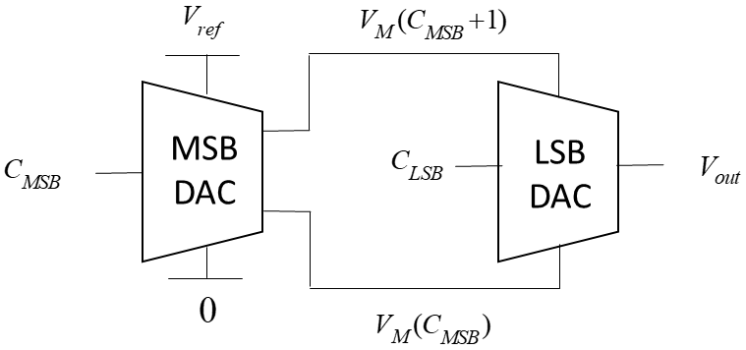
Application to various architectures
uSMILE and ER → incorrect DNLs for interpolated DACs especially at the MSB codes.
A new “interpolated segmented model” needs to be developed for interpolated DACs.

Slide 33
Application to various architectures
uSMILE and ER → incorrect DNLs for interpolated DACs especially at the MSB codes.
A new “interpolated segmented model” needs to be developed for interpolated DACs.

Slide 34
Outline
Conventional linearity testing of DACs
Motivation for segmented testing
uSMILE for DACs
Extrapolated Reconstruction (ER) for DACs
Modifications for Interpolated DACs
Test results

Slide 35

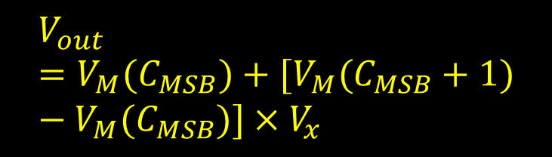
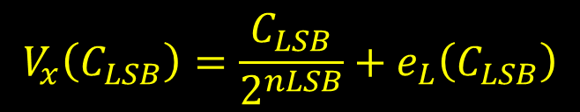
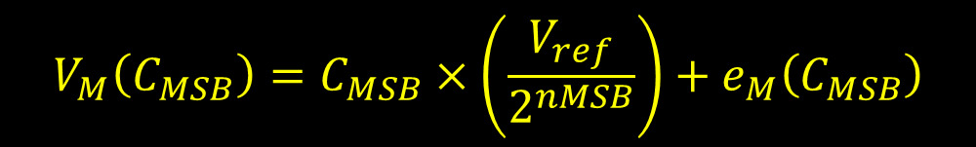
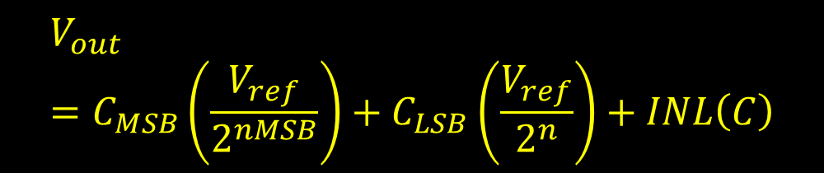
uISMILE: ultrafast Interpolated Segmented Model Identification of Linearity Errors
$$V_{out}=C_{MSB}\left(\frac{V_{ref}}{2^{nMSB}}\right)+C_{LSB}\left(\frac{V_{ref}}{2^{n}}\right)+INL\left(C\right)$$
$$V_{x}\left(C_{LSB}\right)=\frac{C_{LSB}}{2^{nLSB}}+e_{L}\left(C_{LSB}\right)$$
$$V_{out}=V_{M}(C_{MSB})+[V_{M}(C_{MSB}+1)−V_{M}(C_{MSB})]×V_{x}$$
$$V_{M}\left(C_{MSB}\right)=C_{MSB}×\left(\frac{V_{ref}}{2^{nMSB}}\right)+e_{M}\left(C_{MSB}\right)$$

Slide 36
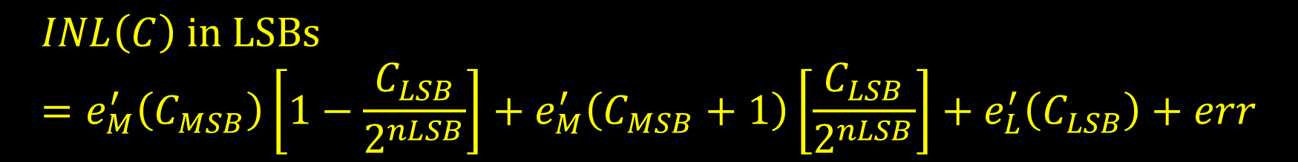
uISMILE: ultrafast Interpolated Segmented Model Identification of Linearity Errors
$$INL\left(C\right) \text{in} \text{LSBs}=e_{M}^{′}\left(C_{MSB}\right)\left[1−\frac{C_{LSB}}{2^{nLSB}}\right]+e_{M}^{′}\left(C_{MSB}+1\right)\left[\frac{C_{LSB}}{2^{nLSB}}\right]+e_{L}^{′}\left(C_{LSB}\right)+err$$

Slide 37
ER+I: Extrapolated Reconstruction with Interpolation
Example: 12-bit interpolated DAC with 7-5 segmentation
Measure DAC output for
1 MSB segment (32 codes: 0,1,2,3,…,31) and
MSB points (0,32,64,….,4032,4064)
with multiple hits for each code
Measured voltages
Extrapolated voltages
“Extrapolate” and “Reconstruct” output curve while accounting for interpolation
Subtract from end-point/best fit line and calculate INLs and DNLs
Notes:
For equivalent accuracy, total number of samples are equal for uSMILE and ER

Slide 38
Simulation results for interpolated DAC
INL simulation results of the 16b interpolated DAC
(a) INL estimations using the different methods
(b) Zoomed in view of the INL plots

Slide 39
Simulation results for interpolated DAC
DNL simulation results of the 16b interpolated DAC
(a) DNL estimations of the 16b DAC using the different methods
(b) Zoomed in view of the DNL plots

Slide 40
Simulation results for interpolated DAC
DNL simulation results of the 16b interpolated DAC
(a) DNL estimations of the 16b DAC using the different methods
(b) Zoomed in view of the DNL plots

Slide 41
Simulation results for interpolated DAC
DNL simulation results of the 16b interpolated DAC
(a) DNL estimations of the 16b DAC using the different methods
(b) Zoomed in view of the DNL plots

Slide 42
Simulation results for interpolated DAC
DNL simulation results of the 16b interpolated DAC
(a) DNL estimations of the 16b DAC using the different methods
(b) Zoomed in view of the DNL plots

Slide 43
Simulation results for interpolated DAC
DNL simulation results of the 16b interpolated DAC
(a) DNL estimations of the 16b DAC using the different methods
(b) Zoomed in view of the DNL plots

Slide 44
Simulation results for interpolated DAC
DNL simulation results of the 16b interpolated DAC
(a) DNL estimations of the 16b DAC using the different methods
(b) Zoomed in view of the DNL plots

Slide 45
Simulation results for interpolated DAC
DNL simulation results of the 16b interpolated DAC
(a) DNL estimations of the 16b DAC using the different methods
(b) Zoomed in view of the DNL plots

Slide 46
Simulation results for interpolated DAC
DNL simulation results of the 16b interpolated DAC
(a) DNL estimations of the 16b DAC using the different methods
(b) Zoomed in view of the DNL plots

Slide 47
Simulation results for interpolated DACs
Robustness test for 16b interpolated DACs
INL correlation
DNL correlation

Slide 48
Outline
Conventional linearity testing of DACs
Motivation for segmented testing
uSMILE for DACs
Extrapolated Reconstruction (ER) for DACs
Modifications for Interpolated DACs
Test results

Slide 49
Measurement results for an interpolated DAC
Production mixed-signal IC
12b interpolating DAC measured by an on-chip higher resolution internal ADC
12b DAC: m-n segmentation, with interpolation between the output voltages of an m-bit MSB DAC.
“Reference” INL estimation: 240 measurements per code averaged across 10 runs (2400 effective hits per code) to get rid of thermal and flicker noise
Notes:
“True” in measurement not possible. Call it reference – explain how it’s obtained

Slide 50
Measurement results for an interpolated DAC
INL Measurement results for DAC-1
(a) INL estimations using the different methods
(b) Zoomed in view of the INL plots
Notes:
“True” in measurement not possible. Call it reference – explain how it’s obtained

Slide 51
Measurement results for an interpolated DAC
DNL Measurement results for DAC-1
(a) DNL estimations using the different methods
(b) Zoomed in view of the DNL plots
Notes:
“True” in measurement not possible. Call it reference – explain how it’s obtained

Slide 52
Measurement results for an interpolated DAC
DNL Measurement results for DAC-1
(a) DNL estimations using the different methods
(b) Zoomed in view of the DNL plots
Notes:
“True” in measurement not possible. Call it reference – explain how it’s obtained

Slide 53
Measurement results for an interpolated DAC
DNL Measurement results for DAC-1
(a) DNL estimations using the different methods
(b) Zoomed in view of the DNL plots
Notes:
“True” in measurement not possible. Call it reference – explain how it’s obtained

Slide 54
Measurement results for an interpolated DAC
DNL Measurement results for DAC-1
(a) DNL estimations using the different methods
(b) Zoomed in view of the DNL plots
Notes:
“True” in measurement not possible. Call it reference – explain how it’s obtained

Slide 55
Measurement results for an interpolated DAC
DNL Measurement results for DAC-1
(a) DNL estimations using the different methods
(b) Zoomed in view of the DNL plots
Notes:
“True” in measurement not possible. Call it reference – explain how it’s obtained

Slide 56
Measurement results for an interpolated DAC
DNL Measurement results for DAC-1
(a) DNL estimations using the different methods
(b) Zoomed in view of the DNL plots
Notes:
“True” in measurement not possible. Call it reference – explain how it’s obtained

Slide 57
Measurement results for an interpolated DAC
DNL Measurement results for DAC-1
(a) DNL estimations using the different methods
(b) Zoomed in view of the DNL plots
Notes:
“True” in measurement not possible. Call it reference – explain how it’s obtained

Slide 58
Measurement results for an interpolated DAC
DNL Measurement results for DAC-1
(a) DNL estimations using the different methods
(b) Zoomed in view of the DNL plots
Notes:
“True” in measurement not possible. Call it reference – explain how it’s obtained

Slide 59
Measurement results for an interpolated DAC
INL and DNL measurement results for DAC-2

Slide 60
Measurement results for an interpolated DAC
INL and DNL measurement results for DAC-3

Slide 61
Measurement results for an interpolated DAC
INL estimation good for all methods
DNL estimation clearly better with uISMILE and ER+I over uSMILE and ER for the interpolated DAC
DNL specs usually stringent (commonly +/-1 LSB)
Theoretical tsf = 20 as compared to conventional method (240 hpc)
Actual total test time reduction (data acquisition + on-chip computation) = ~19.8x for ER+I and ~16x for uISMILE

Slide 62
Measurement results for an interpolated DAC
Probe data (~30,000 units) : INL
Origin not at 0
y=x+/- tol

Slide 63
Measurement results for an interpolated DAC
Probe data (~30,000 units) : DNL
Origin not at 0
y=x+/- tol

Slide 64
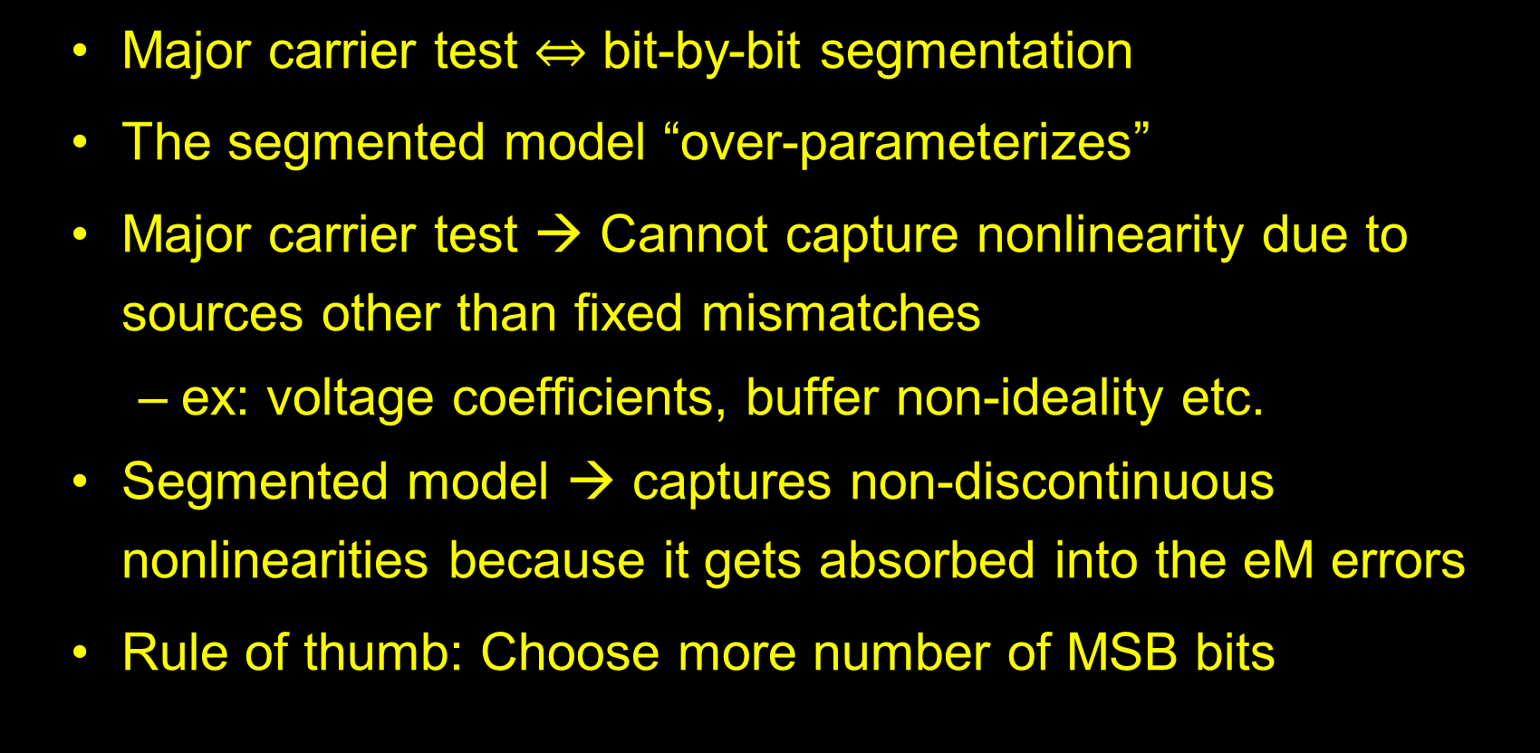
Discussion: Difference from major carrier test:
Major carrier test $⇔$ bit-by-bit segmentation
The segmented model “over-parameterizes”
Major carrier test → Cannot capture nonlinearity due to sources other than fixed mismatches
  ex: voltage coefficients, buffer non-ideality etc.
Segmented model → captures non-discontinuous nonlinearities because it gets absorbed into the eM errors
Rule of thumb: Choose more number of MSB bits

Slide 65
Discussion: ER/ER+I vs uSMILE/uISMILE
ER/ER+I : Multiple measurements at same code → no need to wait after initial settling
ER/ER+I : Data processing extremely simple. Fast and memory efficient
uSMILE/uISMILE:
  Although huge matrix inversions involved, since H matrix depends on input codes, Hinv can be precomputed
  No matrix inversion calculations required, so heavily simplified
  Sequential processing required to get time and memory efficiency == ER/ER+I

Slide 66
Discussion: ER/ER+I vs uSMILE/uISMILE
uSMILE/uISMILE:
  Potential to catch sparkle INLs (sanity check on noisy errors)
  Segmented INL model + ROME → fast DAC testing with low-linearity digitizers → uSMILE-ROME [3]
  INL model can easily be modified to account for different architectures and nonlinearities
Notes:
Inl model modification – alternate flipping between msb voltages

Slide 67
Conclusion
Novel linearity testing methods that significantly reduce test time have been discussed for DACs with various architectures.
uSMILE and ER → significant time savings for normal segmented DACs
uISMILE and ER+I → significant time savings for interpolated segmented DACs
16b DAC simulation results: >100x time savings
12b DAC measurement results: ~20x time savings
Notes:
Contact your topic coordinator if you have any questions. Please route any comments on this slide guide to artdowney@cruzio.com

Slide 68
References
[1] Z. Yu and D. Chen, “Algorithm for dramatically improved efficiency in ADC linearity test,” in 2012 IEEE International Test Conference, 2012, pp. 1–10.
[2] W. Kester and Analog Devices, inc, Eds., Data conversion handbook. Amsterdam ; Boston: Elsevier ; Newnes, 2005.
[3] S. K. Chaganti, T. Chen, Y. Zhuang, and D. Chen, “Low-cost and accurate DAC linearity test with ultrafast Segmented Model Identification of Linearity Errors and Removal Of Measurement Errors (uSMILE-ROME),” in 2018 IEEE International Instrumentation and Measurement Technology Conference (I2MTC), 2018, pp. 1–6.

Slide 69
Thank You!
Questions?

