Slide 1
IEEE Spectral Testing Method for ADC
x(t)
x[n]
Notations
- x(t) : Analog input signal
  - x(t) = A*sin(2πf_{Sig}t+ϕ)
- x[n]: Analog interpretation of
  digital output of ADC,
  n = 0,1,2,..,M-1.
  - f_{Sig}: Input signal frequency
  - f_{Samp}: Clock frequency
  - M: the data record length
  - J: Number of input periods
  recorded in M samples.
  J = M*f_{Sig}/f_{Samp}
Notes:
The word “standard” in this document refers to a mandatory requirement or practice. Failure to follow all ITC standards for visual presentation can result in your presentation being dropped from the ITC program.
A “guideline” is a strongly suggested good practice that you should follow unless you see a compelling reason otherwise. The guidelines we present result from ITC’s experience with hundreds of successful and unsuccessful visual presentations at past conferences.
In order to distinguish between standards and guidelines, we show standards in a special font:
Standards appear with white italic text.
Guidelines are displayed with ordinary yellow text

Slide 2
Spectral Testing
Signal generator Spectral Test
x(t)
x[n]
Spectral characteristics of the Signal generator is tested
Ideal digitizer
x[n] → harmonic information of the Signal generator

Slide 3
IEEE Spectral Testing Method
Requirements
- Instruments at least 10 times better than DUT
- Peak-peak voltage slightly less than ADC input range
- Coherent sampling
J = M*f_{Sig}/f_{Samp} is an integer
Procedure
- Collect M samples (coherently sampled).
- Perform DFT.
- Compute the spectral parameters
Issues
- Challenging to obtain Coherent sampling
  -- Require highly accurate signal generators
  -- Require Frequency synthesizers or PLLs
Notes:
ITC supplies the projection computer for your session and pre loads your visual presentation on its hard disk. You should design your presentation keeping in mind the fact that the projection computer may have low end specifications.
The projection computer will use the Windows 7 operating system. Slides will be projected with Microsoft Office PowerPoint, version 2007.
Note that it will not be possible to make changes to your presentation at ITC. Your PowerPoint presentation will be preloaded onto the hard disk of several presentation computers, and changes after preloading will not be permitted.

Slide 4
Challenges due to coherency
  In labs, both the clock and input signals are generated from different sources with absolute accuracy.
    Expensive
    Not portable
  If absolute accuracy of both the signal generators is not very high, frequency synthesizers can be used so that both the signals can track each other.
    Frequency synthesizers are expensive.
  Maintaining coherency between the input and clock signals to perform on-chip testing is very difficult.
There is a need to develop new spectral testing methods that do not require coherency

Slide 5
Coherent sampling: exact integral periods in record

Slide 6
Example: f_samp / f_sig = 4096 / 255; 14 bit ADC
Input sine
Energy stay in its bins
Distortion due to DUT correctly seen

Slide 7
Non-Coherent: fractional periods in record

Slide 8
Coherent: integral J period
Non-coherent: J+δ period
Power in δ period: δ/J * P_sig
Want this to be less than quantization noise power: P_noise = P_sig/(4^18*3/2) (this is conservative.)
➔δ/J < 1/(4^18*3/2) =10^(-11)
➔ extremely difficult, if not impossible.
For 14 bit, 256 times easier

Slide 9
IEEE Spectral Testing
Effect of Non-coherent Sampling
f_{Sig} = 374.6954kHz
f_{Samp} = 1MHz
f_{Sig} = 374.6948kHz
- Severe spectral leakage (for slight change in f_{Sig})
- Inaccurate spectral results
A test method that accurately estimates Spectral characteristics even with non-coherently sampled data is required
Notes:
ITC requires one file per presentation, and uses an internal file naming convention to ensure that the correct visuals will appear when you begin your presentation. We do not have the resources to support customized file setups for each author.
When uploaded, the web site automatically assigns an algorithmic file name, based on log number, date and time.
Prior to the conference, presentation files are renamed according to the assigned session and speaker number, and the extent changed to “.pps or .ppsx” so that the presentation automatically comes up in slide show mode at the start of your presentation.
The file naming convention is “Session #”.”Speaker #”.ppsx. For example, if you are the third speaker in session 24 your slide file will be named “24.3.ppsx”. Another example: the first lecture series presentation in Lecture 2 would be named L2.1.ppsx.
You can obtain your session and speaker numbers from your topic coordinator.

Slide 10
Effect of non-coherent sampling
Example:
  f_{Samp} = 200 MHz
  M = 8192
  J_{coh} = 1999
  f_{Sig_coh} = 48.8037109375 MHz
  For 1ppm error in f_{Sig}
    f_{Sig} = 48.80376 MHz
    J = 1999.0020096.
  For 0.5 ppm error in f_{Sig}
    f_{Sig} = 48.80373 MHz
    J = 1999.0007808.
Plots show skirting in the spectrum even at 0.5 ppm error level.

Slide 11
Additional graphical illustration

Slide 12
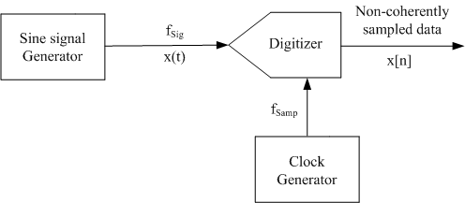
Problem Statement
f_{Sig} and f_{Samp} are not coherent
Goal: From x[n] compute the spectral parameters
of x(t) accurately.

Slide 13
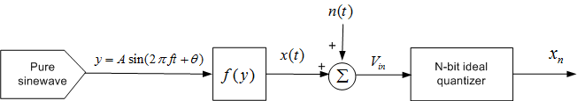
Details on assumptions

Slide 14
Spectral Testing using Traditional FFT
Coherent sampling.
Compute the FFT of M points
Theorem 1: The Fourier coefficient of i^{th} harmonic, X_{i*J} depends only on the i^{th} harmonic power and noise.
This method is very efficient and accurate.

Slide 15
Spectral Testing using Traditional FFT
Non-coherent sampling.
Compute the FFT of M points recorded.
Theorem 2: The error in X_{i*J} due to non-coherency in the fundamental is large. (X_{i*J} is the Fourier coefficient of i^{th} harmonic)
Theorem 3: The error in X_{i*J} due to non-coherency in all harmonics (excluding fundamental) is negligible.
From Theorems 2 and 3, if the non-coherent fundamental component can be identified and replaced by a coherent fundamental, the harmonic power can be accurately estimated.

Slide 16
Existing methods for non-coherency
Windowing
  Most widely used, very fast
How it works
  In time domain: multiply data by a window
  In freq domain: push skirts down so that leaked power squeezed back into main lobe where the fundamental resides
  Good for fundamental power, and SFDR
Limitations
  It alters spectrum, ➔ wrong SNR, wrong spurs
  THD may also have significant errors
Notes:
Don’t read this and next slide now. If you haven’t done so, do it later. Both windowing and sine fitting have fundamental issues that cannot be fixed.

Slide 17
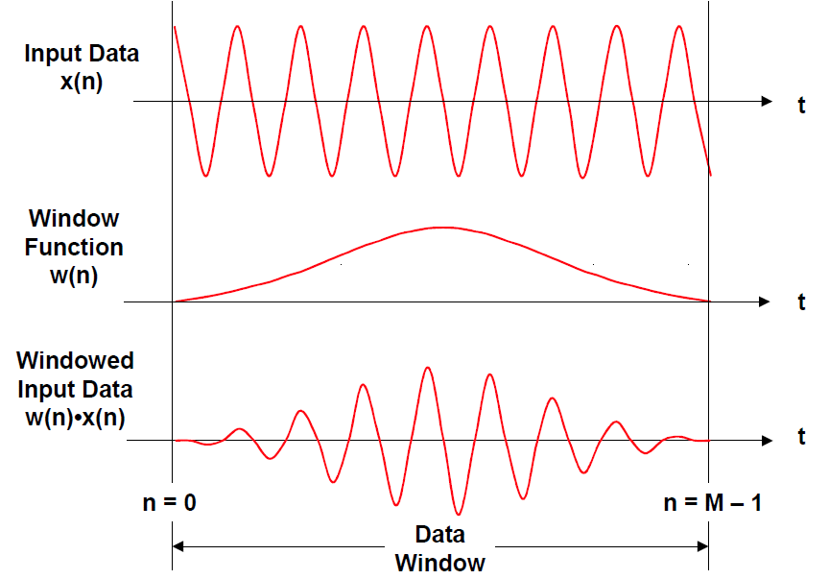
Widely used method: windowing

Slide 18
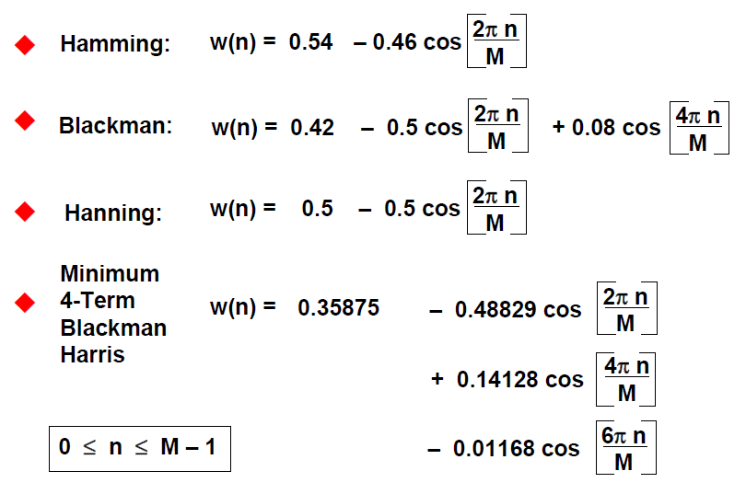
Most widely used windows

Slide 19
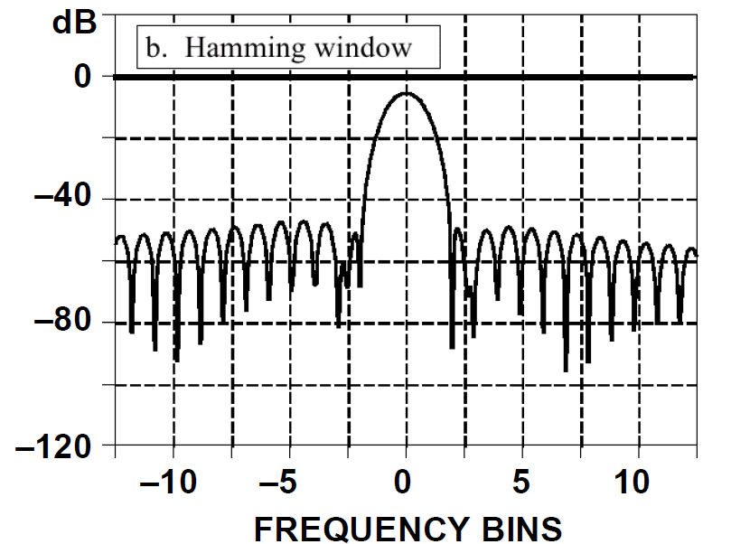

Slide 20
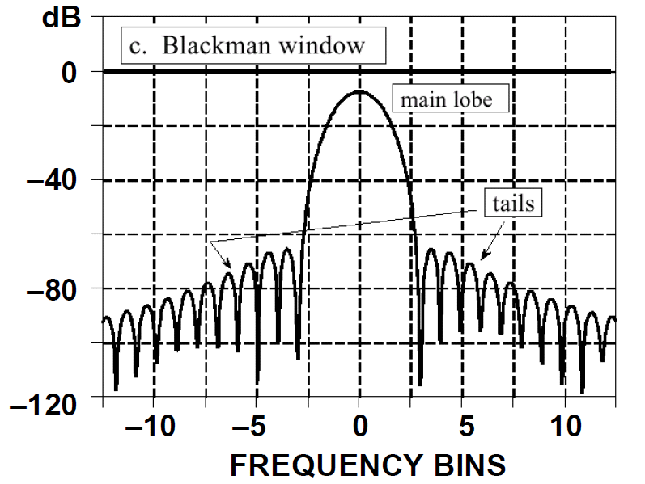

Slide 21
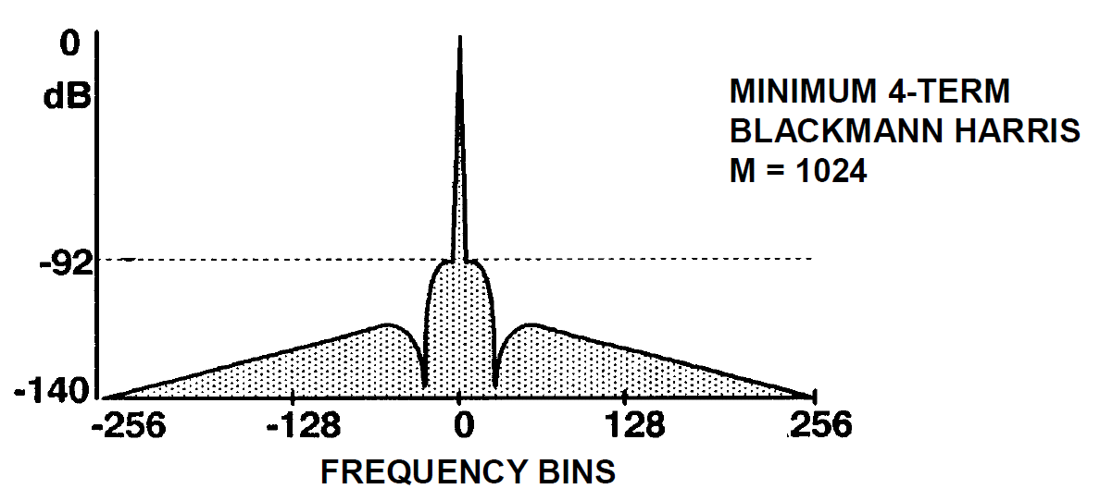
One of the best windows is Blackmann-Harris
Problem: it alters spectrum, requires care

Slide 22
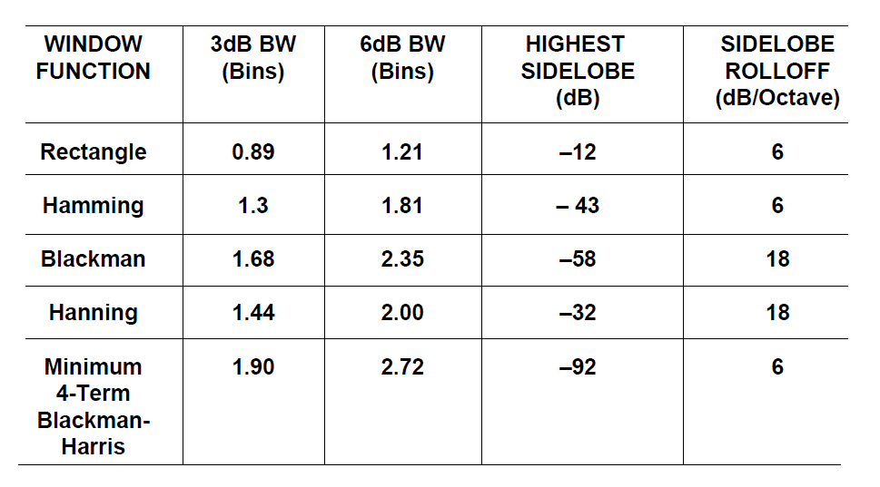

Slide 23
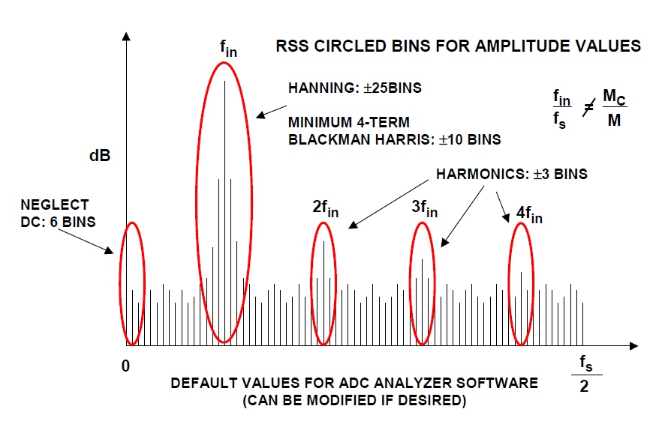
To use windows correctly: include the right #bins

Slide 24
Existing methods for non-coherency
Four parameter sine wave fitting
  Start with simple estimate of f_sig (from DFT)
  Use LS on DC, A, Δf, and φ, with local linearization of Δf.
  Iterate up to six times to get accurate fundamental
  Use three parameter sine fitting (since f_sig is now known) to estimated each harmonic distortion
Limitations
  If Δf is not very small, accuracy degrades since orthogonality is violated in LS algorithm
  THD is right, but SFDR may be wrong if it’s from a spur
  Can adjust #points in data so it contains approximate integer periods, ➔ ~orthogonal bases functions in LS
  Can lead to very slow DFT

Slide 25
Existing methods for non-coherency
Other techniques for Non-coherency
  Fundamental ID and Replacement, several variations
  Single value decomposition, accurate but slow
  Filter Banks
  Resampling
  …
Issues
  Speed (some accurate ones are 1000s, or millions times slower than FFT)
  Accuracy (some only accurate at fundamental, some only accurate at harmonic bins, …)
Notes:
That leads us to the bottom line: we need a method that is about as fast as ideal coherent FFT, computes the whole spectrum, with about the same accuracy.

Slide 26
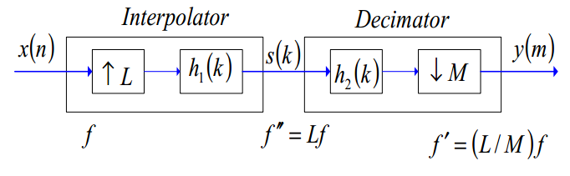
Non-coherent spectral analysis by Resampling
Simulation and measurement results with < 50 dB SNR

Slide 27
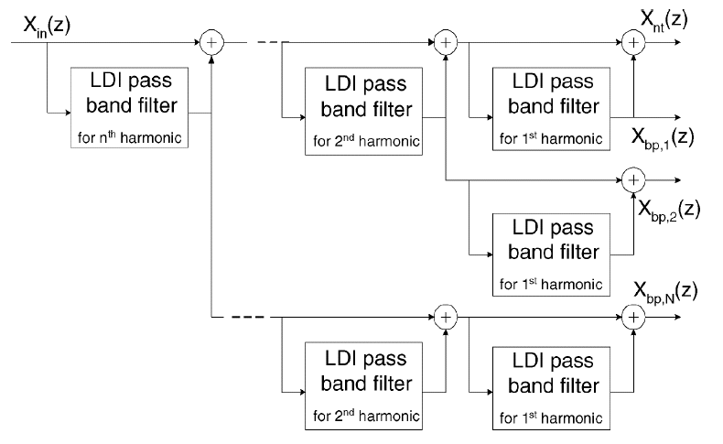
Noncoherent spectral test by filter banks

Slide 28
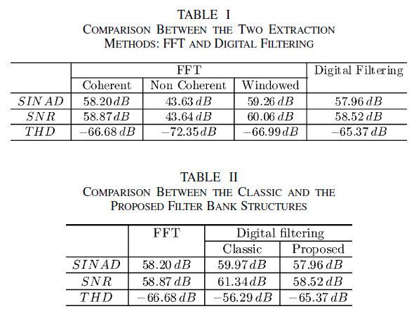

Slide 29
Non-coherent Sampling
Many people studied the issue
Many papers and patents
Bottom line: still need a new method that
    Computes whole spectrum, not just a few terms
    Accurate at all spectral bins,
    Applicable whenever ideal coherent sampling FFT is
    Computationally efficient, O(M*log(M)) as FFT

Slide 30
New approach for noncoherency
Directly use captured data with distortion
Estimate amplitude, frequency, and phase of base harmonic
Replace noncoherent base harmonic with a base harmonic that is coherent with data record length
Perform spectral analysis on modified data.

Slide 31
Basic premise
Harmonic distortion components are much smaller as compared to base harmonic
Harmonic distortion components are at frequencies that are different from that of base harmonic, ➔they are orthogonal
  always true in continuous time
  not necessarily true in sampled data
➔First harmonic can be identified accurately

Slide 32
Procedures:
If possible, synchronize the digitizer and input signal by using the upward zero-crossing edge to trigger the start of data collection
If this is not possible, as in the case of on-chip applications,
  Take some extra data points
  Search for a point that is very close to upward zero-crossing
  Use this as the start of the data record

Slide 33
Procedures:
Take sufficient number of samples
  ADC resolution and target SFDR ➔ noise floor
  SNR and noise floor ➔ minimum data record length M_{min}
  From starting point, take 2M_{min} samples
Search for a suitable data record length M
  From the start, count the number of upward zero-crossing (not including the start point)
  After passing M_{min} points, looking for a “best” zero-crossing that:
    Is an odd number of zero-crossing
    Best matches the starting pattern
  M is the point right before the “best” zero-crossing

Slide 34
Procedures:
Identify base harmonic frequency
  The number of zero-crossing gives the number of integer periods J
  Use mismatch between the pattern at the start of the selected data record, and the pattern right after M
  Estimate phase difference Δφ
  The total number of periods of the signal included in the data record length is J_{tot} = J + Δφ/2π
  Signal frequency is f_{sig} = J_{tot}/M * f_{sample}
Identify signal magnitude
  Signal power ≈ total AC power
Identify signal phase
  Use initial pattern to compute phase

Slide 35
Procedures:
Replace noncoherent base harmonic with a coherent base harmonic
  X_n = X_n – Asin(2πfsig * n/fsample + phi)
  + Asin(2πfcoh * n/fsample + phi)
  = X_n – Asin(2πJtot * n/M + phi)
  + Asin(2πJ * n/M + phi)
Alternatively, can just remove the identified base harmonic component, without adding back a coherent one
Performance FFT on the modified data
Compute THD, SNR, SFDR, SINAD, …

Slide 36
Algorithm Efficiency Analysis
Data acquisition time
  proportional to data record length: double
Computational time
  Best length search: O(M)
  First harmonic estimation: <O(1)
  First harmonic replacement: O(M)
  FFT: O(M*logM)
  But this M may be up to 2X original M
A little more than 2x standard FFT approach with coherent sampling
This is not true.
Only true if M=2^K

Slide 37
Simulation study
Digitizer: 12 ~ 17 bits
Data record length: a few thousand
Signal frequency: random but < Nyquist
Harmonic distortion amount: random
Other small random errors included:
  Signal magnitude
  Random DC offset
  Random synchronization error
  Additive measurement noise

Slide 38
Four methods used and compared
Ideal: perfect coherent sampling and noise free
Standard: DFT assuming periodic signal
Best Length: DFT with record length best matching an integer # signal periods
Proposed: best length plus first harmonic ID and replacement

Slide 39
First example: typical
Ideal and Proposed: zero or minimal skirts
Best Length: with skirt but accurate SFDR measurements
Standard: large skirts and large errors
True SFDR computed analytically in continuous time domain

Slide 40
data samples from coherent and noncoherent sampling

Slide 41
Spectrum from ideal coherent sampling

Slide 42
Standard DFT with noncoherent samples

Slide 43
Best Length with Noncoherent samples

Slide 44
Proposed: noncoherent samples, best data length, 1st harmonic replacement

Slide 45
Second example
Atypical, but with non-negligible probability
  Standard and Best Length:
    Large skirts visible
    Fail to produce correct SFDR results
  Proposed and Ideal:
    Still has non-zero or minimal skirt
    Still achieves accurate SFDR testing

Slide 46
data samples from coherent and noncoherent sampling

Slide 47
Spectrum from ideal coherent sampling

Slide 48
Standard DFT method with noncoherent data samples

Slide 49
Noncoherent samples with best data record length

Slide 50
The proposed method: noncoherent samples, best data length, 1st harmonic replacement

Slide 51
Experimental testing results
Data collected in industry
A 14-bit ADC as sampler
Input sine wave magnitude was a little too big, ➔clipping at top and bottom
Data to be discarded
A noncoherent subset of the data

Slide 52
Captured waveform and its base harmonic

Slide 53
Spectrum by standard application of DFT

Slide 54
Proposed method vs true coherent sampling
Proposed method with
noncoherent sampling
Ideal coherent sampling of a clipped sine wave

Slide 55
Robustness study
Problem: occasionally (a few times in every 1000 runs), very large SFDR errors were produced
Correlation of SFDR error to various parameters studied
Clear correlation to signal frequency
No correlation to other parameters
Certain degenerate frequencies must be avoided.
Same is true in coherent sampling.

Slide 56
SFDR testing errors in 1000 proper runs the proposed method

Slide 57
Ideal perfect coherent sampling

Slide 58
noncoherent sampling with standard approach

Slide 59
noncoherent samples with best data length

Slide 60
Comparison of 4 methods
1000 run SFDR measurement error statistics
Ideal Standard Best_length Proposed
min -8.33 -5.26 -16.35 -4.01
max 91.1 103.2 32.19 3.52
mean 0.01 34.75 0.61 0.17
std 3.08 15.80 2.63 0.91
ideal case skewed by one bad data point, would be comparable to proposed case if that point excluded

Slide 61
Conclusion
The proposed method achieves SFDR testing performance comparable to ideal perfect coherent sampling
It is robust to various sources of errors.
It is computationally very efficient.
It’s vulnerabilities are the same as that of the ideal coherent sampling case.

Slide 62
Multi-tone Testing
Very recent preliminary work
Example for two tone test, but expect to extend to general multi-tone test
Two frequencies randomly generated
Random amplitude mismatch
Random phase mismatch
Random offset error
Random additive measurement noise

Slide 63
First example
Two random tones
Standard DFT leads to significant leakage
Best length alone results in sufficiently small leakage
Proposed method removes leagage

Slide 64
Time domain data of a two tone signal

Slide 65
Standard DFT method with noncoherent data samples

Slide 66
Noncoherent samples with best data record length

Slide 67
The proposed method: noncoherent samples, best data length, base harmonic replacement

Slide 68
Another example
Best length not enough
  Leakage still too high
Proposed method results in sufficiently low leakage
Standard DFT does not work

Slide 69
Time domain data of a two tone signal

Slide 70
Standard DFT method with noncoherent data samples

Slide 71
Noncoherent samples with best data record length

Slide 72
The proposed method: noncoherent samples, best data length, base harmonic replacement

Slide 73
Problems with the proposed algorithm at/near certain frequencies
F_sig too close to f_sample /2
F_sig nearly exactly = f_sample /4
F_sig nearly exactly = f_sample /3
Etc.
These are “bad frequencies” and are always avoided in bench test or production test.
But with BIST, can we avoid these?

Slide 74
When f_sig is too close to f_s/2, signal to be sampled could be near 0 for many samples in a row. Noise present can push the actual sampled value positive or negative.
Thus, it becomes difficult to correctly indentify positive zero-crossings, or to count the cycles.

Slide 75
M randomly selected among 2^10, 2^11, 2^12, 2^13, 2^14;
Ncycle=round(M/200*rand+49*M/200)*2 + 0.5*rand
M =
1024
nbits =
17
Ncycle =
5.114086516103267e+002

Slide 77
standard

Slide 78
Best length

Slide 79
Best length + replacement

Slide 80
working ...
M =
1024
nbits =
13
Ncycle =
5.071555511433252e+002
Done

