Slide 1
Fast Linearity testing of DACs
Shravan Chaganti, Tao Chen, Yuming Zhuang
Advisor: Dr. Degang Chen
April 2nd , 2018

Slide 2
Introduction
With the growth of the Internet-of-things, the DAC volume and performance requirements have increased significantly, and the test cost too keeps increasing.
There is an urgent need to develop low-cost methods for characterization and testing of DACs.
Traditional testing of DAC static linearity →a digital voltmeter (DVM) or a digital waveform recorder with multiple samples per code to average out noise
2 major challenges:
  Long test time
  Expensive test equipment

Slide 3
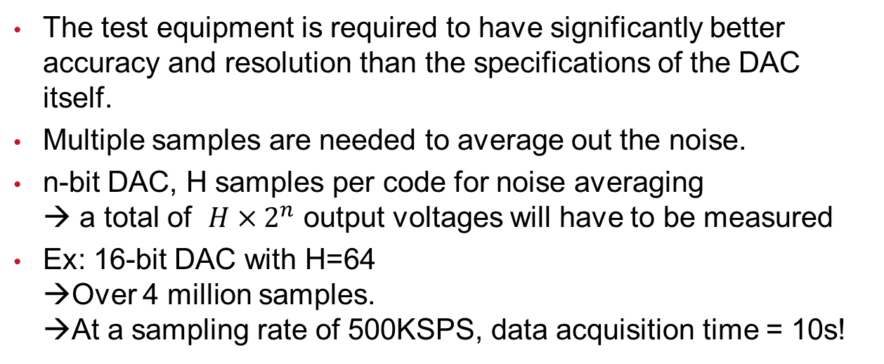
Introduction
The test equipment is required to have significantly better accuracy and resolution than the specifications of the DAC itself.
Multiple samples are needed to average out the noise.
n-bit DAC, H samples per code for noise averaging
→ a total of $H×2^{n}$ output voltages will have to be measured
Ex: 16-bit DAC with H=64
→Over 4 million samples.
→At a sampling rate of 500KSPS, data acquisition time = 10s!

Slide 4
Motivation for segmented linearity testing
Conventional method
→ INL/DNL error at each code treated as unrelated to each other
→ Number of variables to be estimated is equal to the number of DAC codes.
In reality, especially for high resolution DACs
→Number of truly independent error sources << number of codes
Ex: 16-bit R-2R DAC.
→Number of resistor mismatches is just 2*16-1 =31, which is dramatically less than 2^16 = 65536

Slide 5
Motivation for segmented linearity testing
Although there will be many more error sources, it is true that the non-idealities (mismatches, voltage coefficients, etc.) of a limited number of analog components determines the errors in the input output transfer curve of the ADC/DAC.
All the INL/DNL errors are highly correlated and are deterministic functions of a much smaller number of independent errors.
The number of unknowns to be estimated reduces considerably, thus allowing us to estimate INL/DNL with a dramatically reduced number of samples

Slide 6
uSMILE (ultrafast Segmented Model Identification of Linearity Errors)
Correlated nature of INL errors → strong case for model based approach to DAC linearity testing
Fundamentally different approach than basing on circuit laws
DAC’s INL curve modeled with a segmented non-parametric model
Idea very similar to the uSMILE algorithm for ADCs
The INL curve can be segmented such that we define specific error sources due to MSB/LSB codes

Slide 7
uSMILE (ultrafast Segmented Model Identification of Linearity Errors)
Say a 16b DAC’s INL curve is segmented as 6-5-5
First, the INL curve is divided into 2^6=64 different segments, with an average error term associated with each segment
Each MSB segment is further divided into 2^5=32 ISB (Intermediate Significant Bits) segments, each having an error term around the corresponding MSB error
Variation within each ISB segment away from the ISB average values are captured by the 32 LSB errors (5 LSB bits).

Slide 8
uSMILE (ultrafast Segmented Model Identification of Linearity Errors)
Most DAC architectures inherently segmented
  Ex: binary weighted, R-2R, mDAC etc.
Model not valid for string or thermometer-coded type architectures
  Ex:15-bit DAC implemented as a 7-bit thermometer coded resistor DAC and an 8-bit R-2R DAC
  7-4-4 → valid
  8-3-4 → valid
  6-5-4 → invalid
Drastically reduces number of variables to be estimated
  Requires much fewer number of samples

Slide 9
ROME (Removal Of Measurement Error)
Conventional → DAC output measured by accurate and precise DVM
Proposed → Relaxes stringent requirement on linearity of measurement device
Basic idea: similar to USER-SMILE for ADC
Setup:
  DAC output sent to cheap on-board/on-chip digitizer whose linearity can be much less than the DAC itself
  Ability to add a constant voltage “shift” to the output of the DAC before being sent to the digitizer

Slide 10
ROME (Removal Of Measurement Error)
Conditions on digitizer:
  No large “dead zones”
  Sufficiently small kickback
ADC used as measurement device as example
  2 measurements per DAC code:
    DAC code DAC output → ADC input → ADC code
    DAC output + constant voltage shift → ADC input → ADC code

Slide 11
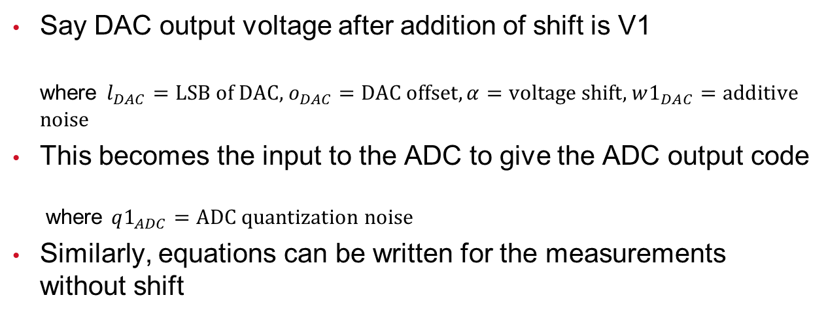
ROME (Removal Of Measurement Error)
Say DAC output voltage after addition of shift is V1
where $l_{DAC}=\text{LSB} \text{of} \text{DAC}\text{,}{ o}_{DAC}=\text{DAC} \text{offset}, α=\text{voltage} \text{shift}\text{, }w1_{DAC}=\text{additive} \text{noise}$
This becomes the input to the ADC to give the ADC output code
where $q1_{ADC}=\text{ADC} \text{quantization} \text{noise}$
Similarly, equations can be written for the measurements without shift

Slide 12

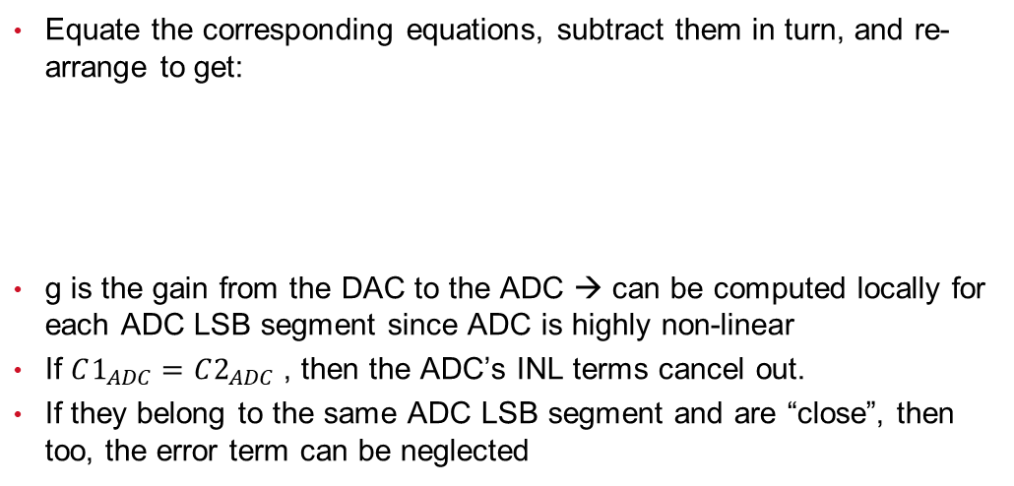
ROME (Removal Of Measurement Error)
Equate the corresponding equations, subtract them in turn, and re-arrange to get:
g is the gain from the DAC to the ADC → can be computed locally for each ADC LSB segment since ADC is highly non-linear
If $C1_{ADC}=C2_{ADC}$ , then the ADC’s INL terms cancel out.
If they belong to the same ADC LSB segment and are “close”, then too, the error term can be neglected
Error term $er$
Notes:
if the LSB segment of the ADC is linear, then the difference in input voltages to the ADC is approximately equal to the difference in ADC codes multiplied by the slope.

Slide 13
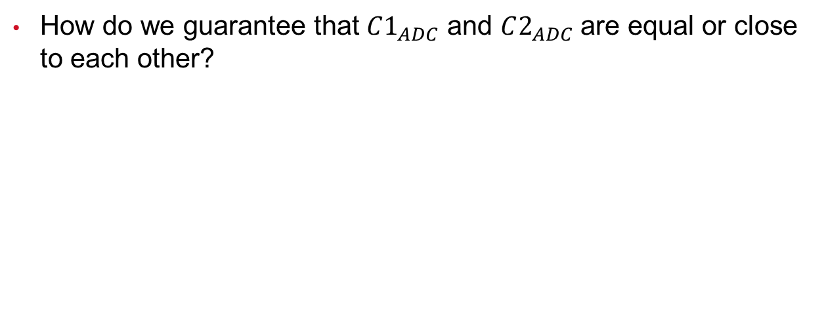
ROME (Removal Of Measurement Error)
How do we guarantee that $C1_{ADC}$ and $C2_{ADC}$ are equal or close to each other?

Slide 14
ROME (Removal Of Measurement Error)
Dummy example
Effectively, error due to measurement device “removed”

Slide 15
uSMILE-ROME
uSMILE → reduces number of variables to be estimated
ROME → removes measurement error
Combine the 2 ideas
  Substitute the segmented INL model into the ROME equation:

Slide 16
uSMILE-ROME
One such equation for each row of A1 and A2. Discard rows when ADC codes not “nearby”
Number of unknowns << number of equations
Overdetermined system → Method of Least-squares to estimate unknown vectors eM, eI and eL and the voltage shift
Reconstruct the INL of the DAC from these estimated variables
Notes:
Can take more/less measurements per code according to noise estimation

Slide 17
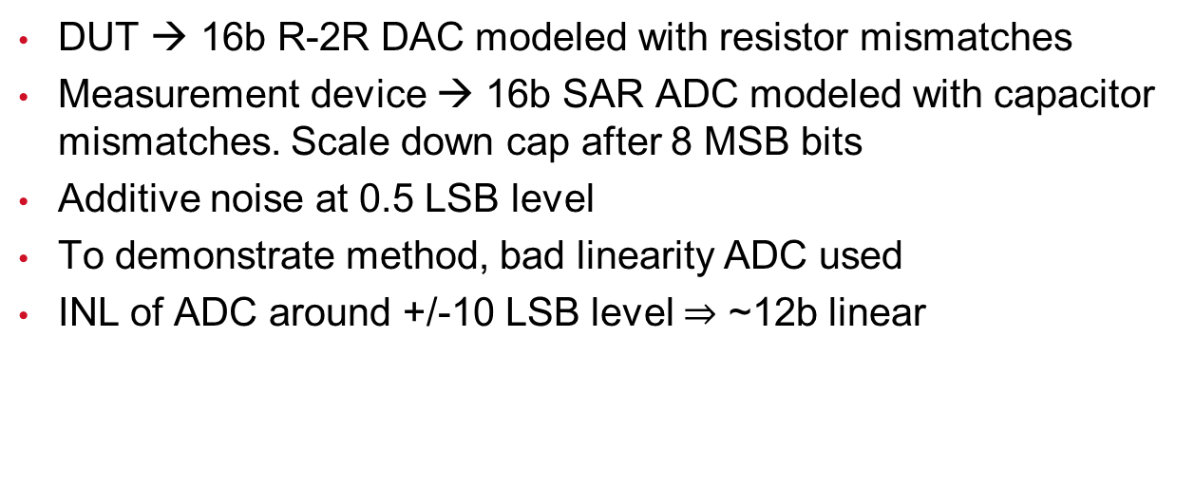
Simulation Results
DUT → 16b R-2R DAC modeled with resistor mismatches
Measurement device → 16b SAR ADC modeled with capacitor mismatches. Scale down cap after 8 MSB bits
Additive noise at 0.5 LSB level
To demonstrate method, bad linearity ADC used
INL of ADC around +/-10 LSB level $⇒$ ~12b linear

Slide 18
Simulation Results

Slide 19
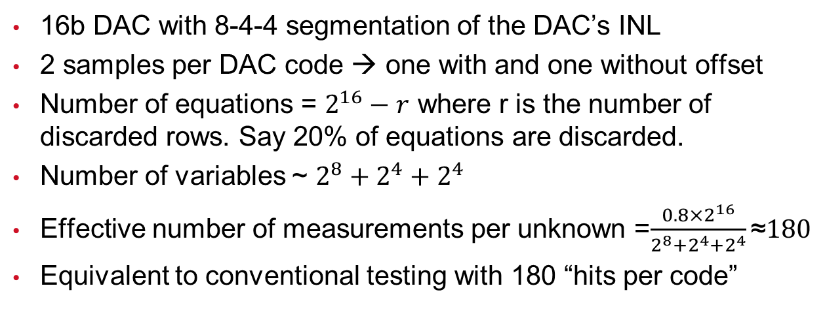
Simulation Results
16b DAC with 8-4-4 segmentation of the DAC’s INL
2 samples per DAC code → one with and one without offset
Number of equations = $2^{16}−r$ where r is the number of discarded rows. Say 20% of equations are discarded.
Number of variables ~ $2^{8}+2^{4}+2^{4}$
Effective number of measurements per unknown =$\frac{{0.8×2}^{16}}{2^{8}+2^{4}+2^{4}}\text{≈}180$
Equivalent to conventional testing with 180 “hits per code”
Notes:
Can take more/less measurements per code according to noise estimation

Slide 20
Simulation Results

Slide 21
Simulation Results
Robustness test: 100 simulations with 100 randomly generated 16-bit DACs and 16-bit ADCs
Maximum error = max(INL_est – INL_tru)
Minimum error = min(INL_est – INL_tru)

Slide 22
Simulation Results
Robustness test: 100 simulations with 100 randomly generated 16-bit DACs and 16-bit ADCs
X-axis → max(abs(INL_tru))
Y-axis → max(abs(INL_est))
+/-0.3 LSB bands around y=x line
y=x+0.3
y=x
y=x-0.3

Slide 23
Summary
A fast, low-cost method for static linearity testing of DACs is presented
uSMILE → reduces number of variables to be estimated
ROME → removes measurement error
Allows the testing of high linearity DACs with low-linearity on board digitizers
On-board/on-chip low-linearity digitizer → Test cost ↓
Fewer samples →Test time ↓ → Test cost ↓
Significant reduction in time and cost for static linearity testing of DACs as compared to the traditional method

