Slide 1
New algorithms for ADC Linearity Test:
Greatly reduce test time while maintaining or even improving test accuracy
Degang Chen
Iowa State University

Slide 2
Why ADC
ADC is the largest volume mixed-signal function
Widely embedded in many large circuits and systems
ADC performance is critical to overall system performance
ADC test is one of the most challenging and most costly tests

Slide 3
ADC test challenges and costs
Many specs to be tested
Require multiple accurate signal sources
May require accurate timing control
Need complex and accurate test circuitry
Require long test time, especially for high performance ADCs
➔for most ADCs, INL/DNL test take the longest time and is a dominant cost component

Slide 4
Existing strategies
Built-in-self-test of ADC
  Sunter et al, polynomial fitting
  Roberts and students, on-chip signal sources
  Cheng et al, loop back and control circuitry
  Provost etal, on-chip linear ramp generators
  Azais, on-chip ramps and histogram test
  Arabi, oscillation based BIST
  Jiang et al, DDEM source for histogram test

Slide 5
Existing strategies
Relax signal source requirements
  Parthasarathy et al, low linearity ramp + slope error correction
  Finland group, improved the above
  Jin et al, stimulus error identification and removal
  Alegria et al, small amp waves together with accurate steps

Slide 6
Existing strategies
Reduce data acquisition time
  Jin et al, Kalman filter + histogram
  Wegener et al, linear model + ID
  Yu et al, pipeline model ID + reconstruction
  Bernard et al, attentive test
  Adamo et al, low freq INL
  Chatterjee et al, reduced code test + reconstruction

Slide 7
Low freq INL from FFT
Adamo et al, Janik et al, Attivissimo et al, Kerzerho et al, Stefani et al, Wu et al
Chebyshev polynomial fitting
  Use HD in FFT to estimate polynomial coeff
  Use Chebyshev polynomial to predict low freq INL
Low pass filtering
  Use reduced data set in sine wave histogram test
  SHT produces “noisy” INL
  Take FFT of noisy INL, ideal low pass filter
  Take IFFT to find low freq INL
Moving average filter

Slide 8
Adamo et al

Slide 9
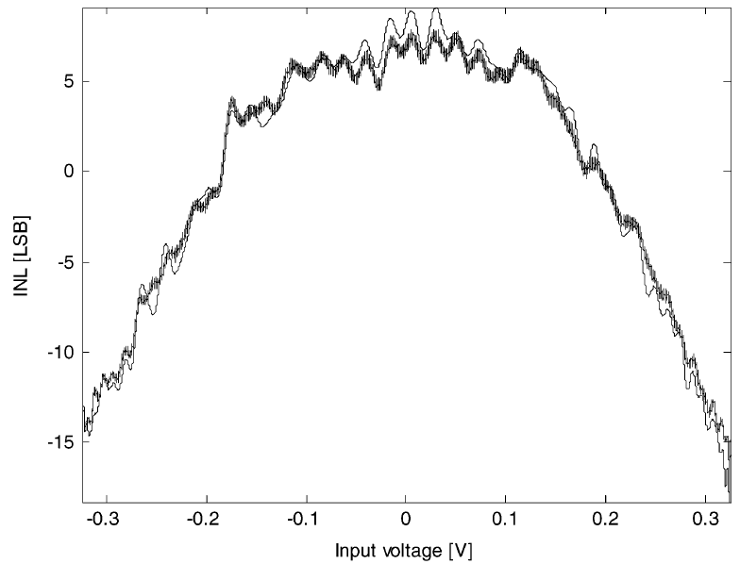
Attivissimo et al
For a grossly nonlinear ADC, the fitted INL curve may look similar to the actual curve.
But the difference is still large.

Slide 10
Complexity
Number of data points in FFT: M
Number of terms in curve fitting: Nh
Complexity:
  ∝ Nh²*M to set up equation
  ∝ Nh³ for matrix inversion

Slide 11
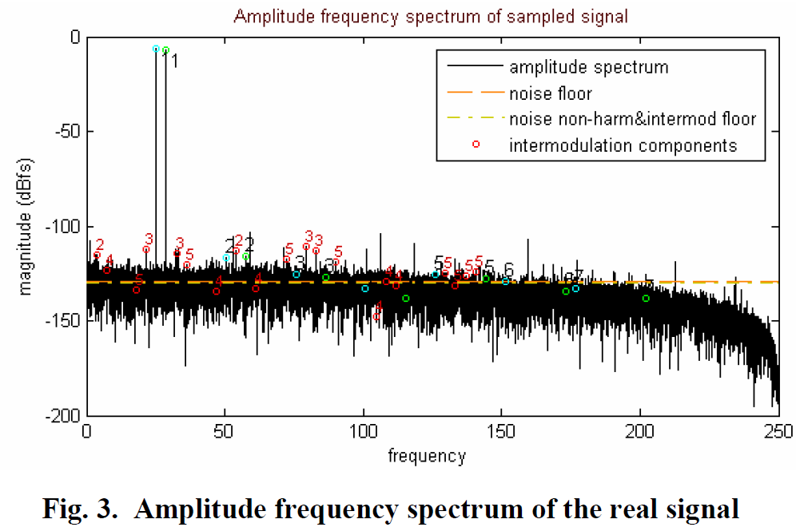
Two tone FFT based INL test
Slepicka, et al

Slide 14
Chatterjee and students
Alternate ADC testing
  Based on linear regression model
  Use large numbers of known good ADC to train
  Fit new ADC response to model and detect diff
  Worked with TI for years on this
  Is TI putting this into production test?
Basic challenge: customer question
Relation to new algorithm: none

Slide 15
Chatterjee and students, (2)
Reduced code test
  Based on characterization, find a subset of codes that are more prone to process variations
  Use piecewise linear ramps to test code bin width of these codes
  Use SAR structure’s linear model to reconstruct full code INL
Significant INL test time reduction: up to 75%
Measurement results for 12 bit ADC

Slide 16
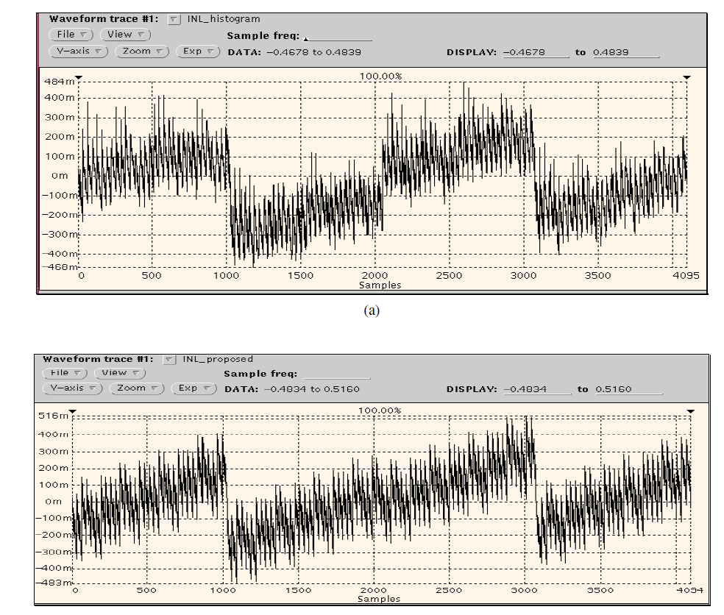

Slide 17
Chatterjee and students, (3)
Complexity
  Algorithm and hardware rely on knowledge of trouble spots
  Not clear if it will catch unpredicted PVT effects
Limited measurement results
  Same 5 devices in multiple papers
  All devices are good devices: INL/DNL ±0.5LSB
  No marginal or bad devices measured
Limited comparison
  Only compared max INL, min INL, max DNL, min DNL
  Peaks happen at different locations
  INL curve shape and individual INL values not compared

Slide 18
Goals of new INL Test Solution
Greatly reduce, or eliminate, data acquisition time for INL/DNL test
Maintain, or even significantly improve, test validity or test accuracy
Flexible on type of stimulus
Efficient in computation
Adaptable to various ADC structures

Slide 19
Basic assumptions / observations
In most ADCs, # of independent error sources << 2^{n}
There are 2^{n} – 1 transition voltages
There are 2^{n} – 3 INL errors to be tested
Hence, # of INL errors >> # of ind error sources
The gross dependency can be exploited

Slide 20
Basic assumptions / observations
In most ADCs, certain intrinsic linearity is available
Eg, for a 16 bit ADC, as long as all components are functional, 10 ~ 12 bit linearity is readily available over all PVT variation.
Hence, several LS bits can be assumed to be approximately linear
This “linear ruler” of 100s LSB long can be used to shift voltages for efficient noise averaging

Slide 21
Conceptual example
Vin
T₁₀₂₄
T₁₀₂₅
T₁₀₂₄₊₆₃
Suppose input noise sigma is 1 LSB
To measure T₁₀₂₄ with 0.2 LSB uncertainty (sigma), how many sample should I place between T₁₀₂₄ and T₁₀₈₇?
Answer: need 1/0.2=5X noise reduction, ➔ 5*5 samples for averaging, ➔multiply that by a factor since not all samples contribute, ➔ take about 64 samples per code, ➔ place 4K samples between T₁₀₂₄ and T₁₀₈₇

Slide 22
Conceptual example
Vin
T₁₀₂₄
T₁₀₂₅
T₁₀₂₄₊₆₃
Alternative approach utilizing “linear ruler”:
For each sample falling between T₁₀₂₄ and T₁₀₈₇, use ruler to shift it by a certain amout so that it become about aligned with T₁₀₂₄
Averaging these to get a measurement of T₁₀₂₄
Only need 5*5 = 25 samples between T₁₀₂₄ and T₁₀₈₇

Slide 23
Conceptual algorithm
Use a known input (or identify it)
Adjust for ADC gain error and offset
Model each transition voltage error as a simple function of grossly reduced # of error sources: INL_{i} = f_{i}(e1, e2, …, eK)
At j-th input output pair, we have
Vin(t_{j}) – C_{j}*LSB = INL_{Cj} = f_{Cj}(e1, e2, …, eK)
Use ruler to shift each equation to desired locations
Solve equations for those e’s
Calculate INL_{i}

Slide 24
One example implementation
Use error in center point of each MSB interval as one independent error source
  For 16 bit, T₀ to T₁₀₂₃, T₁₀₂₄ to T₂₀₄₇, …, are such MSB intervals
  Any “nonlinear” errors are captured by these
  Other errors can add linearly to these
  Resulting function is linear, easy to solve
Within each interval, can further use “minor intervals”
LSB transitions can be assumed linear, but missing transitions should be checked

Slide 25
Additional things that can help
Filter time domain data before putting them into equation
Check large Vin(t_{j}) – C_{j}*LSB for sparkle or transient errors
Choose input waveform to achieve desired sample density at various locations
Let model take advantage of knowledge of architecture

Slide 26
Inefficiencies in standard histogram
Only those samples near transition voltage T_{K} contribute to measurement precision of T_{K}
Samples near the middle of a code bin are not providing information about the bin edges
  Effectively only fraction α of samples in bin_{k} help reduce measurement noise of T_{K}
  Requires H samples to reduce variance of T_{K} to σ²/ αH, where σ is noise sigma
All T_{K}’s treated as independent random var
  Requires H*2^{n} samples
  Gross inefficiency

Slide 27
Example
If ADC input referred noise sigma is σ
Histogram has an average H samples per code
Total samples: 2^{n}*H
Transition voltage error variance:
INL_{k} variance:
INL curve noise band:

Slide 28
Example
DNL error involves two transition voltages:
DNL curve measurement noise band:
For n=16, H=64, σ=0.87, α=0.5,
For device 1 and 2, σ=0.87 from SNR analysis

Slide 29
New Method
No histograming
All samples contribute to measurement noise averaging
  Remove the 1/α factor of inefficiency
Don’t pretend that all transition voltages are independent random variables
All transition voltage errors are a linear combination of a much smaller number of independent random error sources
Ideal low-pass filter in DSP to reduce noise

Slide 30
Example
For a total of M samples, filter bandwidth B*f_{s}, and assuming K independent errors, then
For n=16, σ=0.87, K=144, B=1 (no LPF), M=2¹⁶:
For B=1/4: INL_band = 0.14, DNL_band = 0.19

Slide 31
Improvement prediction
Compare:
  New method with B=1/4: INL_band = 0.14, DNL_band = 0.19
  Standard: INL_band = 0.72, DNL_band = 1.02
Measurement noise bands reduced by about a factor of 5
This is with 64 times less samples
In general:

Slide 32
uSMILE: ultrafast Segmented Model Identification for (accurate ADC) Linearity Estimation
Based on: Z. Yu and D. Chen, ITC 2012
2013 IEEE Nerd Cornfield Best Paper Award

Slide 33
ADC Non-linearity
The transition point for output code from k to k+1 is
Ideally, T_{K} should be uniform and linear in K.
The Integral Non-Linearity is
The Differential Non-Linearity is

Slide 34
ADC linearity test challenge
De-facto standard method: histogram test
As ADC performance becomes better:
  # codes to be tested ↑exponentially
  Sampling rate ↑ much less, or may even ↓
  Hits / code in HT no change
Test time becomes much longer
Test cost becomes too high to be acceptable

Slide 35
Gross Inefficiencies in Histogram Test
In medium to high resolution ADCs
  # of analog components: O(n)
  # of independent error sources: O(n)
  # of transition voltages: 2^{n}
  # of INL/DNL errors to be tested: 2^{n} each
But all INL/DNL errors are completely determined by those much fewer independent error sources
Treating INL/DNL errors as independent is grossly inefficient!
Notes:
2^{n} is orders of magnitude larger than n. The big O notation capture the order of magnitudes.

Slide 36
Standard Histogram Test
Gross Inefficiencies in Histogram Test
H * 2^{n}
histogram
h(k-1)
h(k)
h(k+1)
Accurate source
⁞
f(t)
C(t)
ADC
⁞
2^{n}
2^{n}
What is the most precise here?
f(t)
How did we use it?
Threw it away.
This is a gross loss of information.

Slide 37
Gross Inefficiencies in Histogram Test
In the standard histogram test
  H*2^{n} samples are collected
  But only ~H samples in bin k are used in computing code bin width Wk or DNLk
  Nearby samples, and all other samples that went through the same circuit hardware are ignored
Grossly reduced noise averaging capability
Notes:
2^{n} is orders of magnitude larger than n. The big O notation capture the order of magnitudes.

Slide 38
uSMILE: ultrafast Segmented Model Identification for Linearity Estimation
Expected
Linear code
Accurate source
–
f(t)
ADC
+
+
N.L error
and noise
+
C(t)
INL(C)
Segmented model for INL/DNL
Code k: 0, 1, …, 2^{n}-1
INL(k)
ID goal: search for model that produces the best match at the observed output codes

Slide 39
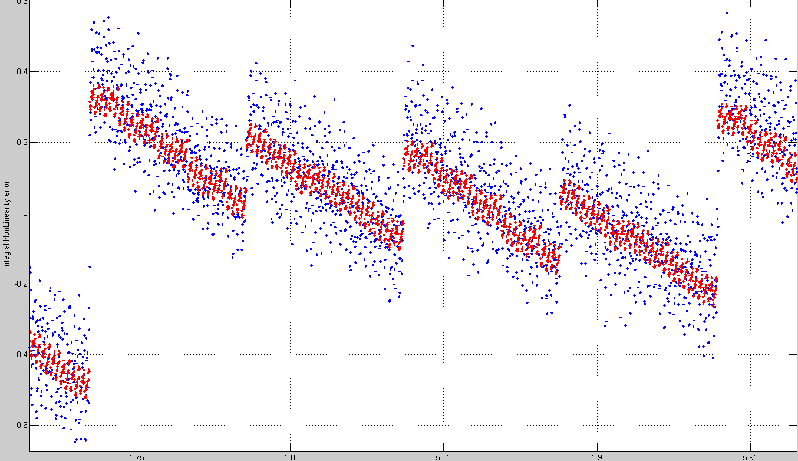
The INLk curve is broken to segments based on MSB codes
Each MSB segment has a center error E(C_{MSB})
MSB broken into ISB segments, with ISB center errors E_{I}(C_{ISB})
Within an ISB, test LSB code bin width errors WE(C_{LSB}) by tail histogram using all samples
ISB
centers
E(C_{MSB})
E(C_{MSB}+2)
E(C_{MSB}+1)
Total # error terms: K = 2^{nMSB} + 2^{nISB} + 2^{nLSB}
For 14 to 20 bits, this number is in the 100~200 range.
Notes:
Graphical illustration of E(C_{MSB}). Even with discontinuities, Taylor expansion applied well within an MSB segment.

Slide 40
Algorithm
With pure sine input, obtain coherent data set
Y={y1, y2, … yM}
Perform FFT, obtain y_{fund}, P_{e}=P_{Y} – P_{fund} – P_{DC}
If P_{e} is excessive, bad ADC, stop
At each I/O pair, write
    yk–C_{out}(y_{fund}(t_{k}))+E(yk_{MSB})+E_{I}(yk_{ISB})+WE(yk_{LSB}) =noise
Identify E(C_{MSB}), E_{I}(C_{ISB}), WE(C_{LSB})
Construct INL(k) and DNL(k) for all code k.

Slide 41
Measurement uncertainty
If ADC is well designed, no dominant errors, all identifiable error sources contribute about equally
From Cremer-Rao Lower Bound, measurement uncertainty variance >= K_{ind} * σ² / M, where K_{ind} is the # of independent error sources
Algorithm uses K > K_{ind} parameters, hence
  Var >= K * σ² / M > K_{ind} * σ² / M
For sine wave input, new method’s test uncertainty:
  Var = π *K * σ² / 2M
RHT: var = σ² / H; SHT: var = π σ² / 2H
RHT var/new var ratio = 2M/(πKH)
Example:
  If new alg. uses M=1*2^16, K=160, but SHT use H=64 hpc, ➔ Var_SHT / Var_new = M/KH = 32/5=6.4
  Uncertainty band reduction = rt(var reduction)
  ➔ new alg. reduces uncertainty band by 2.5 times

Slide 42
Simulation Results
Randomly generate SAR/Pipeline/Cyclic ADCs with various resolutions, various linearity levels
Segmented model with 2 or 3 segments, various bits in different segments
Test conditions with various noise levels and ranging from 1 sample per code to 1 sample per several codes
Always achieves “accurate” test results, with uncertainty and bias as predicted by theory
Not supposed to work for flash, but it does

Slide 43
Blue: true INL, Red: standard RHT w/ 128 hpc
H=128

Slide 44
Blue: true INL, Red: new algorithm w/ 1 hpc
➔ M=2^16; used two segments, with K=512
New algorithm achieved the same test accuracy with 128 times less data.

Slide 45
Measurement results
Full code INL and DNL test
Industry independent measurements
Resolution of ADCs: 12 bits to 18 bits
Comparisons to
  Ramp histogram test
  Sine histogram test
  Servo-loop test

Slide 46
Case study 1: 16 bit SAR, good device, full code INL/DNL test, new method vs RHT new INL curve lies at center of RHT noisy INL curve
Blue: RHT with H*2^n = 64 * 2^16 samples
Red: new algorithm with only M = 2^16 samples
Notes:
Now, let’s look at the performance of the new algorithm. Extensive simulation and measurements are conducted. Here are a few examples.

Slide 47
Case study 2: 16 bit SAR, bad device, full code INL/DNL test, new method vs RHT new INL curve lies at center of RHT noisy INL curve
Blue: RHT with H*2^n = 64 * 2^16 samples
Red: new algorithm with only M = 2^16 samples

Slide 48
Device 3 INL, good device
Full code INL test:
Blue: standard RHT with 64 hpc
Red: new alg with
<2% data

Slide 49
Device 4 INL, poor device
Full code INL test:
Blue: standard
RHT 64 hpc
Red: new with
<2% data

Slide 50
Case study 5: 16 bit SAR, excellent device, full code INL/DNL test, new method vs SHT new INL curve lies at center of SHT noisy INL curve
Blue: SHT with H*2^n = 128 * 2^16 samples
Red: new algorithm with only M 2^15 samples

Slide 51
ADC4 INL, poor device
Case study 6: 16 bit SAR, poor device, full code INL/DNL test, new method vs SHT
new INL curve lies at center of SHT noisy INL curve
Blue: SHT with H*2^n = 128 * 2^16 samples
Red: new algorithm with only M 2^15 samples

Slide 52
ADC7 INL, good device
Full code INL test:
Blue: standard
SHT 128 hpc
Red: new with
<0.5% data

Slide 53
NSC ADC2 INL, good device
Full code INL test:
Blue: standard
SHT 128 hpc
Red: new with
<0.5% data

Slide 54
Repeatability study: INL test1 – test2
Ramp histogram method: 64*2^16 samples
Test noise band: - 0.4 to +0.3 LSB
if we ignore the slope.
Notes:
Uncertainty band is about 0.6 LSB wide, which is about 2.5 times as wide as for the new algorithm.

Slide 55
Repeatability study: INL test1 – test2
New algorithm: 1*2^16 samples
Test noise band: within +- 0.15LSB
Test noise band reduced by 0.7/0.3 = 2.3X.
This is achieved with 64X less data.
Theory says noise band to be reduced by
a factor of (2*M/K/H/pi)^0.5 =
(2*2^16/(64+32+32)/64/pi)^0.5 = 2.26X.
Notes:
Uncertainty band is about 0.25 LSB wide.

Slide 56
A more detailed case study
New method visually more precise than HT
Repeatability is about 2.3 times better.
➔ Need more accurate methods as a reference to check test accuracy of new method
➔ Use the gold standard servo loop
A 16 bit SAR ADC used
Full code tests by new method and servo loop
Compare both INL and DNL, code by code

Slide 57
16 bit SAR
Servo loop takes ~18 minutes
New algorithm used 16K samples, taking <0.1sec
Notes:
Since the new algorithm seems to be generating more repeatable results than RHT or SHT. It is time to compare to the golden standard servo loop test.

Slide 62
Summary
Measurement case studies confirm theoretical prediction
New method with only 16K samples provides 16 bit full code INL/DNL test results whose accuracy is verified code for code by servo loop test
Measurement noise bands for the new method are 2 to 3 times narrower than noise bands from histogram tests using 64 to 256 times more data
Computation time is very small
Extensively validated by TI, in production for select high performance parts

Slide 63
Benefits of the new method
For products whose full code linearity and spectral performance are both tested
  Make sure ADC is not flash or sigma-delta
  Verify sine source is sufficiently pure
  Increase #samples in spectral test to at least ¼ hit/code, if not already at this level or higher
  Retain raw data from spectral test, feed raw data to the new test algorithm for INL/DNL test
  Bypass the data collection for traditional linearity test
  No hardware change necessary
  Same board, sockets, tester can be used
  Requires only software change

Slide 64
Benefits of the new method
In characterization test
  Use pure sine wave as input,
  Run new algorithm for full code INL/DNL test
  Update INL/DNL curve every 0.1 sec, as you change test conditions
  For quick thermal test (with hot or cold air blowing on chip, and observe instantaneous change in INL/DNL curve)
  For checking reference issues, cross talk issues, etc.
To greatly reduce characterization time
Or to greatly reduce time to market
Or to have much more thorough characterization

Slide 65
Evaluation of new algorithm
Did extensive simulation
  New algorithm achieves much better test accuracy with much reduced # of samples, as compared to standard histogram method
  Simulation on various ADC architectures: SAR, pipeline, sub-ranging, moderately high resolution flash
Measurement results
  ISU, TI, NSC
  Various resolutions

Slide 66
12 bit ADC test results

Slide 67
INL difference at each code

Slide 68
TI Evaluation of New Algorithm
16 bit SAR ADC
TI collects 2¹⁶ samples with sine wave input and test ADC with standard INL test
TI sends 2¹⁶ samples to ISU
ISU performs full code linearity test
ISU sends tested INL data to TI
TI sends INL data from standard test to ISU
Both TI and ISU compare two INL tests

Slide 69
TI Device 1 INL, good device
Full code INL test:
Blue: standard
Red: new with
<2% data
End-point INL

Slide 70
TI Device 1 INL, good device
Full code INL test:
Blue: standard
Red: new with
<2% data
Least square
based INL

Slide 71
A zoomed in view at codes 10k to 15k
Full code INL test:
Blue: standard
Red: new with
<2% data
Least square
based INL
Blue noise band: ~0.5 to 0.6 LSB
Red noise band: ~0.1 to 0.13 LSB
Measurement noise band reduction by a factor of 5 as predicted by theory.

Slide 72
TI Device 1 DNL, good device
Full code DNL test:
Blue: standard
Red: new with
<2% data
Least square
based INL
Blue noise band: ~1 LSB
Red noise band: ~0.2 LSB
Measurement noise band reduction by a factor of 5 as predicted by theory.

Slide 73
Program log for major errors
There are sparkle codes in this ADC.
Expected codes: -3.1755838e+004
Actual codes: -3.1765629e+004
Code errors: -9.7912798e+000

Slide 74
±6σ of input referred noise
Sparkle or transient error?

Slide 75
Device 1 with 2¹⁴ samples
Further reduce #samples by a factor of 4
Keep same number of ind error sources
Same filtering
Theory expect noise band to double

Slide 77
TI Device 2 INL, good device
Full code INL test:
Blue: standard
Red: new with
<2% data
Least square
based INL

Slide 78
A zoomed in view at codes 10k to 15k
Full code INL test:
Blue: standard
Red: new with
<2% data
Least square
based INL
Blue noise band: ~0.5 to 0.6 LSB
Red noise band: ~0.1 to 0.13 LSB
Measurement noise band reduction by a factor of 5 as predicted by theory.

Slide 79
TI Device 2 DNL, good device
Full code DNL test:
Blue: standard
Red: new with
<2% data
Least square
based INL
Blue noise band: ~ 0.8 to 1.2 LSB
Red noise band: <~0.2 LSB
Measurement noise band reduction by a factor of 5 as predicted by theory.

Slide 80
Program log for major errors
There are sparkle codes in this ADC.
Expected codes: -2.6234594e+004
Actual codes: -2.6267029e+004
Code errors: -3.2435467e+001

Slide 81
TI Device 3 INL, poor device
Full code INL test:
Blue: standard
Red: new with
<2% data
Least square
based INL

Slide 82
A zoomed in view at codes 10k to 15k
Full code INL test:
Blue: standard
Red: new with
<2% data
Least square
based INL
Blue noise band: ~1 to 1.5 LSB
Red noise band: ~0.2 to 0.25 LSB

Slide 83
TI Device 3 DNL, poor device
Full code DNL test:
Blue: standard
Red: new with
<2% data
Least square
based INL
Blue noise band: ~ 2 to 2.5 LSB
Red noise band: ~0.2 to 0.25 LSB

Slide 84
Program log for major errors
There are missing codes in this ADC
There are 1 code(s) missing near code 1023 There are 1 code(s) missing near code 2047
There are 1 code(s) missing near code 3071 There are 2 code(s) missing near code 4095
There are 1 code(s) missing near code 5119 There are 1 code(s) missing near code 6143
There are 1 code(s) missing near code 7167 There are 4 code(s) missing near code 8191
There are 1 code(s) missing near code 8192 There are 1 code(s) missing near code 9215
There are 1 code(s) missing near code 10239 There are 1 code(s) missing near code 11263
There are 2 code(s) missing near code 12287 There are 1 code(s) missing near code 14335
There are 1 code(s) missing near code 15359 There are 2 code(s) missing near code 16383
There are 1 code(s) missing near code 17407 There are 1 code(s) missing near code 18431
There are 1 code(s) missing near code 19455 There are 2 code(s) missing near code 20479
There are 1 code(s) missing near code 22527 There are 4 code(s) missing near code 24575
There are 1 code(s) missing near code 24576 There are 1 code(s) missing near code 25599
There are 1 code(s) missing near code 26623 There are 2 code(s) missing near code 28671
There are 1 code(s) missing near code 30719 There are 1 code(s) missing near code 31743
There are 3 code(s) missing near code 32767 There are 1 code(s) missing near code 34815
There are 1 code(s) missing near code 35839 There are 2 code(s) missing near code 36863
There are 1 code(s) missing near code 38911 There are 1 code(s) missing near code 39935
There are 4 code(s) missing near code 40959 There are 1 code(s) missing near code 40960
There are 1 code(s) missing near code 43007 There are 2 code(s) missing near code 45055
There are 1 code(s) missing near code 47103 There are 1 code(s) missing near code 48127
There are 1 code(s) missing near code 49151 There are 1 code(s) missing near code 50175
There are 1 code(s) missing near code 51199 There are 1 code(s) missing near code 52223
There are 2 code(s) missing near code 53247 There are 1 code(s) missing near code 55295
There are 1 code(s) missing near code 56319 There are 4 code(s) missing near code 57343
There are 1 code(s) missing near code 57344 There are 1 code(s) missing near code 58367
There are 1 code(s) missing near code 59391 There are 2 code(s) missing near code 61439
There are 1 code(s) missing near code 63487

Slide 85
TI Device 4 INL, poor device
Full code INL test:
Blue: standard
Red: new with
<2% data
Least square
based INL

Slide 86
A zoomed in view at codes 10k to 15k
Full code INL test:
Blue: standard
Red: new with
<2% data
Least square
based INL
Blue noise band: ~1 to 1.5 LSB
Red noise band: ~0.15 to 0.2 LSB

Slide 87
TI Device 4 DNL, poor device
Full code DNL test:
Blue: standard
Red: new with
<2% data
Least square
based INL
Blue noise band: ~ 2 to 2.5 LSB
Red noise band: ~0.2 to 0.25 LSB

Slide 88
Observations
INL curves
  Very similar shape
  Measurement noise band reduced as predicted
  Still non-trial differences
  Is new method accurate?
DNL curves
  Clear patterns in new method
  Pattern corresponds well with INL curves
  No clear pattern in standard histogram method

Slide 89
Assess test precision
Compare differences from run to run
Repeat standard method many times and use average results for comparison

Slide 90
Device 1, new method
DNL test1 – test2

Slide 91
Device 1, new method
INL test1 – test2

Slide 92
Device 2: standard method typical INL differences between loops

Slide 93
Device 2, new method
DNL test1 – test2

Slide 94
Averaging the standard method
For device 1 and 2, the standard method is applied to each device 16 loops
The 16 loops were repeated at another time, producing two groups of 16 runs for each device
Two averages of 16 loops were obtained, and one average of 32 loops was obtained
Average to average, average to single loop, and average to new method were compared

Slide 95
Device 2 INL: standard method
16 loop average – another 16 loop average

Slide 96
Device 2 DNL: standard method
16 loop average – another 16 loop average

Slide 97
Device 2 DNL: standard method
16 loop average – single loop

Slide 98
Device 1 INL/DNL comparison
Red: new method with 64K samples
Blue: 16 loop average of standard method each with 64*64K samples

Slide 103
Device 1 INL/DNL comparison
Red: new method with 64K samples
Blue: 32 loop average of standard method each with 64*64K samples

Slide 104
Red: new method with 64K samples
Blue: standard with 2048*64K samples

Slide 105
Red: new method with 64K samples
Blue: standard with 2048*64K samples
Red is shifted up by 1 LSB for easy comparison

Slide 106
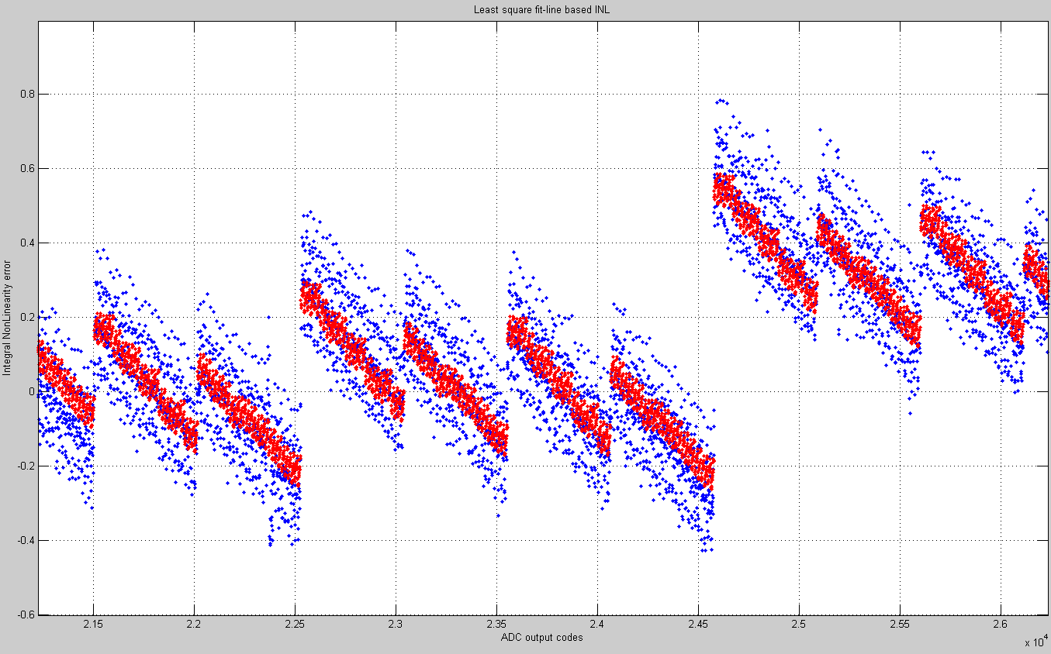
A zoomed in view of INL comparison
Notice that blue is in much better agreement with red than we’ve seen before (on next page)

Slide 108
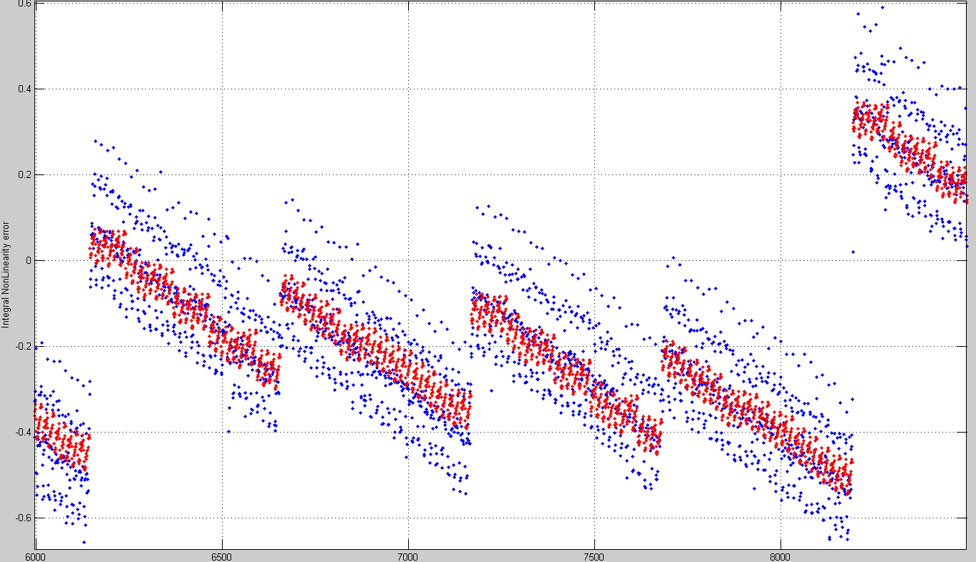
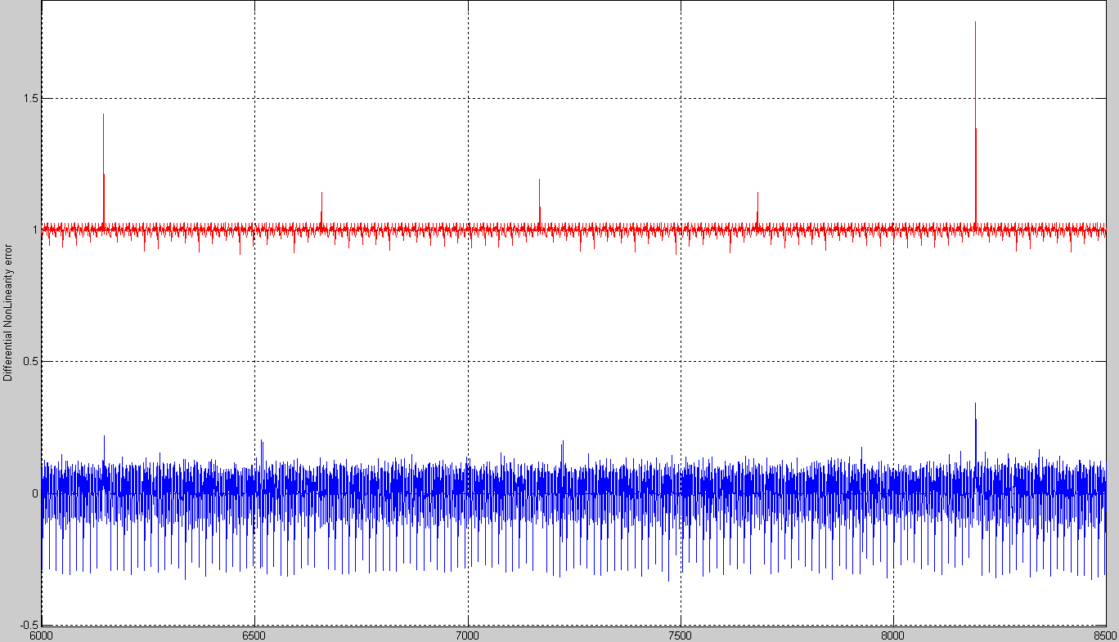

Slide 109
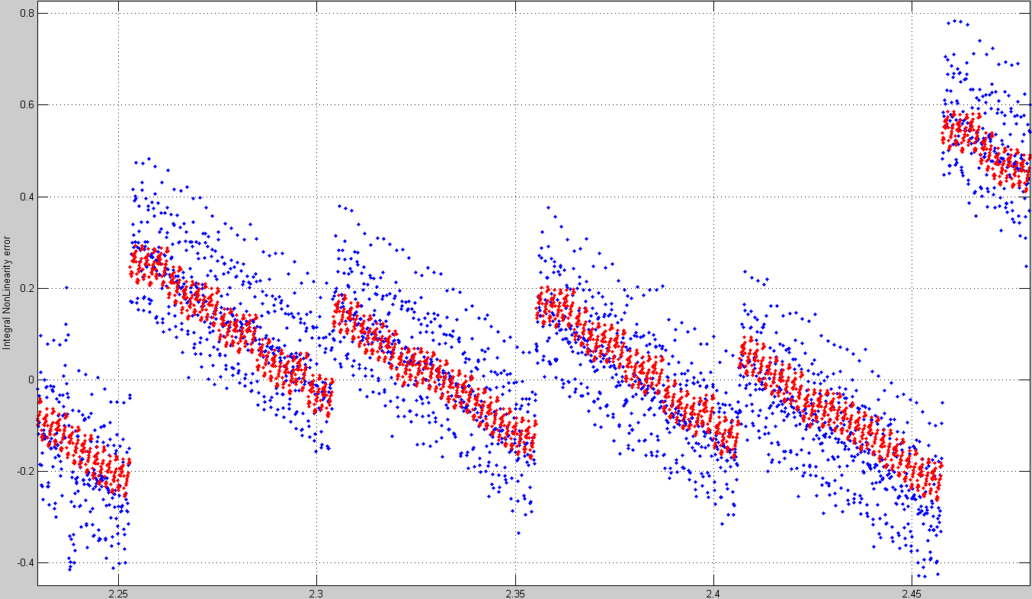
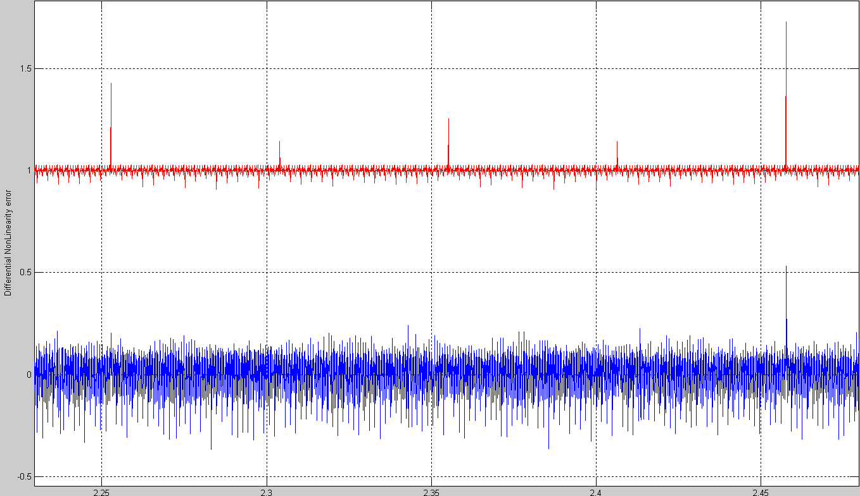

Slide 110
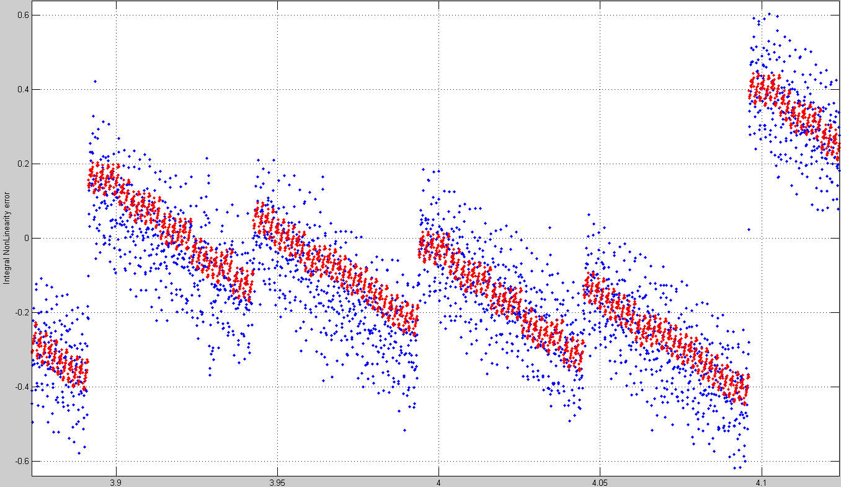
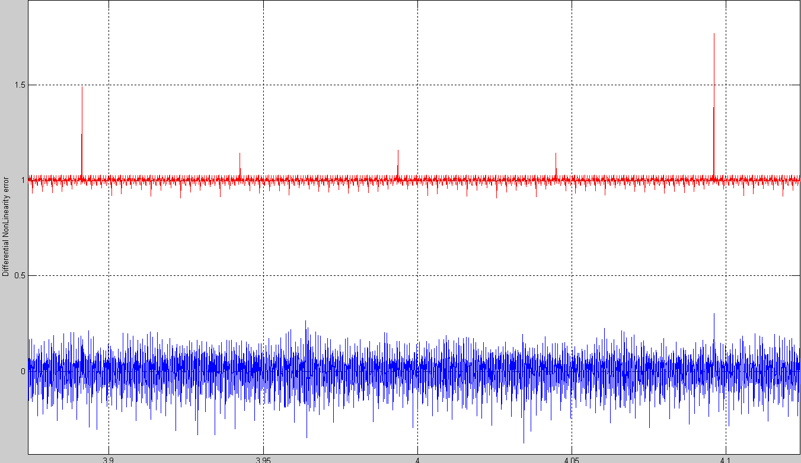

Slide 111
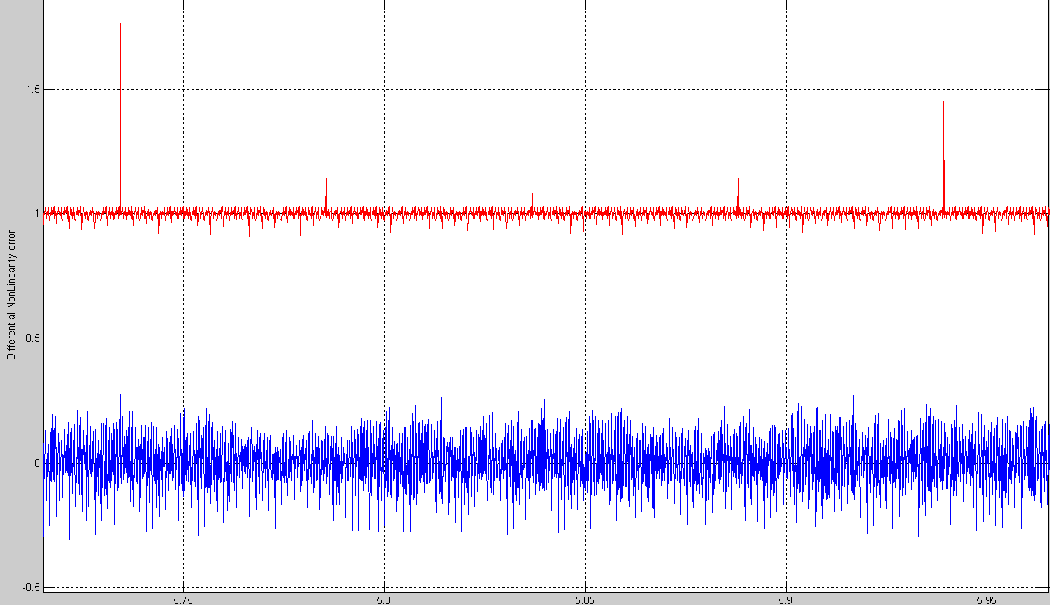

Slide 112
Validation with NSC ADC’s
16 bit SAR ADC
  2¹⁵ samples for spectral testing
  New method uses these 2¹⁵ samples for INL test
  Standard method use 128 sample per code, or a total of 2²³ samples for INL test
  That is 256X more than new method
Comparison of results suggests that the new method is highly likely to be more accurate!

Slide 113
NSC ADC1 INL, good device
Full code INL test:
Blue: standard
Red: new with
<0.5% data
Least square
based INL

Slide 114
NSC ADC1 DNL, good device
Full code DNL test:
Blue: standard
Red: new with
<0.5% data
Least square
based INL
Blue noise band: ~ 0.8 to 1.2 LSB
Red noise band: <~0.2 LSB

Slide 115
NSC ADC2 INL, good device
Full code INL test:
Blue: standard
Red: new with
<0.5% data
Least square
based INL

Slide 116
NSC ADC2 DNL, good device
Full code DNL test:
Blue: standard
Red: new with
<0.5% data
Least square
based INL
Red noise band: ~0.2 LSB
Blue noise band: ~ 0.6 to 1 LSB

Slide 117
NSC ADC3 INL, marginal device
Full code INL test:
Blue: standard
Red: new with
<0.5% data
Least square
based INL

Slide 118
NSC ADC3 DNL, marginal device
Full code DNL test:
Blue: standard
Red: new with
<0.5% data
Least square
based INL
Red noise band: ~0.1 LSB
Blue noise band: ~ 0.5 to 0.9 LSB

Slide 119
Zoomed in view at codes 30k to 35 k
Full code DNL test:
Blue: standard
Red: new with
<0.5% data
Least square
based INL
Very wide code
Big INL jump
Slightly wide codes
Blue has more noise
Red more accurately captures wide codes
Small INL jumps
INL plot

Slide 120
Program log for major errors
There are wide codes in this ADC
Code 32767 is wide by 2 LSB(s).
There are missing codes in this ADC
There are 1 code(s) missing near code 16383
There are 1 code(s) missing near code 49151

Slide 121
NSC ADC4 INL, poor device
Full code INL test:
Blue: standard
Red: new with
<0.5% data
Least square
based INL

Slide 122
NSC ADC4 DNL, poor device
Full code DNL test:
Blue: standard
Red: new with
<0.5% data
Least square
based INL
Blue noise band: ~ 0.6 to 0.9 LSB
Red noise band: ~0.1 LSB

Slide 123
Zoomed in view at codes 30k to 35 k
Full code DNL test:
Blue: standard
Red: new with
<0.5% data
Least square
based INL
Very wide code
Big INL jump
Slightly wide codes
INL plot
Blue has more noise
Red more accurately captures wide codes
Small INL jumps

Slide 124
Program log for major errors
There are wide codes in this ADC
Code 16383 is wide by 2 LSB(s).
Code 32767 is wide by 1 LSB(s).
Code 49151 is wide by 2 LSB(s).
There are missing codes in this ADC
There are 1 code(s) missing near code 8191
There are 1 code(s) missing near code 24575
There are 1 code(s) missing near code 40959
There are 1 code(s) missing near code 57343

