Slide 1
USER-SMILE
Ultrafast Stimulus Error Removal and Segmented Model Identification for Linearity Estimation
Tao Chen, Degang Chen
Iowa State University

Slide 2
Motivation
For high performance ADCs, the linearity test is time consuming
The stimulus are required to be extremely linear
A new ADC linearity test algorithm is presented
  Reduce data acquisition time by >100x
  Eliminate the stimulus linearity requirement
  Maintains same or better precision

Slide 3
Outline
Background
Ultrafast linearity test algorithm
Simulation Results
Conclusion

Slide 4
Background
Standard ADC Linearity Test (histogram)
H*2^{n}
histogram
h(k-1)
h(k)
h(k+1)
Accurate source
⁞
f(t)
C(t)
ADC
⁞
2^{n}
2^{n}

Slide 5
Challenges
Highly linear signal
  Expensive instruments
  Complex test board design
Many hits per code
  Extremely long test time
  Environment non-stationarity

Slide 6
Need
Nonlinear signal: low-cost signal generator
Reduced test time: save test cost
Ultimate goal: built-in on-chip test
There is a strong need to test the ADC on-chip with significantly reduced test time

Slide 7
SEIR Algorithm
SEIR relaxes the input signal linearity requirement
x₁(t)
C_{k,1}
ADC
x₂(t)
C_{k,2}
SEIR
ADC INL measurement

Slide 8
Review of uSMILE
ultrafast Segmented Model Identification of Linearity Errors (uSMILE)
High resolution ADCs always use architectures for which the number of ADC output codes is orders of magnitude more than the number of analog components used to build the ADC.
For SAR ADC, N-bit ADC requires O(n) components.
The non-ideality of these components completely determines all the errors in the ADC transfer curve.

Slide 9
Review of uSMILE
This algorithm takes a system identification approach using a segmented non-parametric model that captures both the linear errors and non-linear errors.
It works for SAR ADC, Pipeline ADC and other ADCs having the segmentation characteristics.
The number of test data can be reduced by a factor of 100

Slide 10
uSMILE Algorithm
uSMILE reduces the test time significantly
Expected
Linear code
Accurate source
–
f(t)
ADC
+
+
N.L error
and noise
+
C(t)
INL(C)
Segmented non parametric model for INL/DNL
Code k: 0, 1, …, 2^{n}-1
INL(k)

Slide 11
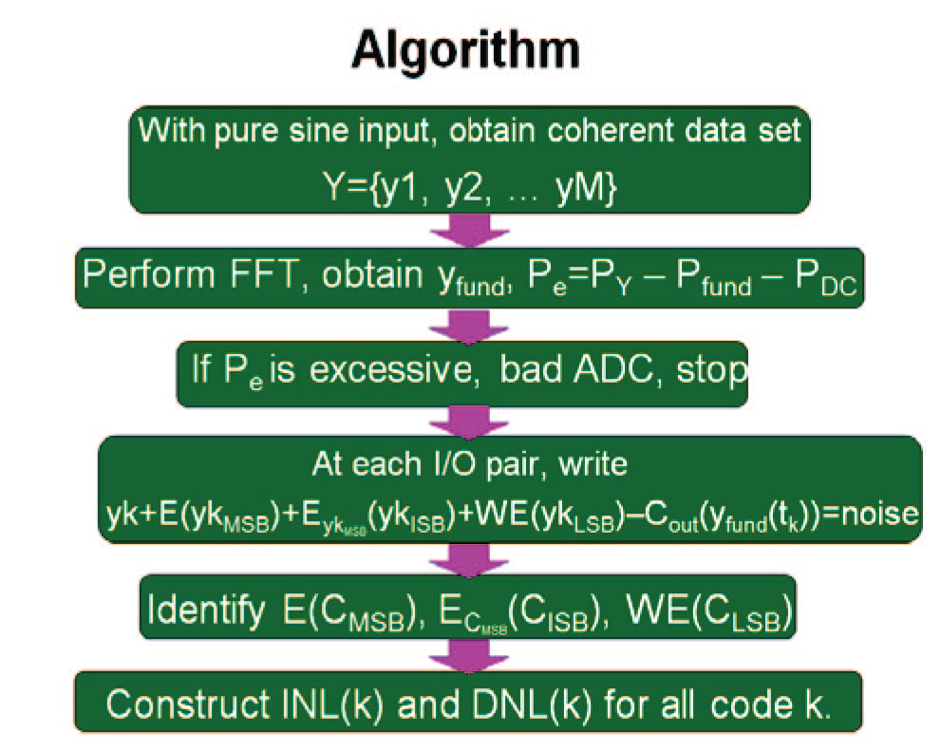
uSMILE Algorithm Procedures

Slide 12
Challenges
Pure Input Signal
  It requires highly linear input signal
Coherent Sampling
  It is difficult to realize coherent sampling
Difficult to implement on chip

Slide 13
Need
There is a need for a way to achieve ultra fast testing time without linear input source requirement

Slide 14
Proposed Algorithm
No linearity requirement for the input signal
Number of samples are small
Implementation is simple (easy to implement on chip)
ADC INL error is modeled with segmented model
  Segmented model identification of linearity errors
Input source’s error is removed
  Stimulus error removal
Using only arount 1 sample per ADC code
  Ultra fast data acquisition

Slide 15





Proposed Algorithm
USER-SMILE: Ultrafast Stimulus Error Removal and Segmented Model Identification of Linearity Errors
$$α$$
$$V_{in}^{\left(1\right)}$$
Nonlinear
source
+
$$C^{\left(1\right)}$$
ADC
$$C^{\left(2\right)}$$
$$V_{in}^{\left(2\right)}$$
α: constant voltage
w: input-referred noise
q: quantization noise
$$V_{in}^{\left(1\right)}+w^{\left(1\right)}=C^{\left(1\right)}∙V_{LSB}+e_{M}\left({C^{\left(1\right)}}_{MSB}\right)∙V_{LSB}+e_{I}\left({C^{\left(1\right)}}_{ISB}\right)∙V_{LSB}+e_{L}\left({C^{\left(1\right)}}_{LSB}\right)∙V_{LSB}+q^{\left(1\right)}$$
$$V_{in}^{\left(2\right)}+w^{\left(2\right)}=C^{\left(2\right)}∙V_{LSB}+e_{M}\left({C^{\left(2\right)}}_{MSB}\right)∙V_{LSB}+e_{I}\left({C^{\left(2\right)}}_{ISB}\right)∙V_{LSB}+e_{L}\left({C^{\left(2\right)}}_{LSB}\right)∙V_{LSB}+q^{\left(2\right)}$$

Slide 16

USER SMILE Algorithm
Unknown error terms in the equations
eM: MSB segment average error
eI : ISB segment average error
eL : LSB segment average error
$C^{\left(1\right)}−C^{\left(2\right)}−\frac{α}{V_{LSB}}$
$=$ $−e_{M}\left({C^{\left(1\right)}}_{MSB}\right)−e_{I}\left({C^{\left(1\right)}}_{ISB}\right)−e_{L}\left({C^{\left(1\right)}}_{LSB}\right)$
$+e_{M}\left({C^{\left(2\right)}}_{MSB}\right)+e_{I}\left({C^{\left(2\right)}}_{ISB}\right)+e_{L}\left({C^{\left(2\right)}}_{LSB}\right)$
$+{\left(q\right.}^{\left(2\right)}−q^{\left(1\right)}+ w^{\left(1\right)}−w^{\left(2\right)})/{V_{LSB}}$
Noise

Slide 17
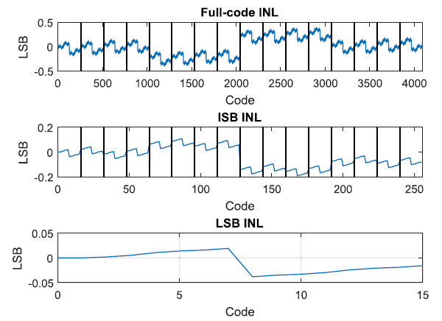
Example of INL segmentation

Slide 18


USER SMILE Algorithm
Total # of unknowns
$2^{N_{M}}+2^{N_{I}}+2^{N_{L}}$ (e.g. $2^{6}+2^{5}+2^{5}=$ 128)
Total # of equations
$2^{N}∙hpc$ (e.g. $2^{16}∙0.5=32768)$
Use your favorite identification algorithm
$N_{M}$
$N_{I}$
$N_{L}$
N
hpc
: MSB segment bits
: ISB segment bits
: LSB segment bits
: ADC resolution
: Input signal hits/code

Slide 19
USER SMILE Algorithm
Input signal
  Held for two samples
  Ramp or sine wave for the convenience of implementation
  Cover most of the input range
The offset:
  Remains constant
  Identified using the average output difference

Slide 20
Simulation
16-bit SAR ADC model with capacitor mismatches
0.5 LSB input-referred noise
Nonlinear ramp signal

Slide 21
Simulation Result
Two 1 hit/code nonlinear ramps

Slide 22
Simulation Result
Two ¼ hit/code nonlinear ramps

Slide 23
Simulation Result
100 simulations (randomly generated ADC)
Two 1 hit/code nonlinear ramps

Slide 24
Simulation Result
100 simulations (randomly generated ADC)
Two 1/4 hit/code nonlinear ramps

Slide 25
Conclusion
The stimulus’ linearity is relaxed
Test time is significantly reduced
Achieve better test accuracy and coverage
BIST solution to embedded ADC

Slide 26
New Algorithm
The new algorithm proposed in this project is to combine the ultra-fast and accurate linearity test methodology with the nonlinear excitation approach.
The target is to obtain ultra-fast and accurate linearity test results of ADCs with imprecise instruments.
By applying the uSMILE algorithm, a 16-bit ADC can be divided into 3 segments (MSB, ISB and LSB). For each segment, certain number of parameters need to be solved. After getting all the parameters, full-code INL can be constructed.

Slide 27
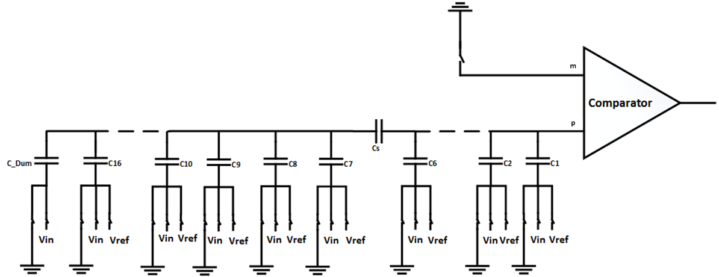
Implementation in SAR ADC
For each input signal, the ADC samples it twice. In the two samplings, 3 capacitors are selected to connect either Vref or GND.
After sampling, the ADC will continue its conversion as a normal SAR ADC

Slide 28
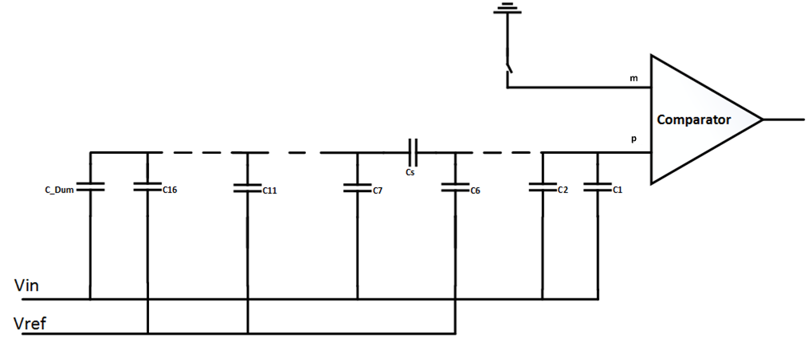
First Conversion
For the an input signal, in the first conversion:
  connect the 3 selected capacitor to Vref and all others to Vin during sampling phase
  Conversion phase is the same as a normal SAR ADC
  Output value ys1 is obtained

Slide 29
First Conversion
Charge on the top plate
(Ceq is the equivalent capacitance without the split capacitor)

Slide 30
First Conversion
After sampling , all capacitors are connected to GND but C1 (MSB) is connected to Vref for normal SAR ADC conversion.
The sampled voltage on the top plate is
The ADC will evaluate the voltage and the output of the first conversion is:

Slide 31
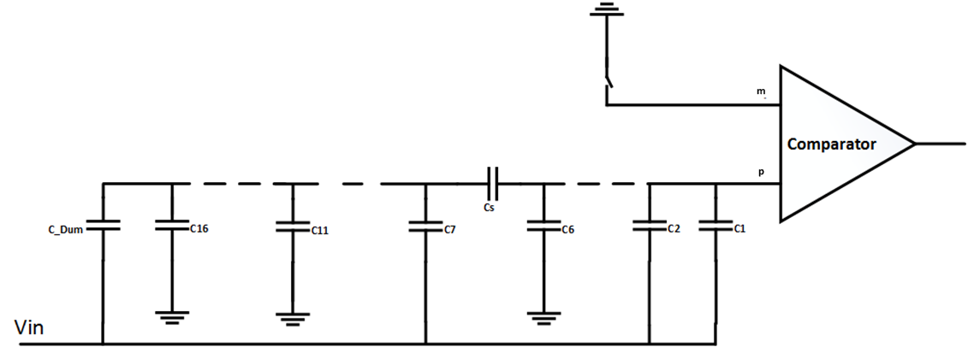
Second Conversion
For the same input, in the second conversion:
  connect the 3 selected capacitor to GND and all others to Vin during sampling phase
  Conversion phase is the same as a normal SAR ADC
  Output value ys2 is obtained

Slide 32
Second Conversion
Charge on the top plate

Slide 33
Second Conversion
After sampling , all capacitors are connected to GND but C1 (MSB) is connected to Vref for normal SAR ADC conversion.
The sampled voltage on the top plate is
The ADC will evaluate the voltage and the output of the first conversion is:

Slide 34
Output Data Processing
The difference between the equivalent input Vin1 and Vin2 is:

Slide 35
Output Data Processing
The difference between the equivalent input Vin1 and Vin2 is:
So, there is a constant offset between the two sampled voltage.
The corresponding digital output value for the offset amount is approximately equal to the digital code for the three capacitors (in this case, it is 2^10 + 2^5 + 2^0).
Define this digital value as ycc = 2^10 + 2^5 + 2^0.

Slide 36
Output Data Processing
Due to the nonlinearity in ADC, the digital output will include the nonlinearity component (INL).
For the first conversion
Similarly, for the second conversion
-INLv1 and INLv2 are INL in term of voltage
-INL1 and INL2 are INL in terms of LSB .

Slide 37
Subtracting removes Vin from Eq
Take the difference of ys1 and ys2:
The difference of two white noise is still white noise with variance doubled.
When the noise is at a certain amount of level, the quantization noise can be whiten so than all noise all white. Under this assumption, the total noise can be expressed as one noise.

Slide 38
Write in Least Square form
Apply the segmentation concept and move ycc to the left side.
INLM, INLI and INLL are the parameters in the each segments (uSMILE algorithm).
By using a H matrix to represent the above equation

Slide 39
Implementation in SAR ADC
Least square method can be used to solve the equation.
Define , the parameters can be found by the following equation

Slide 40
Nonlinear Ramp Input
By subtracting the two sampled voltage, the nonlinearity in the input signal is removed.
Each input signal need to be held for two conversions.
A simple DAC can be used as the signal generator (the DAC doesn’t need to be a good DAC)

Slide 41
Least Square Reformulation
In the proposed algorithm, least square method is used to compute the final results.
In the previous equations, we have many parameters to be solved.
Matrix inversion and multiplication is involved. It requires a long computation time and data storage.

Slide 42
Least Square Reformulation
To reduce the computation time and data storage, the least square is reformulated.
For the following equation:
Multiply both size by , the equation becomes:
and can be constructed during the data acquisition, so that the ADC output doesn’t need to be stored.

Slide 43

Block Diagonal by Proper Reformulation
Due to characteristics of the H matrix, most values in the upper right and lower left of are 0s.

Slide 44
Least Square Reformulation
By this estimation, the following equations can be obtained.
The values of INLM, INLI and INLL can be solved by least square method with much smaller matrix.
There’s no need to store the ydk and output data of ADC.
For a 12-bit ADC, 1 hit/code, with 4-bit MSB, 4-bit ISB and 4-bit LSB, the least square will involve a matrix size of 48x4096.
After the reformulation, the matrix size becomes 16x16.

Slide 45
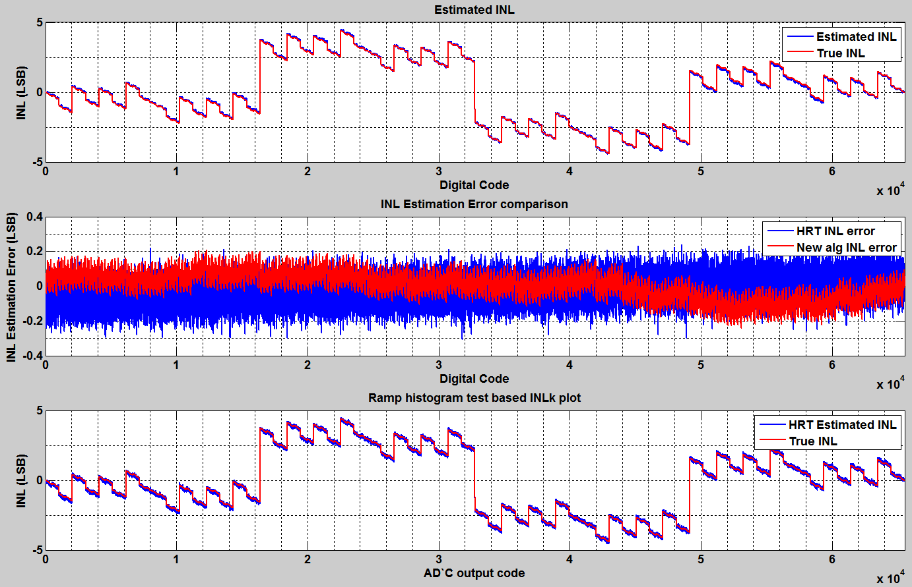
1 hit/code nonlinear ramp signal compared with 64 hits/code HRT

Slide 46
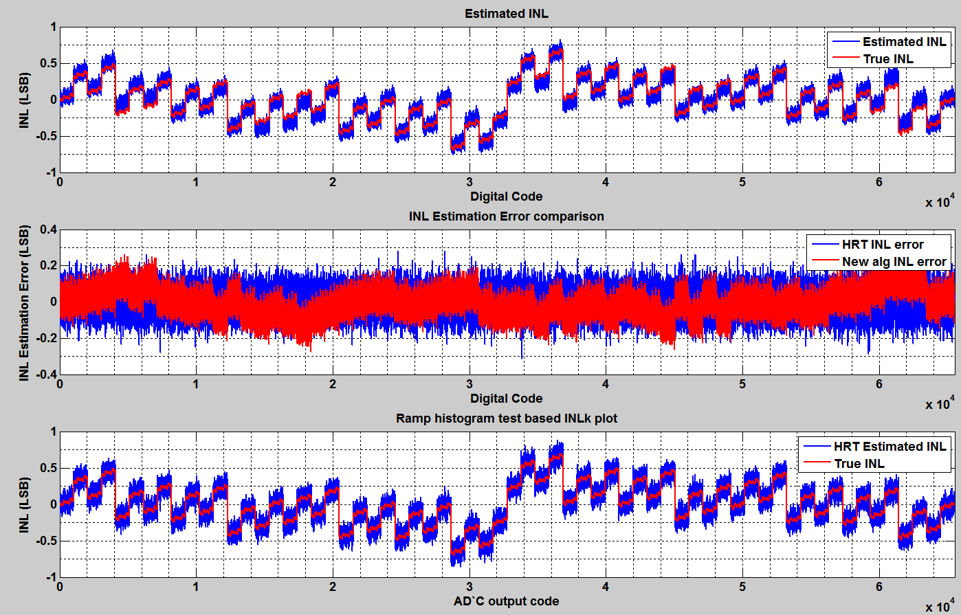
¼ hit/code nonlinear ramp signal compared with 64 hits/code HRT

Slide 47
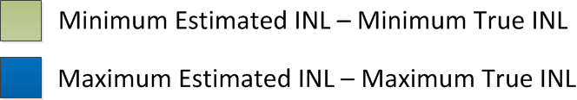
10,000 runs on a 12-bit SAR ADC with 0.3LSB noise added to the input

Slide 48
Conclusion
From the simulation results, the INL estimation with 1 hit/code in the proposed method is better than 64 hits/code in histogram method for a 16-bit SAR ADC.
The statistical results in a 12-bit SAR ADC shows the most of the estimated error is within 0.2LSB (1 hit/code signal).
The proposed method can achieve robust and accurate, saving a large amount of test time with imprecise instruments.
Simplified computation and nonlinear signal source allow BIST solution for embedded ADCs and the test results can be used to calibrated the ADC to achieve better performance.

Slide 49
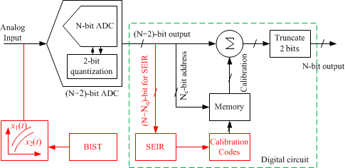
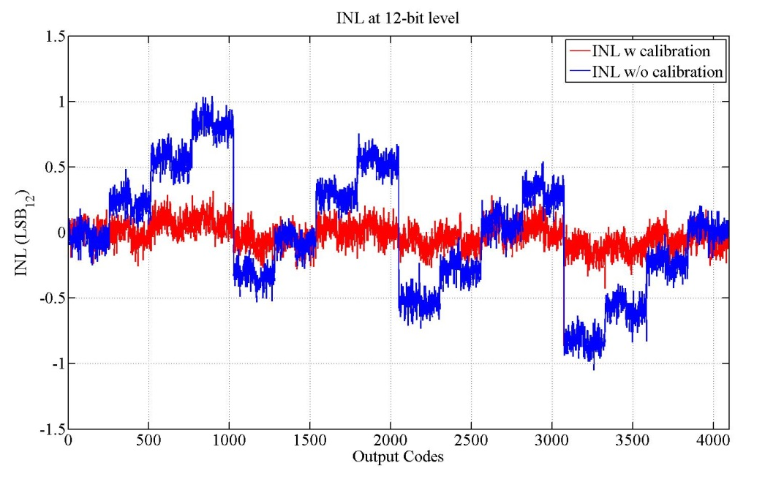
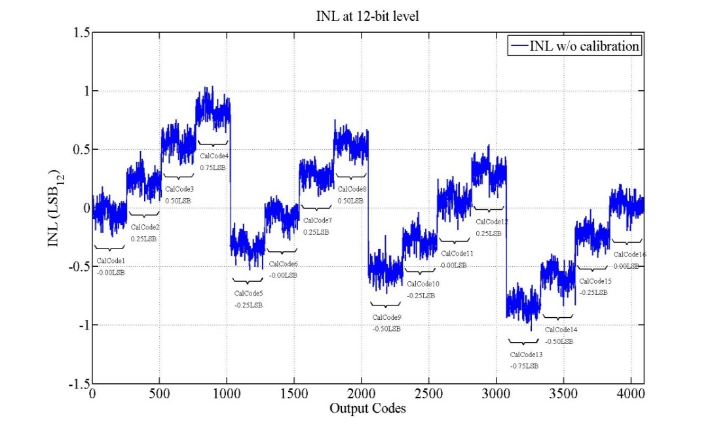
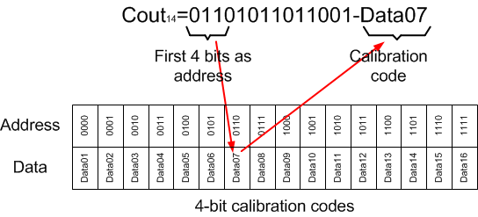
BIST-based ADC Cal: conceptual
BIST generates two nonlinear stimuli
ADC generates two output quantized at N+2 bit level
Segmented model reduces samples
USER-SMILE computes ADC INLk
Cout14
Spectrum
Data
Tested INL ➔ CalCodes
Averaged INL in each MSB segment give CalCode for the segment
Segment index vs CalCode forms calibration look-up table
From BIST tested INL:
DNL cal/trim to remove INL jumps
INL cal to remove smooth N.L. errors
INL after calibration limited by quantization and noise

Slide 50
ADC architectural modification
Add additional quantization bits to reduce quantization error to negligible levels
Add redundant bits to prevent dynamic errors
  Due to insufficient settling
  Due to momentary NBTI
  Due to momentary thermal imballance
Intentionally introduce mismatches to prevent non-recoverable static errors
  E.g. by increasing the weight of the bridge cap before LSB segment

Slide 51
Additional circuits
On chip signal generator (available N. L. DAC)
ADC input buffer/shift generator
BIST control circuit
Calibration circuit
On-chip computing capability

Slide 52
Hardware Implementation
ADC BIST and Calibration
For SAR ADC, the MSB segment errors are used for calibration
Two tapeouts in Freescale
Can be implemented in software

Slide 53
Low-cost Shift Generator in CDAC SAR
USER-SMILE / SEIR requires a constant voltage shift
  Low cost
  Easy to implement on chip
Proposed Shift Generator
  Reuse the capacitor from the CDAC of SAR ADC
  Modify the sampling capacitor connection during sampling phase
  Passive component ratio is very constant
Sampling 1
C6 connected to GND
Sampling 2
C6 connected to Vref

Slide 54
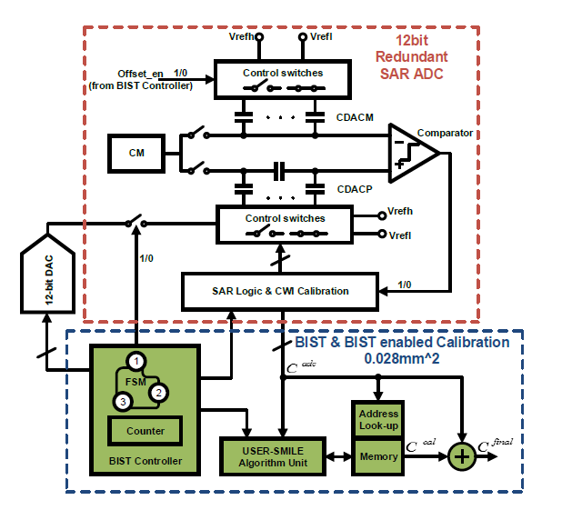
On-chip BIST Implementation
First on-chip full-parametric BIST
28nm automotive processor
Existing ADC as DUT
Existing DAC as input
Everything on-chip
(Verilog for digital circuits)
4 KB RAM
0.028mm² total area

Slide 55
Test Results
1 HPC USER-SMILE
Compared with 200 HPC Histogram

Slide 56
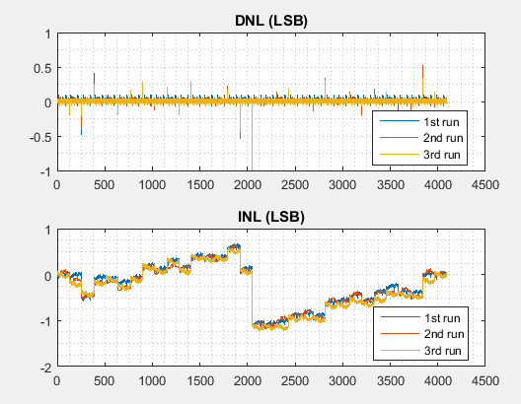
Measurement repeatability

Slide 57
Test Results for large number of chips
Over 700 parts

Slide 58
Calibration Results
Calibrate first 5-bit MSB
13-bit conversion
12-bit truncated output code

Slide 59
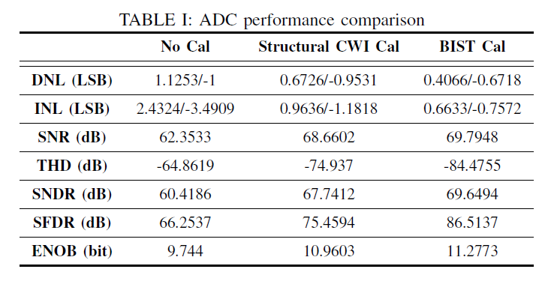
Calibration Results
Dynamic performance

Slide 60
Cost Comparison
Area overhead
  0.028mm² total area
Test time
  1MSPS ADC with 20 HPC histogram ➔ 80ms
  1MSPS ADC with 1 HPC USER-SMILE ➔ 8ms
  USER-SMILE data processing time (80MHz clock) ➔ 1ms
1/10 of the cost saving

Slide 61
Other Benefits
Enable in-field & on-demand test
Self calibration
  Reliability & safety
  Performance improvement
  Relax design requirements
Eliminate the need for precision tester
Simplify the test development & board design
And more …
More important
in the future

Slide 62
Calibration for Pipeline ADC
Pipeline ADC is different from SAR ADC
There are challenges to test and calibration pipeline ADCs
Gain stage
  The INL will have slope for each MSB segment
Redundancy between stages
  The final output code cannot identify the segments
There is a need to develop a new method for pipeline ADC

Slide 63
Architecture
16-bit Pipeline ADC modeled in Matlab
16 unary-weighted capacitors
Digital code determined by
flash ADC
1 bit redundancy between
two stages

Slide 64
Architecture
16-bit Pipeline ADC modeled in Matlab
C1, C2 as feedback capacitors
Digital code controls C3-C16

Slide 65
Non-ideality
Unit capacitor C_{u1} = 200fF (1st stage), C_{u2} = 25fF(2nd stage)
  Total sampling capacitance Cs = 3.2pF
  With V_{ref}=5V, ➔kT/Cs = (0.5 LSB)²
  Capacitor mismatch sigma = 0.3fF (1st stage), 0.1 fF (2nd stage)
Digital code determined by flash ADC
  Comparator has random offsets up to 80% of segment width
Amplifier
  Offset
  Nonlinearity (can be easily added later)
3rd stage makes no error
Total input referred noise rms value = 0.6 LSB

Slide 66
One representative INL/DNL Simulation
INL/DNL is measured by 32 hits/code histogram ramp

Slide 67
uSMILE Algorithm
Input signal
  1 hit/code pure sine wave
  0.6 LSB rms input referred noise
Segmented model identification
  FFT: DC & fundamental to find the linear code
  Least square used to identify the slope and averaged error for each segment ➔ translated into capacitor relative error
Capacitor error is the relative error
multiplied by the expected value

Slide 68
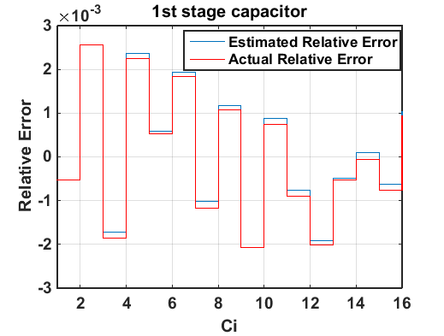
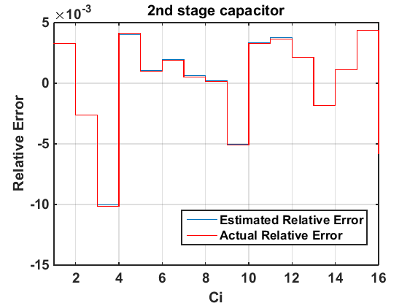
Capacitor / Gain Error Comparison
 | 1st Stage Gain | 2nd Stage Gain
Actual | 0.9990 | 0.9997
Estimated | 0.9989 | 0.9997

Slide 69
Trimming/Calibration
Analog trimming
  A small capacitor array is added with resolution of ¼ LSB
  It will be put in parallel with each capacitor in 1st and 2nd stage according to the trimming code
Digital calibration
  The digital codes from 1st, 2nd and 3rd stages are D1, D2 and D3
  Subtract the rounded value of mismatches for the D1 and D2
  The gain errors are 1st and 2nd stages are Ge1 and Ge2
  Subtract D3*[(1+Ge1)*(1+Ge2)-1]
  Subtract D2*(1+Ge1)

Slide 70
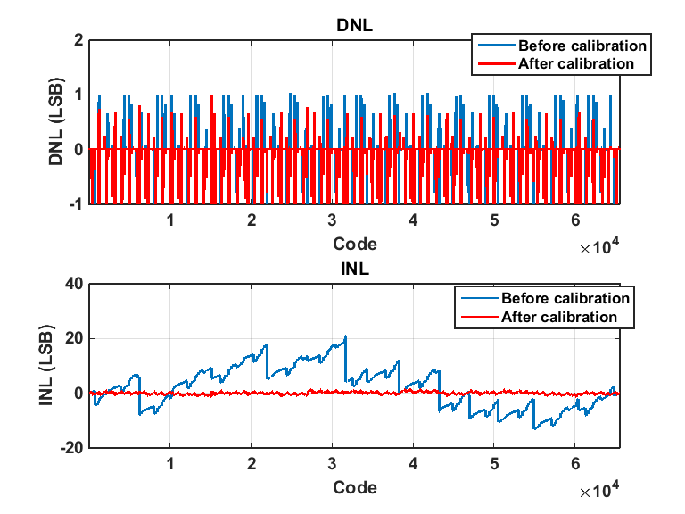
Digital code calibration
Calibration resolution: 1 LSB
 | Before calibration | After digital cal
DNL | 1.0313 -1 | 1.0002 -1
INL | 20.8276 -13.2863 | 1.6244 -1.2941
INL/DNL is measured by 32 hits/code histogram ramp test

Slide 71
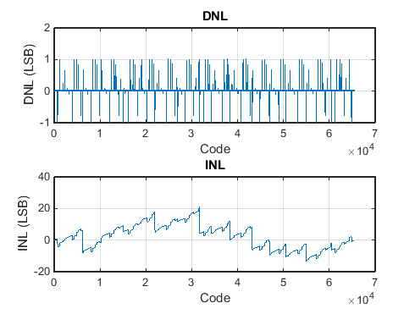
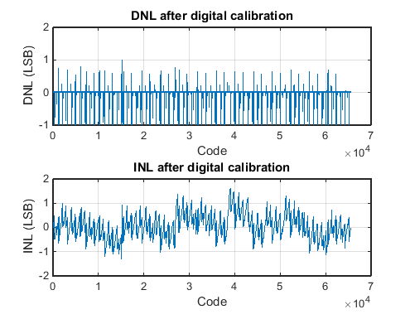
 | Before calibration | After digital cal
DNL | 1.0313 -1 | 1.0002 -1
INL | 20.8276 -13.2863 | 1.6244 -1.2941

Slide 72
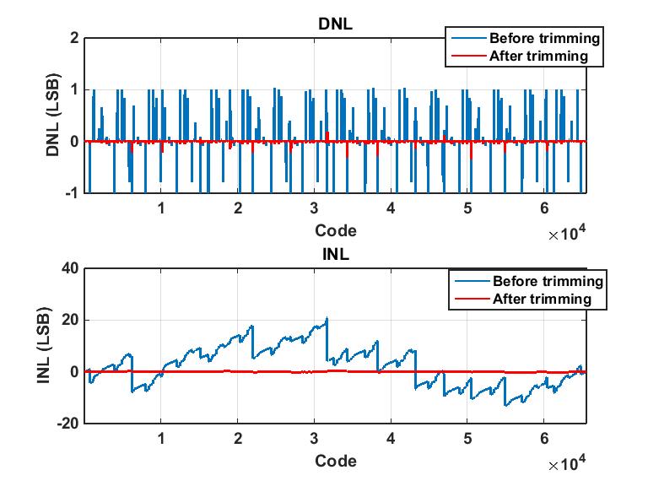
Analog cap-size trimming
Trimming resolution: ¼ LSB
 | Before Trimming | After Trimming
DNL | 1.0313 -1 | 0.1875 -0.3437
INL | 20.8276 -13.2863 | 0.3289 -0.2238
INL/DNL is measured by 32 hits/code histogram ramp test

Slide 73
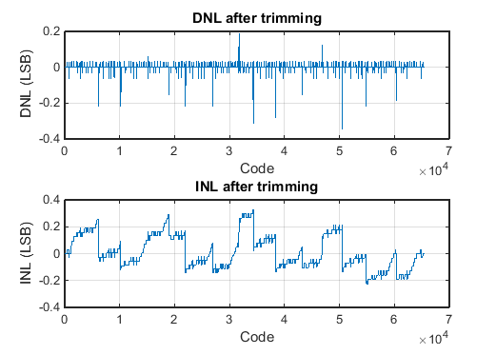
 | Before Trimming | After Trimming
DNL | 1.0313 -1 | 0.1875 -0.3437
INL | 20.8276 -13.2863 | 0.3289 -0.2238

Slide 74
Conclusion
Presented analog techniques to improve matching, performance, and reliability
Presented methods to verify against hidden design faults or manufacturing faults
Presented methods with dramatically relax resource requirements to make on-chip ready
Demonstrated incorporation of AMS BIST and BIST-based calibration to make it possible for in-field or on-road self-diag and self-healing

