Slide 1
Chopper-stabilized Op Amp Design
Chongli Cai
11/2015

Slide 2
What is Chopper-stabilized Amp?
Firstly published by TI in 2006 [1]
Goal is to achieve μV offset and extremely low offset drifts for high gain/precision applications.
It turns the polarity of offset constantly so that the average offset is small
[1]Burt, R.; Zhang, J., "A Micropower Chopper-Stabilized Operational Amplifier using a SC Notch Filter with Synchronous Integration inside
the ContinuousTime Signal Path,“in Solid-State Circuits Conference, 2006. ISSCC 2006. Digest of Technical Papers. IEEE International ,
vol., no., pp.1388-1397, 6-9 Feb. 2006

Slide 3
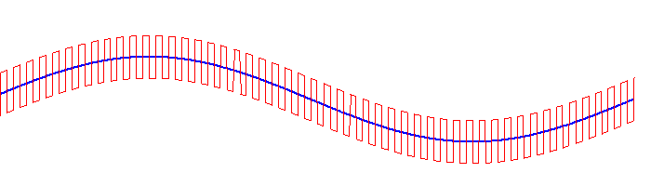
Basic of Chopping
Figure. 2 Chopping timing diagram
Blue: V_{in}
Red: V_{out}
Figure. 1 Chopping amplifier in unity gain configuration
Figure. 3 Frequency domain signal plot
Notes:
DC offset gets translated to chopping frequency ($f_{chop}$).
Chopper is a simple mixer implemented using cross-coupled switches
The signal is unaffected overall at the end of chopping

Slide 4
Basic Architecture of CHS Amp
Two-stage
High-speed path
High-gain path
Input stage Offset of high-gain path directly contributes to the overall offset voltage
Input stage of high-gain path requires to be chopped.
Multipath Nested Miller Compensation (MNMC) is applied for stabilization

Slide 5
Frequency Compensation (MNMC)
The stitching frequency is defined as
LF
HF
Pole-zero cancellation needs to be precision controlled for fast transient
Chopping frequency needs to be selected higher than pseudo-static BW

Slide 6
Frequency Compensation (MNMC)
The notch filter in ripple reduction loop can introduce “unclear” roll-off, which can degrade the stability & settling performance.
Put the fchop higher than stitching frequency can avoid this

Slide 7
Top Level

Slide 8
Input Chopper Switch
Input chopper is directly connected to the amplifier’s input
It needs to support rail-to-rail input CM range => bootstrapped
The switch size needs to be carefully determined in terms of noise

Slide 9
Input Chopper – with bootstrap
ɸ0 & ɸ1 are two complementary clocks
ɸ0F & ɸ1F are chopper switches
gate control clocks, which have voltage
levels dependent on Vcm of inputs
Input CM voltage V_{ssF} is generated
by Vcm detector circuit
All transistors are isolated transistors
ac-coupled Level shift
Switches’ Ron need
constant through ICMR
V_{cm} detector
Chopper Switches

Slide 10
Top Level

Slide 11
Output Chopper
Output chopper & chopper in the RRL are less critical than input chopper
The switches are not required to be bootstrapped because the voltage
variation at first stage output is small.

Slide 12
Top Level
Down-modulated Vos back to DC to compensate Initial offset.
Up-modulated Vin & offset of gm3 are filtered
Notch filter is used to filter out signal at fchop

Slide 13
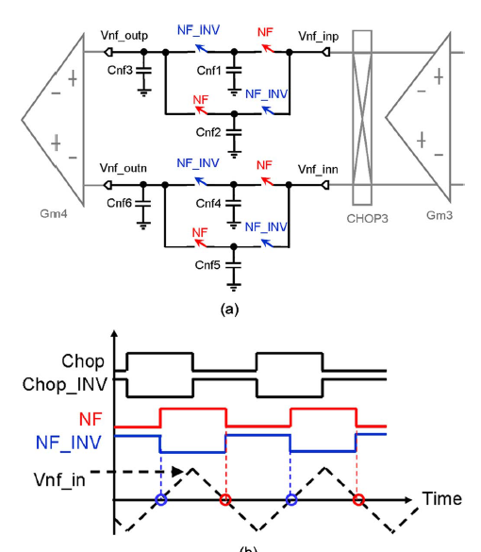
Ripple Reduction Loop
Switched-capacitor based notch filter
is used
Notch filter clock signal has 90 degree
phase shift with chopping clock.
DC input @ gm3 becomes modulated
Current flowing into input of NF and then
Integrated by sampling caps.
The signal is only sampled when it
crosses zero due to orthogonal CLK
Orthogonal clock
Kusuda, Y., "Auto Correction Feedback for Ripple Suppression in a Chopper Amplifier,"
in Solid-State Circuits, IEEE Journal of , vol.45, no.8, pp.1436-1445, Aug. 2010

Slide 14
Orthogonal Clock Generation

Slide 15
Gain stages
Folded input pair
Monticelli
output stage
With cascode stage
Folded-cascode
gain stage

Slide 16
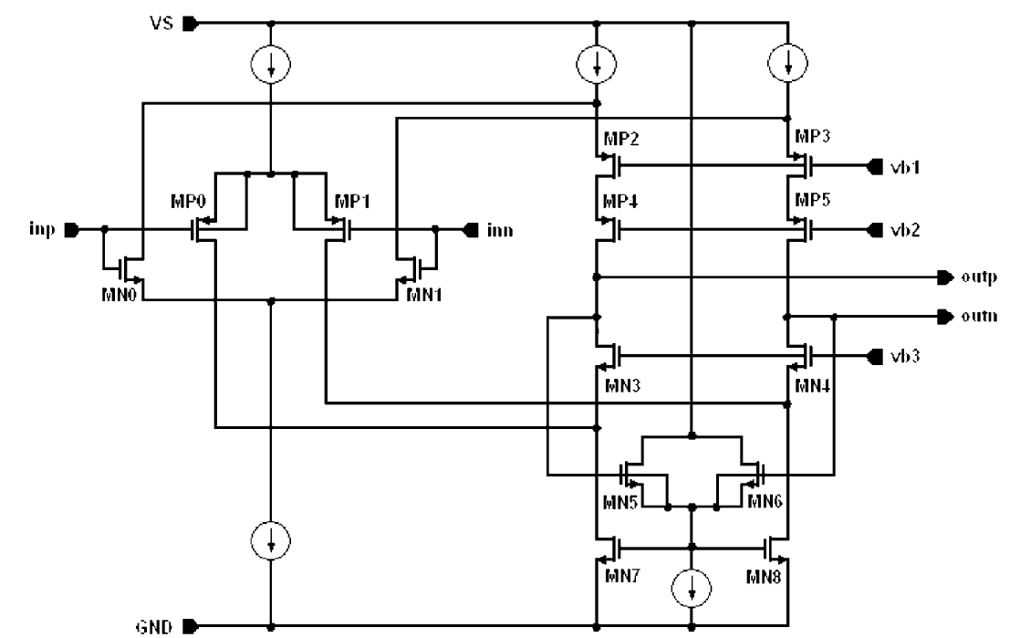
Gm1 (folded-cascade in HG path)
Connect to input chopper
Connect to input chopper
RRL current adding here

Slide 17
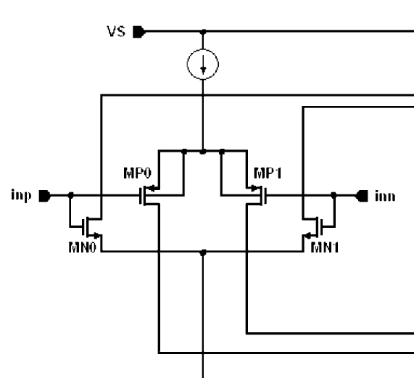
gm0
Connect to the cascode
Stage before output stage

Slide 18
A3
NMOS pair
PMOS pair
Cascode stage
Output stage

Slide 19
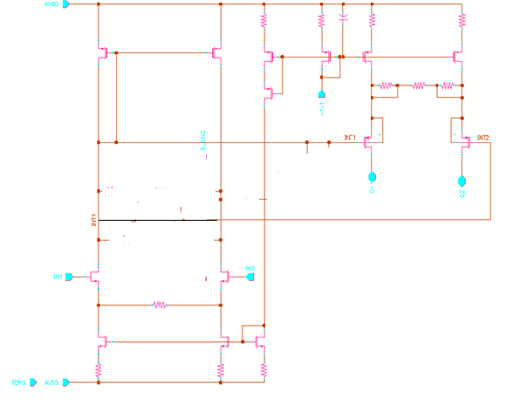
gm2

Slide 20
Design Steps
Design the 3-stage amplifier with MNMC
Simulate its AC performance (GBW, UGF, PM), transient performance (SR. settling time) and noise
Design ripple reduction loop (RRL)
Add the RRL to the amp with ideal I/O choppers
Run transient simulation to verify amp output can settle into a steady-state and offset ripple is small enough (<5µV)
Design input/output choppers
Replace the ideal chopper with real one in the amp
Run transient simulation to ensure the amp output can settle into a steady-state and offset ripple is small (<5µV)
Run PAC/ Pnoise to verify the ac and noise performance with chopping on

Slide 21
Simulation Test-bench - offset
Offset voltage
Setting the Vicm at sweet spot of the input common mode range
Run the transient simulation and plot (V_{o} - V_{icm})

Slide 22
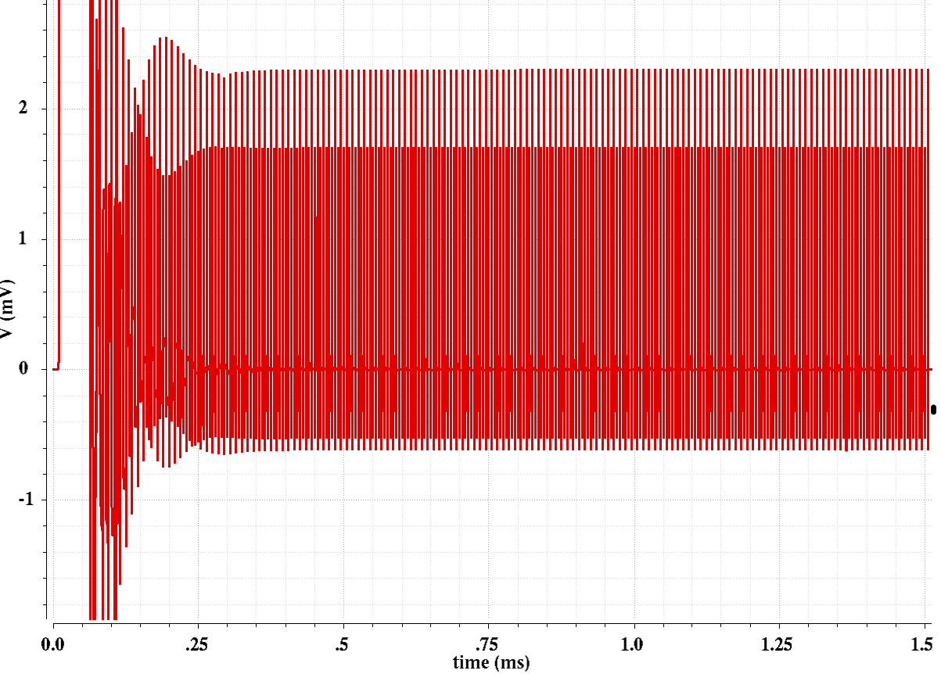
Simulation Results - Vos
glitch
Clip range for aver Vos Cal
Average OS= 663.4nV with 1.1mV(3σ) initial OS
Offset is calculated by clipping the waveform after settled
and taking the average value.

Slide 23
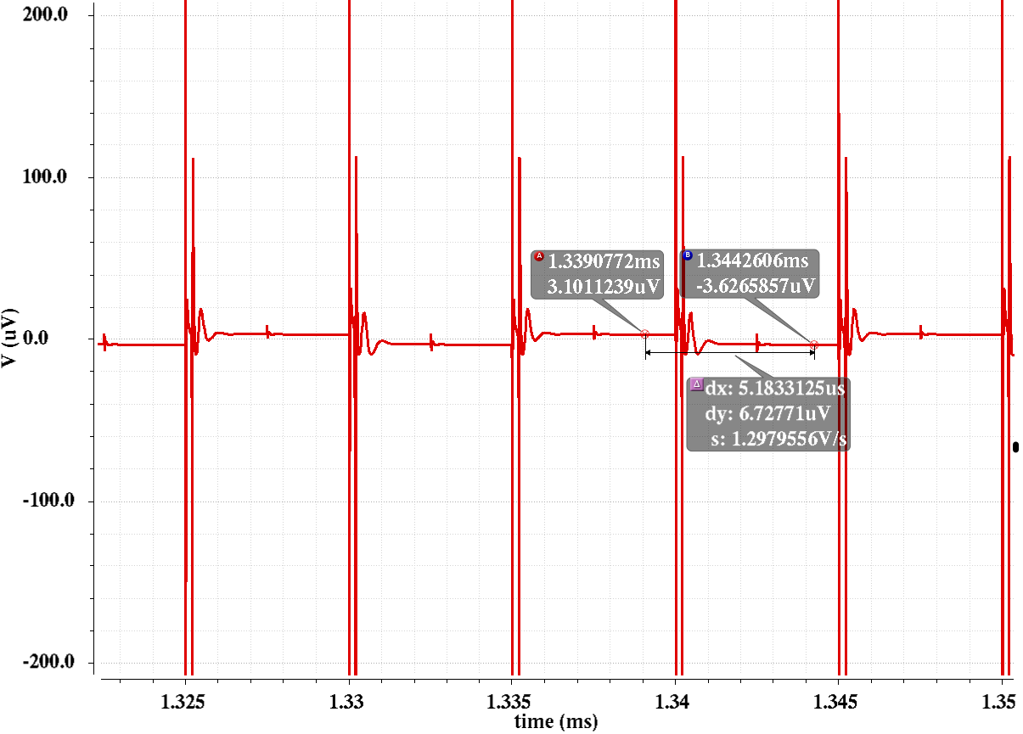
Offset Ripple
Offset ripple

Slide 24
Simulation Test-bench – AC/Noise
PAC / Pnoise
Setting the Vicm at sweet spot of the input common mode range
Run PSS/PAC/Pnoise simulation

Slide 25
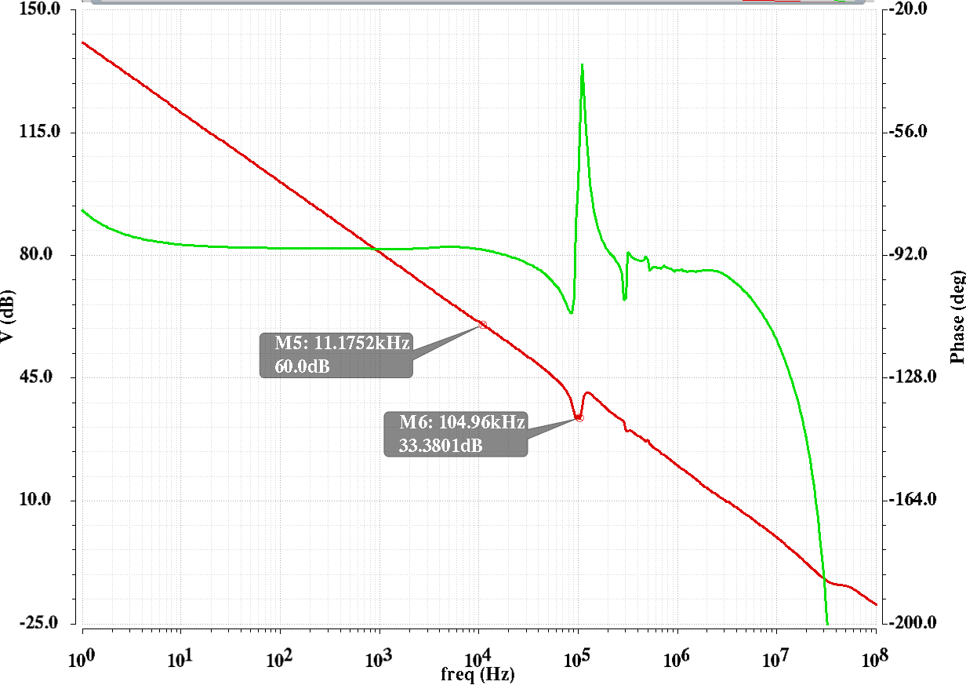
PAC Simulation

Slide 26
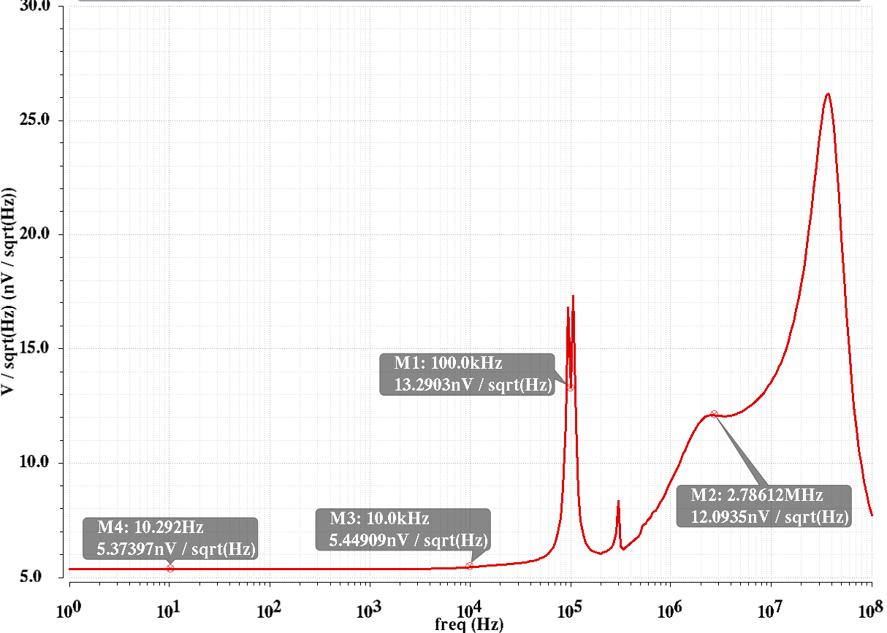
Pnoise

Slide 27
Simulation Test-bench - transient
transient simulation is used to verify the start-up of the op-amp, SR, settling time
and ripple reduction loop stability.

Slide 28
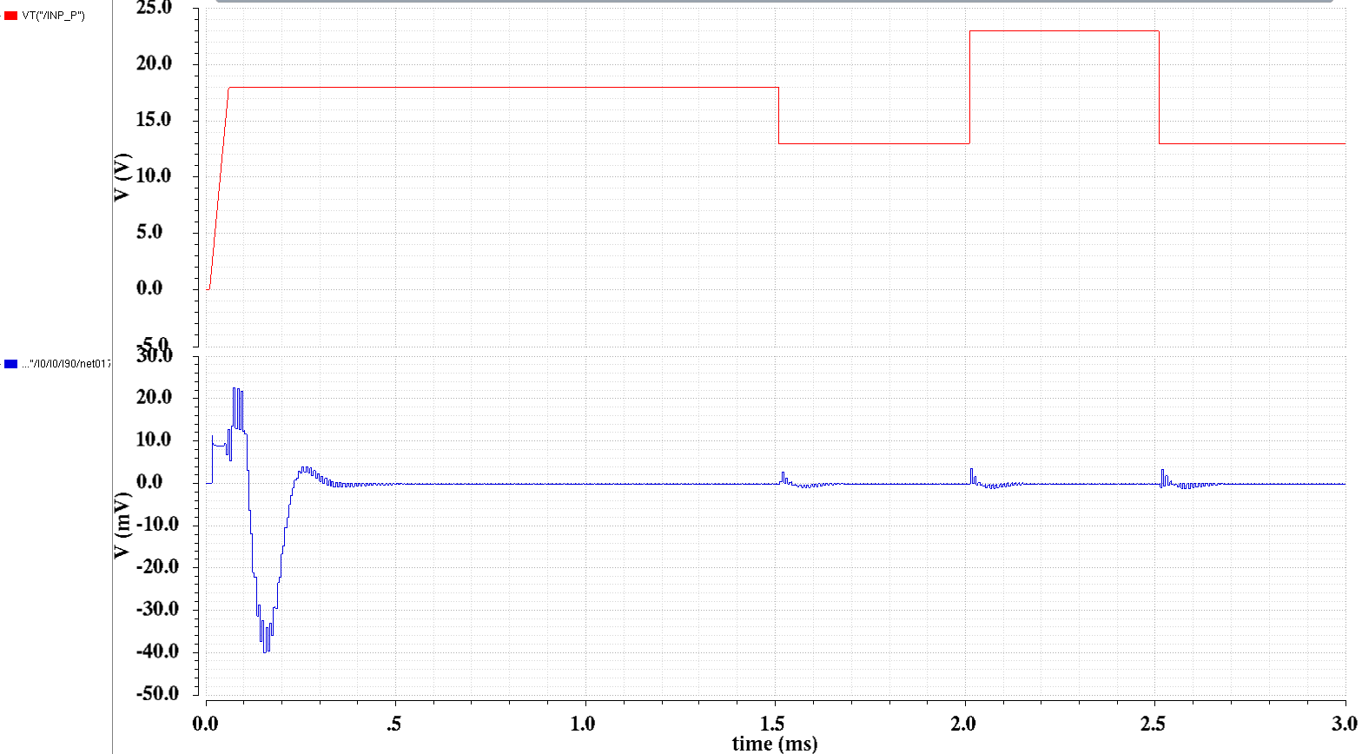
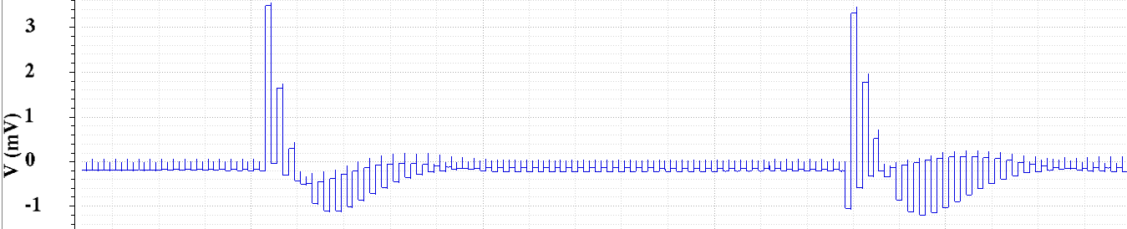
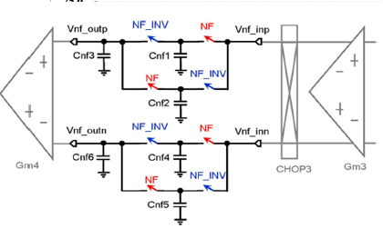
RRL Stability Simulation
Op-amp start-up
Notch Filter Output

Slide 29
Simulation Test-bench - ICMR
ICMR is measured in terms of Vos.
In this step, we can keep the chopping off and sweep Vicm from rail to rail to find the range where the Vos is keeping near zero (without mismatch)
Another voltage source is used to force the Vo at its sweet spot.

Slide 30
Simulation Test-bench (AOL)

